Slide 1
Tommy Cook, Chairman

Slide 2
ITSF – International Timing & Sync Forum
Founded 2001
Industry experts led by Chairman
Charles Curry,
Chronos
Technology
Format Papers covering all
aspects of Time and Synchronisation from a diverse spectrum of applications selected by SG for technical content aligned to mission statement.
Mission: To encourage a wider understanding of the needs for synchronisation, time and timing in critical infrastructure and wider applications, by bringing together individuals from industry, government and academia representing users, suppliers and professionals in the timing community.
Event
Management
EIE: Andy Bateman, Carole Mayhew
AV: Mike Godden
ITSF17 170 Delegates,
from 25 Countries, from 98 Companies.
19 from Operators
Steering
Group
29 members

Slide 3
Current drivers and recent events
Time becoming a critical infrastructure component for many industries;
Automotive, Industrial Ethernet, Financial, Power Utilities, etc.
Time transfer increasing in important in Telecom networks;
5G driving tighter time accuracy delivery needs.
ITU-T just agreed to progress to ratification 3 new standards for Enhanced Clocks;
G.8262.1: Enhanced SyncE Clock specification
G.8273.2: T-BC Class C & D specification
G.8272: Class B PRTC specification
plus 7 other document updates / amendments
Security of critical infrastructure concerns;
GNSS robustness and protection
IEEE1588 packet security

Slide 4
Frequency and Time for F.U.N: Finance, Utilities and 5G Networks
Tutorial day
(7 papers)
Evolution of 5G and Future Networks (7 Papers)
Time enabling of SMART Infrastructure (6 papers)
Practical Implementations of Time & Sync in the Network (16 Papers)
Timing Security (3 Papers)
GNSS & Time References (10 Papers)
Monday
Tuesday
Wednesday
Thursday
Notes:
Tuesday: The direction of the Telecom network, and the implications and needs for time and synchronisation.
After lunch, we have 6 papers from across a number of industry sectors discussing the need for time and sync in their applications.
Wednesday: Monster session of 16 papers discussing the practical implementation of Time & Sync. The theory is important but also hearing about how the theory has been put into practice
Thursday: Start with a short session with 3 papers on the need for security on this aspect of the critical infrastructure, and the challenges in implementing a robust system.
Finally on Thursday we will have a session on GNSS and Time References. This session will discuss distributing time using GNSS systems as well as include papers on high precision osciallators.

Slide 5
Conference logistics
39 Speakers from 34 companies.
Requests to speakers;
Please keep to time.
Please use the house PC and ensure (AV) Mike has your latest presentation ahead of your session.
Meet 5 minutes before the start of section to get mic’d up!
Questions from the delegates are encouraged:
Questions after each section rather than each paper.
Please state your name and company.
Use the roving microphone when asking questions

Slide 6
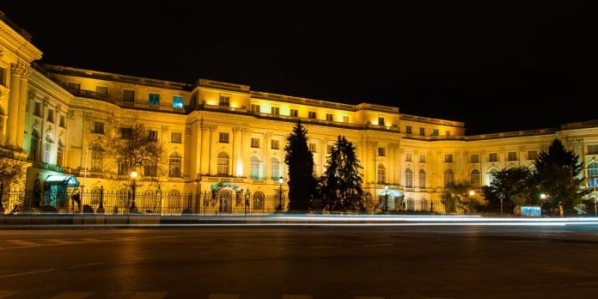
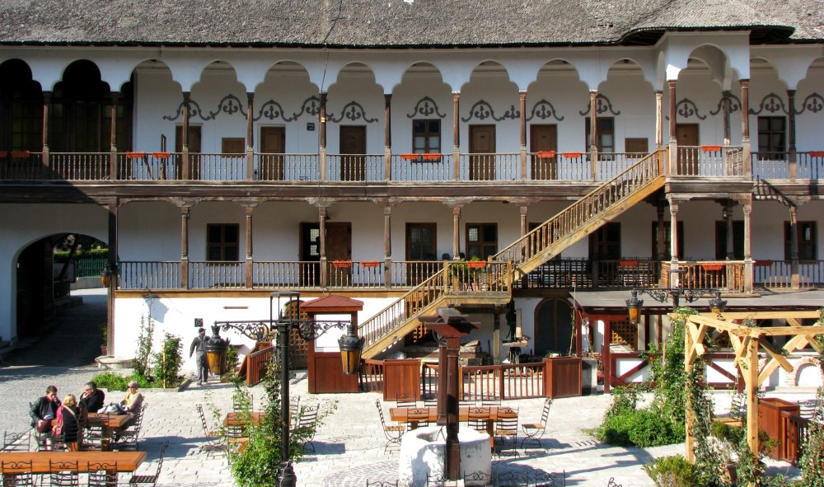
F.U.N.
Tuesday evening Icebreaker
National Art Gallery (inside former Royal Place)
Drinks and nibbles at Manuc’s Inn
Sponsored by

Slide 7
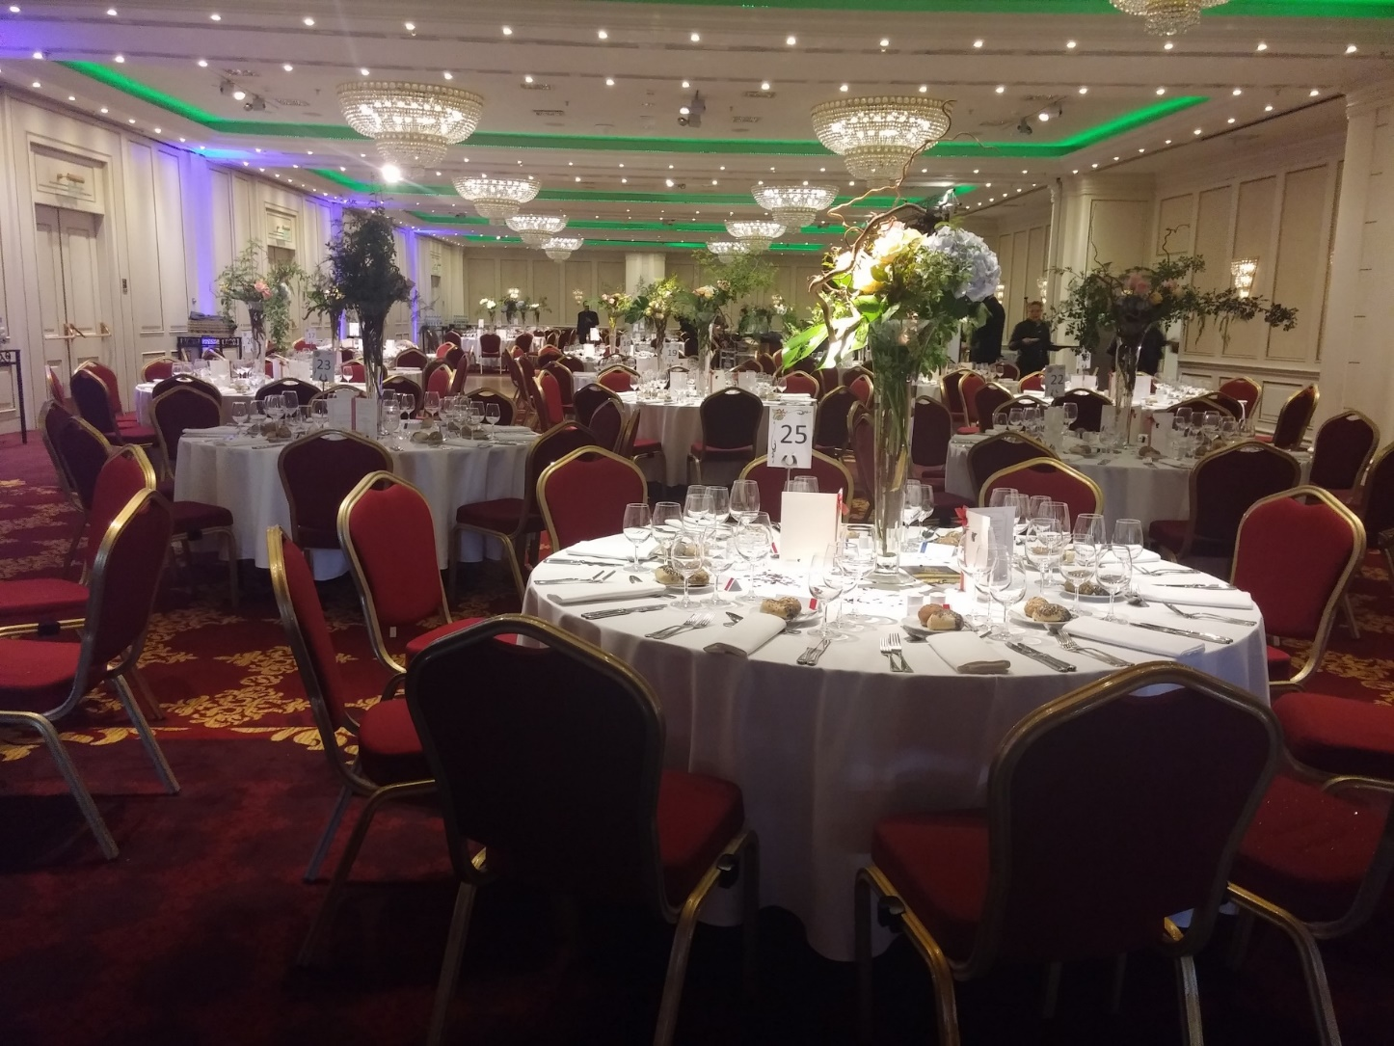
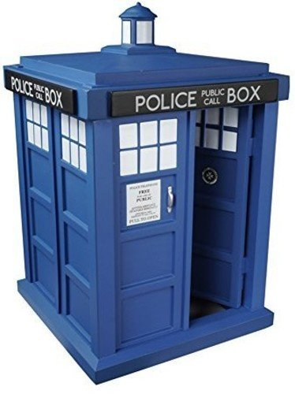
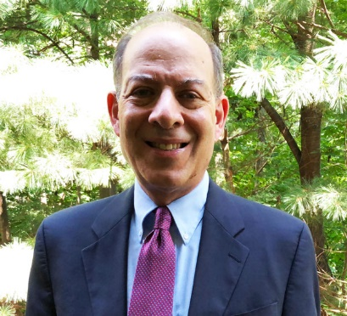
F.U.N.
Wednesday, Conference Dinner
Dinner here in the hotel
Time Lord Award
Geoff Garner
Sponsored by
Sponsored by

Slide 8
Frequency and Time for F.U.N: Finance, Utilities and 5G Networks

Slide 9
Tommy Cook, Chairman

