Slide 2
Precision Time Sync Toward the End-User
Ahmad Byagowi
Research Scientist, Meta

Slide 3
Precision Time Sync Toward the End-User: Why and How?

Slide 4

Latency Challenges and End-Users
Latency
Latency
Latency
End User Device
End User Device
Internet (Global)
Latency
Latency
Latency
Cloud Server
Latency

Slide 5
Problem Formulation
Latency
Defying Distance
Peripherals
End-User Device
Illusion of Presence
7 Layers of OSI
Queuing and Buffering
Implementation of Virtual Reality
$$Σ$$
Latency
Degradation of UX
Finite Speed of Light
Network
Advancement in cloud-based services in virtual reality are on the horizon and latency is an issue

Slide 6
Managing Latency
Managing Latency
Precision Measurement
Estimation and Projection
Prediction and Compensation
The challenge is to enable end-to-end latency measurement

Slide 7




Latency: From Cloud to the End-User
5G
Cloud Servers
Internet
Cable Modem to ISP
WIFI and Router
End-User

Slide 8
Latency: The Journey of Data Packets
5G
Cloud Servers
Internet
Cable Modem to ISP
WIFI and Router
End-User
NIC
PCIe
OS
CPU
USB
Peripherals

Slide 9
7 Layers of the OSI Model
Application
Presentation
Session
Transport
Network
Data link
PHC
Physical Layer
NIC
PCIe
OS
CPU
USB
Peripherals

Slide 10
PTM: Precision Time Measurement
NIC
PCIe
OS
CPU
USB
OS
Peripherals
PHC
ART
HC
PCIe
OS
GPU
GHC

Slide 11
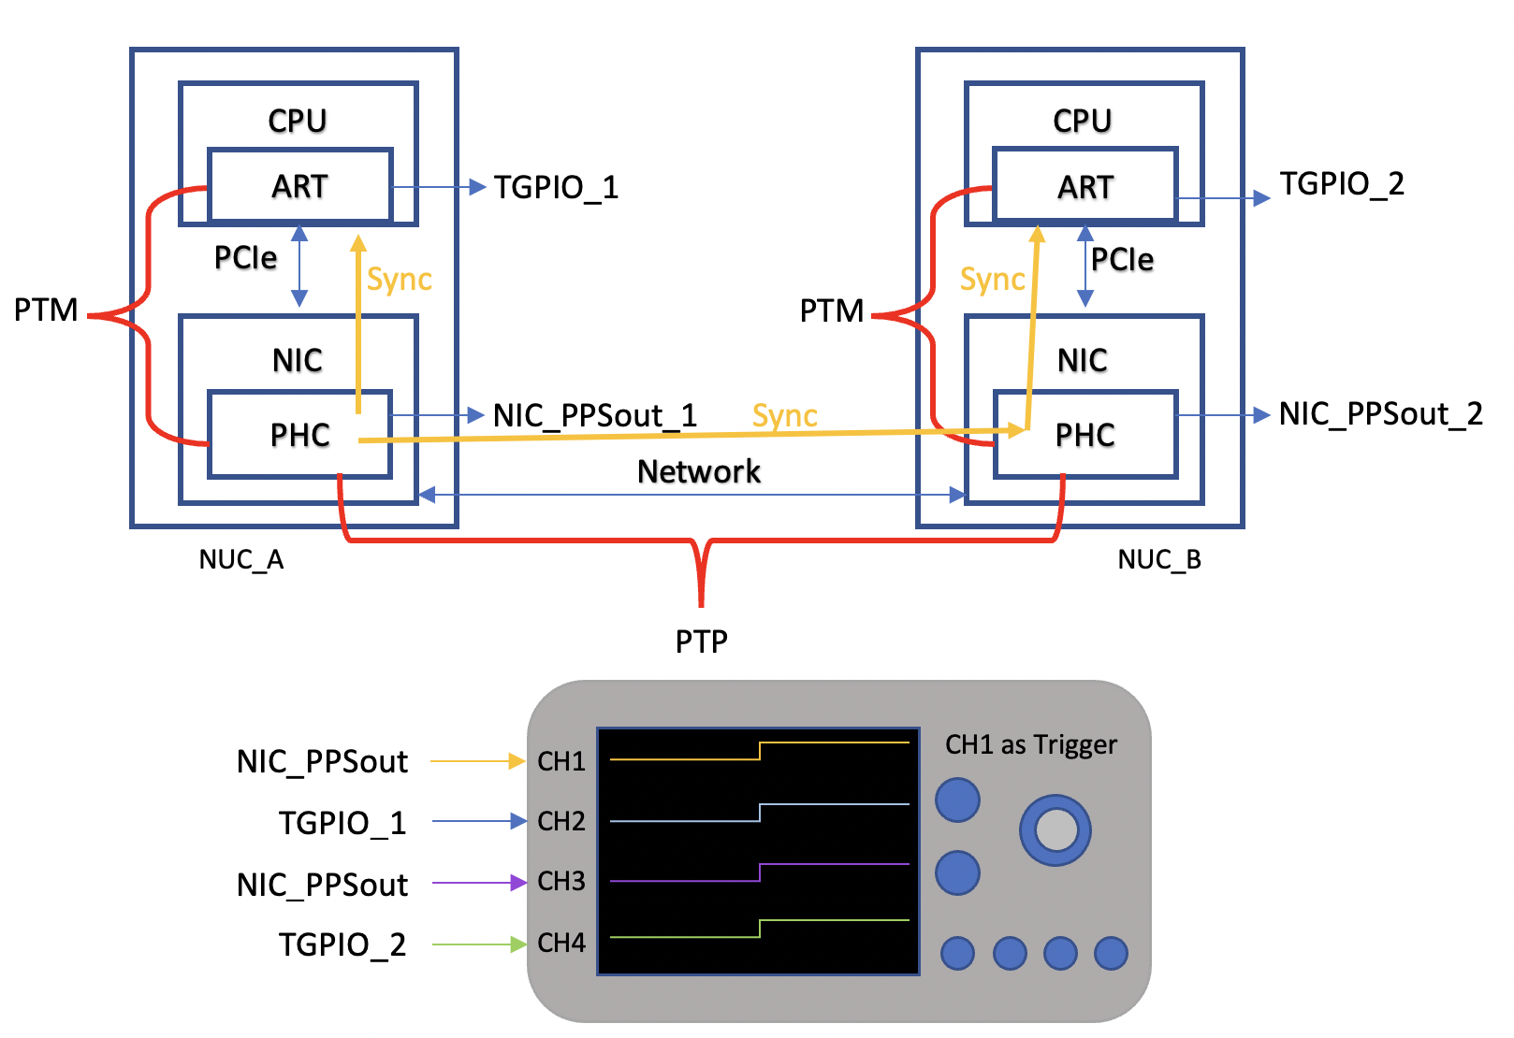
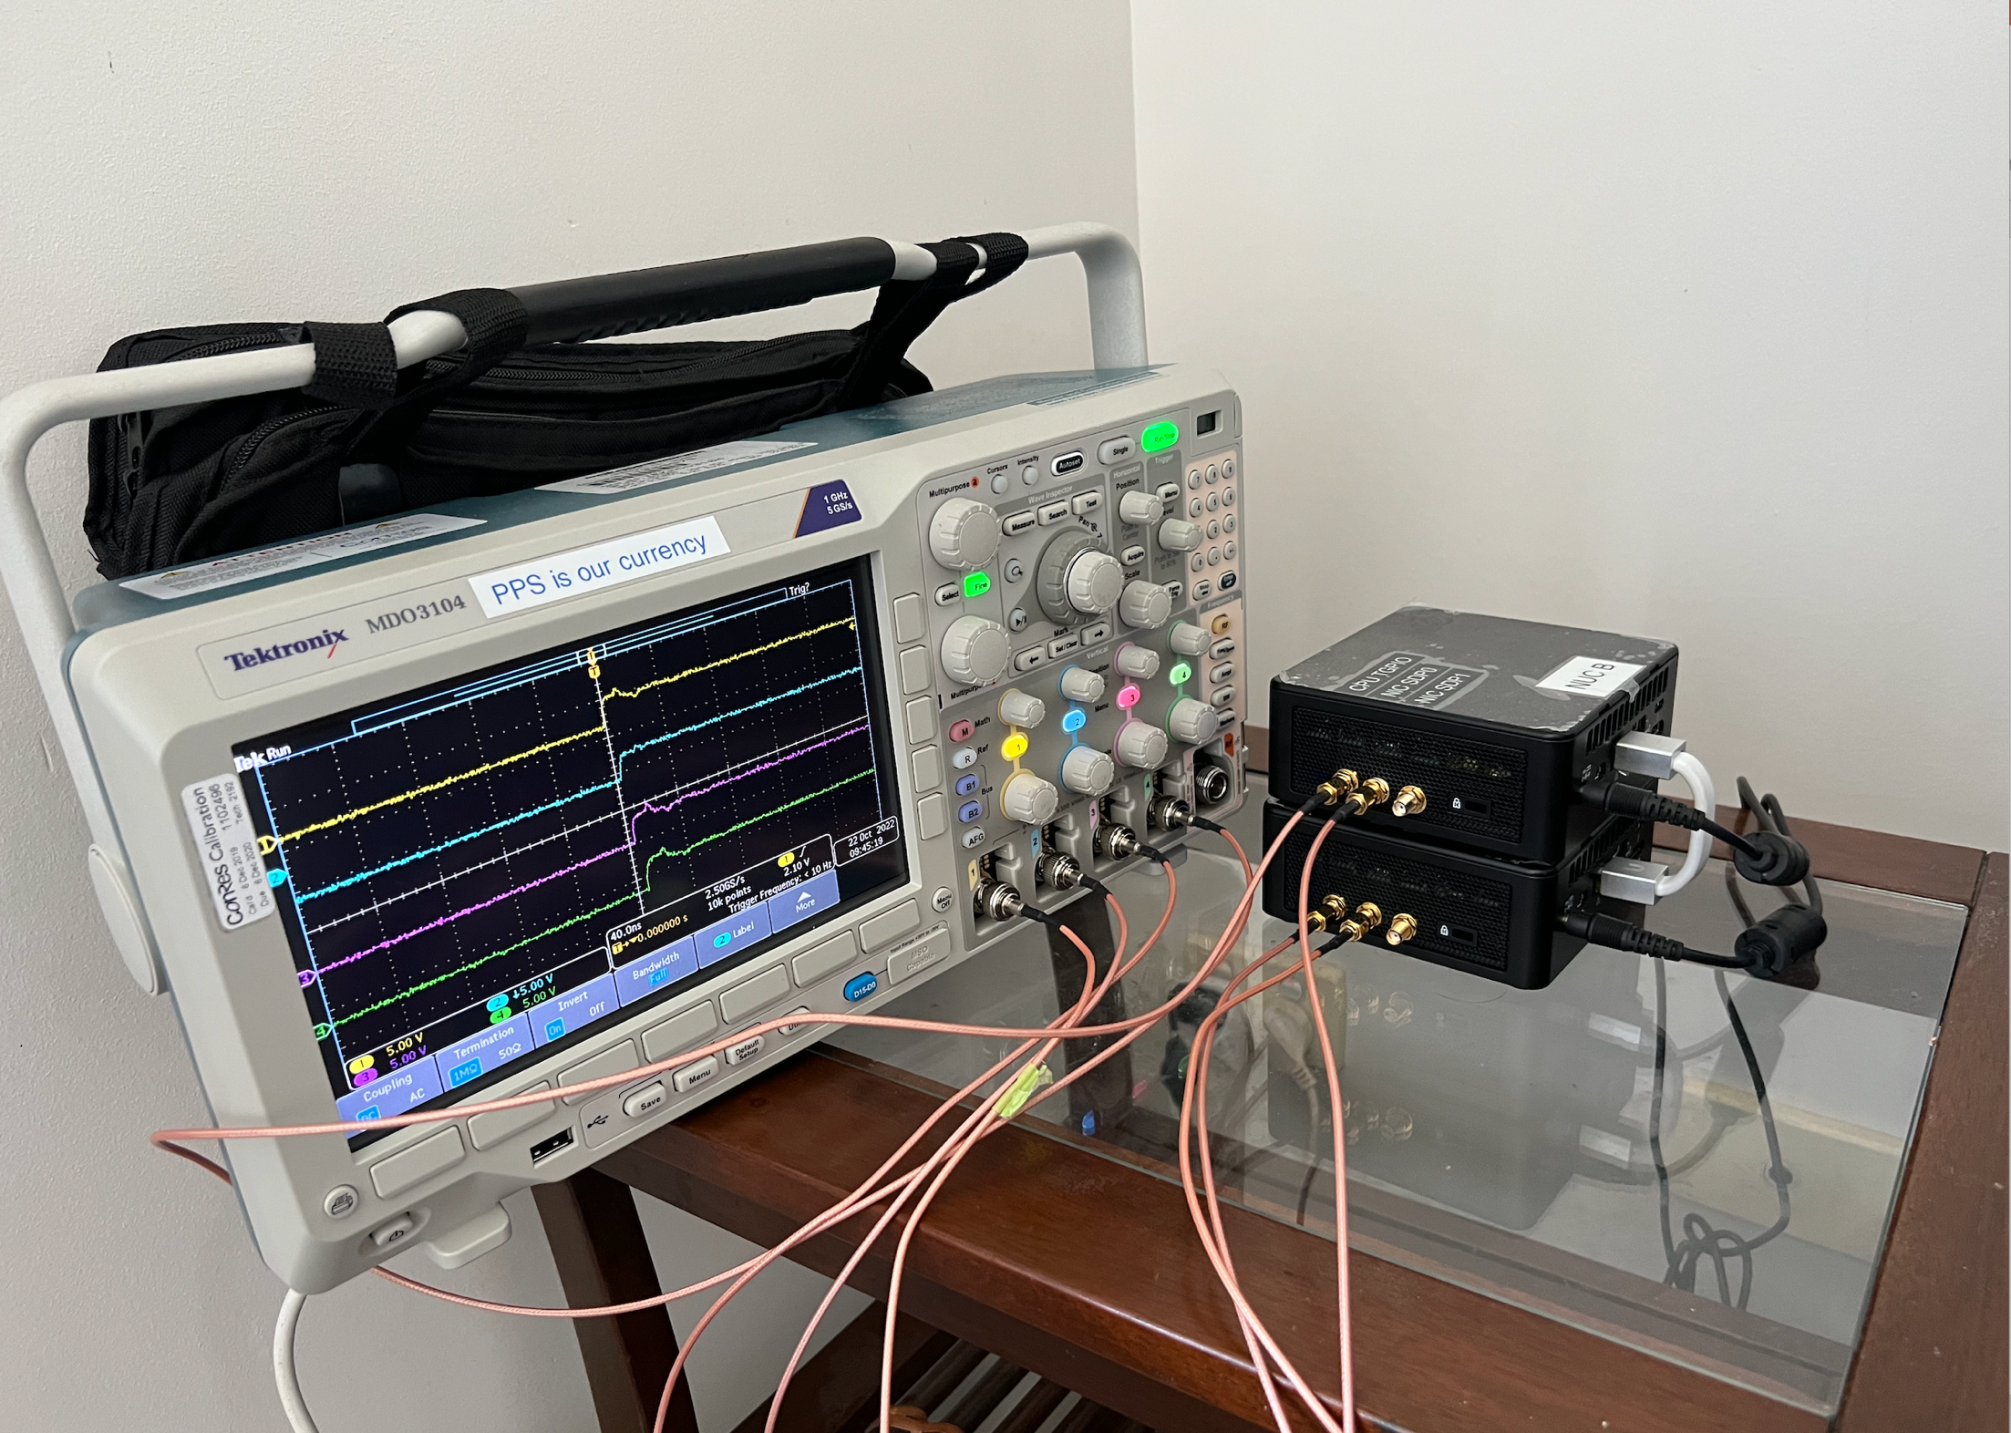
CPU TGPIO (PTM) Demo

Slide 12
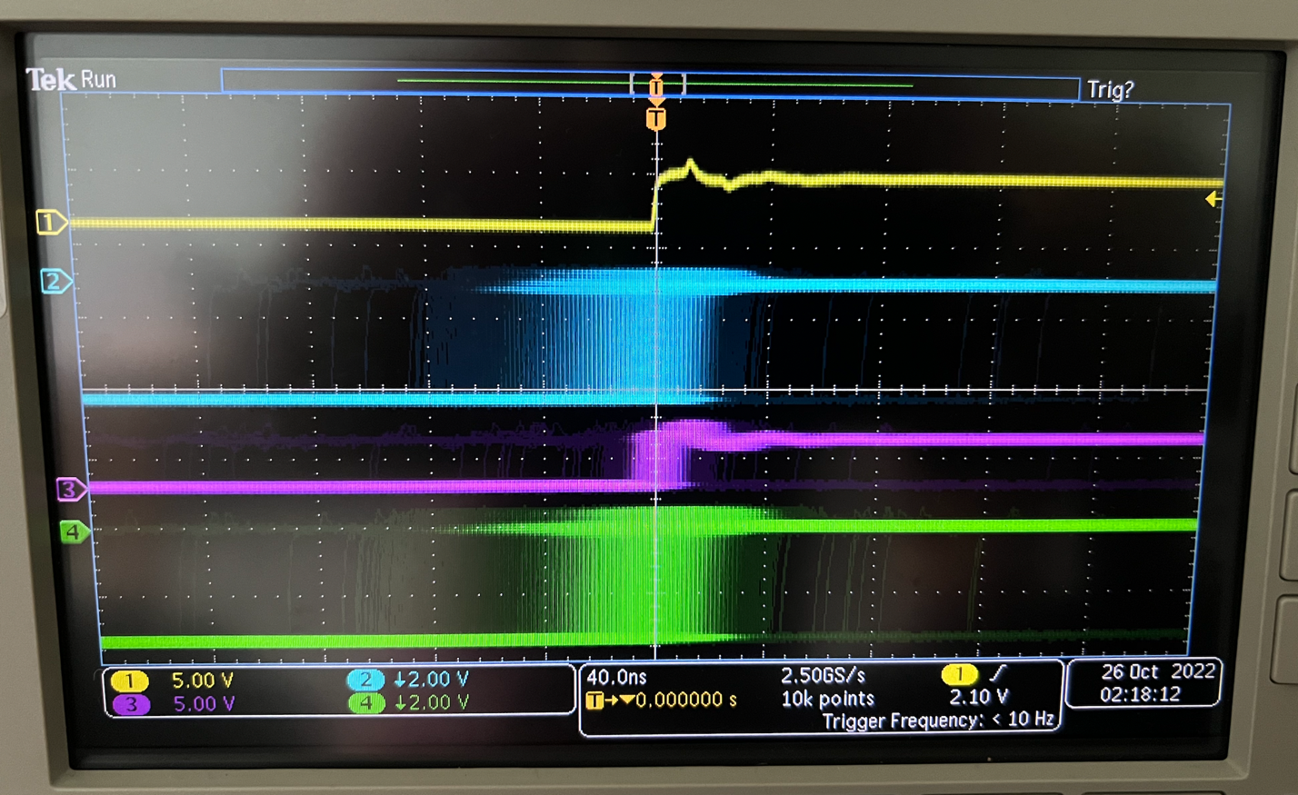
CPU TGPIO (PTM) Demo
Special Thanks to:
Intel for the PTM enablement
AMI for the TGPIO enablement on the BIOS
Please Come See the demo in person at our booth (Showing everything based on PPS signals “PPS in our currency”)

Slide 13
GNSS Receiver on the End-User Device
Outdoor and Open Sky
GNSS Antenna
Synchronization
GNSS Receiver
Local Oscillator
Peripherals
CPU

Slide 14
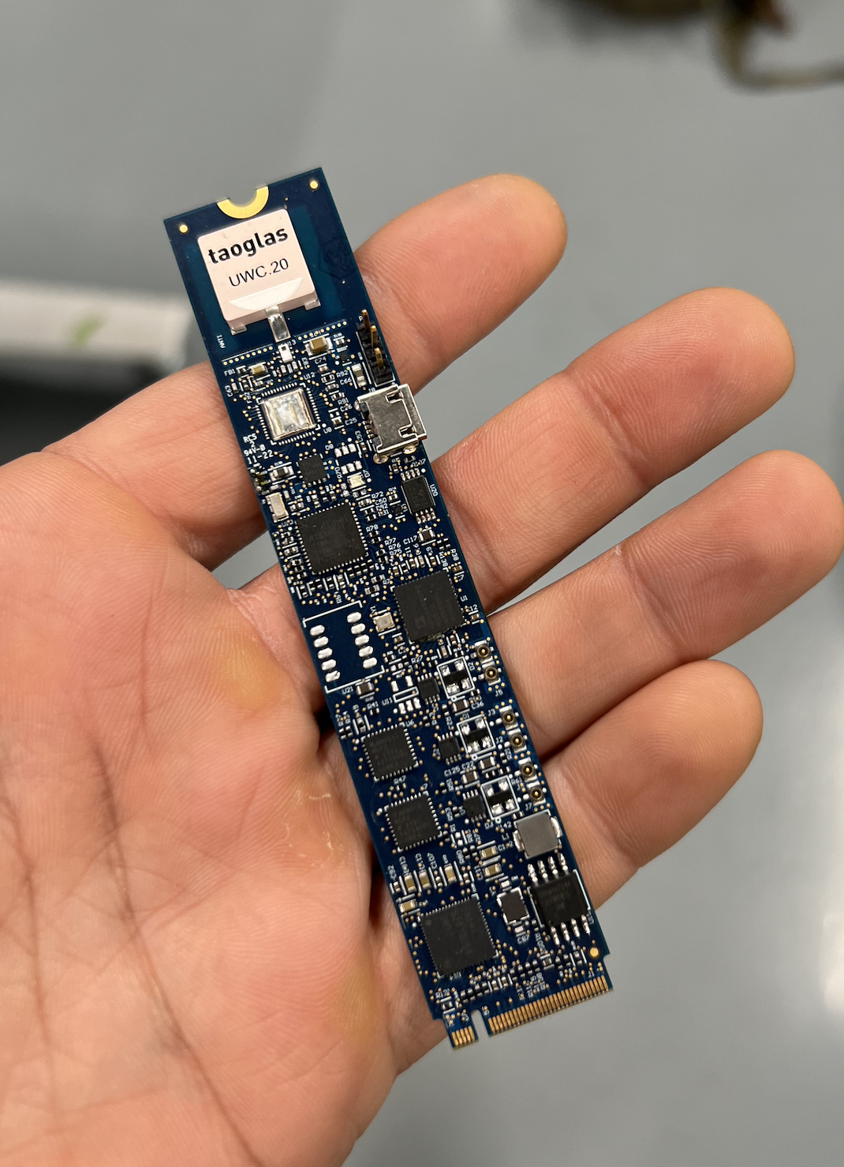
Time Drive: Miniature Time Card in m.2 FF

Slide 15
Latency: WIFI and Router
5G
Cloud Servers
Internet
Cable Modem to ISP
WIFI and Router
End-User
Downlink
Buffering
Routing
Buffering
Uplink

Slide 16
Getting Precision Time by the Home Modem
Local GNSS Receiver
GNSS Antenna
DOCSIS+HWTS
GNSS Receiver
DOCSIS+HWTS
Local Oscillator
Compute
Compute
ISP server
Modem
User’s Home
Internet Service Provider (ISP)
Synchronizing the local oscillator of the home modem from a local GNSS receiver

Slide 17
Synchronization from the Modem to the Device
Local GNSS Receiver
T2, T3
GNSS Antenna
Local Oscillator
T1, T4
Synchronization
GNSS Receiver
PTP over WIFI
WIFI +HWTS
Local Oscillator
Peripherals
DOCSIS+HWTS
Local Oscillator
WIFI +HWTS
Or WIFI plus
UWB or ISM
ETH +HWTS
CPU
PTP over Ethernet
User Device
Compute
Modem
It can be part of the modem or independent
ETH +HWTS
Local Oscillator
Peripherals
CPU
T2, T3
User Device
User’s Home

Slide 18
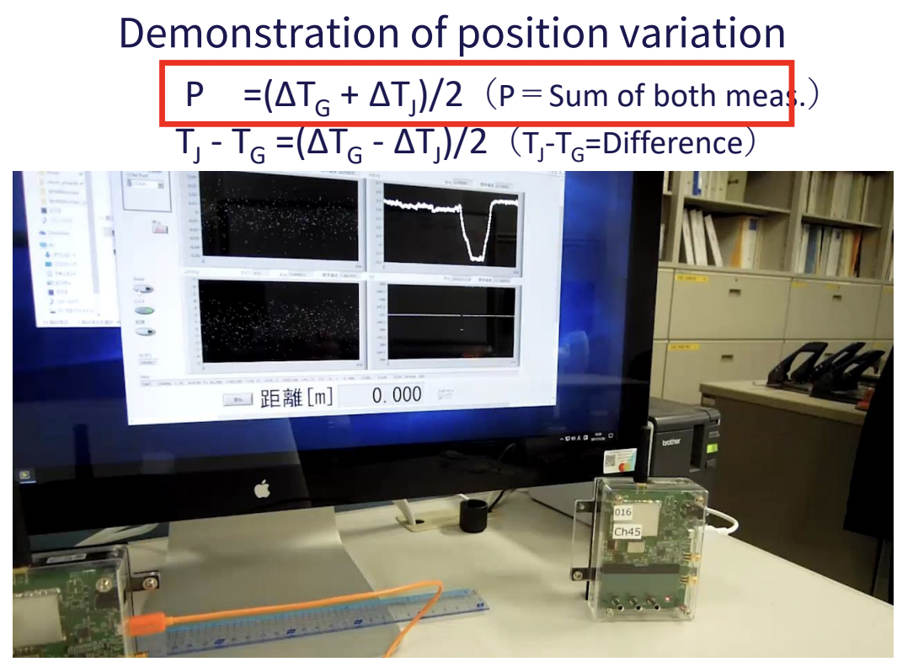
Short-Range Wireless Synchronization
Refer to Nobuyasu Shiga’s presentation on OCPTAP 2022

Slide 19
Latency: Cable Modem to ISP
5G
Cloud Servers
Internet
Cable Modem to ISP
WIFI and Router
End-User
5G/DOCSIS
Buffering
Service

Slide 20
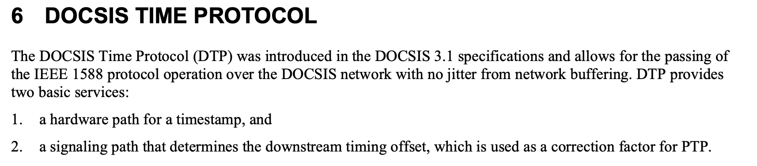
Latency: Cable Modem to ISP
L4S: Minimize Latency (still not zero, so measurement is still needed)
DOCSIS: CM-SP-SYNC-I02-210407
  Synchronization Techniques for DOCSIS® Technology Specification

Slide 21
Getting Precision Time from the ISP
GNSS Antenna
Synchronization
T1, T4
GNSS Receiver
Internet Connection
DOCSIS+HWTS
Local Oscillator
DOCSIS+HWTS
Local Oscillator
Compute
Sync over the cable
Compute
ISP server
Modem
T2, T3
User’s Home
Internet Service Provider (ISP)
Synchronizing the local oscillator of the Home Modem from the ISP via the cable connection

Slide 22
Latency: In case of 5G
5G
Cloud Servers
Internet
Cable Modem to ISP
WIFI and Router
End-User

Slide 23
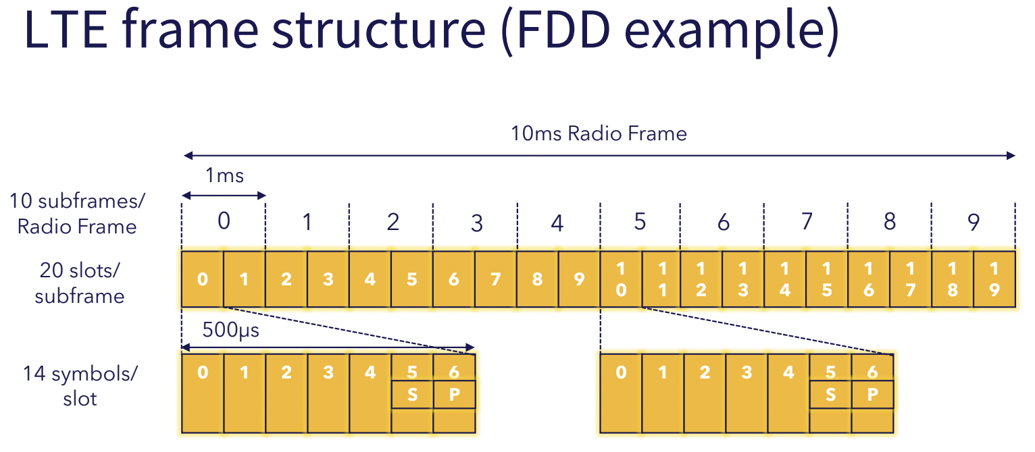
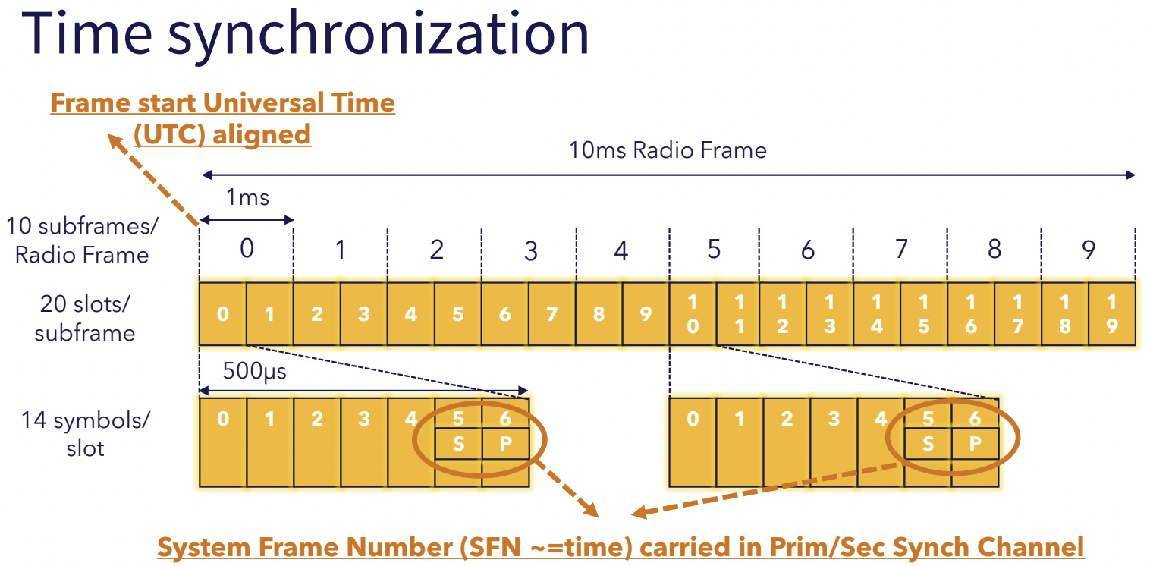
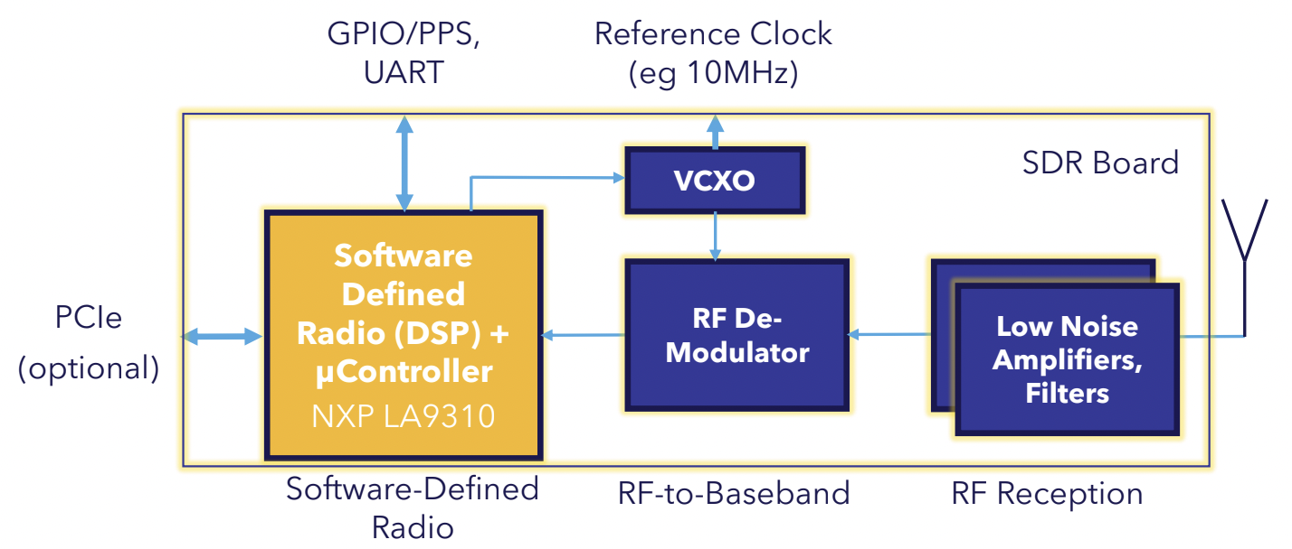
Latency: In case of 5G
Great work by Wim Rouwet fom NXP

Slide 24
Latency: Internet
5G
Cloud Servers
Internet
Cable Modem to ISP
WIFI and Router
End-User
NSP
NAP
NSP
ISP

Slide 25
Getting Precision Time from a POP to the ISP
GNSS Antenna
Synchronization
T1, T4
GNSS Receiver
PTP Connection
Backhaul
Network
Switches with TC
Backhaul
Network
Local Oscillator
Local Oscillator
Compute
Compute
T2, T3
POP with GNSS Receiver
ISP Server
Point of Presence (POP) with GNSS
Internet Service Provider (ISP)
Synchronizing the ISP with a GNSS to a POP equipped with GNSS using PTP

Slide 26
Latency: Cloud Servers
Precision Time Sync Toward the End-User: Why and How?
5G
Cloud Servers
Internet
Cable Modem to ISP
WIFI and Router
End-User
Server
Leaf SW
Spine SW
DCI
DFC
Core Network

Slide 27
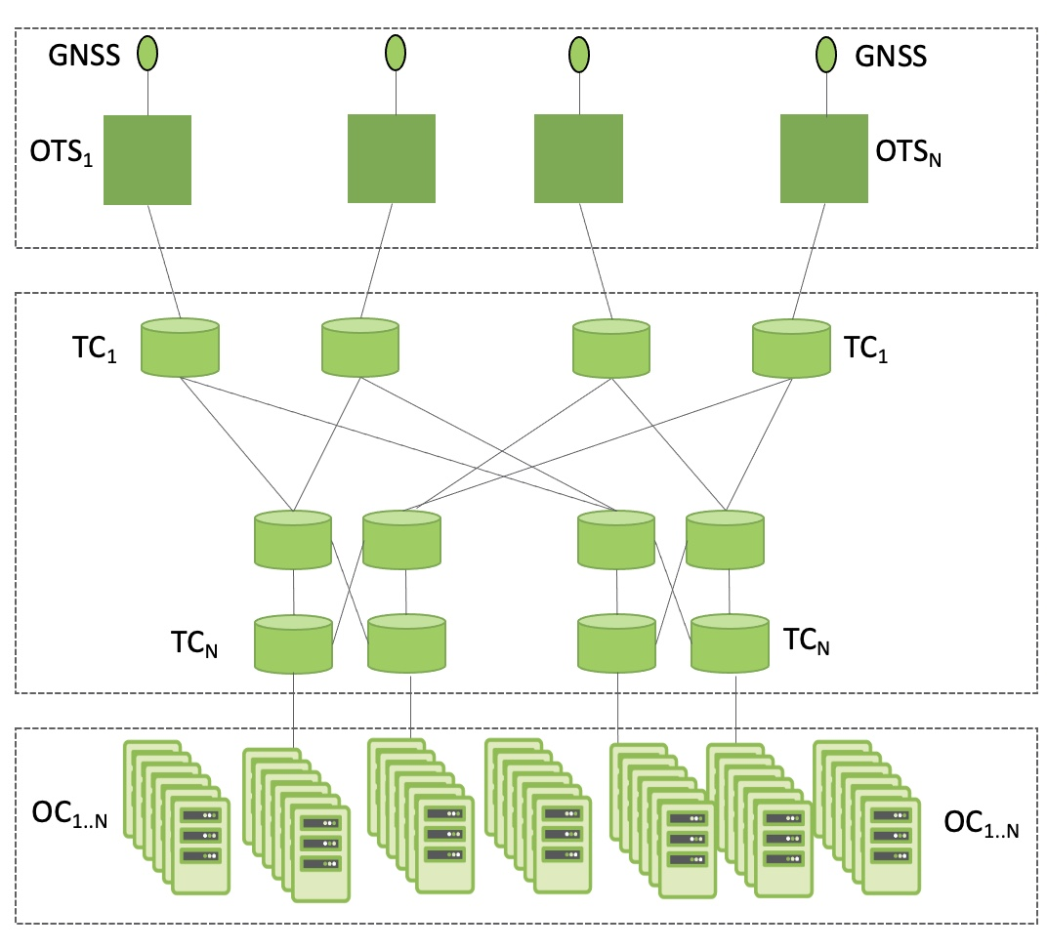
Simplified Architecture of Precision Time in a Datacenter
T = Time Error
OTS = Open Time Server
TC = Transparent Clock (switches)
OC = Ordinary Clock (end node)
|T_{OTS,j} – TAI| ≤ 100 ns
|T_{GM,j} – T_{GM,k}| ≤ 200 ns for k ≠ j
|T_{TCj,k} | ≤ 200 ns
|T_{OTS,i} – T_{OC,k}| ≤ 50 ns for k ≠ j
|T_{OC,j} – TAI| ≤ 100 ns
|T_{OC, j} – T_{OC,k}| ≤ 50 ns for k ≠ j

Slide 28

Open Time Server
How to sync a Datacenter?
Software
Mgmt.
Tools
Monitoring
Time
Appliance
Drivers
Time Card
NIC
COTS Server
Traditional
Open Time Server

Slide 29
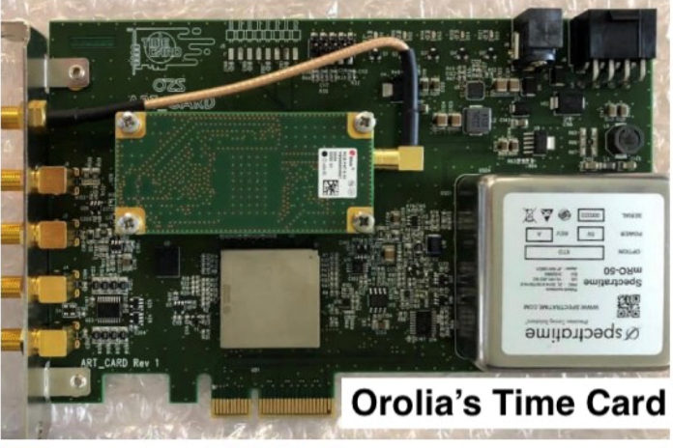
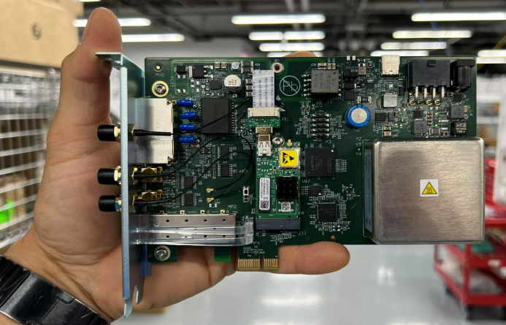
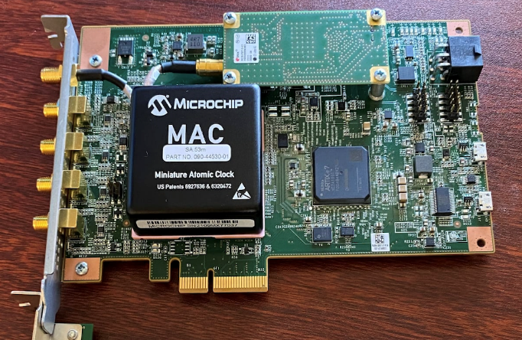
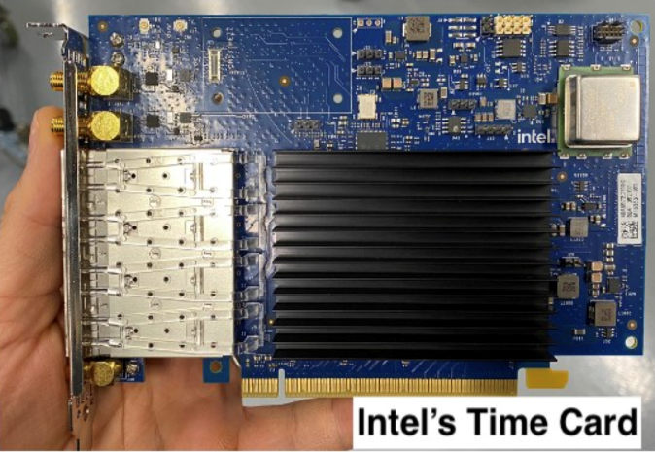
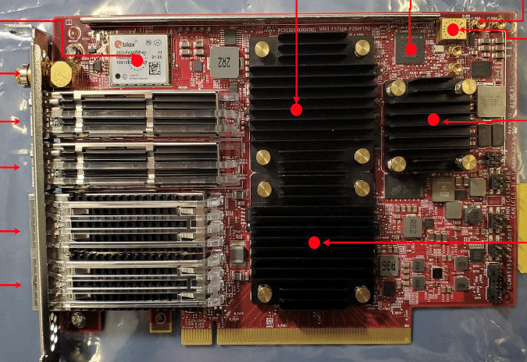
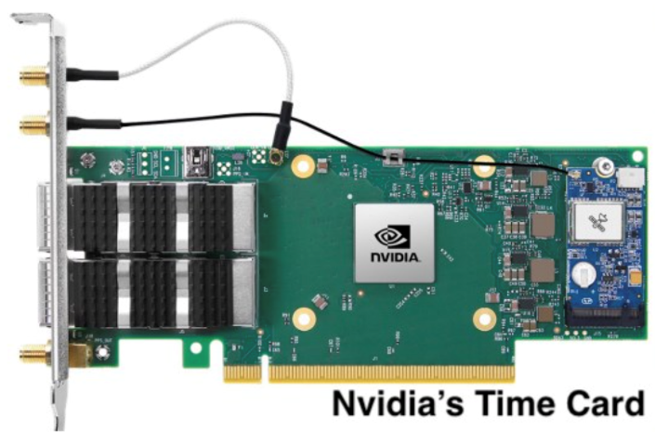
Time Card Family
ADVA’s Time Card
Celestica’s Time Card
Broadcom’s Time Card

Slide 30
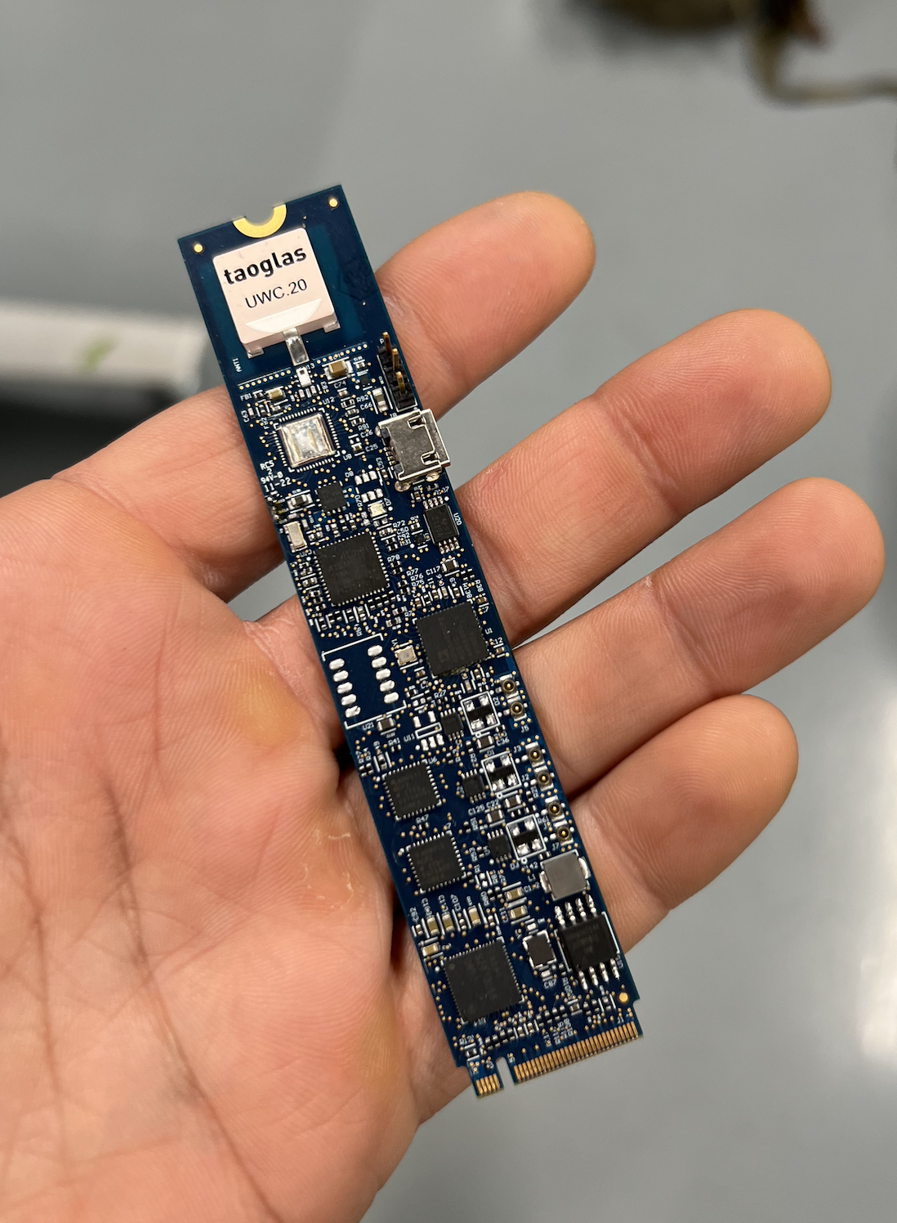
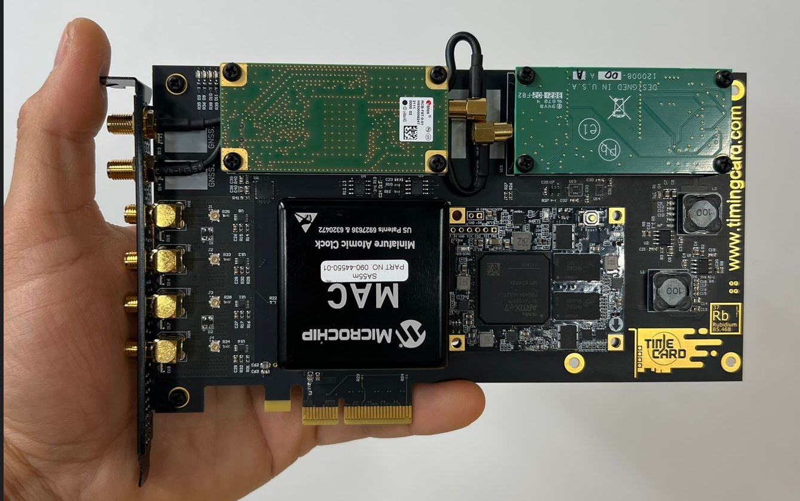
Time Card
Dual GNSS
m.2 form factor
For more details on how, please join my colleague, Oleg’s talk tomorrow

Slide 31
Conclusion
It is possible to get precision time sync to end users.
With milestones precision time sync can be enhanced.
Gaming and security can benefit immediately from the outcome
More advanced applications can emerge as the technology is proven
Open Source is a strong way to influence the industry
  Together we are stronger

