Slide 2
End-To-End PTP Monitoring in Broadcast Operations
Thomas Gunkel
Global Market Director Broadcast, Skyline Communications

Slide 3

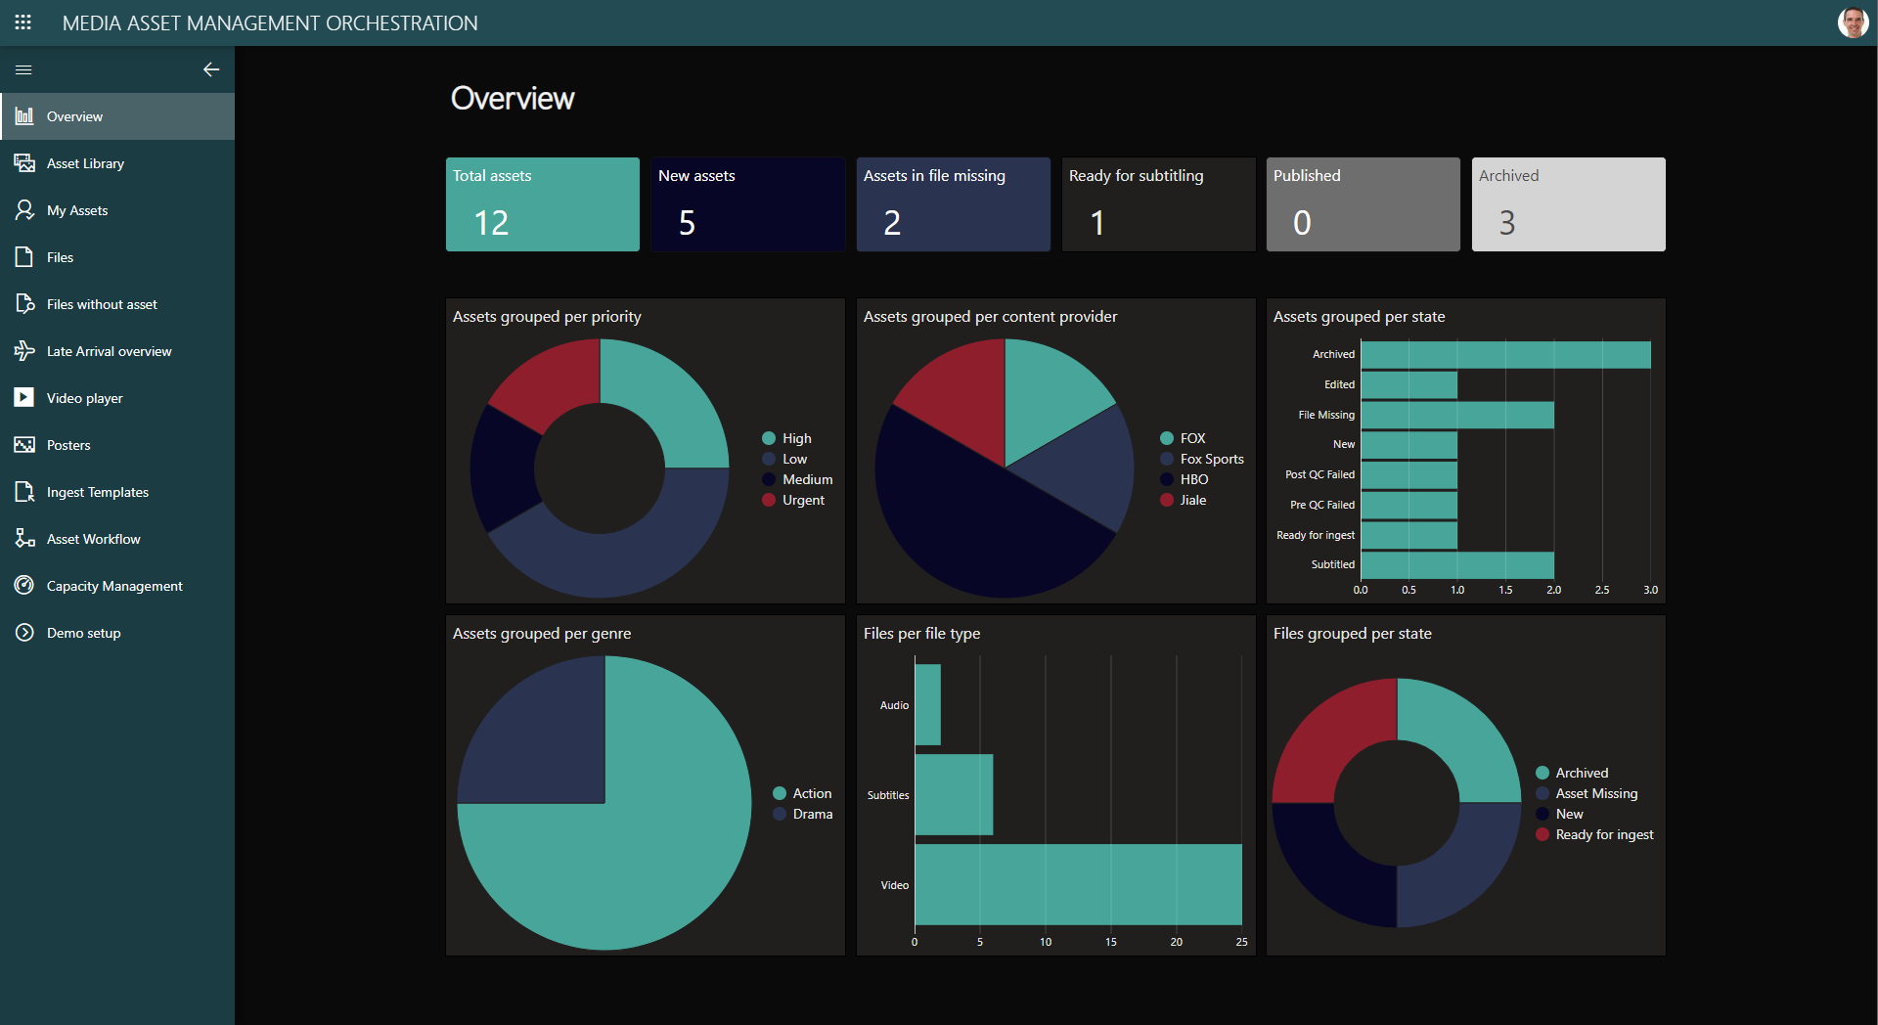

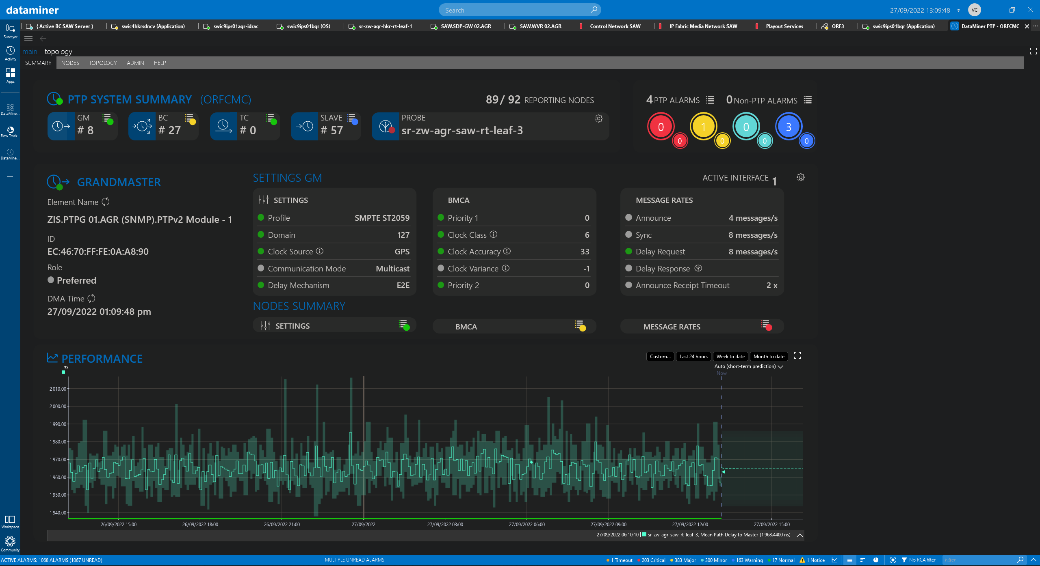
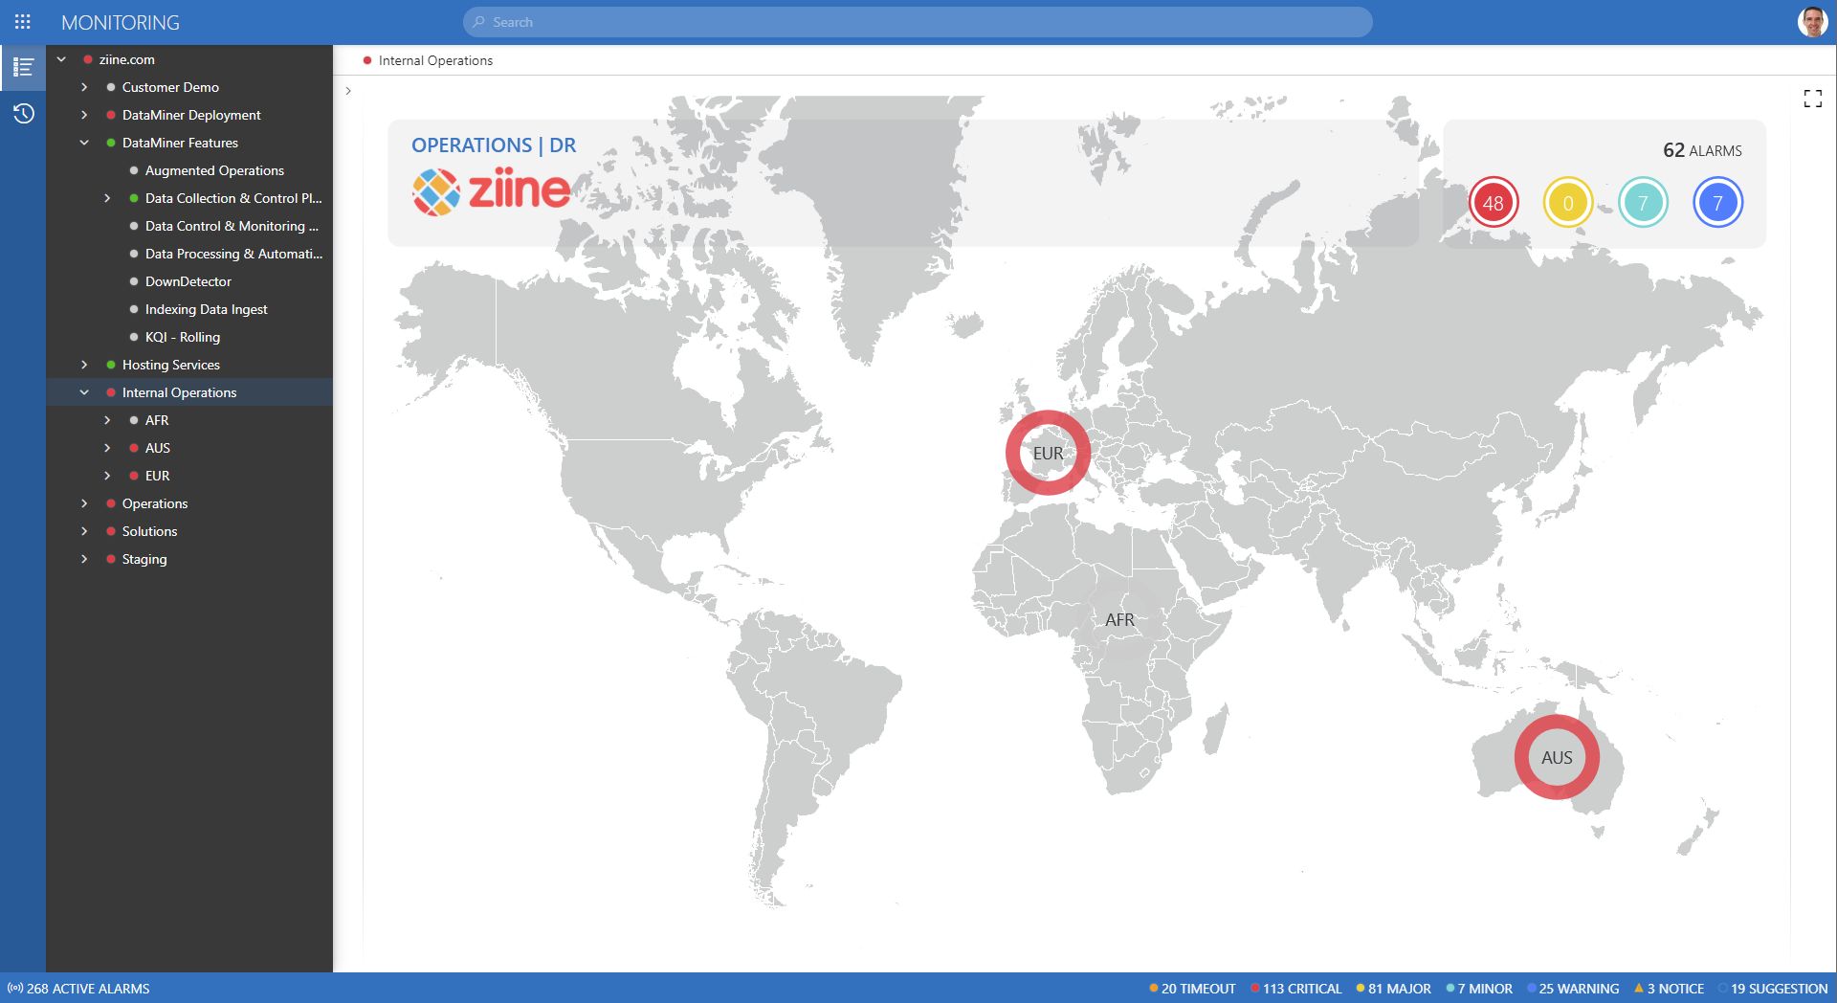
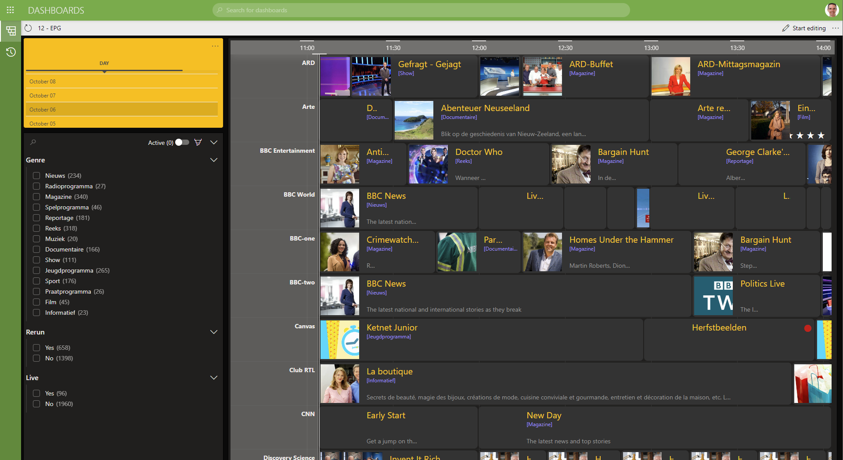

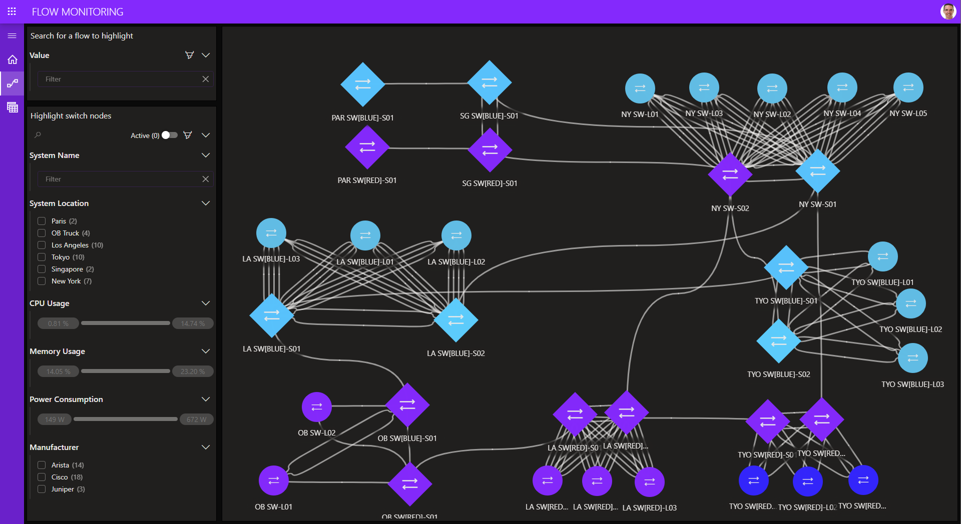
1500+ users across 120 countries
many of them use PTP
10.000+ dataminer nodes deployed
7.000+ product integrations
1000+ different vendors
350+ people
local presence in 20 countries
ICT, software, cloud, media & broadband experts
modular open monitoring and orchestration software for ICT media and broadband platforms
Notes:
Pitch: cannot afford any issue with PTP – impact is huge!
Loss of signal……
Meet and exceed what an enterprise needs…..
Extremely critical areas – top notch – high demanding applications

Slide 4
WHY PTP MONITORING?

Slide 5



WHY PTP MONITORING?
PTP is a mission critical service things can (and do) go wrong
bad foundation
-design & configuration
network issues
PTP node issues
network design: no routed network, non PTP-aware switches, mix of PTPV1 and PTPV2, devices locked to different time, …
PTP configuration: PTP parameters, BMCA settings, messaging rate intervals, communication mode
missing or corrupted PTP event messages
increased packet delay variations (PDV)
network asymmetry between receive and transmit path (link speed conversion)
multicast issues
grandmaster, boundary clock failure
loss of external reference (GNSS)
implementation bugs: BMCA or PTP master election process
Notes:
PTP parameters & BMCA settings (domain, priority1, priority2, profiles, delay mechanism, etc.)
messaging rate intervals (announce message, announce timeout, sync message, delay request, delay response, etc.)
communication mode (unicast, multicast, mixed)

Slide 6
WHY IS PTP MONITORING A CHALLENGE?

Slide 7



WHY IS PTP MONITORING in Broadcast a Challenge?
Technology: move from SDI to IP
  No need in the past to monitor B&B and SDI
  Transition to IP still ongoing
  PTP still relatively new to the media & broadcast industry
    ST 2022-6 (2012) - ST 2059 (2015) - ST 2110-10 (2017)
Operations Teams: different teams
  monitoring teams in broadcast historically separate from IT / NOC teams
  lack of experience, knowledge & expertise
Multi-Vendor Environments:
  every system is multi-vendor by nature
  vendors implement PTP in different ways
Notes:
PTP parameters & BMCA settings (domain, priority1, priority2, profiles, delay mechanism, etc.)
messaging rate intervals (announce message, announce timeout, sync message, delay request, delay response, etc.)
communication mode (unicast, multicast, mixed)

Slide 8
MULTI-VENDOR ENVIRONMENT
- different APIs & interfaces
- different set of supported parameters
- different names, values, units, intervals
standards and recommendations are available
vendors implement PTP in different ways
Difficult to monitor & Inconsistent
EXAMPLE
EXAMPLE
PTP Announcement Rates
Vendor Implementation
logAnnounceInterval
-2 (log base 2)
Vendor A: announce 0,25
Vendor B: announcement messages -2
Vendor C: announce interval 1/4s
Vendor D: announcement interval 4/sec
Vendor E: announce interval 4

Slide 9
WHAT DO WE NEED?

Slide 10




WHAT DO WE NEED?
PTP monitoring tools for operations MUST..
.. streamline (mediate) parameters & data
(e.g. announcement rate = 4 messages/s)
.. be easy to use
.. first help detecting PTP issues
.. then help troubleshooting and fixing the problem
Notes:
PTP parameters & BMCA settings (domain, priority1, priority2, profiles, delay mechanism, etc.)
messaging rate intervals (announce message, announce timeout, sync message, delay request, delay response, etc.)
communication mode (unicast, multicast, mixed)

Slide 11

WHAT TO MONITOR?
Everything that is required to successfully deliver PTP
PTP Nodes
GrandMaster
Boundary Clocks / Transparent Clocks
Slave (Follower) Devices
PTP Supporting Infrastructure
GNSS Source
Network Infrastructure
PTP Traffic
Network Traffic
PTP Traffic
Notes:
PTP parameters & BMCA settings (domain, priority1, priority2, profiles, delay mechanism, etc.)
messaging rate intervals (announce message, announce timeout, sync message, delay request, delay response, etc.)
communication mode (unicast, multicast, mixed)

Slide 12
PTP MONITORING IN PRACTICE

Slide 13
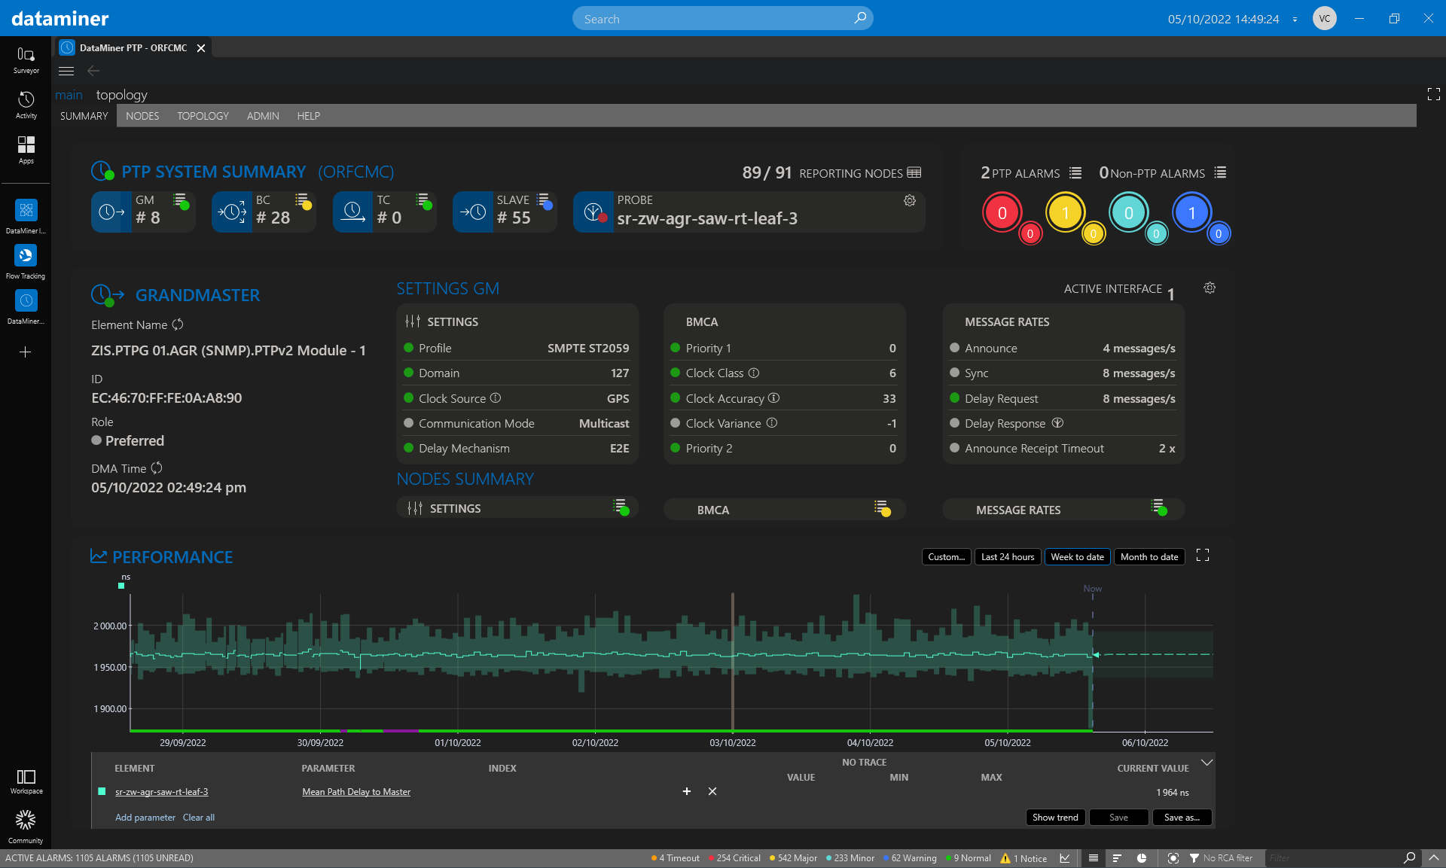

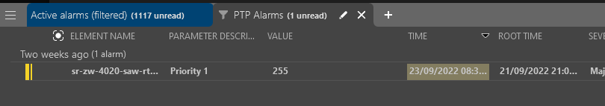
PTP MONITORING – PTP stack at a glance
Active GrandMaster
PTP node overview
PTP config check
PTP alarms
PTP performance
non-PTP device alarms
Notes:
PTP parameters & BMCA settings (domain, priority1, priority2, profiles, delay mechanism, etc.)
messaging rate intervals (announce message, announce timeout, sync message, delay request, delay response, etc.)
communication mode (unicast, multicast, mixed)

Slide 14
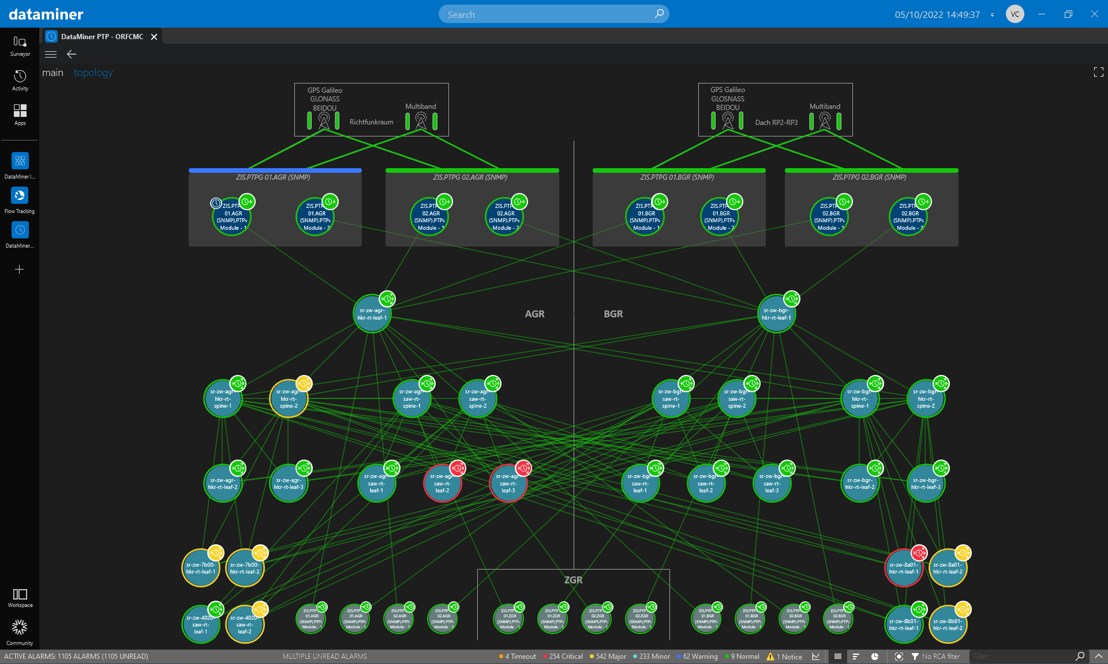
PTP MONITORING – PTP Topology Views
PTP Topology
GNSS Monitoring
Network Monitoring
Notes:
PTP parameters & BMCA settings (domain, priority1, priority2, profiles, delay mechanism, etc.)
messaging rate intervals (announce message, announce timeout, sync message, delay request, delay response, etc.)
communication mode (unicast, multicast, mixed)

Slide 15
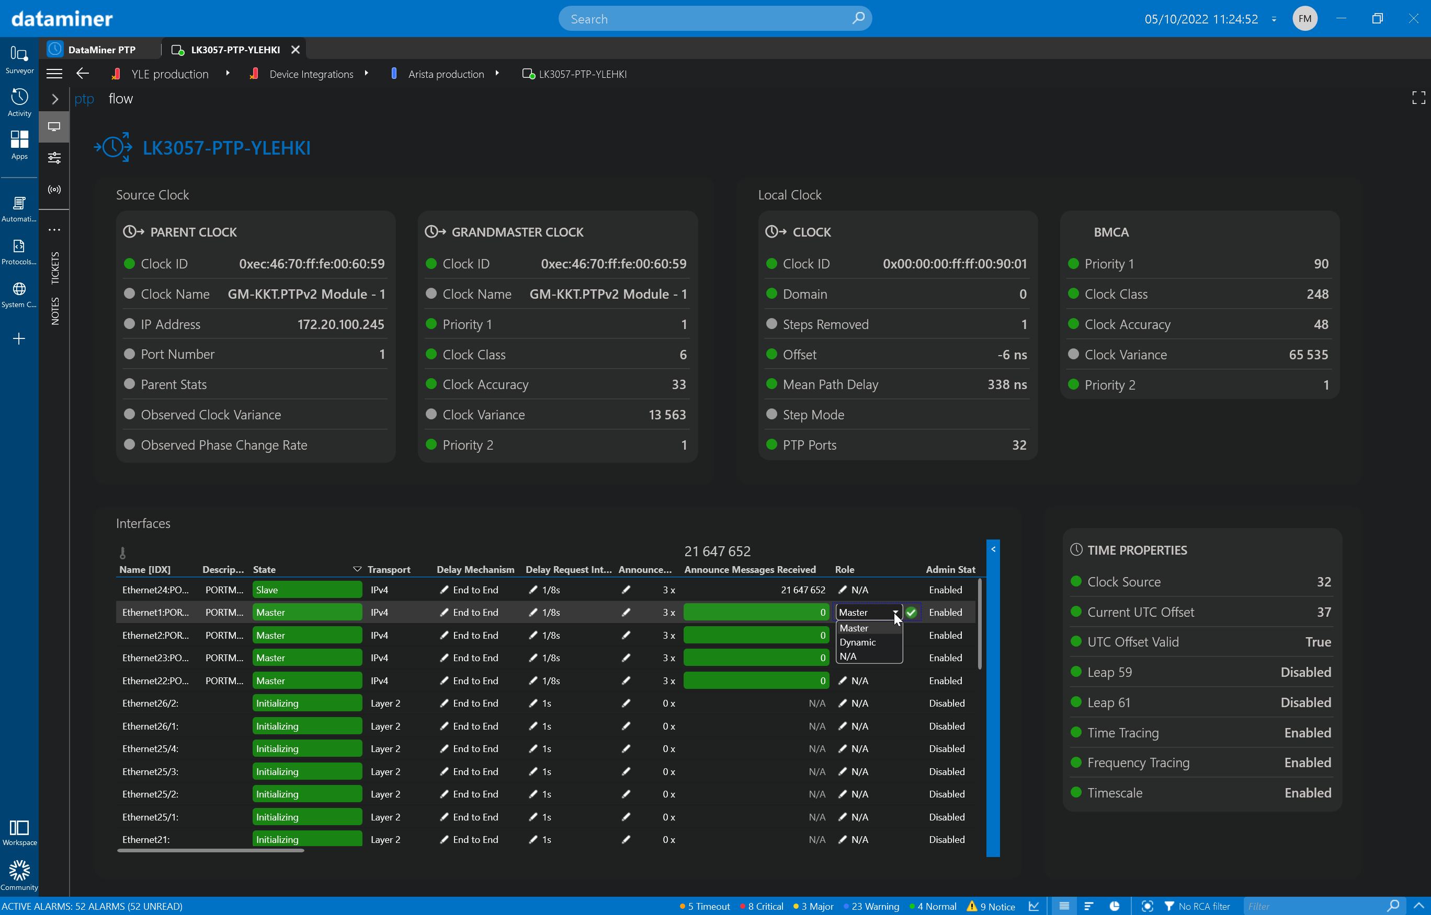
PTP MONITORING – Boundary Clock Details
GrandMaster Clock
Parent Clock
Local Clock
PTP Interface details
PTP Security
Notes:
PTP parameters & BMCA settings (domain, priority1, priority2, profiles, delay mechanism, etc.)
messaging rate intervals (announce message, announce timeout, sync message, delay request, delay response, etc.)
communication mode (unicast, multicast, mixed)

Slide 16
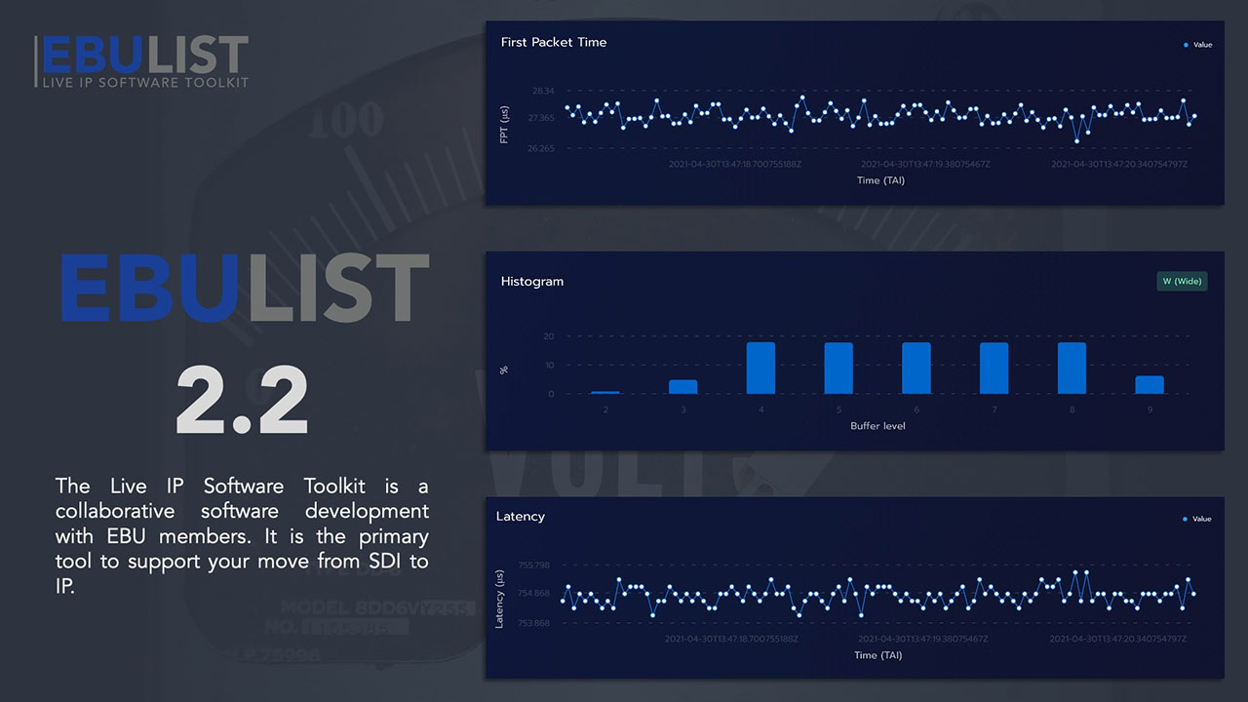



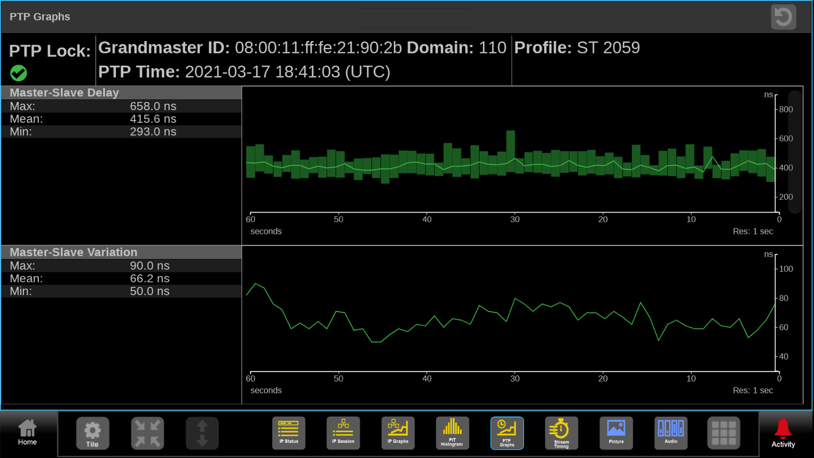





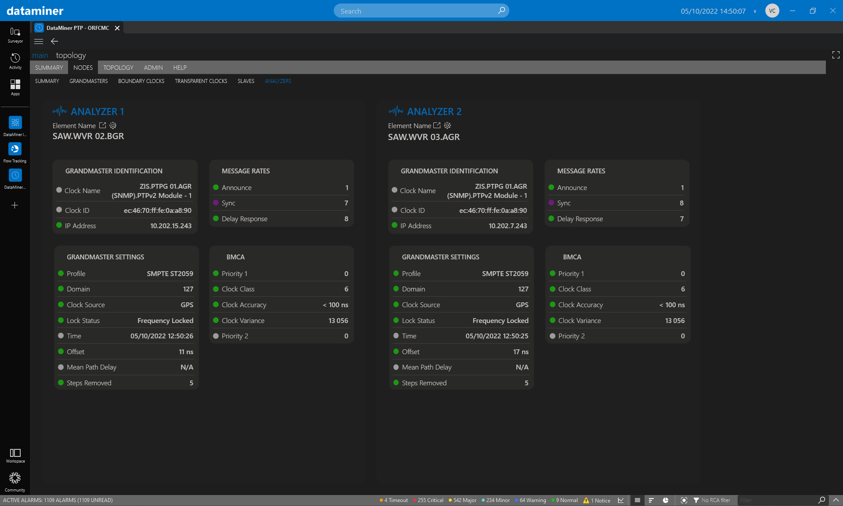



PTP MONITORING – Analyzer Integration
Compare PTP configuration vs. measured packets in the network
Automate analyzer workflows
- analyzer configuration
- start/stop capture
- notify TierII-support
- switch port mirroring & tap aggregation
Notes:
PTP parameters & BMCA settings (domain, priority1, priority2, profiles, delay mechanism, etc.)
messaging rate intervals (announce message, announce timeout, sync message, delay request, delay response, etc.)
communication mode (unicast, multicast, mixed)

Slide 17
CONCLUSION
PTP Monitoring..
..is a must
..is much more than analyzing PTP traffic at one point in the network
..goes along with automated PTP infrastructure configuration
..is tightly coupled with security workflows

