Slide 1

Oscilloquartz
Precise & Assured Timing for Enterprise Networks
November 8th - ITSF
Jeremy Thomas

Slide 2



ADVA Oscilloquartz
HEL
STO
YRK
BLN
GDN
YOW
LON
HAN
MGN
Warsaw
MUC
ATL
PAR
ZRH
VIE
TYO
RDU
NCH
DAL
ROM
DEL
SZ2
SZX
HFA
DXB
HKG
TLV
BLR
SIN
SAO
PRY
Headquarter
Facility
Representative
MEL
ADVA Optical Networking & Transport / Oscilloquartz E2E Time and Sync
Notes:
Just on that global piece - As you can see we have facilities and presence across the globe, this is important to assist our customers and be able to provide front line best in class 24/7/365 service and localised support.
For example our Enterprise cloud and financial customers are spread all over yet demand the very best and closest attention which we are able to meet.

Slide 3
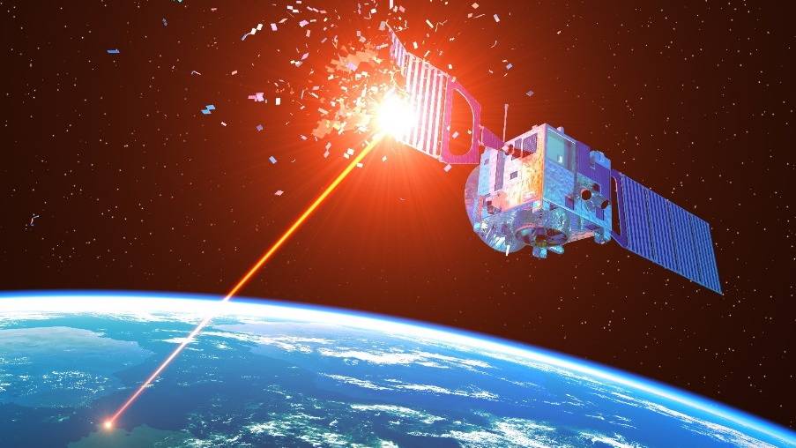
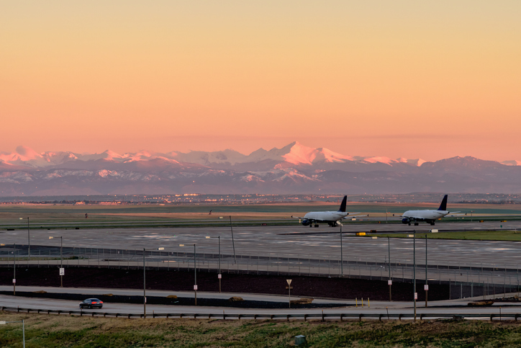

. . Impact on Timing / PNT in the last 6 weeks
Ukraine updates: US warns Russia over satellites threats – DW – 10/27/2022
US warns Russia over satellites threats.
Counter-threat came after Konstantin Vorontsov said Western commercial satellites could become legitimate targets
Danish waters – four vessels Jammed, PNT systems ‘went black’ 20KM radius from warships
Air Traffic Control issued a notice advising pilots of problems with GPS reception spanning about 8,000 square miles in the Denver area.
‘Incident lasted for 33.5 hours’
Mike Roskind (DHS)
What happened to GPS in Denver? - GPS World : GPS World 09/21/2022
Russian warships played kispus with Danish pilots - TV 2 – 10/07/2022

Slide 4
Challenges with satellite-delivered timing
Obstructed sky view, lightning strike, multipath
Interference from high-power RF transmitters, e.g., TV, cellular, radar
Ionospheric disturbances and solar activity
Jamming attack: overpowering weak GNSS signal Spoofing attack: fake GNSS signal
globally available, free to access, accurate and traceable
Notes:
So lets next take a look at the market trends
Regulators
here in the financial space you can see here of the likes of
ESMA – European Securities & Markets Authority
FINRA
SEBI – India
What is happening is that regionally financial transaction regulation is now well established – ultimately each body has similar goals so are aligned in the main and increasingly are enforcing. Enterprise infrastructure as often global so essentially looks to standardise their infrastructure.
Regulation
Here in Europe we are currently up to MIFID2 – essentially for timing this mandates the need for microsecond accuracy, 100 microsecond UTC traceability on the clients, 5 year+ data storage and flexible reporting. There was a MIFID1 in the noughties there will be a MIFID3 in the 2020s
so far we are seeing the next focus to Fairness, additional data transparency and increased local and centralised DBs – further increasing the demands for timestamping and synchronisation.
Interestingly in Europe ESMA is also going to shortly be the regulator for MICA bringing crypto and elements of blockchain within regulation.
Sync Drivers
So from the sync perspective there is increasingly a move to ever resilient Timing – this phrase aPNT – assured Position Navigation and Timing is often used and we provide the critical T element.
This additional movement has already started in the US with their Exec order 13905 in 2020 mandating the need for critical industry to build in resiliency beyond only using GNSS satellite timing signals.
Currently the European Commission as well as the post Brexit UK Gov and the IEEE are all working to release their aPNT strategies and likely regulation.
DC growth and cloud adoption post covid post GDPR increasing effects
Ageing, upgrading, expansion

Slide 5
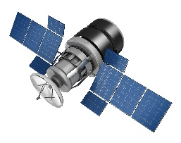
Precise & assured timing is fundamental
Transportation
Utilities
Tracking goods and navigation of vehicles on ground, water or in the air
Detecting and accurately localizing failures; synchronizing control
Position
Navigation
Timing
Precise timing of radio access networks
Synchronizing data backup and distributed compute processes
Regulation and HFT
Fixed/mobile networks
Financial & Enterprise
Notes:
Today PNT services are key to many critical infrastructures. Geolocation is obviously an essential information with transportation e.g. for navigation but also security in air travel. And time is required with many industries, enterprises but also networks. Mobile networks require precise time to syn their base stations, utilities need accurate time at any substation to localize failures in realtime and data centers need to efficiently synchronize data this requires a means to separate latest data from older records.
All of those critical infrastructures require precise PNT and as we have seen before, that time is fundament to this services. However, GNSS signals come from very far away, it is like looking at a 25W light bulb from a distance of almost 40tkm. What can happen, if this signal gets detoriated?

Slide 6
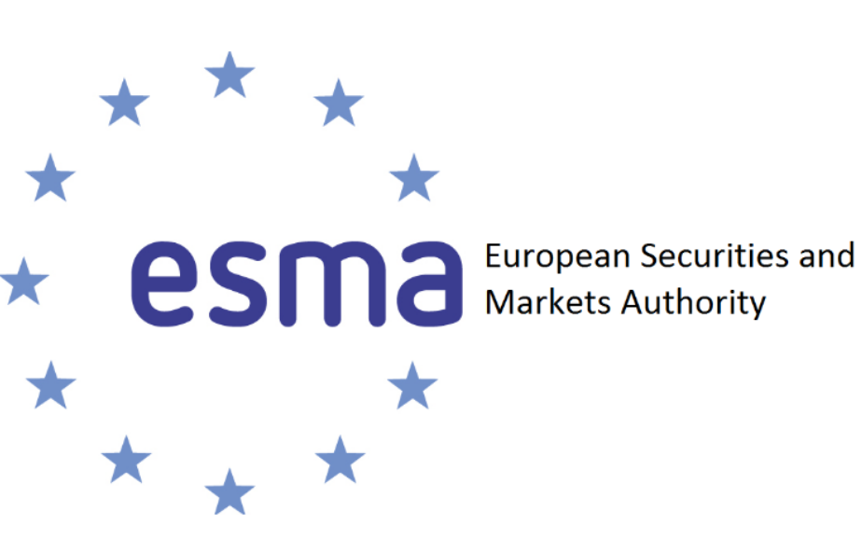



Financial Enterprise Ecosystem
Regulators
Next: Additional
regional requirements
Regulation
Jan 2018
Next: MICA > ESMA
(Markets In Crypto Assets)
Traditional Finance > DeFi
MIFID 1
5 Year enforcement
Next: MIFID 2.5 > 3? – Trading Fairness, data transparency, increased local / centralised DB
Resiliency
Next: Europe / UK moves on aPNT
EC & UK Gov & IEEE P1952
eg European Radio Navigation Plan revision
Next: DC Growth > Cloud Adoption, Movement and Innovation
eg 10G > 25G PTP next years
USA
PNT Exec Order 13905 Feb 2020
Regulation and Innovation driving more precise and resilient timing
Notes:
So lets next take a look at the market trends
Regulators
here in the financial space you can see here of the likes of
ESMA – European Securities & Markets Authority
FINRA
SEBI – India
What is happening is that regionally financial transaction regulation is now well established – ultimately each body has similar goals so are aligned in the main and increasingly are enforcing. Enterprise infrastructure as often global so essentially looks to standardise their infrastructure.
Regulation
Here in Europe we are currently up to MIFID2 – essentially for timing this mandates the need for microsecond accuracy, 100 microsecond UTC traceability on the clients, 5 year+ data storage and flexible reporting. There was a MIFID1 in the noughties there will be a MIFID3 in the 2020s
so far we are seeing the next focus to Fairness, additional data transparency and increased local and centralised DBs – further increasing the demands for timestamping and synchronisation.
Interestingly in Europe ESMA is also going to shortly be the regulator for MICA bringing crypto and elements of blockchain within regulation.
Sync Drivers
So from the sync perspective there is increasingly a move to ever resilient Timing – this phrase aPNT – assured Position Navigation and Timing is often used and we provide the critical T element.
This additional movement has already started in the US with their Exec order 13905 in 2020 mandating the need for critical industry to build in resiliency beyond only using GNSS satellite timing signals.
Currently the European Commission as well as the post Brexit UK Gov and the IEEE are all working to release their aPNT strategies and likely regulation.
DC growth and cloud adoption post covid post GDPR increasing effects
Ageing, upgrading, expansion

Slide 7
Synchronization in finance – Past
Historically moderate timing requirements
Internet-hosted NTP server
GPS
NTP
Communication network
Local clock is sourcing local appliances with NTP,
Exchanges / COLO 1PPS,
Financial venues
Communication network
Notes:
Next I want to take a look across time at the evolution in finance
10-15 years ago Financials would have had more basic Network Tim Protocol - NTP timeservers, exchanges would have used older 1PPS frequency for their trading, some GPS or ‘internet time’ even was used.

Slide 8
Synchronization in finance – Past >Present
Higher timing accuracy, Traceability, cloud migration
Time related regulation
GNSS
PTP
Communication network
Complementing NTP/PPS with PTP and GNSS-delivered timing
Metro & regional DC DR COLO interconnects
Hosted finance applications need precise timing; PTP and GNSS-delivered timing
Financial venues
Communication network
Data centers
Notes:
5-10 years ago NTP use turned to the more accurate and traceable PTP (precision time protocol)
Multiconstellation GNSS not just the US GPS was adopted to see more satellites and mostly in house infrastructure was built out, redundancy and interconnectivity was added and regulation really raised the game on traceability, accuracy and reporting.
However it was also at this time that Cloud / DC / Hyperscalers had huge growth and adoption taking on some of the hosting in this space

Slide 9
Synchronization in finance – Present > Future
Optical network delivered timing providing resilience
Progression to both Internal & External Time as a Service (TaaS)
Multiband GNSS
Resilient TaaS
Resilient TaaS
PTP
DWDM, optical network and/or national timing infrastructure
Backing-up GNSS, Local GMs with network delivered timing. Increasing PTP & WR
Time-delivery optical timing channel, core & boundary clocks
Backing-up GNSS with
POP GMs, key ePRTC / Cs clocks
Financial venues
Communication network
Data centers
Notes:
This is where we come to more recent times. Where resiliency as well as connectivity comes down a fibre, and where networks and hosting are king.
Time as a Service – TaaS for short.
External TaaS Increasingly Financials look to an external time feed, this can be from a Telco or ISP thus reducing their own infrastructure overhead and engineering , metrology labs
and/or they shift the bulk out into the hosted cloud, the hyperscalers who themselves setup a resilient timing infrastructure and then offer TaaS internally, effectively as a utility spurred on by ever increasing regulation, resiliency demands, security and infrastructure overheads

Slide 10
Evolution of assured Timing / aPNT
Expansion of Telco & ISP end users and services
Scalable Resilient Core, Access & Edge / DWDM networks.
Enhanced GNSS and Clock central monitoring inc ML & AI use
Cybersecurity - Public and private TaaS
Backing-up GNSS with both POP and network delivered timing.
Time ownership and Utilitisation
Build out of established ‘As a Service’ models to incorporate Timing
Augmentation of Space, Local and TaaS Timing
Generational evolving regulation and standards
HFT & COLOs retain core house operations
Financial venues
Communication network
Data centers
Notes:
This is where we come to more recent times. Where resiliency as well as connectivity comes down a fibre, and where networks and hosting are king.
Time as a Service – TaaS for short.
External TaaS Increasingly Financials look to an external time feed, this can be from a Telco or ISP thus reducing their own infrastructure overhead and engineering , metrology labs
and/or they shift the bulk out into the hosted cloud, the hyperscalers who themselves setup a resilient timing infrastructure and then offer TaaS internally, effectively as a utility spurred on by ever increasing regulation, resiliency demands, security and infrastructure overheads

Slide 11
jethomas@adva.com

