Slide 1
A Deep Dive Investigation into The Challenges of Sync Over DWDM Networks
Jon Baldry
ITSF – Düsseldorf – 8th November 2022

Slide 2








Sychronization Distribution Strategies for 5G
In-band delivery of synchronization
Transponder synchronization performance
Coherent synchronization performance
High-performance PTP 1588 and SyncE delivery
T-BC
T-BC
T-BC
In-band Delivery
T-GM
Out-of-band delivery of synchronization
Very high-performance PTP 1588 and SyncE
Single-fiber CWDM and O/E/L-band overlay
OTC network elements:
T-BC Class D boundary clocks
Optical 3R regeneration
Optical Timing Channel
T-BC
T-BC
T-BC
T-BC/3R
T-BC/3R
T-GM
Hybrid use of in-band and OTC mechanisms
Interoperable and interchangeable
All high-performance 1588 PTP, not proprietary
Use the appropriate solution for the best fit
In-band delivery perfect for metro-access
OTC widely used as core distribution
Hybrid Sync Distribution
T-BC
T-BC
T-BC
T-BC/3R
T-GM

Slide 3



Creating an OTC2.0-enabled vPRTC/Timing Cloud
vPRTC (Timing Cloud) with every DWDM node capable of delivering timing/synchronization
OTC2.0-ENABLED vPRTC:
Provides GNSS-like omnipresent timing, overcoming GNSS security/reliability/accessibility issues
Uses secure and reliable optical network to deliver highly-accurate timing/synchronization:
Predictable, traceability to UTC and PRC
Reliable, resilient and secure
Highly-accurate, Class D in Timing Cloud
Flexible and independent
Every DWDM node capable of delivering timing/synchronization
Preserves timing budget for access/aggregation networks
Simplifies timing/synchronization planning and ongoing operations
5G Fronthaul /Midhaul
5G Fronthaul /Midhaul
100 ns
Redundant GNSS spoofing hardened GM/ Cesium source
Other timing critical applications (power distribution, scientific)
Range of 100 ns vPRTC (Timing Cloud) resilient timing service

Slide 4
Let’s Dive into The Challenges of Sync Over DWDM Networks

Slide 5



5G Drives High-accuracy Synchronization Requirements
3GPP TS 38.104 Time Alignment Error
ITU-T G.8271.1 Network Limits
ITU-T G.8273.2 PTP T-BC Class C
ITU-T G.8273.2 PTP T-BC Class B/C
IP Router or Ethernet Switch with inbuilt T-BC
ITU-T G.8275.1 Full Onpath Support
ITU-T G.8275.1 Full Onpath Support
ITU-T G.8262.1 eEEC Synchronous Ethernet
ITU-T G.8262.1 eEEC Synchronous Ethernet
4G
DU
BBU
CU
Fronthaul
Network
Midhaul
Network
CU
MEC
Backhaul
Network
CPRI
MEC
MEC
eCPRI
5G
T-TSC
CPRI
PRTC/T-GM
5G
T-TSC
eCPRI
Ethernet
4G
IP/MPLS Metro DWDM
IP/MPLS Core DWDM
IP/MPLS Access DWDM
5G
Network Budget
Max|TE|
Fronthaul
Midhaul and Backhaul
eRE
eCPRI Transport
60 ns - 190 ns
eREC
Transport Network 1000 ns
ePRT/PRTC
15 ns - 100 ns
Inter antenna relative phase alignment
TDD/LTE-A and 5G macro phase services traceable to UTC

Slide 6
G.8271.1 Time Error Budget
G.8271.1 Network Reference Points
A, B
C
D
±100 ns
(PRTC/T-GM)
±200 ns dTE
(random network
variation)
link asymmetry
compensation
node asymmetry
Class A T-BCs:
±250 ns cTE
±550 ns cTE (11 nodes @ ±50 ns per node)
Class B T-BCs:
±380 ns cTE
±420 ns cTE (21 nodes @ ±20 ns per node)
Class C T-BCs:
±590 ns cTE (link asymmetry compensation)
±250 ns
(short term holdover)
±210 ns cTE (21 nodes @ ±10 ns per node)
±150 ns
(end application)
±1.1 µs network equipment budget
±1.5 µs end-to-end budget
ONLY 250-590 ns cTE AVAILABLE FOR THE DWDM TRANSPORT NETWORK

Slide 7

Example Causes of Asymmetry in Optical Transport
OTN Mapping
Coherent Optics
Optical Devices
Fiber
Optical Devices
Coherent Optics
OTN Mapping
Class C T-BC
Ethernet Switch
Class C T-BC
Ethernet Switch
Contributor | Fiber | Optical Devices (Dispersion Comp, OA/ILA, ROADM) | Coherent Optics | OTN Mapping | IP Routing and Ethernet Switching
Source | Asymmetry in fiber lengths, jumper cables, etc. 2.5 ns/m (vs 5 ns/m latency) | Random asymmetry in fiber lengths used in each direction | FIFO buffers in DSP Varies on restarts | Deep FIFO buffers in OTN mapping Varies on restarts | Traffic/buffering asymmetry and timestamping inaccuracy
Impact | Large but static | Very large but static | Varying and random | Large and random | Tight requirements to control impact
Range | Fixed cTE of ±5 to 1000+ ns | Fixed cTE of ±5 to 20,000 ns | Random cTE of ±20 to 130 ns on restart | Random cTE of ±20 to 1000 ns on restart | Class A/B/C specifications Max(TE) of 30 to 100 ns cTE of 10 to 50 ns dTE (low-pass filtered) of 10 to 40 ns
Fixed cTE components
Random cTE components
Random cTE components

Slide 8
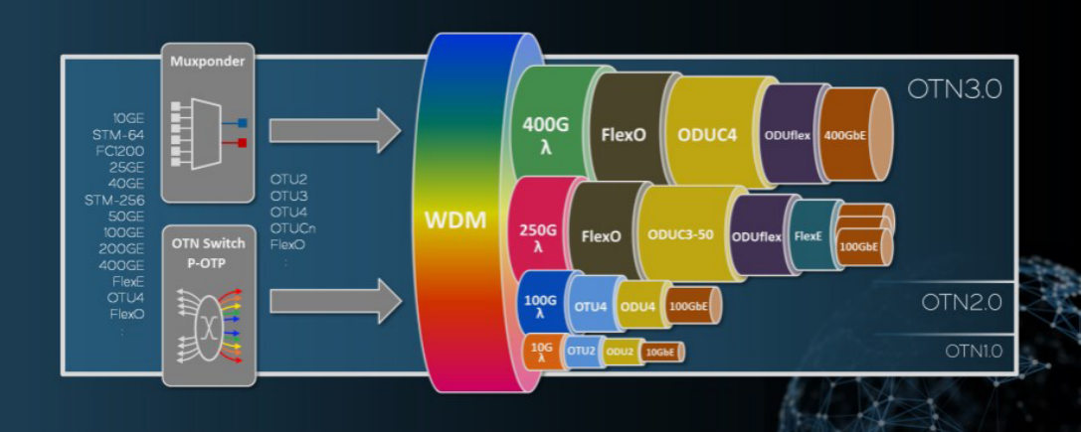
FIFO Buffers and Their Impact on Sync Distribution
Electrical Domain
Optical Domain
DCM
OSC
Client Optics
Client traffic aggregation
OTN Mapper/ Framer
Coherent Optics (DSP)
λ1
WSS
EDFA
Client Optics
OMD
λn
WSS
EDFA
Client Optics
DCM
Deep buffers required for broad range of OTN client services
FIFO buffer cTE varies on restart/power cycles
Source: Microchip

Slide 9
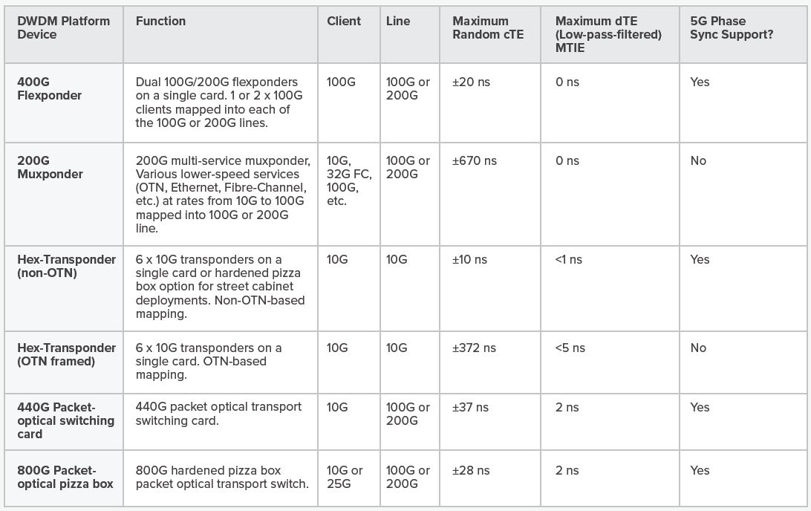
Real World DWDM Max Random cTE Measurements
OTN Mapping destroys cTE margin
OTN Mapping destroys cTE margin

Slide 10
OSC vs OTC
Electrical Domain
Optical Domain
DCM
OSC
3 – OSC
Client Optics
Client traffic aggregation
OTN Mapper/ Framer
Coherent Optics (DSP)
λ1
WSS
EDFA
2 – Wavelength
Client Optics
OMD
1 – In-band
λn
WSS
EDFA
Client Optics
4 – OTC
DCM
OTC
Optical Supervisory Channel (OSC)
Integrated and locked to OLS
Pre-existing channel for management comms
OSC not exclusive to timing, TE is heavily dependent on load due to scheduling
Lower cost
Lower performance
Typically dual fiber (more cTE) with no asymmetry control
Locked to existing wavelength
Lower bandwidth (FastE) and shared
No/limited interworking between platforms/vendors
Optical Timing Channel (OTC)
Independent of OLS
Dedicated and optically optimised sync/timing channel
Higher cost
Higher performance
Single fiber (no additional cTE) with asymmetry and TE control
Wavelength optimized for sync on span-by-span basis
Higher bandwidth (GbE) and dedicated
Platform/vendor agnostic

Slide 11
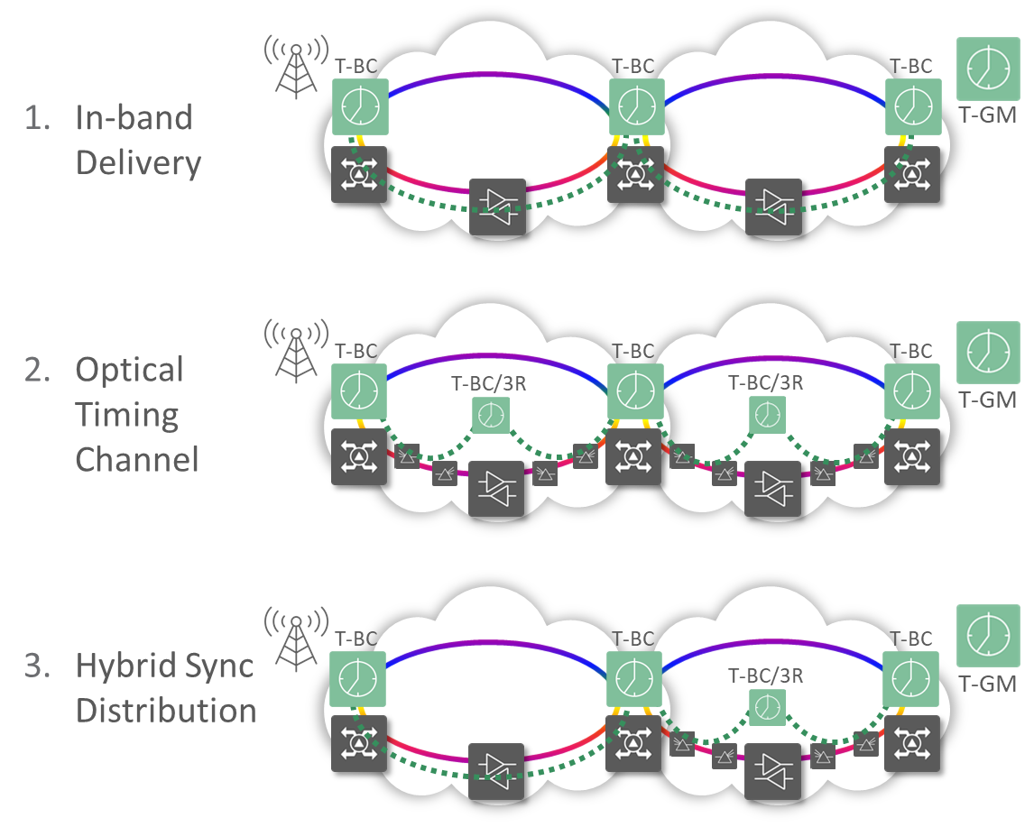
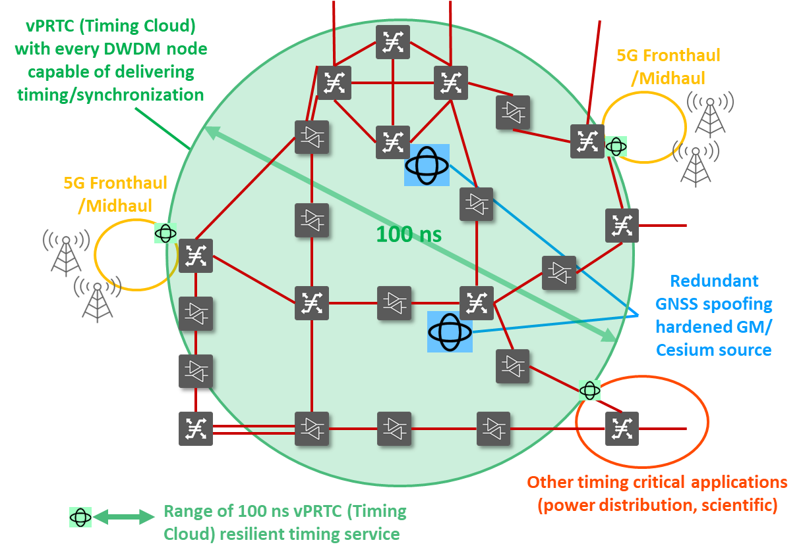
Summary
Timing/Sync distribution over DWDM requires:
Multiple sync strategies
Timing channels optimized for sync distribution
Careful system level and network level design
High-performance timing/sync distribution over DWDM enables:
Highly reliable and resilient network timing/sync
vPRTC/Timing cloud architectures
Support for multiple applications – not just 5G

Slide 12
Thank You

