Slide 1
Are you on time?
Verify PTP accuracy on pre-silicon ASICs
Nitzan Dror
Switch ASIC Architect
20/6/22

Slide 2
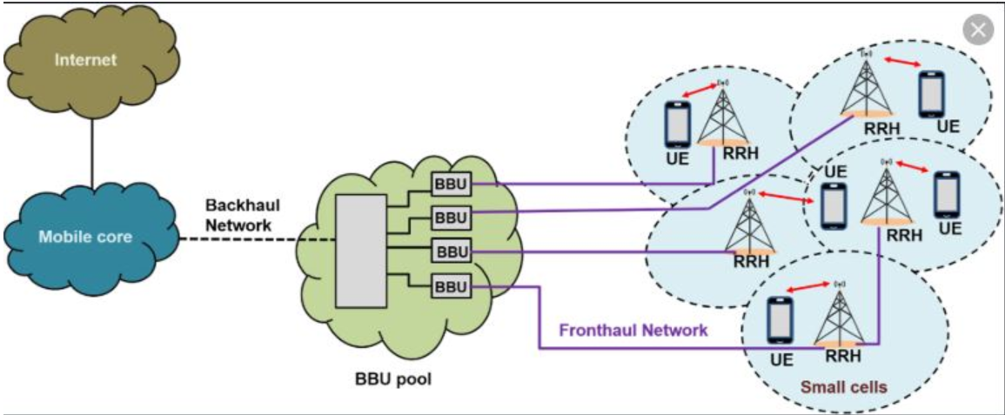
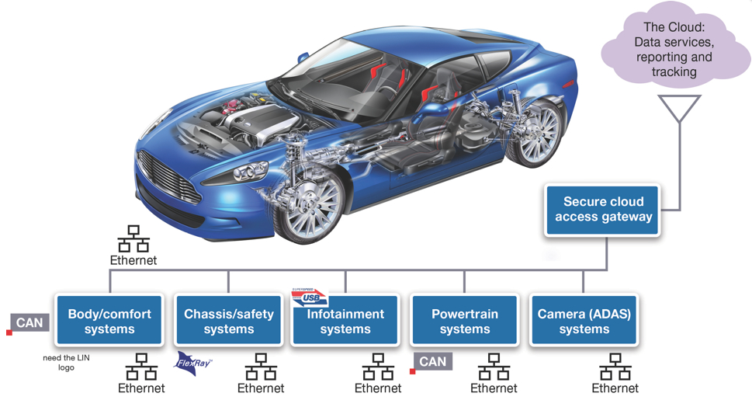
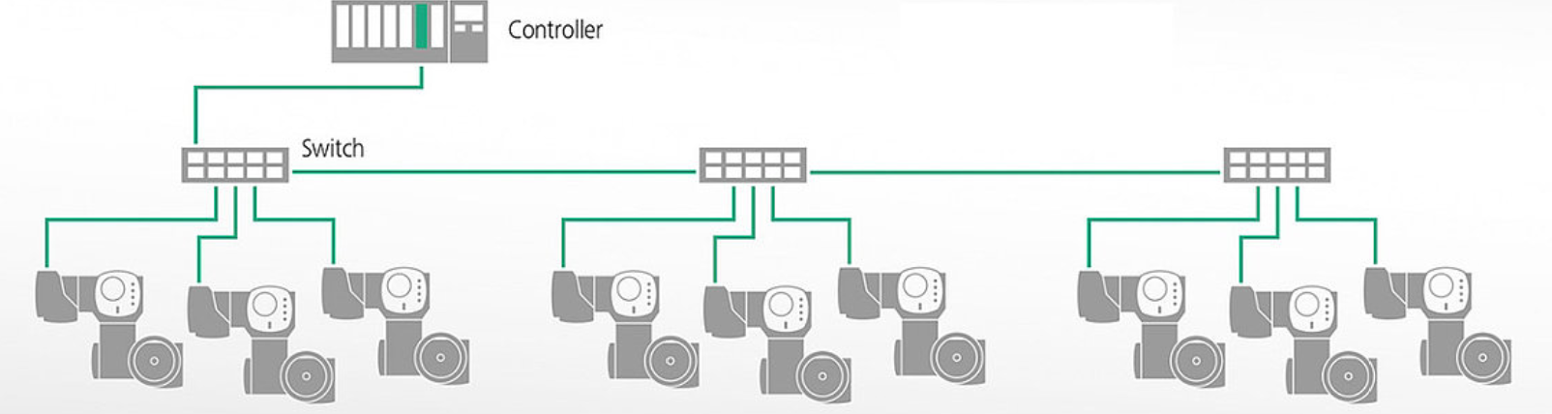

Motivation
Time sync
  Mobile/5G networks
  Industrial networks (gPTP)
  Autonomous cars
Silicon inside
  Processor SOC
  NICs
  Switches

Slide 3


Embedded PTP HW engines
Maintain the local time (TAI/TOD)
  Phase Update
  Frequency update
  Sync to a peer device (e.g. PPS)
Ingress / Egress timestamp

Slide 4

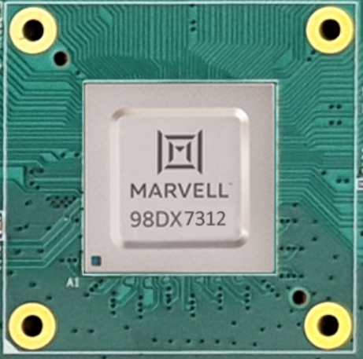
Chips PTP HW Requirements
Accurate
  Symmetric
  Minimal PDV
A system is only as accurate as its underlying chip!

Slide 5
Accuracy Requirements
Parameter | Measurement | Class C | Class D
Max |TE| | Unfiltered | 30 ns | -
Max |TE_{L}| | Low pass | - | 5 ns

Slide 6
What Can Go Wrong?
High frequency clk
Balanced time distribution (Symmetric)
Sample/Sync IO as close to pin
HW clock frequency
cross
(min PDV)
Timestamp with min PDV
(AM, multi-lane, IDLE, clk phases)

Slide 7

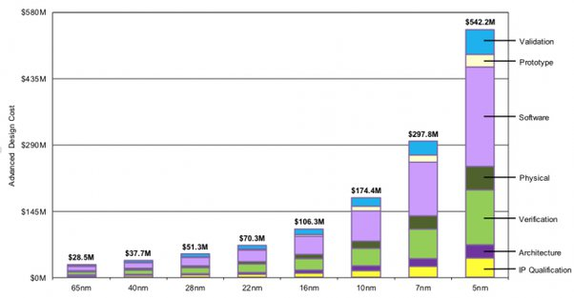
Why Verify Before Manufacturing?
Metal fix at 5nm is ~M$
Tapeout at 5nm is ~10x M$
Complex bugs – re-development
*From quora
Notes:
From Quora

Slide 8
Motivation - Summary
Strict PTP accuracy requirements (small margin)
+
Complex design (high risk)
+
High penalty ($)
=
Verify PTP accuracy in pre-silicon

Slide 9
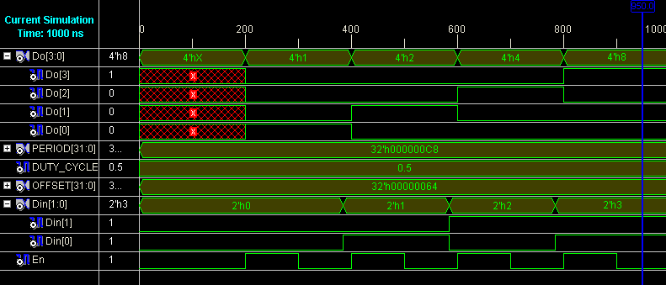
How Should We Do It?
HW Simulation
Use a 3rd party (sim) traffic generator
  No PTP dedicated one
  Poor timestamp accuracy

Slide 10

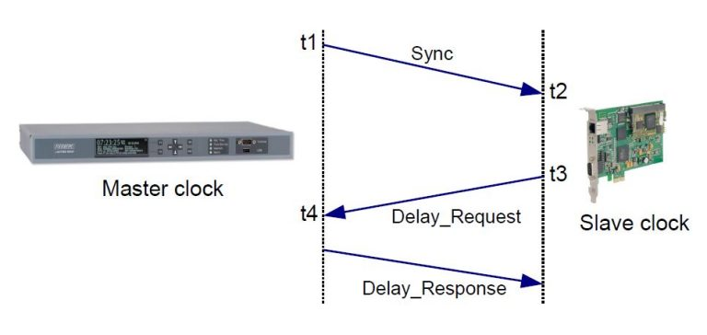
Test Topology #1 - OC
?
==
Target (DUT) clk == Source clk
Not good for pre si
  Slow convergence
  PTP Software application
    Heavy to simulate
    Not a part of the DUT
Source Clock
Target Clock
(DUT)

Slide 11
Test Topology #2 – E2E TC
Timestamp latency ➔PTP header (CF)
Real latency (sim time) = timestamped latency (CF)
How to measure real latency (on pins boundaries)?
  Traffic Gen – inaccurate
  Identify the start of packet on the SERDES
    Hard, especially with multiple encoding, lanes, FEC

Slide 12
Where Does My Inaccuracy Come From?
Where the PDV is unaccounted for!
PDV beyond the timestamping points

Slide 13
Our Solution
Measure PDV beyond the timestamping points
Use port loopback
Timestamp the packet on ingress & egress
  Time delta = latency = ingress timestamp – egress timestamp
  This latency variation is the inaccuracy
    Packet to packet
    Power up to power up (simulations)
DUT
OK
OK
X

Slide 14
PROs
Covers PTP HW accuracy
Applicable for pre-silicon verification
  Quick convergence
  No SW needed
Applies the same to post-silicon
Allows for mix of PTP and background traffic
Same concept for all port modes/speeds
  Even encrypted PTP

Slide 15
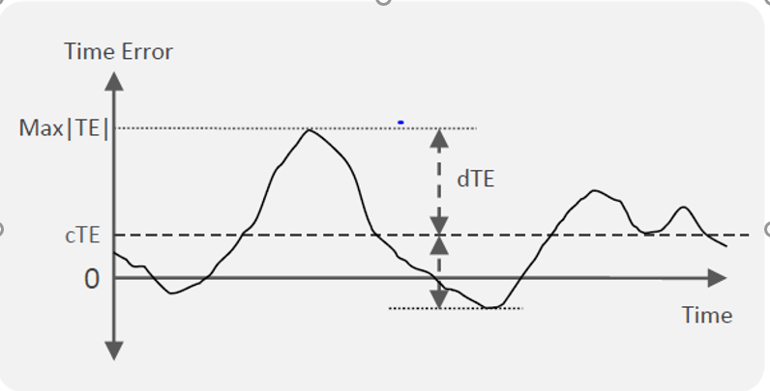
The Gory Details
Latency
--------
Timestamp the packet on ingress & egress
  Time delta = latency = ingress timestamp – egress timestamp
Avg = average(latency)
  Over multiple PTP frames in a test
dTE = Max(|latency_{[i]} - avg|, )
  Latency variation – between PTP frames (i=0,1,…) in a test
cTE = ( Max(avg_{[j]}) – Min(avg_{[j]}) ) / 2
  Average (latency) variation – between tests (j=0,1,…)
*From Calnex

Slide 16

Really, Does It Actually Work?
Marvell Switches are PTP Class D Accurate

Slide 20
CONs
Rx & Tx inaccuracy is combined
Rare events require artificial speedup (e.g. AM)
  Make them more frequent
Doesn’t cover TAI/TOD updates
  Interfaces (PPS)
  Phase drift
  Freq/phase update
    Should be covered in TAI stand alone

