Slide 1
eLoran as an Alternative Timing Source Tony Flavin – Chronos Technology
10th November 2022 (V1.1)

Slide 2
Intention
A non-sky based source of timing
And Navigation
Similar performance to GNSS
Fully meeting requirements for most applications
Harder to Jam
Much higher level Ground based signals
Penetrates Buildings, Ground and Water

Slide 3
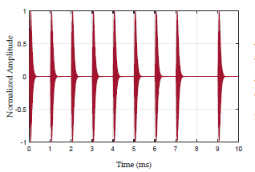
The eLoran LF Pulse (Master Shown = Secondaries do not have the 9th pulse)
T0
A
100kHz carrier
A/2
30us
65us
200us

Slide 4

The enemy ---- Skywave
Good name for Bond Villain
Reflections off of the Ionosphere creates a delayed signal at the receiver.
This is why CW systems such as MSF DCF etc are poor candidates
Unlike GPS with urban canyon reflections. This villain is easily defeated by eLoran

Slide 5
The eLoran LF Pulse
The Skywave has a minimum propagation distance of around 60km, so cannot interfere until this part of the pulse
T0
A
100kHz carrier
A/2
For timing purposes. T0 is the third crossing.
30us
The extra Data carrying 9th pulse is only transmitted by the Primary station and is delayed until the nominal 10th position to allow time for any significant skywave reflections to clear
65us
200us

Slide 6
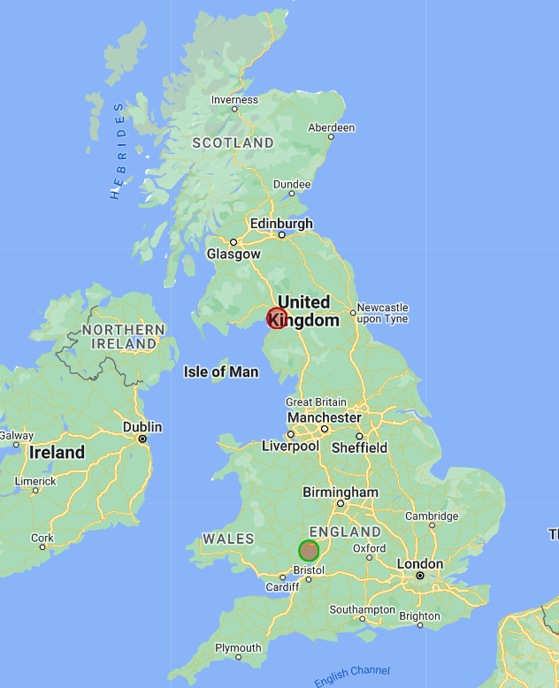
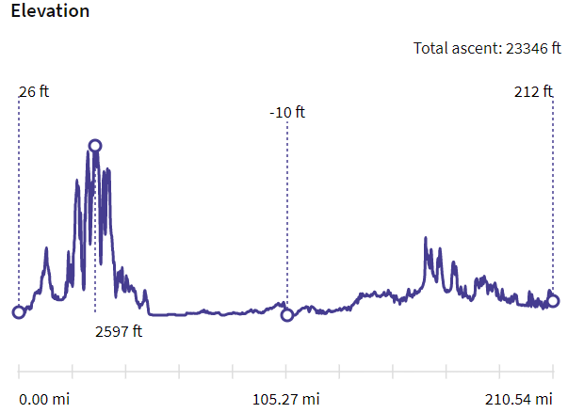
ASF Additional Secondary Factor
Distance from Anthorn to the Chronos is 210 miles (338km) which is 1.127ms at the speed of light
Total ascent and descent from Anthorn to Chronos is around 23,000 feet (7km)
Which could equate to a hill time error of approx. 23 uS without correcting for terrain
This is the Primary factor and is effectively a known figure. The ASF is additional variation due to Ground conditions (Moisture, temperature) and needs active compensation
6

Slide 7
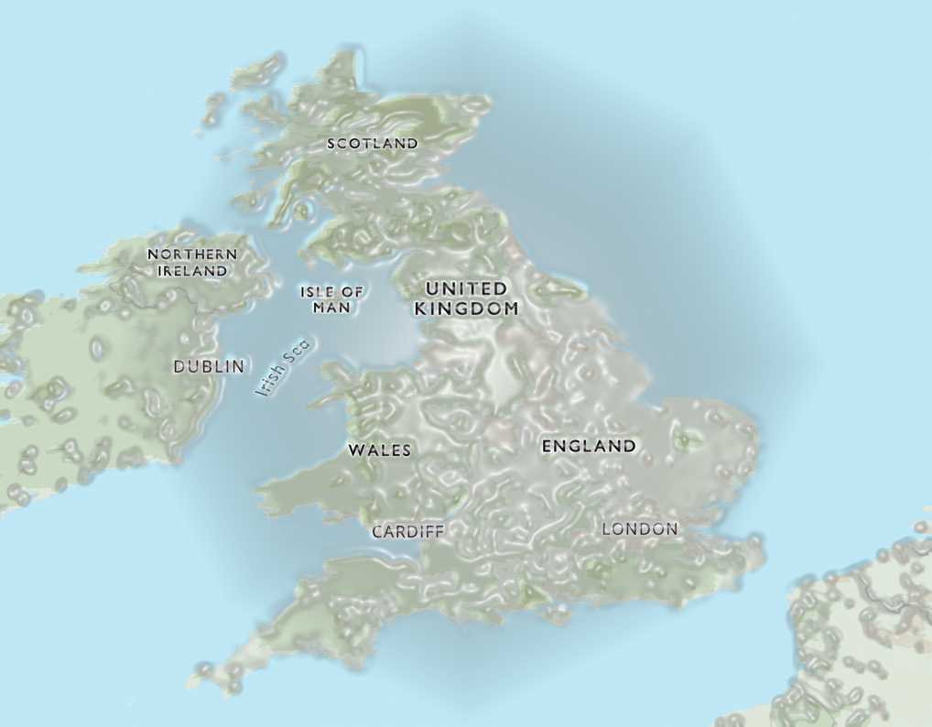
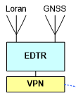


ASF Mapping Architecture
20 stations across the UK
Monitor ASF Variation
Transmit correction data over Data channel 13 from Anthorn
Collate with Weather information
It will be UTC(NPL)

Slide 8
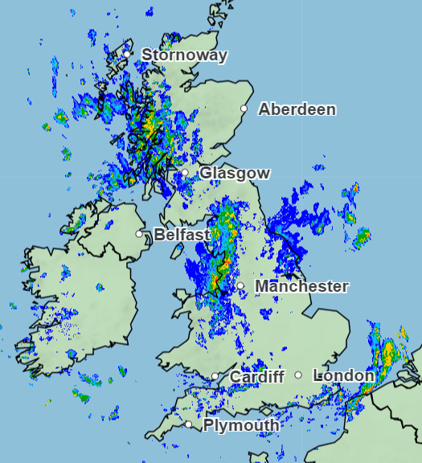
ASF Weather prime influencer
Distance from Anthorn to the south coast is 310 miles (500km) which is 1.66ms at the speed of light
8

Slide 9
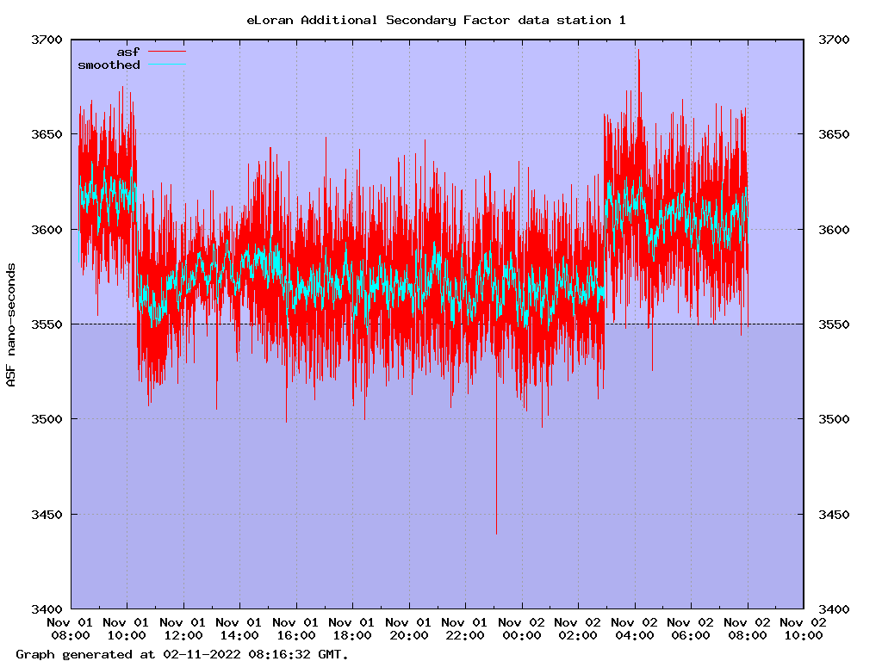
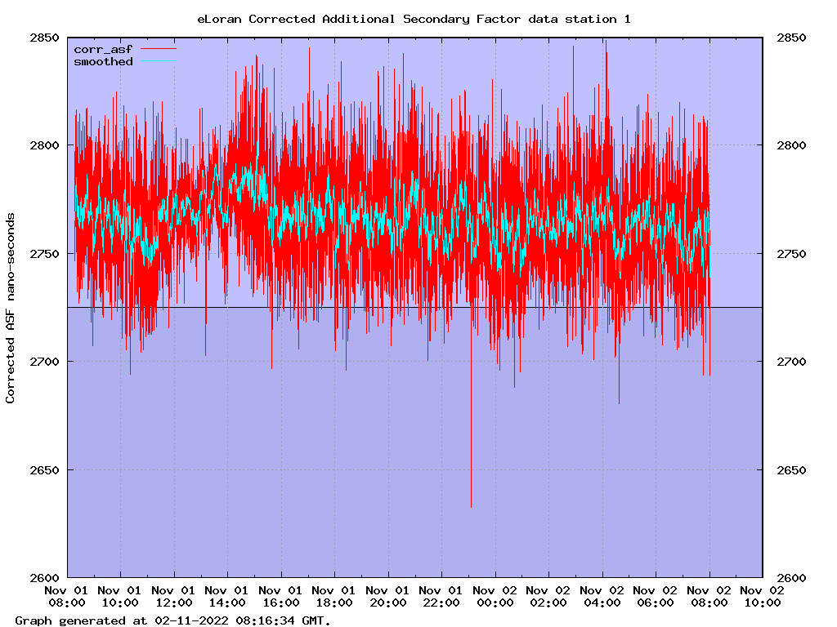
ASF Visualisation – pre and post processing Error largely constrained to < 100ns

Slide 10
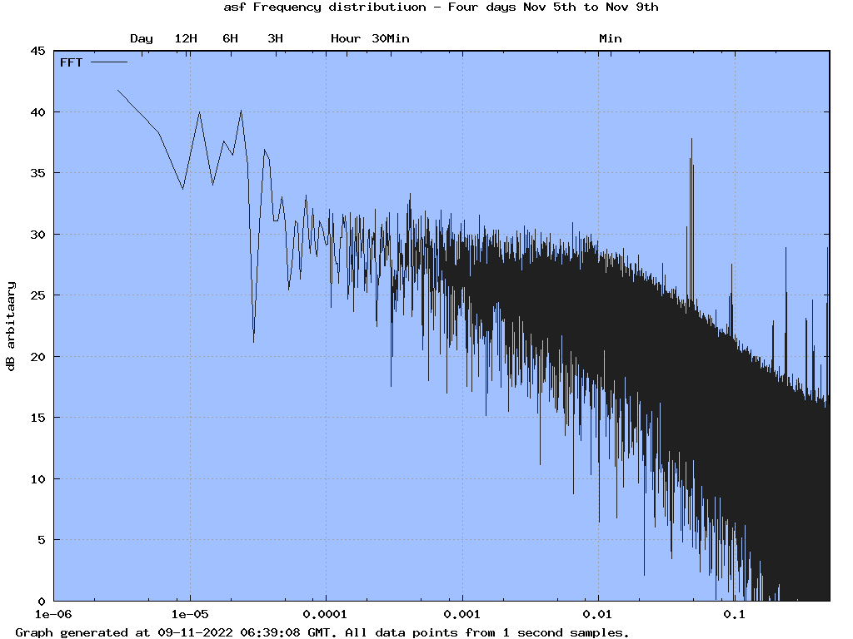
FFT of three days of ASF noise
Vertical scale completely arbitrary
338473 point FFT
Yes the fftw library can do that!
No prefiltering of data
Nothing unexpected
Not enough data yet to see any Day/Night effects

Slide 11
NPL Time over eLoran
In 2023 we will “Upgrade” Anthorn to provide UTC(NPL)
Will Transmit the UK National timescale from NPL
Connecting Anthorn to the new Strathclyde NPL RETSI node
Initially using two way satellite transfer between Strathclyde and Anthorn
Any available time transfer method/protocol could be used.
On site Caesiums at Anthorn will be trained to UTC(NPL)
On site Caesiums once tuned giving Parts in 10-14 performance
Holdover in case of GNSS issues assured
Fallback to UTC(USNO) if required

Slide 12
Outcome
A service proposition for a UK wide Timing service
Comparable timing performance to GNSS
Able to operate in GNSS blackspots
Able to penetrate inside buildings and other GNSS blackspots

Slide 13
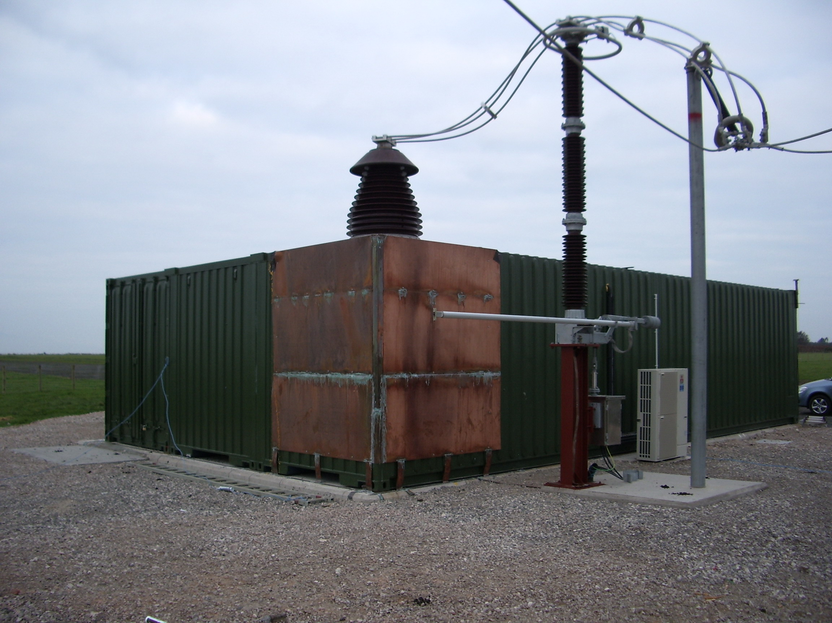
Summary
eLoran IS coming back for timing and ultimately navigation
It will be available across the whole of the UK
It will reach places that GNSS cannot
It IS a complementary technology that can be used in conjunction with GNSS
Combined eLoran/GNSS can reduce the cost of holdover oscillators due to the overall increased availability
Start putting it into future system designs now

Slide 14
Thank you

