Slide 1
IEEE P1952 – Resilient Positioning, Navigation and Timing User Equipment Working Group
Doug Arnold, Meinberg
Shelby Savage, MITRE
Stephen Guendert, IBM
ITSF 2022

Slide 2
Agenda
Critical infrastructure and GNSS
IEEE 1952 project scope and purpose
Process and organization
Position, navigation and timing user equipment
Use cases
Threats, hazards and disruptions to PNT user equipment
Resilience levels
For further information

Slide 3
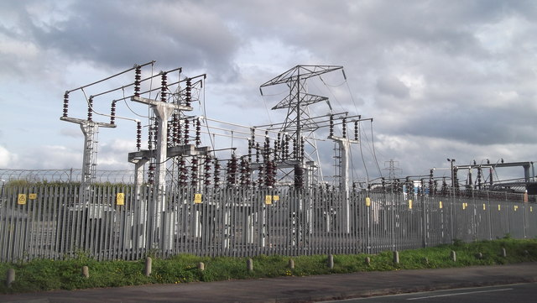
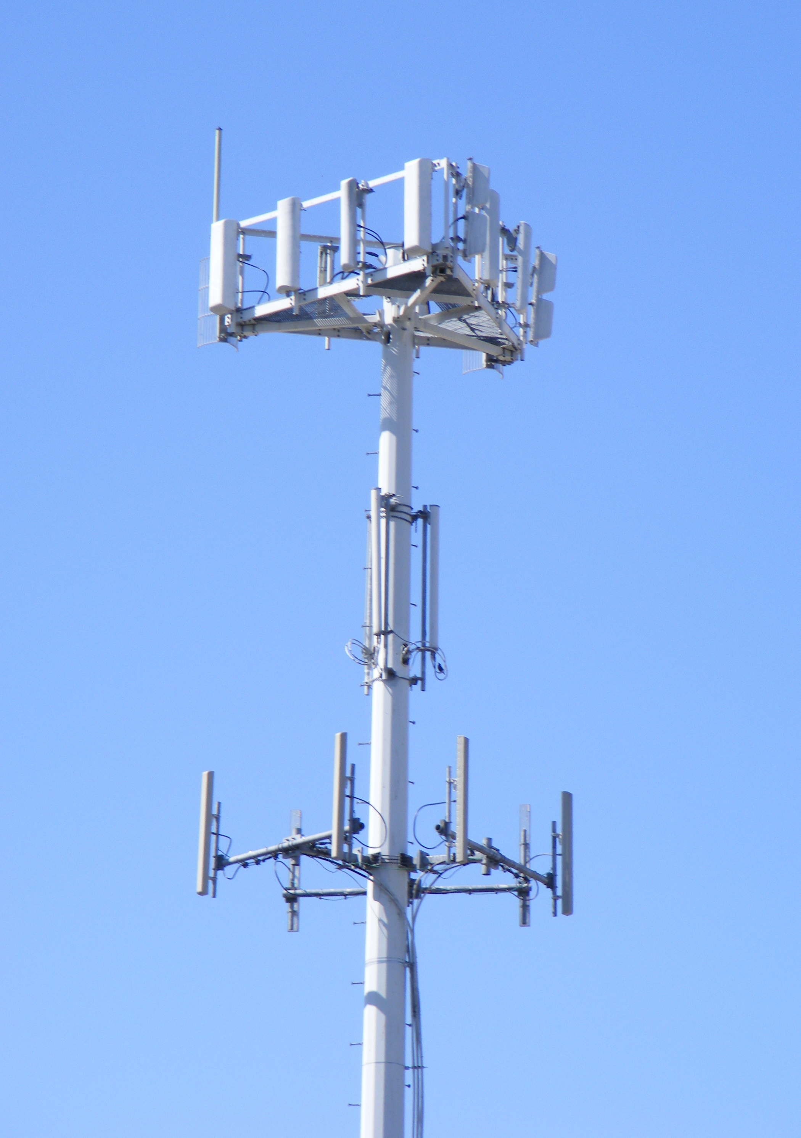

Critical Infrastructure dependent on GNSS
Power Grid
Telecommunications
Finance
Transportation
Manufacturing
Defense
Broadcast-media
Copyright
IainTussis
Copyright J. Smith
Copyright J. Smith

Slide 4
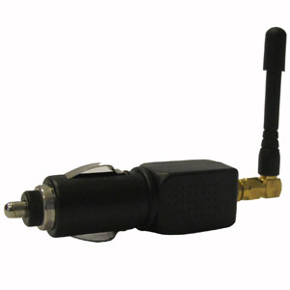
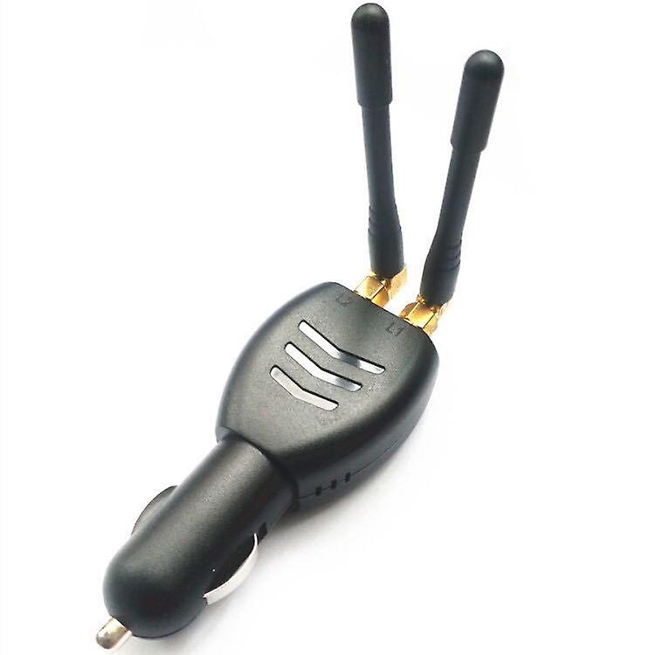

GNSS jamming and Spoofing is easy
Jamming devices
Used by professional drivers and vehicle thieves to avoid tracking
Can be purchased online for as little as $25
Spoofing with software defined radios
SDR unit be purchased online for about $300
Free open source GPS spoofing software available at github

Slide 5
So what do we do?
Make use of PNT information sources, which are not GNSS
Build systems of PNT user equipment systems that use multiple sources of PNT information
Makes sure that the solution meets the necessary level of resilience required for reliable operation
Including making sure each subsystem exhibits the resilience required of it
How to do this is not obvious
PNT Resilience is more complex than, for example, PNT accuracy
The IEEE SA launched a project to help meet this challenge – P1952

Slide 6

IEEE P1952 project
Resilient Positioning, Navigation and Timing User Equipment Working Group
Project to create an IEEE standard
Standard for Resilient Positioning, Navigation and Timing User Equipment
In Scope
Requirements on behaviors of PNT User Equipment
Defines levels of resilience for PNT UE
Out of scope
Requirements on PNT source systems (e.g. Galileo)
UE design to achieve resilience levels

Slide 7

Vision for helping industry
IEEE 1952
Define behaviors
to achieve
resilience levels
IEEE Conformity Assessment Program (ICAP)
Standard
Test plan
Manufacturer,
System Integrator
ICAP Approved
Laboratory
PNT UE
to test
Conformance
certification

Slide 8
IEEE P1952 Officers
Chair: Shelby Savage (MITRE)
Vice Chair: Steve Guendert (IBM)
Secretary: Patricia Larkoski (MITRE)
Meeting minutes,
Working group voting rights tracking
Program manager: Jennifer Santulli (IEEE)
Knowledge resource for WG on IEEE process and rules
Editor: Doug Arnold (Meinberg)
Add contributions into IEEE template
Organize comment resolution

Slide 9
Subgroups
Use Cases
Chair: David Sohn (Orolia)
Threats, Hazards and Disruptions
Co-chair: Marc Weiss (Consultant, formerly NIST)
Co-Chair: Pat Diamond (Consultant, formerly Semtech)
Resilience Levels
Chair: Cristina Siebert (NextNav)
Editing
Chair: Doug Arnold (Meinberg)
System Engineering
Co-Chair Magnus Danielson (Net Insight)
Co-Chair Mitch Narins (Strategic Synergies)

Slide 10
PNT User Equipment
Chemical Sector
Commercial Facilities Sector
Critical Manufacturing Sector
Dams Sector
Defense Industrial Base Sector
Emergency Services Sector
Financial Services Sector
Food and Agriculture Sector
Government Facilities Sector
Healthcare and Public Health Sector
Information Technology Sector
Nuclear Reactors, Materials, and Waste Sector
Transportation Systems Sector
Water and Wastewater Systems Sector
Energy Sector
Communications Sector
remote PNT source
…
Any number of remote PNT sources
external input
PNT input interface
…
PNT User Equipment (UE)
local PNT source
…
…
Any number of
local PNT sources
PNT input interface
…
PNT input and
monitoring
Core functionality
PNT output interface
…
PNT solution
solution validity(s), uncertainty estimate(s), alert(s), protection level(s)
PNT User
…
Any number of
PNT Users

Slide 11
Use Cases
Chemical Sector
Commercial Facilities Sector
Critical Manufacturing Sector
Dams Sector
Defense Industrial Base Sector
Emergency Services Sector
Financial Services Sector
Food and Agriculture Sector
Government Facilities Sector
Healthcare and Public Health Sector
Information Technology Sector
Nuclear Reactors, Materials, and Waste Sector
Transportation Systems Sector
Water and Wastewater Systems Sector
Energy Sector
Communications Sector
Chemical Sector
Commercial Facilities Sector
Critical Manufacturing Sector
Dams Sector
Defense Industrial Base Sector
Emergency Services Sector
Financial Services Sector
Food and Agriculture Sector
Government Facilities Sector
Healthcare and Public Health Sector
Information Technology Sector
Nuclear Reactors, Materials, and Waste Sector
Transportation Systems Sector
Water and Wastewater Systems Sector
Energy Sector
Communications Sector
diagram thanks to David Sohn

Slide 12
Threat, Hazards and Disruptions
Threats are malicious
For example: GNSS spoofing
Hazards are accidental or unintentional
For example: effects of weather
For example: unintentional RF interference
Disruptions are caused by either threats or hazards
PNT User equipment unable to meet the requirements of the use case
Goal of subgroup is to identify categories of threats and hazards that cause disruptions in PNT operation
Not to identify all possible threats and hazards
Limit the number of tests needed to prove resilience

Slide 13
Resilience Levels
Based on broad definition of resilience, including:
Robustness
Integrity
Assurance
Ability to withstand disruptions or recover from them
PNT systems for critical infrastructure will need to meet higher levels of resilience
Lower resilience levels can be useful for subsystems
For example, multiple lower resilient subsystems managed by a PNT source selector can achieve a higher resilience level than that of any of the subsystems

Slide 14
Systems engineering Subgroup
Outputs of the subgroup to include:
Map each use case to appropriate resilience levels
List suggested metrical variables relevant (like availability, continuity, etc.) to each resilience level
Assessment of resilience level requirements produced by the RLD subgroup for evaluability within the THD Subgroup’s threat model
From high-level requirements established in the RLD subgroup, derive example low-level requirements for key use cases
Informational material recommending how regulators may use the P1952 standard

Slide 15
To find out more or become involved
https://sagroups.ieee.org/p1952/
Contains: email addresses of officers
upcoming meetings

