Slide 1
Optical Atomic Clocks for Stable UTC
Ekkehard Peik
Time and Frequency Department
PTB, Braunschweig, Germany
ITSF 2022, Düsseldorf, 10.11.2022

Slide 2
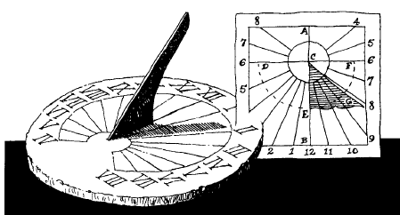
Definitions of the SI unit of time and the scale unit of UTC
The SI unit of time – the second – is defined as:
→ until 1956 : the fraction 1/86 400 of the mean solar day
→ 1956 to 1967 : the fraction 1/31,556,925.9747 of the tropical year 1900
1 tropical year = 365,2422 solar days = 366,2422 sideral days
1967 : the duration of 9 192 631 770 periods of the radiation corresponding to the transition between the two hyperfine levels of the ground state of the cesium 133 atom Added in 1999: This definition refers to a cesium atom at rest at a temperature of 0 K
(Rewording in 2018)
Astronomy
(angle/phase of a linear process)
Quantum physics
(frequency of a periodic process)

Slide 3
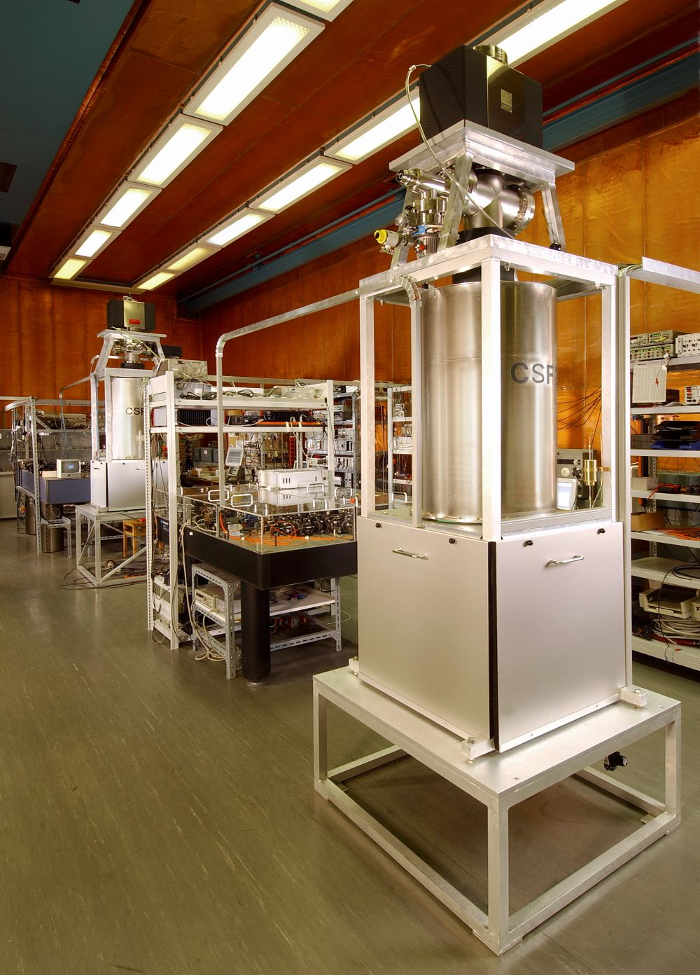
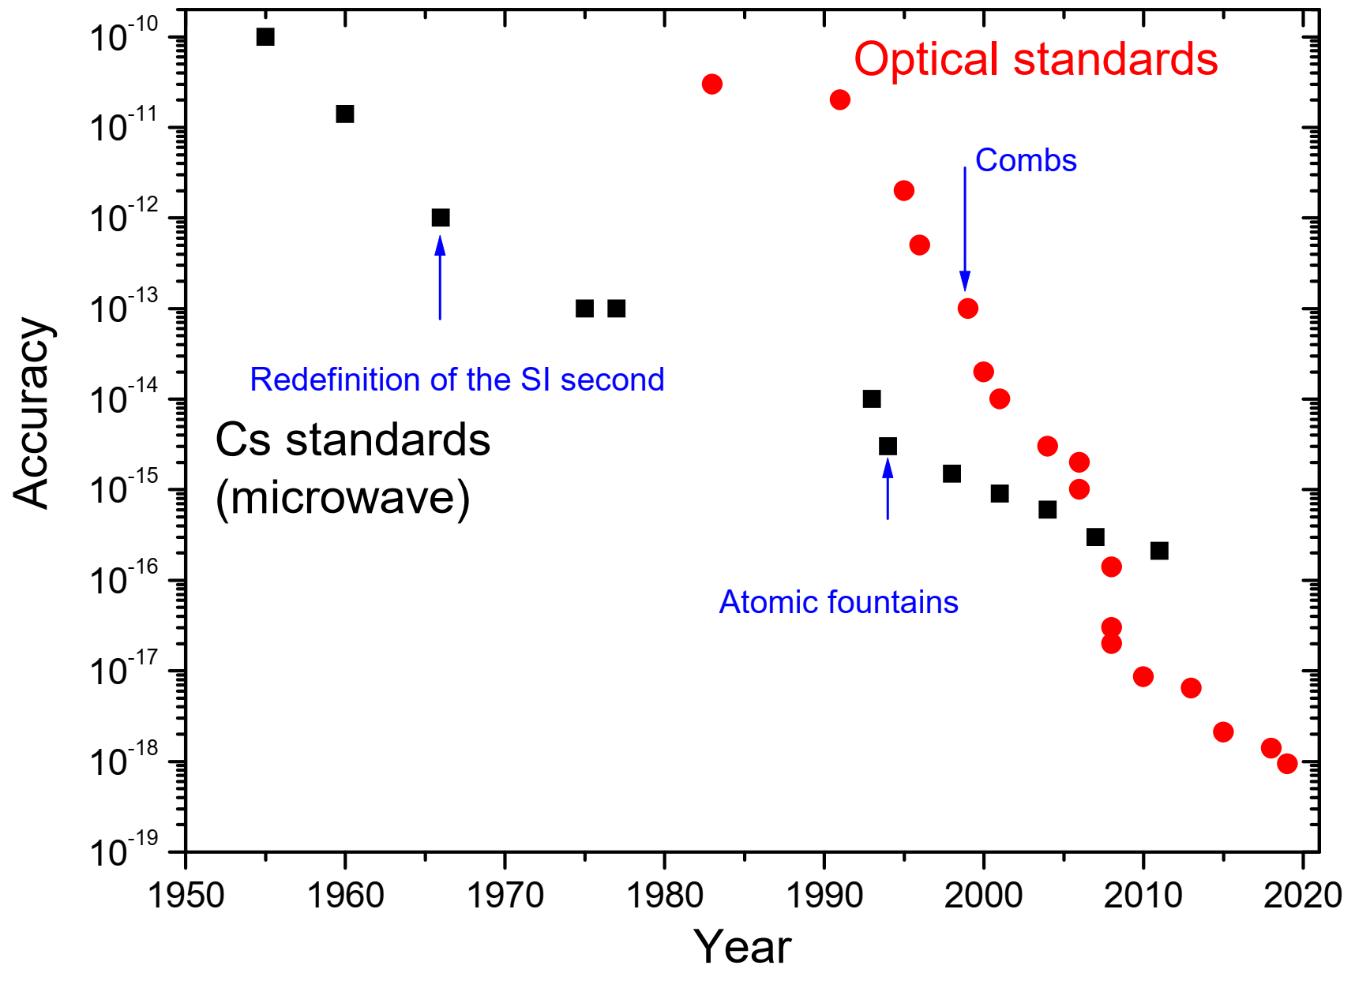

Realization of the SI second with primary Cs frequency standards
Cs fountain accuracy ∼ 10⁻¹⁶
PTB fountain clocks
CSF1 and CSF2

Slide 4
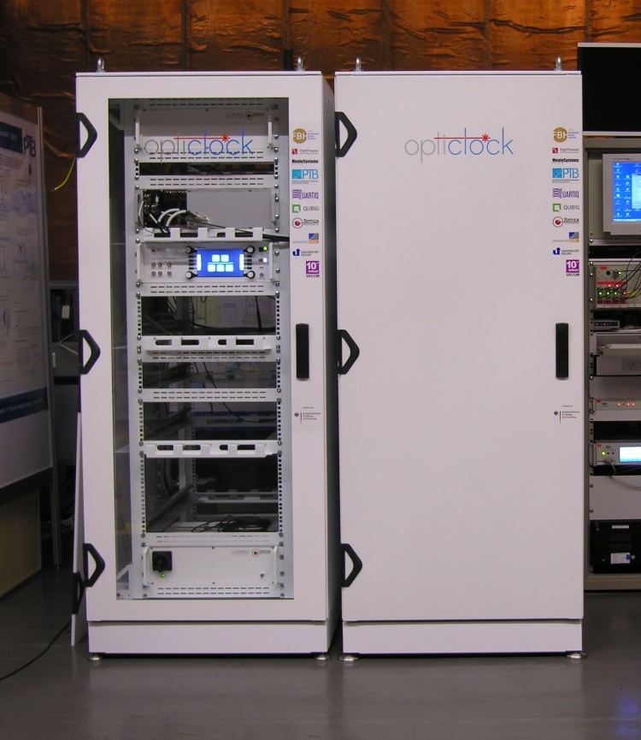
The era of Optical Frequency metrology
Optical Frequency Standards (Sr, Yb, Yb+, Al+, Ca+, …) at 10⁻¹⁸ level
→ Time to change the definition?

Slide 5
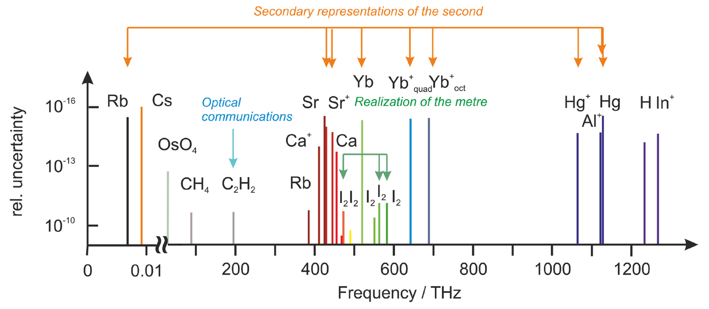
Secondary representations of the second
List of recommended standard frequencies (published on the BIPM website):
1 microwave (Rb) and 8 optical standards are recommended for applications as secondary representations of the second, with an uncertainty similar to primary Cs clocks.

Slide 6
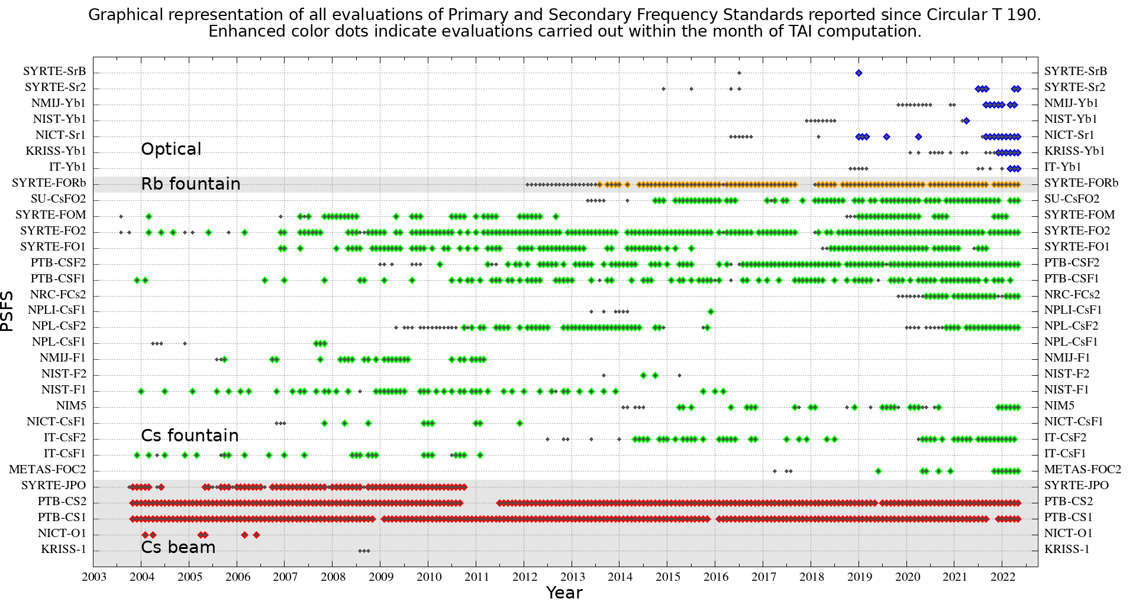
Contribution from Primary and Secondary Frequency Standards to TAI
Monthly updated plot https://webtai.bipm.org/database/show_psfs.html

Slide 7
Optical Clocks: Improved Stability and Accuracy
Instability:
(Allan deviation)
At Δν=1 Hz, an optical single-ion clock (N=1) provides an instability σ_{y}≈10⁻¹⁵ (τ/s)^{-1/2},
lower than a caesium fountain clock with Δν=1 Hz and 10⁶ atoms.
Accuracy: Some systematic shifts that are determined by external fields and atomic properties and are relatively much smaller in the optical range:
relative shift for:
Cs 9.19 GHz Yb⁺ E3, 642 THz
quadrat. Zeeman shift at 1 μT 4.7 × 10⁻¹² 3.3 × 10⁻¹⁸
AC Stark of thermal radiation at 300 K -1.7 × 10⁻¹⁴ -7.1 × 10⁻¹⁷

Slide 8
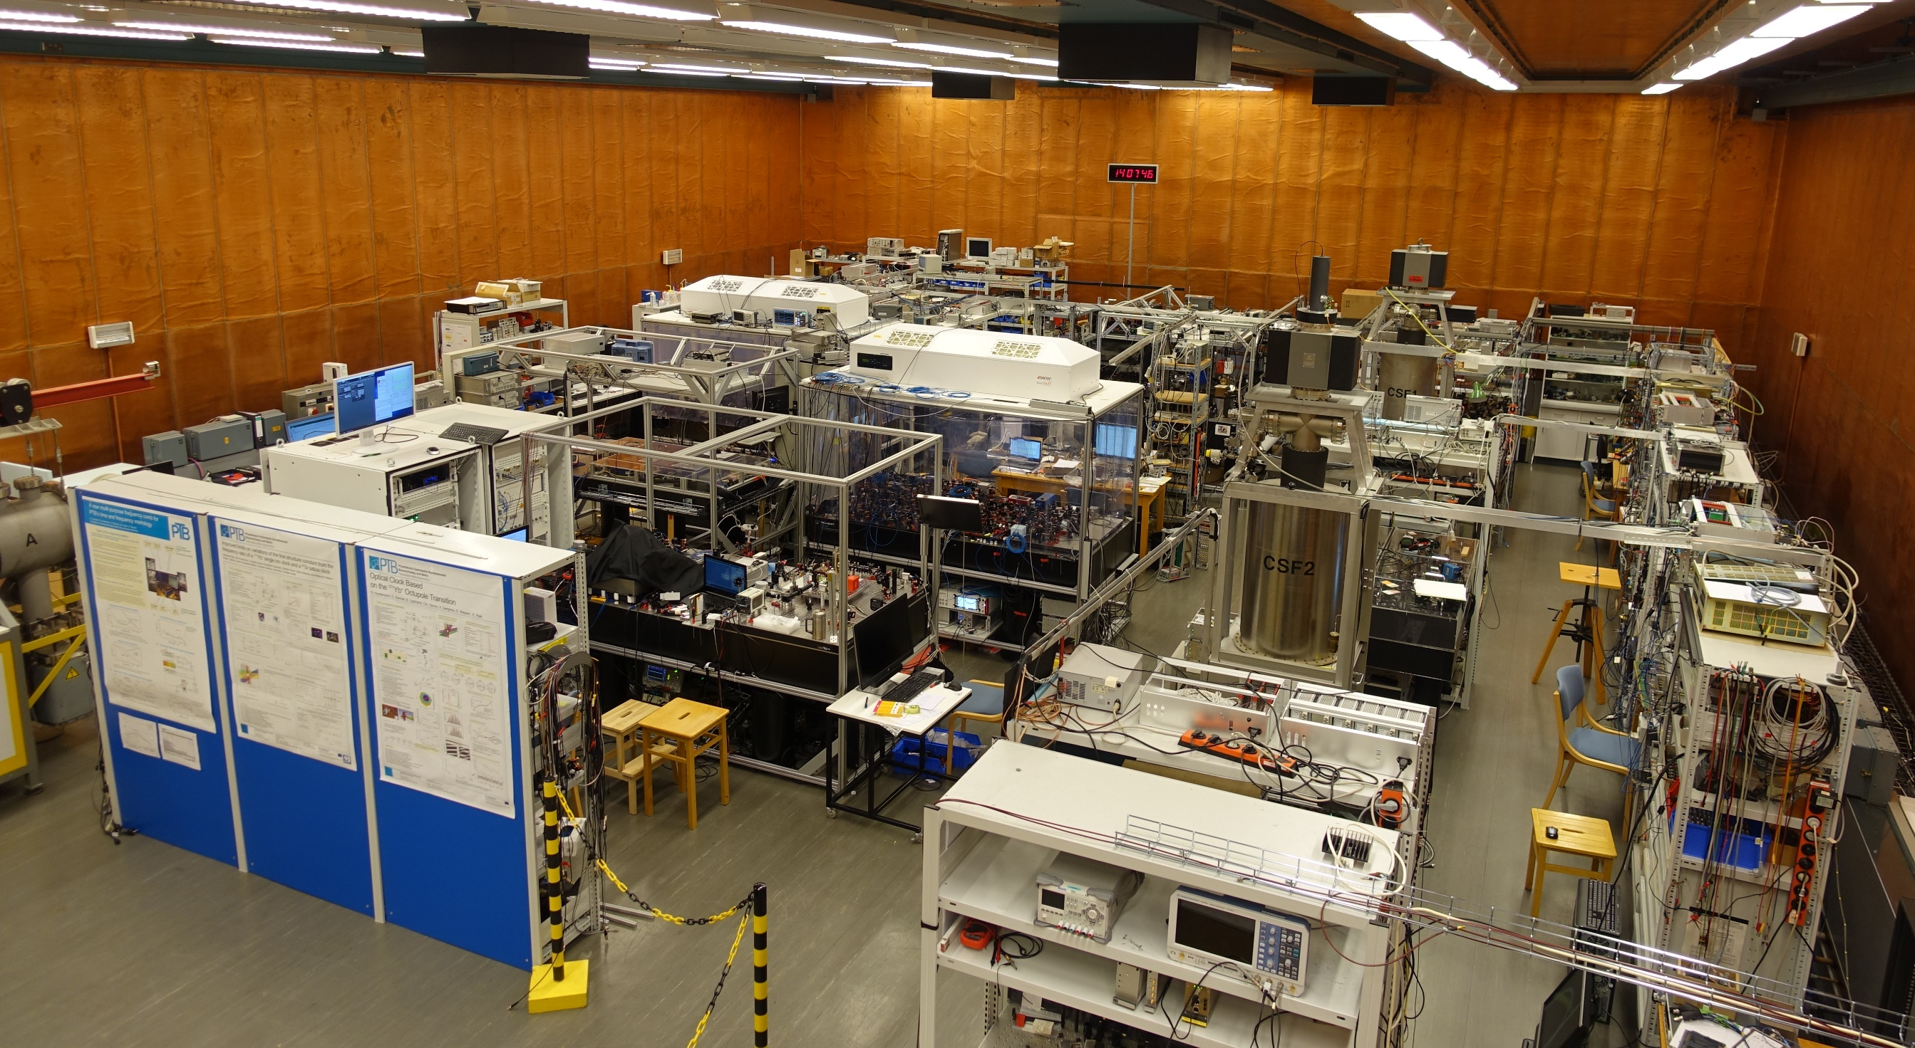

Clock ensemble in PTB‘s clock hall
frequency comb
Yb2
Yb1
CSF1
Yb/Sr
CSF2
Yb3

Slide 9
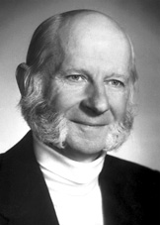
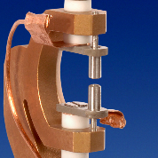
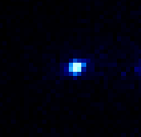
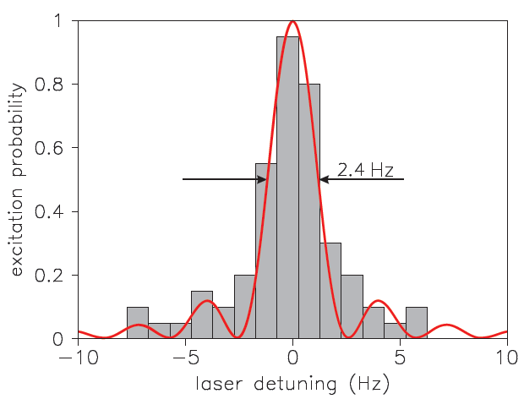
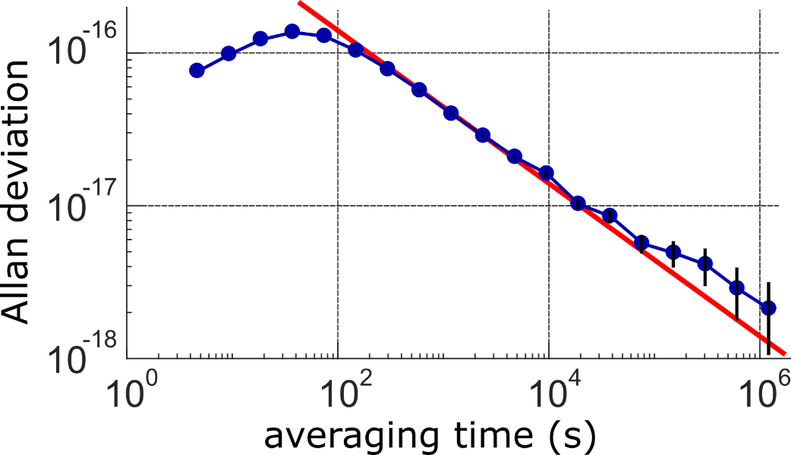
Optical clock with a single laser-cooled ion in a Paul trap
The ion trap provides long interaction and coherence times
Combined with laser cooling:
Lamb-Dicke confinement of a single ion
Hans Dehmelt
quantum noise limited stability
high spectral resolution,
excellent control of systematic shifts

Slide 10
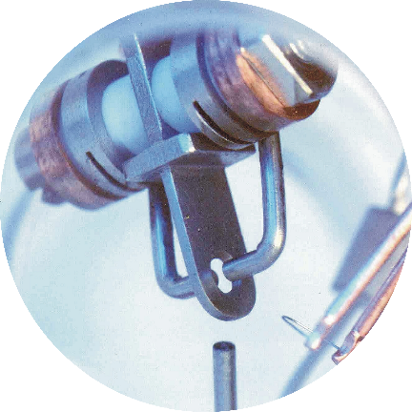
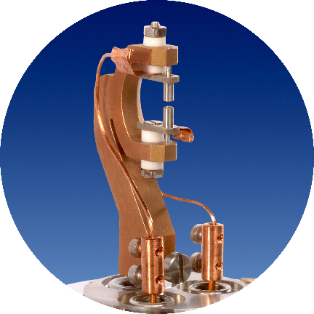
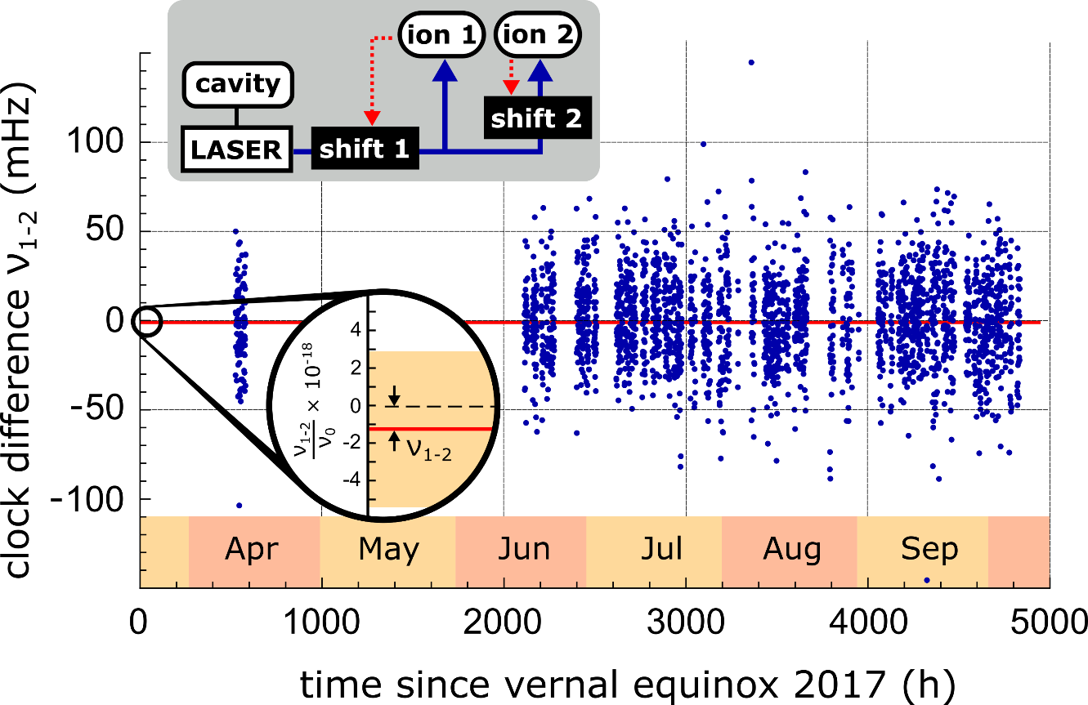

Yb⁺ E3 clock comparison
Yb1
Yb2
six-month-long comparison
two clocks on the E3 transition 642 THz
different experimental setups
statistical uncertainty of 2.1 × 10⁻¹⁸
C. Sanner, N. Huntemann, R. Lange, Chr. Tamm, E. Peik, M. S. Safronova, S. G. Porsev, Nature 567, 204 (2019)

Slide 11
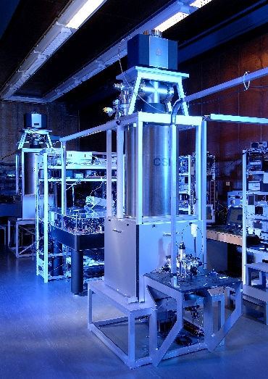
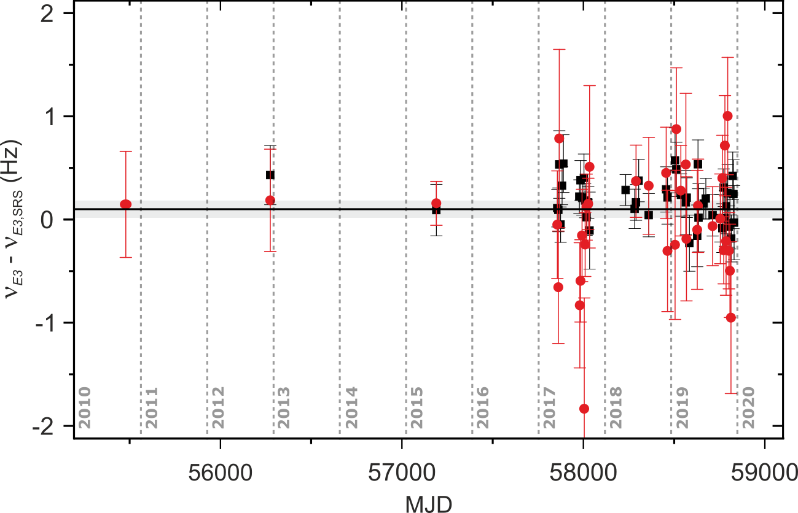
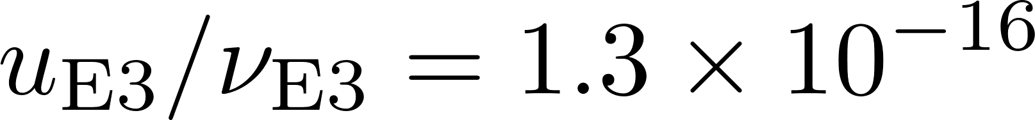
Yb⁺(E3) vs Cs clock comparison
repeated measurements since 2017
Yb1(E3) and two caesium fountains
Yb1
CSF
most accurate determination of an optical transition frequency
R. Lange, N. Huntemann, J. M. Rahm, C. Sanner, H. Shao, B. Lipphardt, Chr. Tamm, S. Weyers, E. Peik, Phys. Rev. Lett. 126, 011102 (2021)

Slide 12

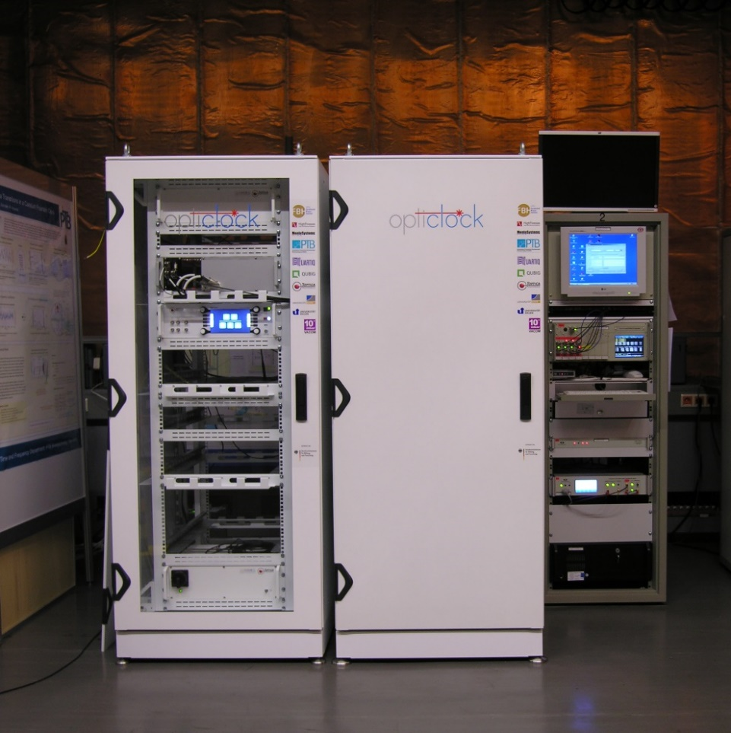




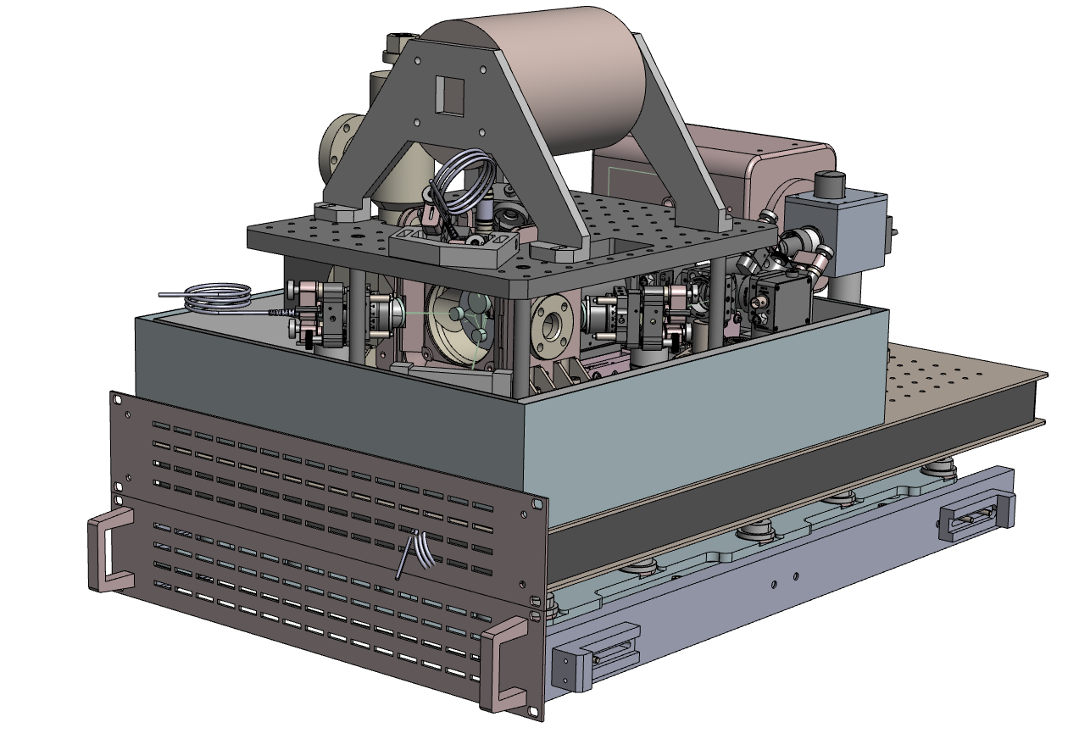







Robust optical clock for users:
BMBF sponsored quantum-technology pilot project 2017-2020
Demonstrator of a turn-key optical clock for autonomous operation using ¹⁷¹Yb⁺ (E2)
Target market: superior H-Maser alternative (for NMIs, radio astronomy, ground station of GNSS, …)
physics package
6 companies, 4 institutes

Slide 13

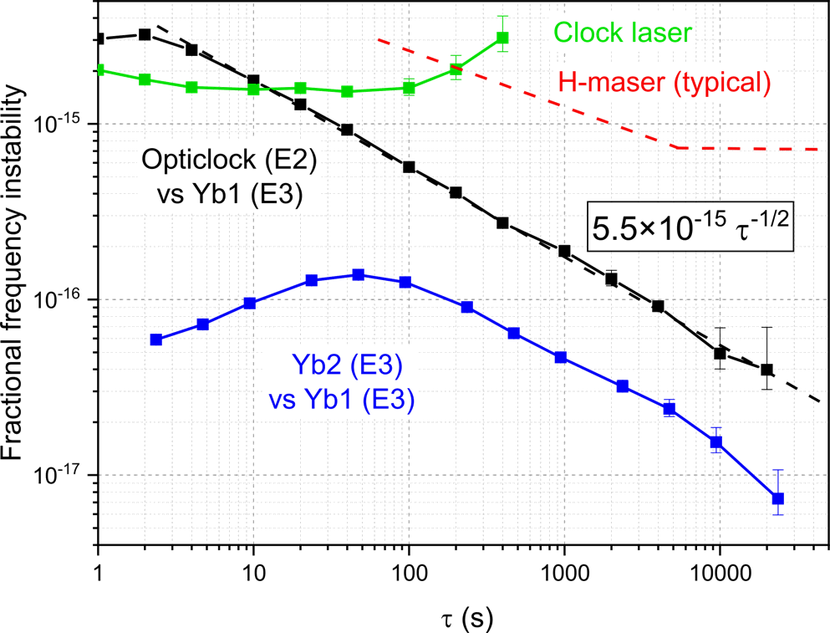
Evaluation of the clock
Comparison of opticlock with
the lab clock Yb1 (E3)
Interrogation time:
opticlock (E2): 40 ms,
Yb1(E3): 300 ms
Test run for 2 weeks with 99.8 % uptime
Systematic uncertainty 2 × 10⁻¹⁷
J. Stuhler et al., Measurement: Sensors 18, 100264 (2021)

Slide 14




PTB Working Groups: Unit of Time / Optical Clocks with Trapped Ions
Yb⁺ clocks
N. Huntemann
R. Lange now: auto. Ind.
B. Lipphardt
Chr. Tamm
M. Steinel
M. Filzinger
C. Sanner now: JILA
M. Abdel Hafiz now: U. Franche Comté
Hu Shao now: CAS
Thanks:
N. Dimarcq (CCTF)
P. Tavella (BIPM)
J. Stuhler (Toptica)
P. Schmidt (QUEST, PTB)
Cs clocks
S. Weyers
J. Rahm
M. Kazda
V. Gerginov now: NIST
Funding:
DFG, EURAMET, EU H2020

Slide 15
Physikalisch-Technische Bundesanstalt
Braunschweig and Berlin
Bundesallee 100
38116 Braunschweig, Germany
Dr. Ekkehard Peik
Head of Department Time and Frequency
E-Mail: ekkehard.peik@ptb.de
http://www.ptb.de/zeit/
http://www.ptb.de/time/

