Slide 1


Resilient, Trustworthy, Ubiquitous Time Transfer
Martin Bransby - Telespazio UK
Louise Mercy - Telespazio UK
Dana Jamal - Telespazio UK
Calum Dalmeny - Chronos Technology Limited
International Timing & Synchronisation Forum
10 November 2022

Slide 2














Shareholders
Space Alliance
.
100%
~600M €
+3K
2021 REVENUES
EMPLOYEES
67%
33%
+60
15
13
YEARS OF
EXPERIENCE
COUNTRIES
OF PRESENCE
COMPANIES WORLDWIDE
33%
67%

Slide 3
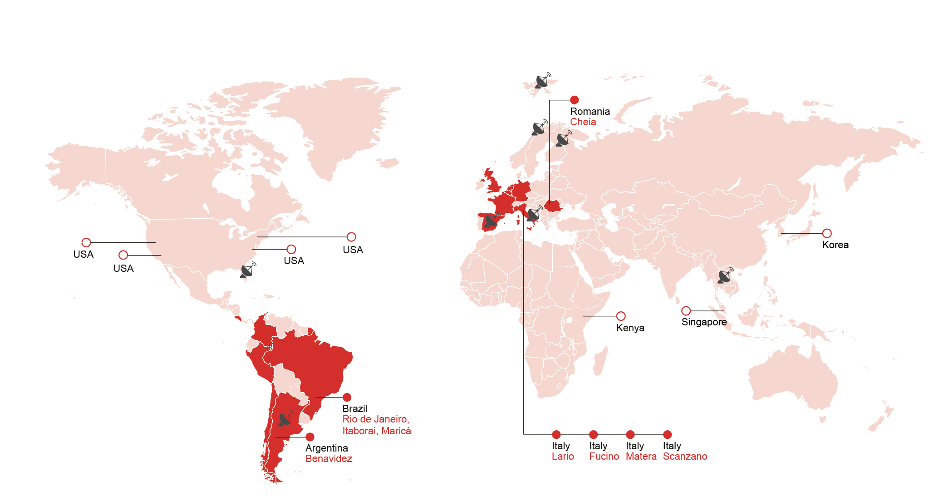

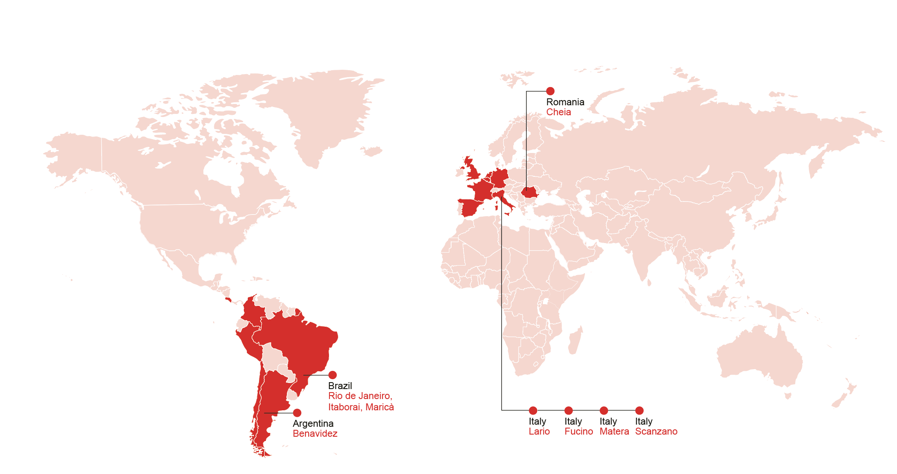
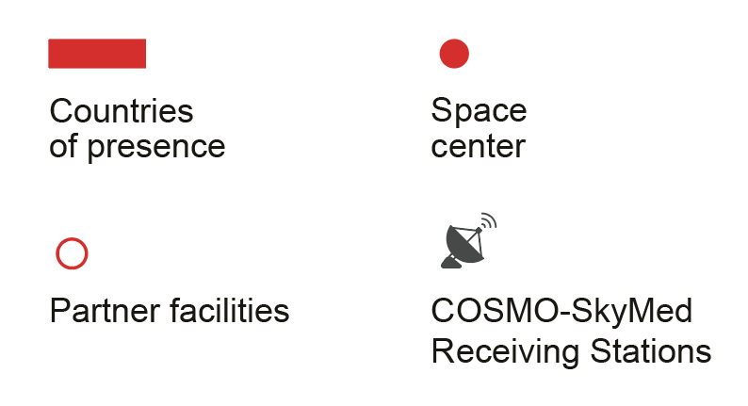
A worldwide footprint
COSMO-SkyMed Receiving Stations
Countries of presence and Space Center
Partner facilities

Slide 4
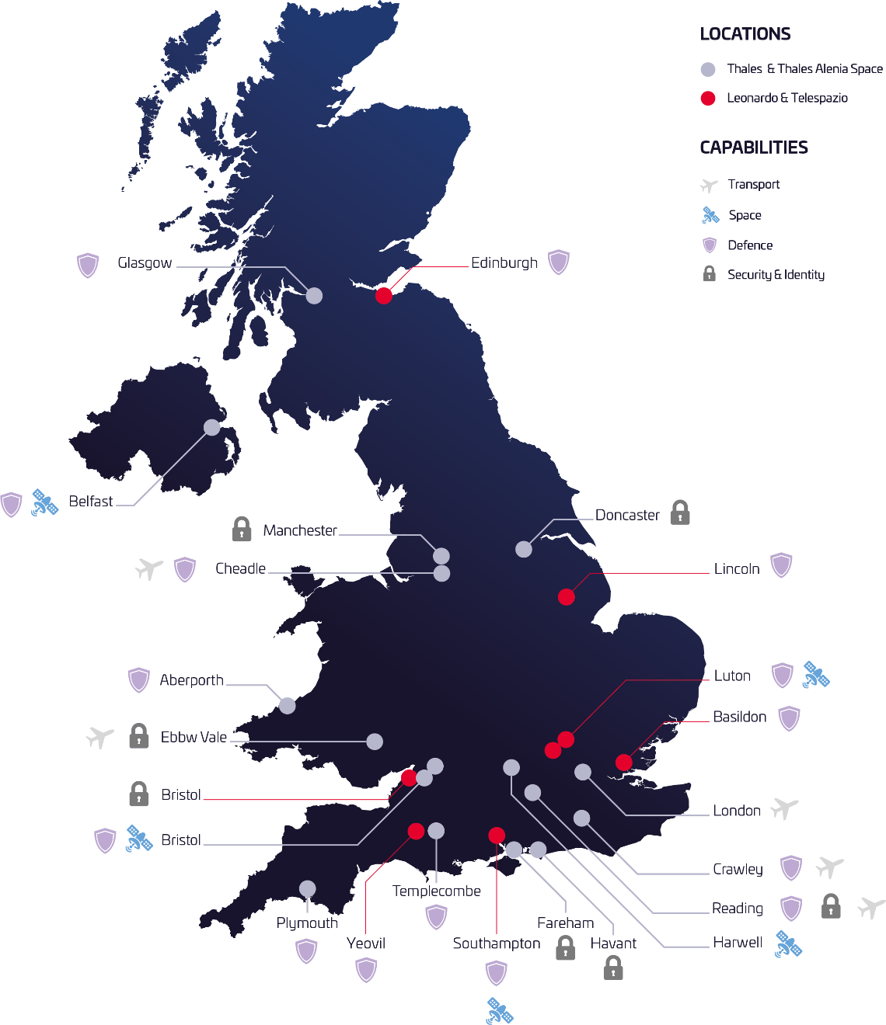




Space Alliance in the UK (Including Shareholders)
Boosting the UK’s prosperity through innovation, research and engineering
Our combined
strength
We are investing to accelerate the UK’s leadership in the global space economy.
14k+
employees
£250m
We fight climate change by building earth observation missions and providing trusted data to mitigate climate risk.
Per year invested in UK R&D
Supporting
52,000
Jobs across the UK
£3.5bnGVA
We provide intelligence and surveillance services to critical civil and military decision makers.
(Gross Value Added)
25
Sites across England, Wales, Scotland & Nothern Ireland
We protect and defend critical national assets in space and on Earth.
£1.3bn
Spent with UK
local supply chain…
4,000
The Space Alliance is committed to inspiring and attracting young people, including underrepresented group through offering award winning training programmes.
companies

Slide 5
Project Overview – Funded under ESA NAVISP Element 1 call 011
  “To develop an innovative hybrid solution of time dissemination, transfer and synchronisation to provide ubiquitous, accurate, secure and reliable timing services that are cost-effective for future commercial and mission-critical applications”
  Objective breakdown:
  Identify Use Cases for which ubiquitous, accurate, secure and reliable time transfer and synchronisation will be required
  Identify and assess potential candidate terrestrial or space based technologies that can complement GNSS time transfer for each of the use cases
  Develop hybridised solutions for each of the use cases
  Design and develop an evaluation platform to assess the potential candidate hybridised solutions
  Identify the most promising technologies and to produce a technology Development Roadmap and TTM plan based on the gap analysis

Slide 6
Technology Review

Slide 7



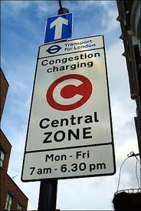
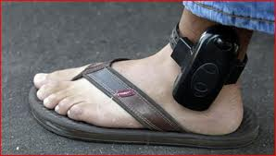
GNSS Time Vulnerabilities
GNSS is the key technology for timing dissemination, thanks to:
  Global availability,
  High accuracy (ns),
  No direct cost to users.
However, GNSS is vulnerable, due to its extremely weak signal at the end-user level on the earth surface.
The main GNSS vulnerabilities that can cause service loss:
  Space Weather
  Constellation error
  RFI
    Jamming
    Spoofing
    Meaconing

Slide 8
Assessment of Candidate Technologies
Due to vulnerabilities an alternative timing technology is required to complement GNSS, in order to :
  Improve robustness and overall system
  Maintain availability and accuracy
Alternative Technology Assessment looked at:
  MCMF
  LEO Satellite-Based (STL)
  Cellular Wireless Signal – LTE / 5G
  eLORAN
  Other LF Transmissions (R4)
  Locata
  Wireless Time Transfer via LoRaSync
  IEEE 1588 PTP
  White Rabbit
  Synchronous Ethernet
  GNSS Firewall technologies
  Oscillator Technologies (CSAC)
Assessment Criteria included:
  Accuracy
  Security
  Reliability
  Ubiquity
  Cost and
  Dependency on GNSS

Slide 9
Use Cases

Slide 10

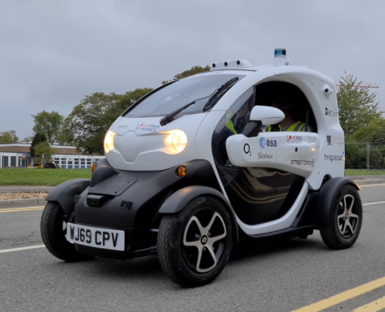

Selected UCs and Timing Requirements – 5G
UC1A – 5G and Beyond – Network Synchronisation – TDD
  Time sync is needed to comply with the time slot alignment
  Required accuracy is ±1.5µs wrt UTC
UC1B – 5G and Beyond – V2X - high automation application
  Time sync is needed for trajectory alignment (relative positioning)
  Timing is relative
  Required accuracy is 3ms
UC1C – 5G and Beyond – FoF – motion control
  Communication service is provided by a wireless 5G access point
  Timing is relative within a small indoor area, no interaction is required with public network
  Required accuracy is ±1.0µs

Slide 11



Selected UCs and Timing Requirements – Other
UC2 – Power Grid - PMU
  Time sync is required for the PMUs for monitoring of power stability and fault prediction in the power grid
  Required accuracy is ±1.0µs wrt UTC
UC3 – Financial Market – High Frequency Trading (HFT)
  Time sync is required to time stamp all stock exchanges and trading to avoid stock market fraud
  Required accuracy is ±100µs wrt UTC
UC4 – Avionics – Automation data stamping
  Time sync is required for data time stamping
  Required accuracy is ± 10ms wrt UTC

Slide 12
Innovative Hybrid Timing Solution

Slide 13






Design Requirements for An Innovative Timing Solution
The timing requirements for critical applications/infrastructures include:
  Resiliency
  High accuracy
  Security (against external threats)
  Ubiquity
  Availability
  GNSS Dependency
  Cost effectiveness
The GNSS complement should be:
  Able to enable resilient timing
  Independent (if possible) of GNSS
  Dissimilar to GNSS in terms of failure modes
  Provide similar performance levels to GNSS
  Easily integrated with GNSS at chip-level

Slide 14
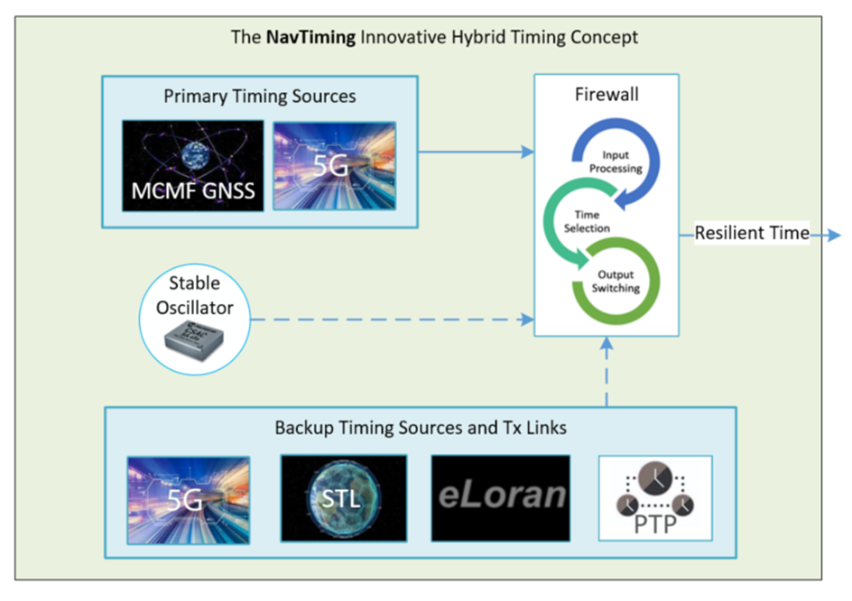
Proposed Innovative Hybrid Timing Concept
The Key Components of the Hybrid Timing “system-of-systems”
  Primary Timing Sources
    MCMF-GNSS
    5G
  Alternative Timing Sources
    Time Transfer via LEO (STL)
    eLoran
    PTP
  GNSS Firewall
    Spoofing & jamming detection
  Enhanced Oscillator Discipline Mechanism
    CSAC

Slide 15
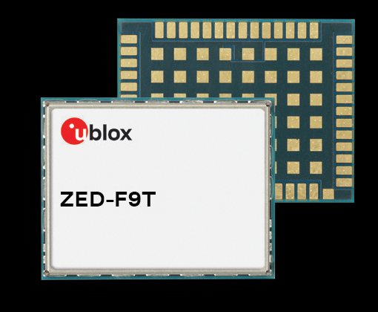
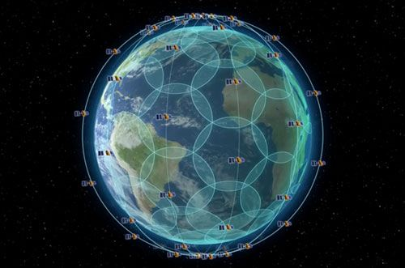

Capabilities of the Key Components of the Hybrid Timing (1)
Multi-Constellation and Multi-Frequency (MCMF)
  MC provides robustness against single system failure
  MF provides some resilience to interference and jamming (frequency diversity)
  Accuracy in nanoseconds
Satellite Time and Location (STL)
  Global coverage with 66 Iridium satellites and traceable to UTC
  Accuracy in nanoseconds – delivering timing with no GNSS signals
  1000x stronger than GNSS signal – reaching indoor and overcoming some jamming issues
  Cryptographic security provides resilience to intentional spoofing
Enhanced Loran (eLoran)
  National UK coverage and traceable to UTC
  Accuracy in microseconds – delivering timing with no GNSS signals
  3-5 million times stronger than GNSS signal reaching indoor and overcoming jamming issues

Slide 16

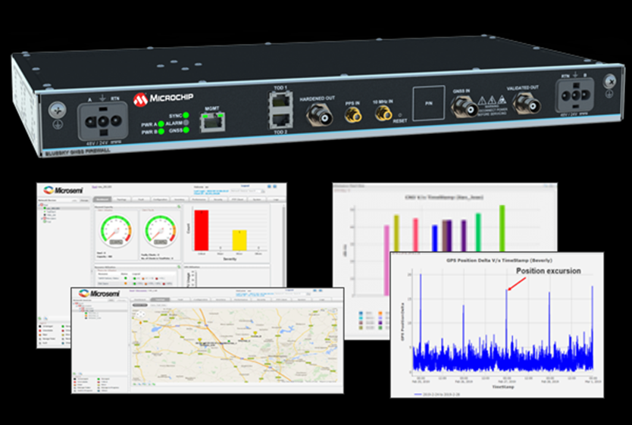
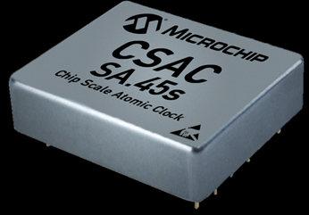
Capabilities of the Key Components of the Hybrid Timing (2)
Precision Time Protocol
  Accuracy in sub-microsecond
  Local-wide area coverage
GNSS Firewall
  Identify and protect the GNSS system from spoofing and jamming
  Switching to an alternative backup timing source
  Accepts an alternative source of UTC
Chip Scale Atomic Clock
  Reduced SWaP clock compared to the conventional atomic clocks.
  CSAC can provide an extended holdover period.
  Improve the resilience of the system during timing service outage
  CSAC could bring the accuracy and stability of atomic clocks to portable receivers with reduced SWaP

Slide 17
Test Results and Data Analysis

Slide 18
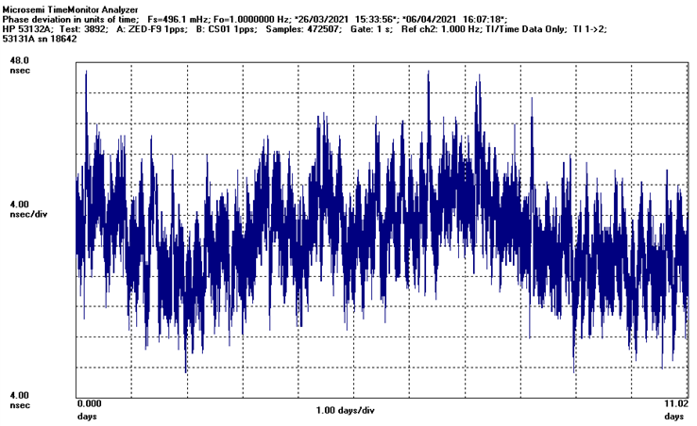
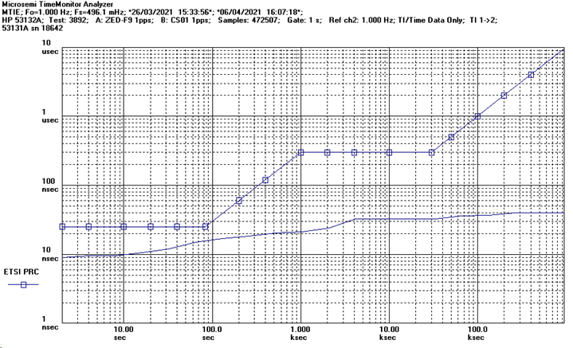
MCMF-GNSS Timing
TIE = ±16ns wrt UTC MTIE = 30ns
ETSI = European Telecommunications Standards Institute
PRC = Primary Reference Clock
MTIE = Maximum Time Interval Error

Slide 19
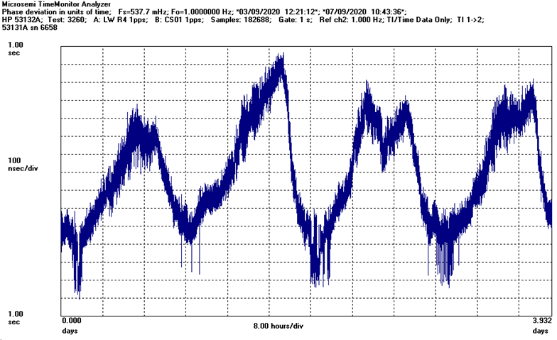
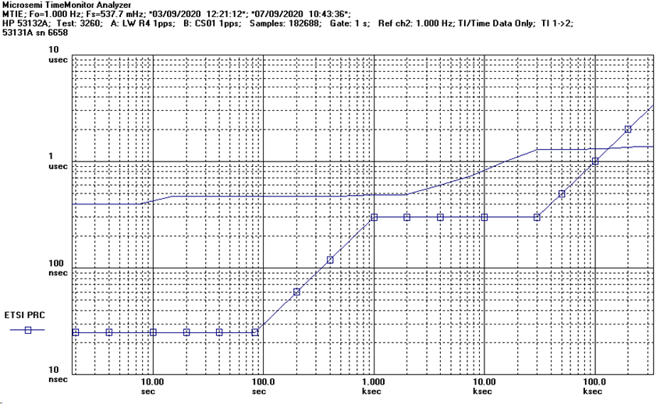
R4 198KHz LF Timing
TIE = ±800ns wrt UTC MTIE = 1.6µs

Slide 20
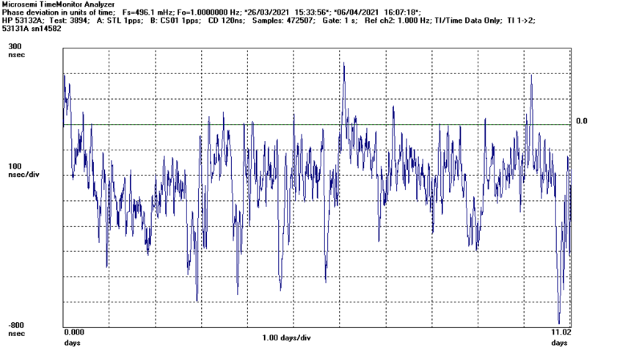
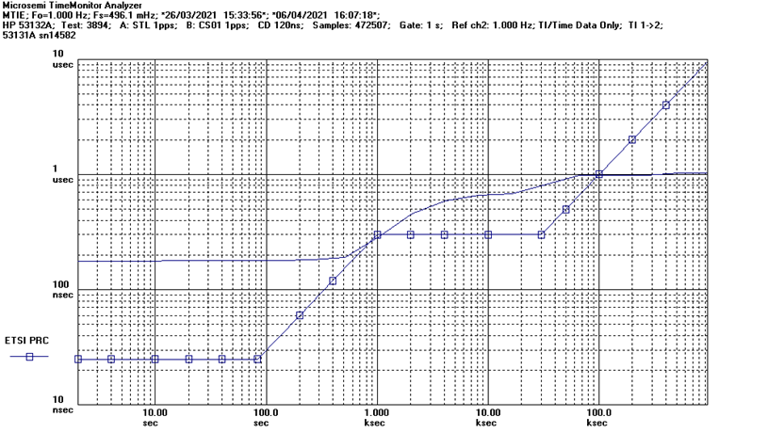
STL Timing
TIE = ±600ns wrt UTC MTIE = 1.0µs

Slide 21
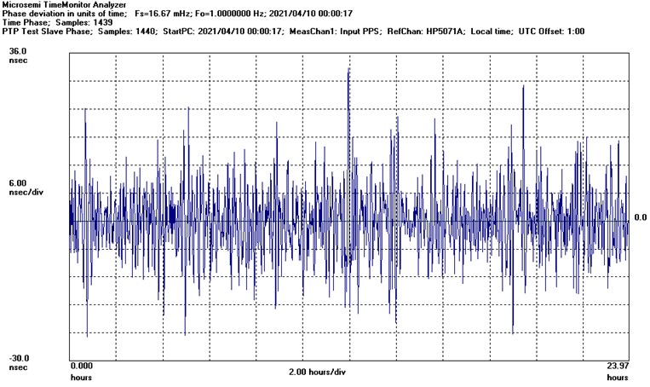
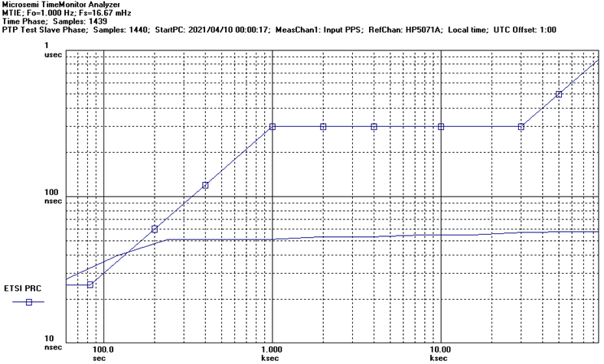
PTP Timing
TIE = ±40ns wrt UTC MTIE = 50ns

Slide 22
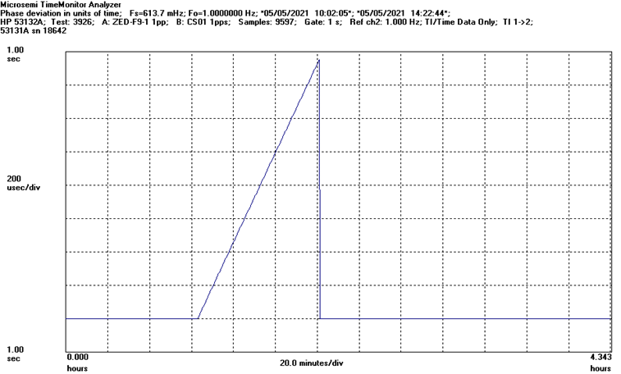
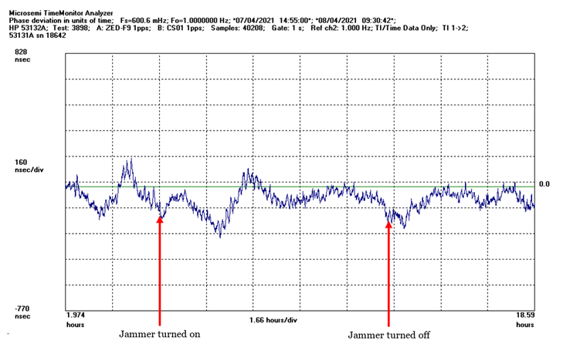
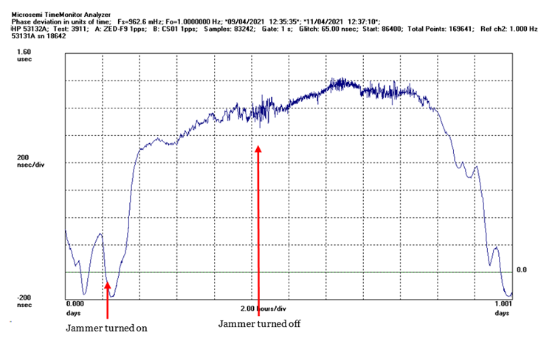
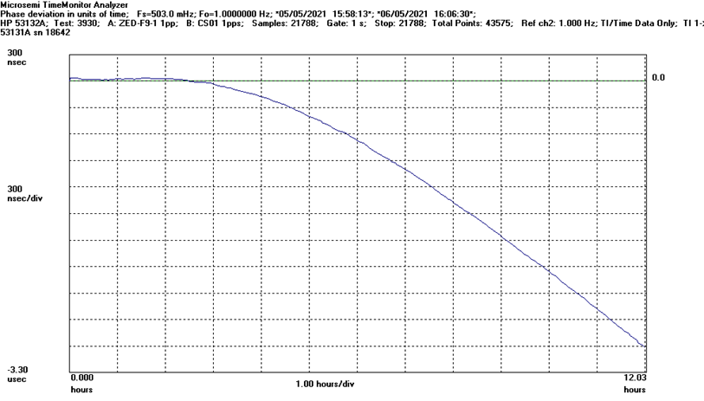
Performance Evaluation of Hybrid Timing against Jamming
STL backup and BlueSky Firewall
Stand alone MCMF
Radio 4 back-up and BlueSky Firewall
Holdover mode with CSAC

Slide 23
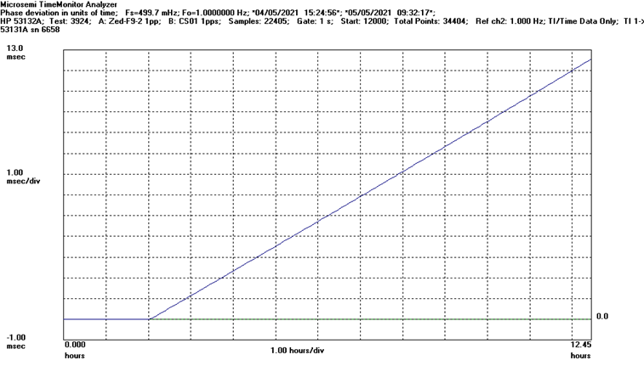
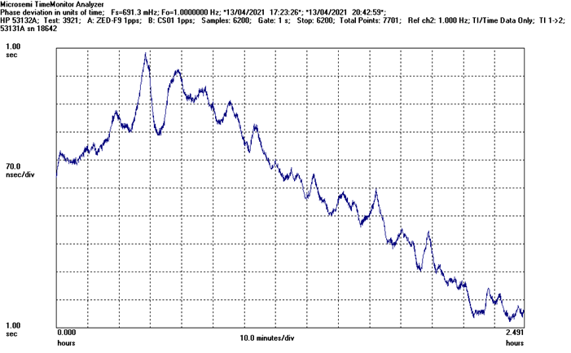
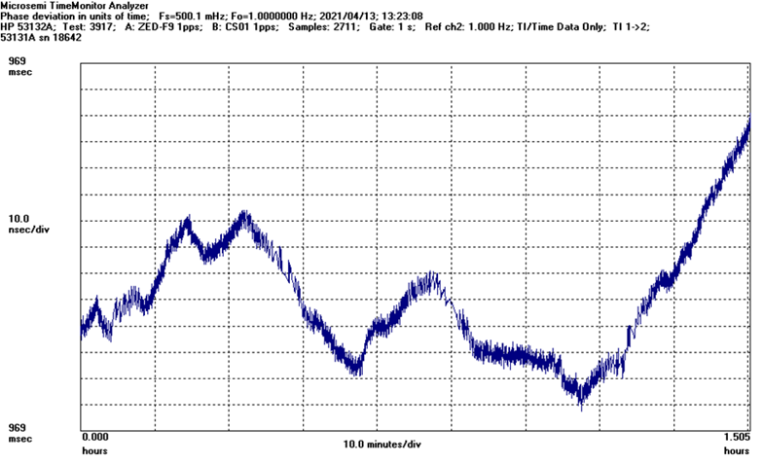
Performance Evaluation of Hybrid Timing against Spoofing
STL backup and BlueSky Firewall
Stand alone MCMF
Radio 4 back-up and BlueSky Firewall
Holdover mode with CSAC

Slide 24
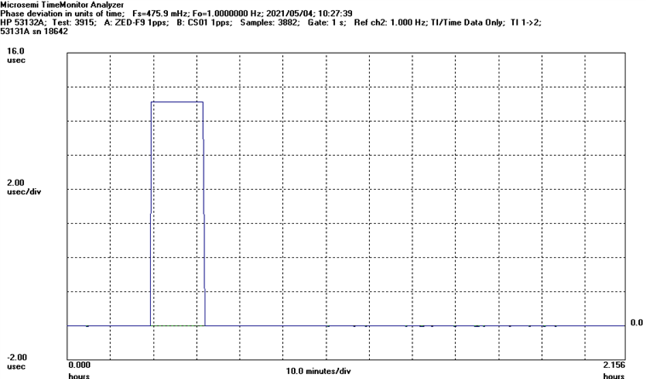
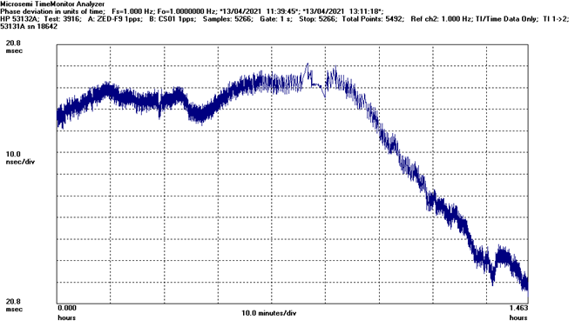
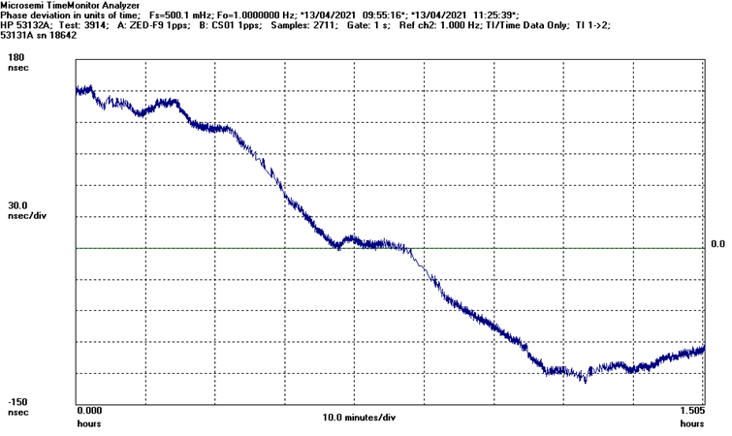
Performance Evaluation of Hybrid Timing against Constellation Error
STL backup and BlueSky Firewall
Stand alone MCMF
Radio 4 back-up and BlueSky Firewall
Holdover mode with CSAC

Slide 25
Summary Results
  Overall performance was very promising
Use Case | UC Accuracy Req | Scenario | Backup Timing Source | Accuracy Criteria | Accuracy Achieved | PASS/ FAIL
UC1a 5G Network Sync | ±1.5µs wrt to UTC | Spoofing / Jamming / Constellation Error | R4 | ±1.5µs | ±840ns | PASS
 |  |  | CSAC² | ±1.5µs/12hr | ±1.5µs/6hr | PASS¹
UC1b 5G V2X | 3ms relative | Spoofing / Jamming / Constellation Error | 5G | ±10µs | ±120ns | PASS³
 |  |  | CSAC² | ±10µs/24hr | ±7µs/24hr | PASS
UC1c 5G FoF | <=1µs | 5G LoS | R4 | ±1µs | ±800ns | PASS
 |  |  | Iridium | ±1µs | ±500ns | PASS³
UC2 Power Grid | ± 1µs 2σ wrt UTC: typical ± 100ns 2σ wrt UTC: extended | Spoofing / Jamming / Constellation Error | R4 | ±1µs | ±840ns | PASS
 |  |  | Iridium | ±1µs | ±540ns | PASS
UC3 Financial | ± 100µs wrt UTC: typical ± 1µs wrt UTC: extended | Spoofing / Jamming / Constellation Error | R4 | ±10µs | ±840ns | PASS
 |  |  | Iridium | ±10µs | ±540ns | PASS
UC4 Avionics | 10ms wrt UTC | Spoofing / Jamming / Constellation Error | Iridium | ±100µs | ±540ns | PASS
 |  |  | CSAC² | ±100µs/24hr | ±7µs/24hr | PASS
  PASS criteria only achieved with the use of IEEE PTP V2 as the selected transmission protocol. The use of LoRaSync pushed the total phase error beyond the PASS criteria of ±1.5µs
  Use of CSAC for holdover is only suitable for up to 6hrs before PASS criteria can no longer be met
  Synthetic test verdict based on Steady State 5G test results

Slide 26
Demonstrator SWOT Analysis

Slide 27
Strength and Weakness Summary
Subject | Strengths | Weaknesses
Performance | System less vulnerable to interference, jamming and spoofing Supports a range of flexible design options and the system can be configured for specific applications Supports indoor scenario application, when the system is backed-up by an STL or LF timing source Wide ranging accuracy performance, from ms level to sub-µs level. Global or wide area coverage through wireless time transfer (satellite-based or terrestrial-based). Improved resilience and threat awareness via “Firewall” technologies. Provides Enhanced holdover via CSAC Supports security features (e.g. authentication and encryption), via some alternative timing technologies such as STL | Backup coverage may be local or regional (excl. STL) Backup accuracy provided not on par with GNSS Backup Ubiquity, in general, not on par with GNSS (excl. indoor scenario)
Feasibility | backup timing sources either relatively mature or have a clear roadmap for development (e.g. 5G) | Additional HW costs Service subscription could be required

Slide 28
Opportunities and Threats
Subject | Opportunities | Threats
Adoption | The impact of GNSS outage due to GNSS vulnerability increases the need for resilient PNT The criticality of timing to national infrastructure such as communications network, power grid and financial. | Potentially complicated standardisation and regulation instead of voluntary choice, due to upgrade of the UE .
Technology development | Supports higher accuracy performance by evolving existing technologies System cost reduction to promote adoption, e.g. highly integrated HW/SW solution (such as existing GPS/ eLoran maritime receiver) Support software-level timing hybrid | The evolution of 5G has the potential to render some KPI requirements covered - without the need for additional system elements for some UCs

Slide 29
Conclusions

Slide 30
And so…
CNI & other applications require accurate, secure and reliable time inter alia:
  5G/LTE
  Avionics
  Power Grids
  Secure Communications
  Financial transactions
GNSS has done this for the last few decades with sub-ns sync and traceability to UTC (plus it’s free at the point of use!)
  But… GNSS is vulnerable
    interference, spoofing, built environment, vegetation, indoors, etc.
We have proposed an Innovative Hybrid Timing System

Slide 31
This Innovative Hybrid Timing Solution Provides:
Application support to various Use Cases
  Flexibility to choose alternative timing sources, adaptive to the requirement/application
A wide range of accuracy
  From ms level to sub-μs level
  From different alternative timing sources
Improved holdover performance
Improved resiliency - less vulnerable to interference, jamming or spoofing (vs. GNSS)
Global coverage or wide area (e.g. 1000 km) coverage
  Through wireless time transfer (satellite-based or terrestrial-based)
Ubiquity
  Supporting indoor scenarios (by STL and LF signal)
Support to security features such as authentication and encryption
  Using alternative timing technologies (such as STL)

Slide 32
Recruiting:
Navigation System Engineer
Martin Bransby
Louise Mercy
Head of Navigation – Telespazio UK
Navigation Project Manager – Telespazio UK
Martin.Bransby@Telespazio.com
Louise.Mercy@Telespazio.com

Slide 33


Slide 34
Back up slides

Slide 35
Candidate Technology TRL Summary
Technology | Description | TRL
GNSS | A space-based radio navigation system, capable of providing accurate positioning, navigation and timing (PNT). All four constellations in GNSS are in FOC providing free open service for civil users. | 9
5G | A wireless technology with timing distribution capability. The 5G standards for accurate reference time delivery are still developing and evolving. | 7
STL | A commercial system that uses a series of short data messages on the Iridium constellation of Low Earth Orbit (LEO) satellites. The system provides a commercial service to users around the globe. | 9
eLoran | A low-frequency, long range Terrestrial Radio navigation System, capable of providing positioning, navigation and timing (PNT). A prototype has been demonstrated in an operational environment successfully in UK. | 7
PTP | A timing standard used to synchronize clocks throughout a computer network on a local area network. This service is available commercially. | 9
CSAC | A reduced SWaP clock, as compared to the conventional atomic clocks. CSAC is able to provide an extended holdover period, which can help to improve the resilience of a system during timing service outage. CSAC is the world's first commercially available chip scale atomic clock from Microsemi. | 9
BlueSky | A GNSS firewall, which identifies and protects GNSS systems from spoofing and jamming threats. BlueSky is commercially available from Microsemi. | 9

Slide 36
Development Roadmap & TTM

Slide 37
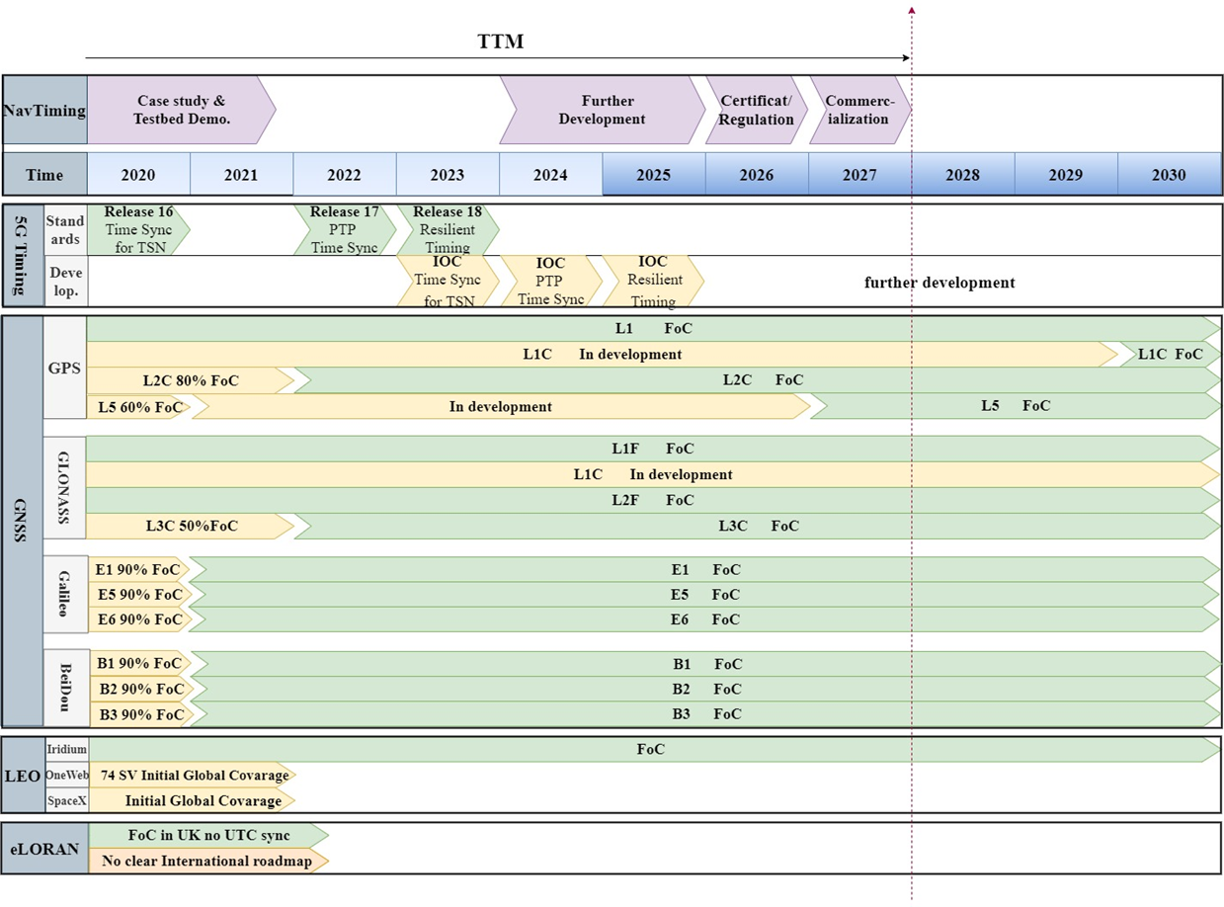
Development Roadmap & TTM
The candidate technology roadmap can be summarised as:
  Currently there are three core constellation frequencies plus two frequencies from GPS
  Soon there will be two more LEO-based services with IOC available, in parallel with the Iridium constellation
  eLoran is at Initial Operating Capability (IOC) in the UK and the Far East, with no clear roadmap for wider international deployment
  Initial 5G services for TSN, PTP and Resilient Timing Synchronisation are expected by 2023, 2024 and 2025 respectively

Slide 38
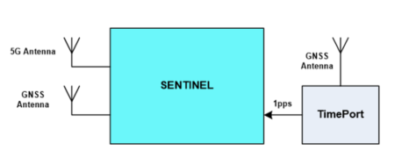
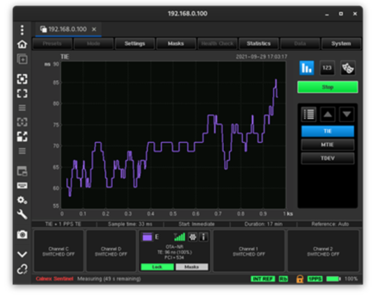
5G Testing
  5G test plans were halted
  5G user equipment unavailable to physically measure time transfer over 5G transmissions
  Cellular modems with time transfer capabilities
  Some Ublox equipment existed with time transfer capabilities
  However.. only 4G capable (5G on the roadmap)
  Sentinel from Calnex Solutions
  Used to measure time transfer over 5G networks
  Supported standalone 5G testing only
    Testbed integration not possible due to lack of 1pps output
  However, it did allow synthetic assessment of 5G capabilities
  Testbed configuration
  Sentinel testbed included a “TimePort” device (battery powered GNSS-synchronised CSAC)
    Designed for field test use as a portable timing reference

Slide 39
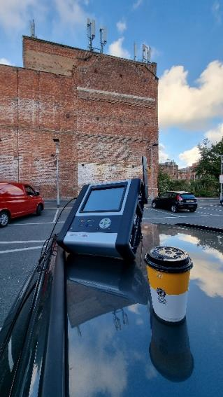
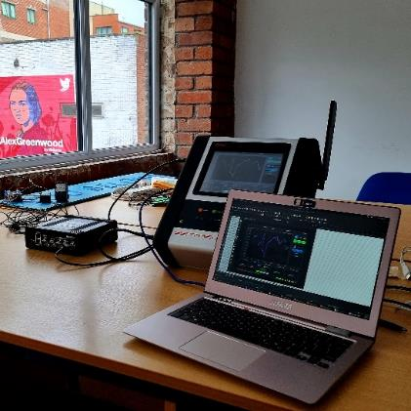
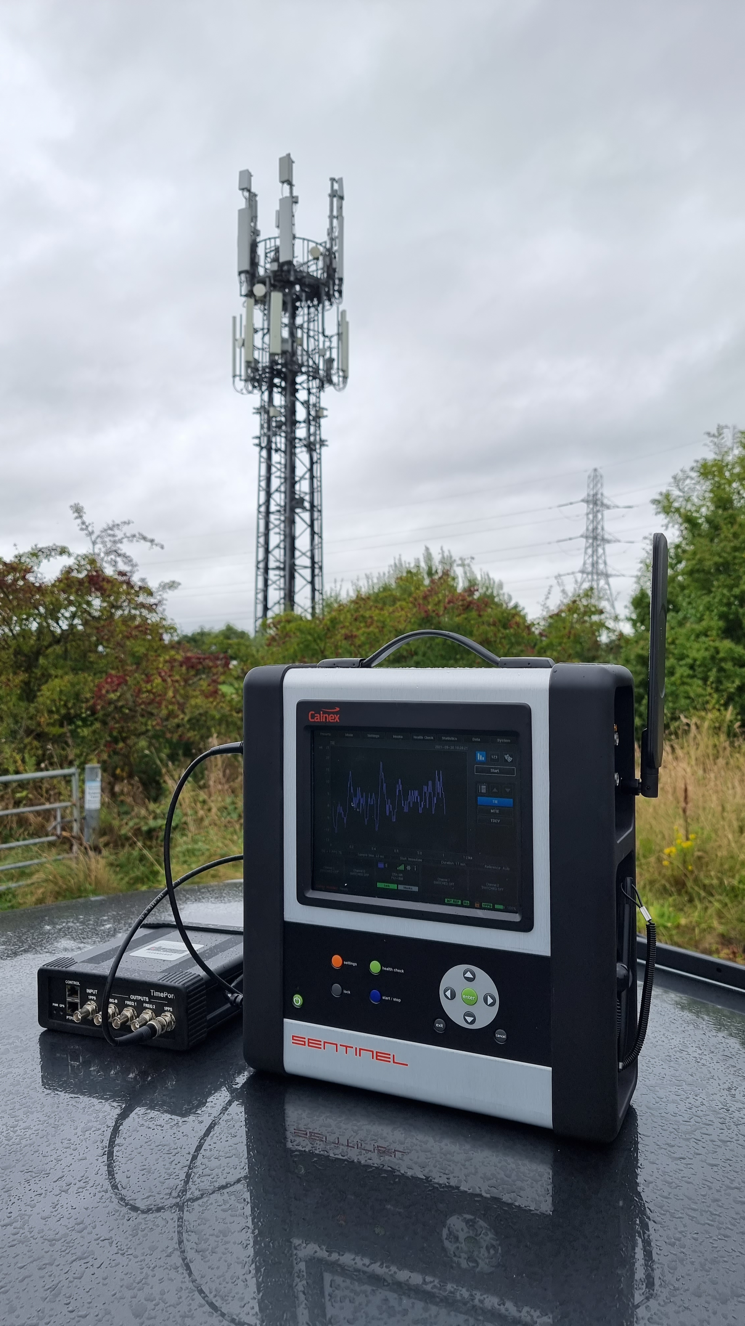
5G Testing
5G Basestation | Test Plan
Site 1 | Test at 30m distance Apply 30m propagation delay compensation Outdoor direct line of sight
Site 2 | Test at 30m distance Apply 30m propagation delay compensation Outdoor direct line of sight
Site 3 | Test at 30m distance Apply 30m propagation delay compensation Outdoor direct line of sight
Site 4 | Test at 200m+ range Apply propagation delay compensation Indoor non line of sight
  5G field trials were undertaken
  in a variety of live 5G basestation locations
    Northwest of England (supported by EE and Calnex)
  Line-of-Sight (LoS) at varying ranges and non-LoS
  Manual calibration supported
  Distance from basestation to test equipment
  TIE data captured for each test site location
  MTIE data being calculated post-trial

Slide 40
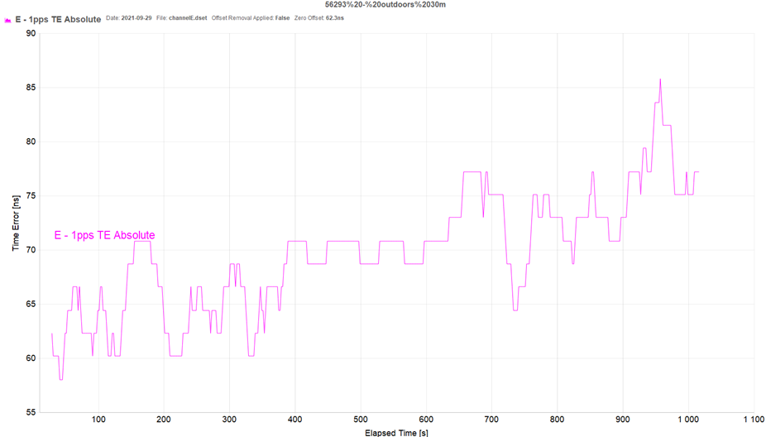
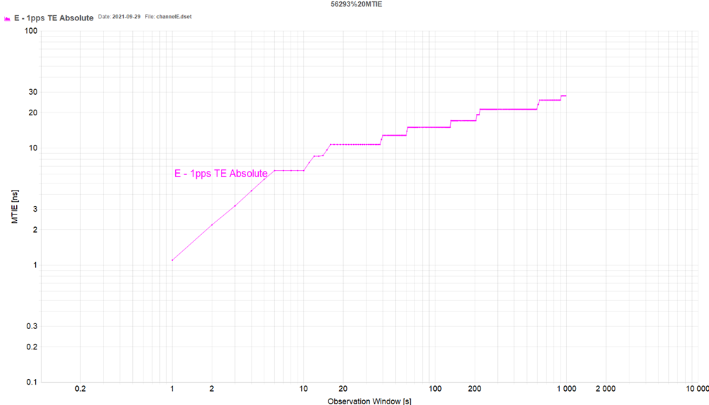
5G Baseline Testing Site 1 30m Direct Line of Sight
  Shows very tight time transfer accuracy
MTIE = 30ns relative to Basestation

Slide 41
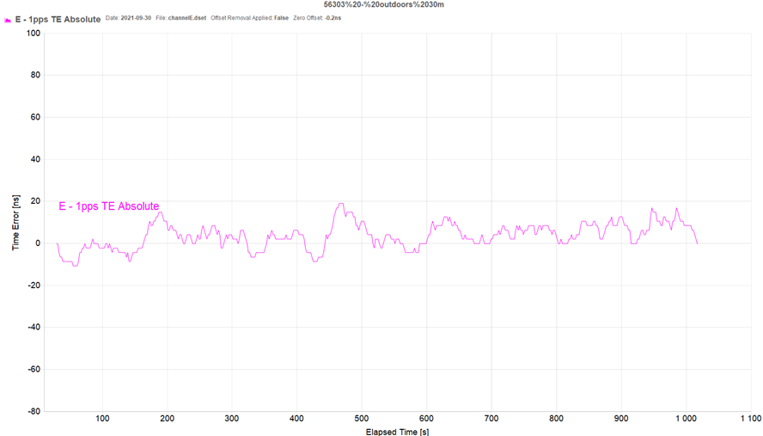
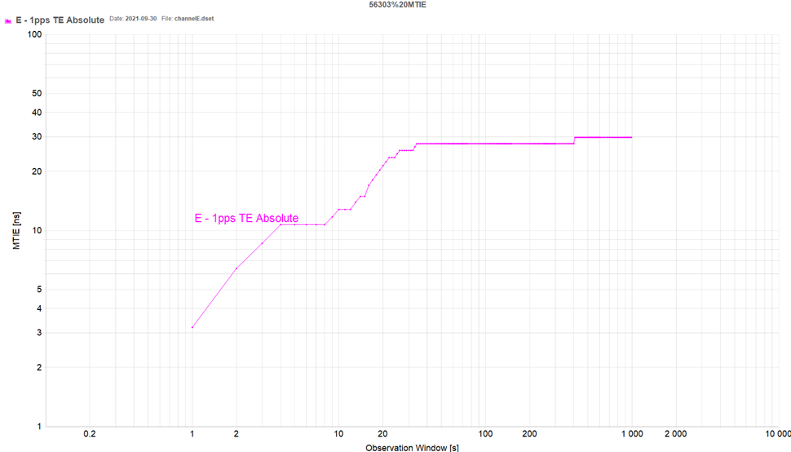
5G Baseline Testing Site 2 30m Direct Line of Sight
  Shows very tight time transfer accuracy
MTIE = 30ns relative to Basestation

Slide 42
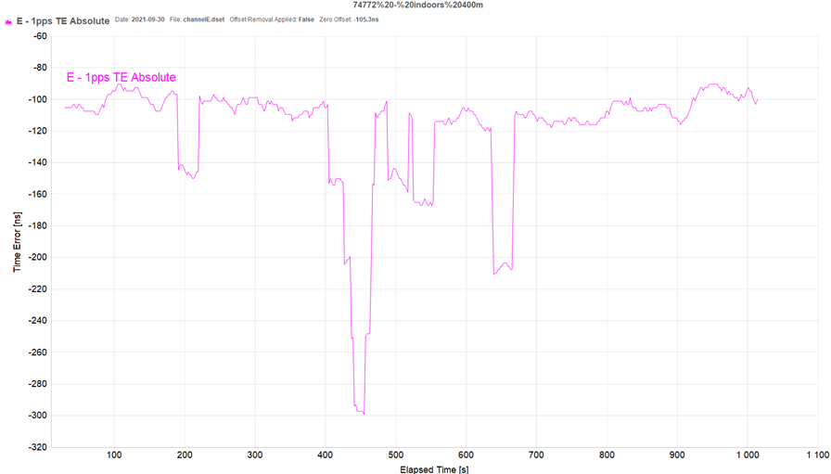
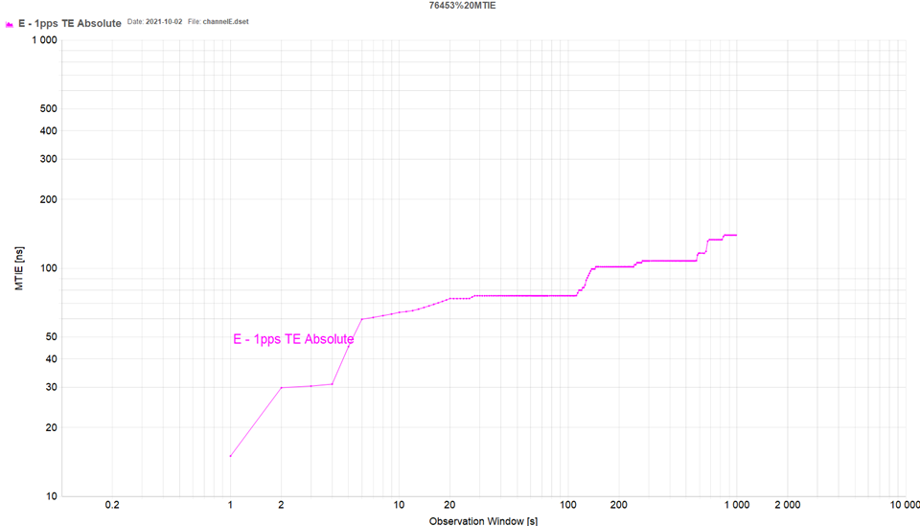
5G Baseline Testing Site 3 400m Non Line of Sight (Indoors)
  Shows good time transfer accuracy
MTIE = 150ns relative to Basestation

Slide 43
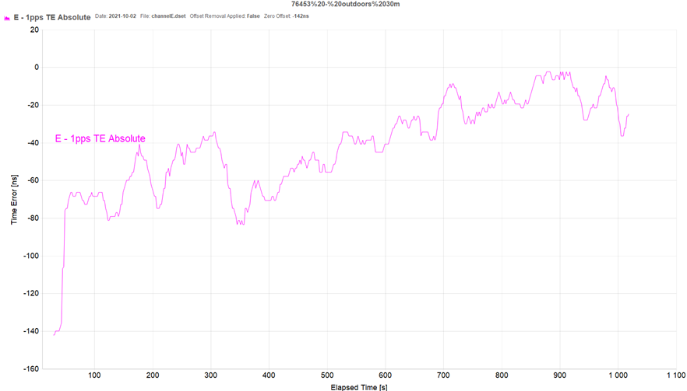
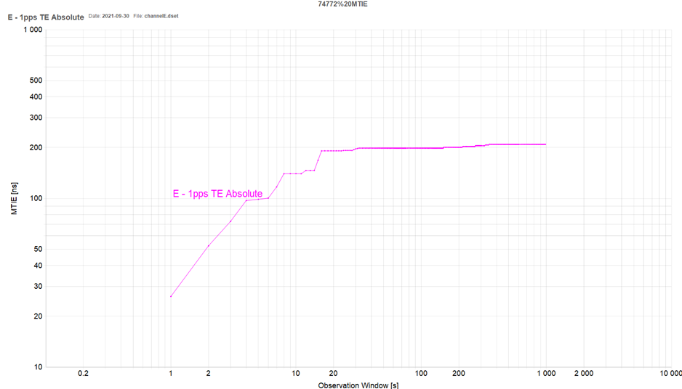
5G Baseline Testing Site 4 30m Direct Line of Sight
  Shows good time transfer accuracy
MTIE = 200ns relative to Basestation

Slide 44
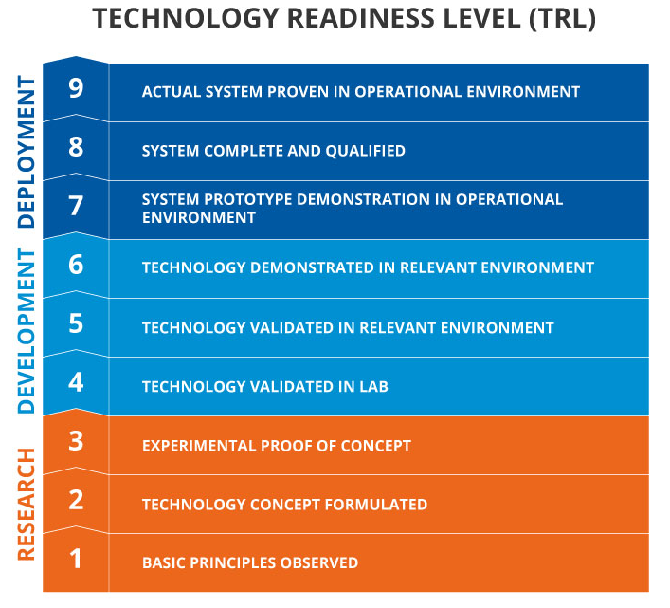
Innovative Hybrid Timing Concept – Steps to Commercialisation
  Currently, the solution designed during the project is TRL 4/5
  The solution is validated but not fully demonstrable
  ~2 year development plan
  Prototype demonstration in operational environment; and
  System qualification in an operational environment
  However…
    start point depends on the IOC and availability of COTS - specifically for the target 5G technology (due from 2024)
  Finally, the solution would move forward through standardisation and commercialisation phase
  Anticipated availability as a commercial product by 2027

Slide 45
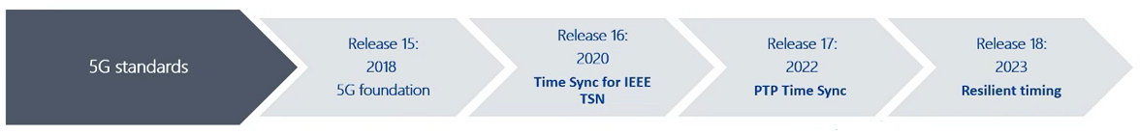
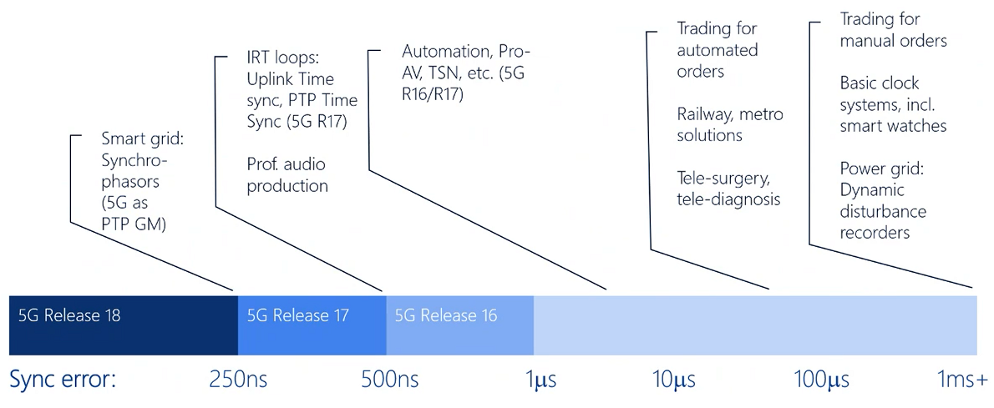
Gap Analysis
Testing with 5G in lab is not considered possible at this stage:
  No clear roadmap for the release of 5G UE products
  Theoretically UEs installed in a smart grid could get a common time reference from the Rel-16 5G SIB9
  SIB is not yet being transmitted in live 5G networks
  The granularity of the time information in the SIBs is currently limited to ~10 ms
    UC applications chosen for this study require µs or ns level
eLoran has not been included in the test architecture:
  UK transmitter at Anthorn is not currently synchronised to UTC due to a failure the atomic clock ensemble
  R4 198KHz LF timing service was adopted as an alternative
  Radio4 performance provided accurate time synchronisation for most UC requirements within this project

Slide 46
Potential Upgrade Costs
UC | Technology |  |  |  |  |  |  | CAPEX € | OPEX €
 | MCMF | 5G | BlueSky | CSAC | STL | PTP | eLoran
1a and 2 | ✓ |  | ✓ | ✓ |  | ✓ | ✓ | 15,250 | 1,000
3 | ✓ |  | ✓ | ✓ | ✓ | ✓ |  | 12,650 | 5,600
4 | ✓ |  | ✓ | ✓ | ✓ |  |  | 9,650 | 4,600
1b and 1c | ✓ | ✓ | ✓ | ✓ |  |  |  | 8,800 | 300
Basic | ✓ |  |  |  |  |  |  | 400,00 | 0,00

