Slide 1
Adding Resilience and Accuracy to GNSS
ITSF 2022
Düsseldorf, Germany

Slide 2
Heiko Gerstung
Managing Director, Meinberg heiko.gerstung@meinberg.de
Tor Melgård
Principal Innovation Engineer, Fugro t.melgard@fugro.com
Ole Petter Rønningen
Senior Innovation Engineer, Fugro o.ronningen@fugro.com
Frank Boon
Principal Innovation Engineer, Septentrio frank.boon@septentrio.com
Jean-Marie Sleewaegen
Systems Architect & Pricipal Signal Processing Expert, Septentrio jean-marie.sleewaegen@septentrio.com

Slide 3
Agenda
GNSS Today
Weaknesses
Jamming and Spoofing
New Approach to Secure and Enhance GNSS
Continous monitoring of all SVs of all four major constellations
Computed orbital/timing corrections to improve performance
Integrity checks and detection of failing/misbehaving SV clocks in real time
State of Test Campaigns
UTC Traceability
First Commercial Implementation

Slide 4

GNSS Today
Weaknesses and Vulnerabilities

Slide 5
GNSS Weaknesses
Civil GNSS signals available for the general public are unencrypted and vulnerable
to spoofing and jamming attacks.
Widely used to synchronize critical infrastructure
(power grids, telecom networks, financial markets, media broadcasts).

Slide 6
Jamming and Spoofing
Jamming relatively easy to detect (you will notice it) and mitigate (holdover is your friend)
Spoofing much more problematic unless detected (detected spoofing = jamming)

Slide 7

New Approach
Adding Resilience and
Accuracy to GNSS

Slide 8
New Approach to Secure and Enhance GNSS
Enhance GNSS resilience and performance using data aquired by a large number of reference stations which is securely transmitted via geostationary satellites to end-user-devices.
Global coverage and very robust and reliable infrastructure both in space and on the ground.
Commercial implementation currently undergoing extensive tests and performance measurements.

Slide 9
Reference Stations
Continuous reception of GNSS satellite signals at ~100 locations all around the world
Own independent timescale used to verify/measure timing parameters of satellites
All Reference stations together allow to collect data from every single GNSS satellite
of the four constellations in real time
Anomalies and failures (e.g. SV clock misbehaving) can be detected immediately

Slide 10
Control Centers
Each Control Center runs two independent software/firmware versions and operates 24/7
in a highly redundant configuration
Real time data of reference stations is collected, stored and analyzed in real-time
Precise orbit and clock corrections as well as timescale computed based on the received data
Correction values and state information for each SV of all four constellations are sent via
Inmarsat to all end user devices

Slide 11
End User Devices
Receiving GNSS signals for all four constellations
In addition, L-Band transmissions from geostationary satellites received
Verification of integrity of received GNSS SV data to detect spoofing attacks
Applies correction values for positioning and timing

Slide 12
L-Band Satellite Transmission
Inmarsat satellite constellation consists of a number of geostationary satellites
Covers almost the whole planet, only exception is the pole regions
“Out of band” data transmission (independent of the GNSS signals)
Proven technology used widely for global satcom applications since 1979
(last launch of a new satellite in Dec 2021)
Data transmission protected by asymmetric cryptography (private/public keys)

Slide 13
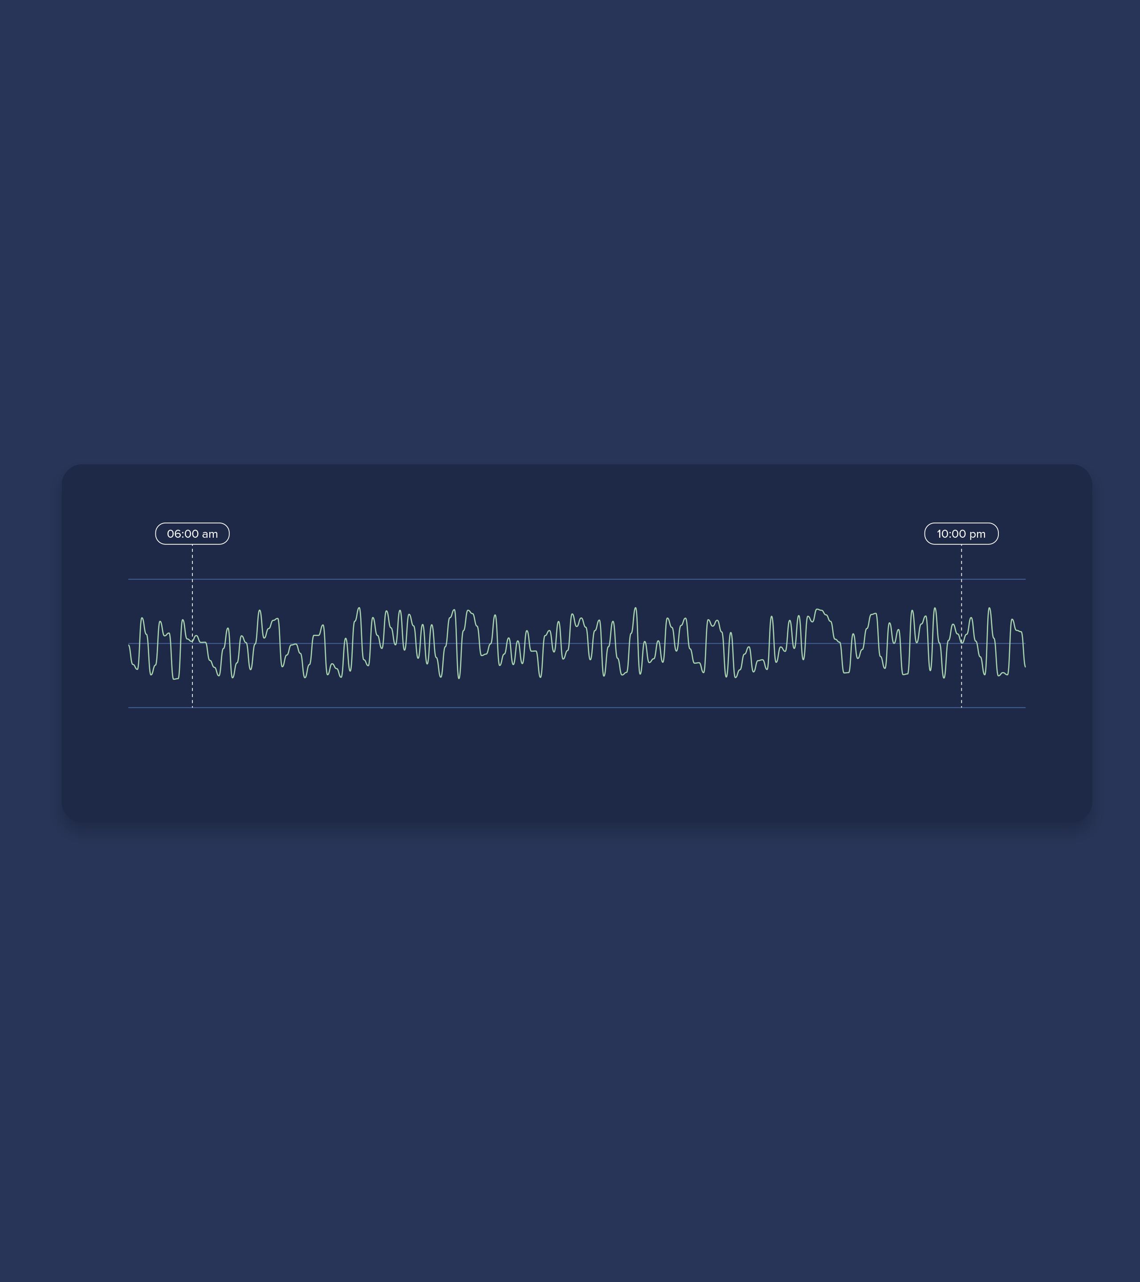
State of the Tests
Spoofing Protection and
High-accuracy Measurements

Slide 14
Spoofing Protection
Tests planned for Q4/2022 with independent lab
Not easy to test
  Most spoofing tests use GNSS simulator directly connected to antenna path
  L-Band signal needs to be added
  Looking for spoofing tests in protected areas
Results will be published in Q1/2023

Slide 15
High-Accuracy Measurements (1)
Impressive timing improvements over standard GNSS:
< 1ns over several weeks
Test campaign in cooperation with Norwegian NMI

Slide 16
High-Accuracy Measurements (2)

Slide 17
High-Accuracy Measurements (3)

Slide 18
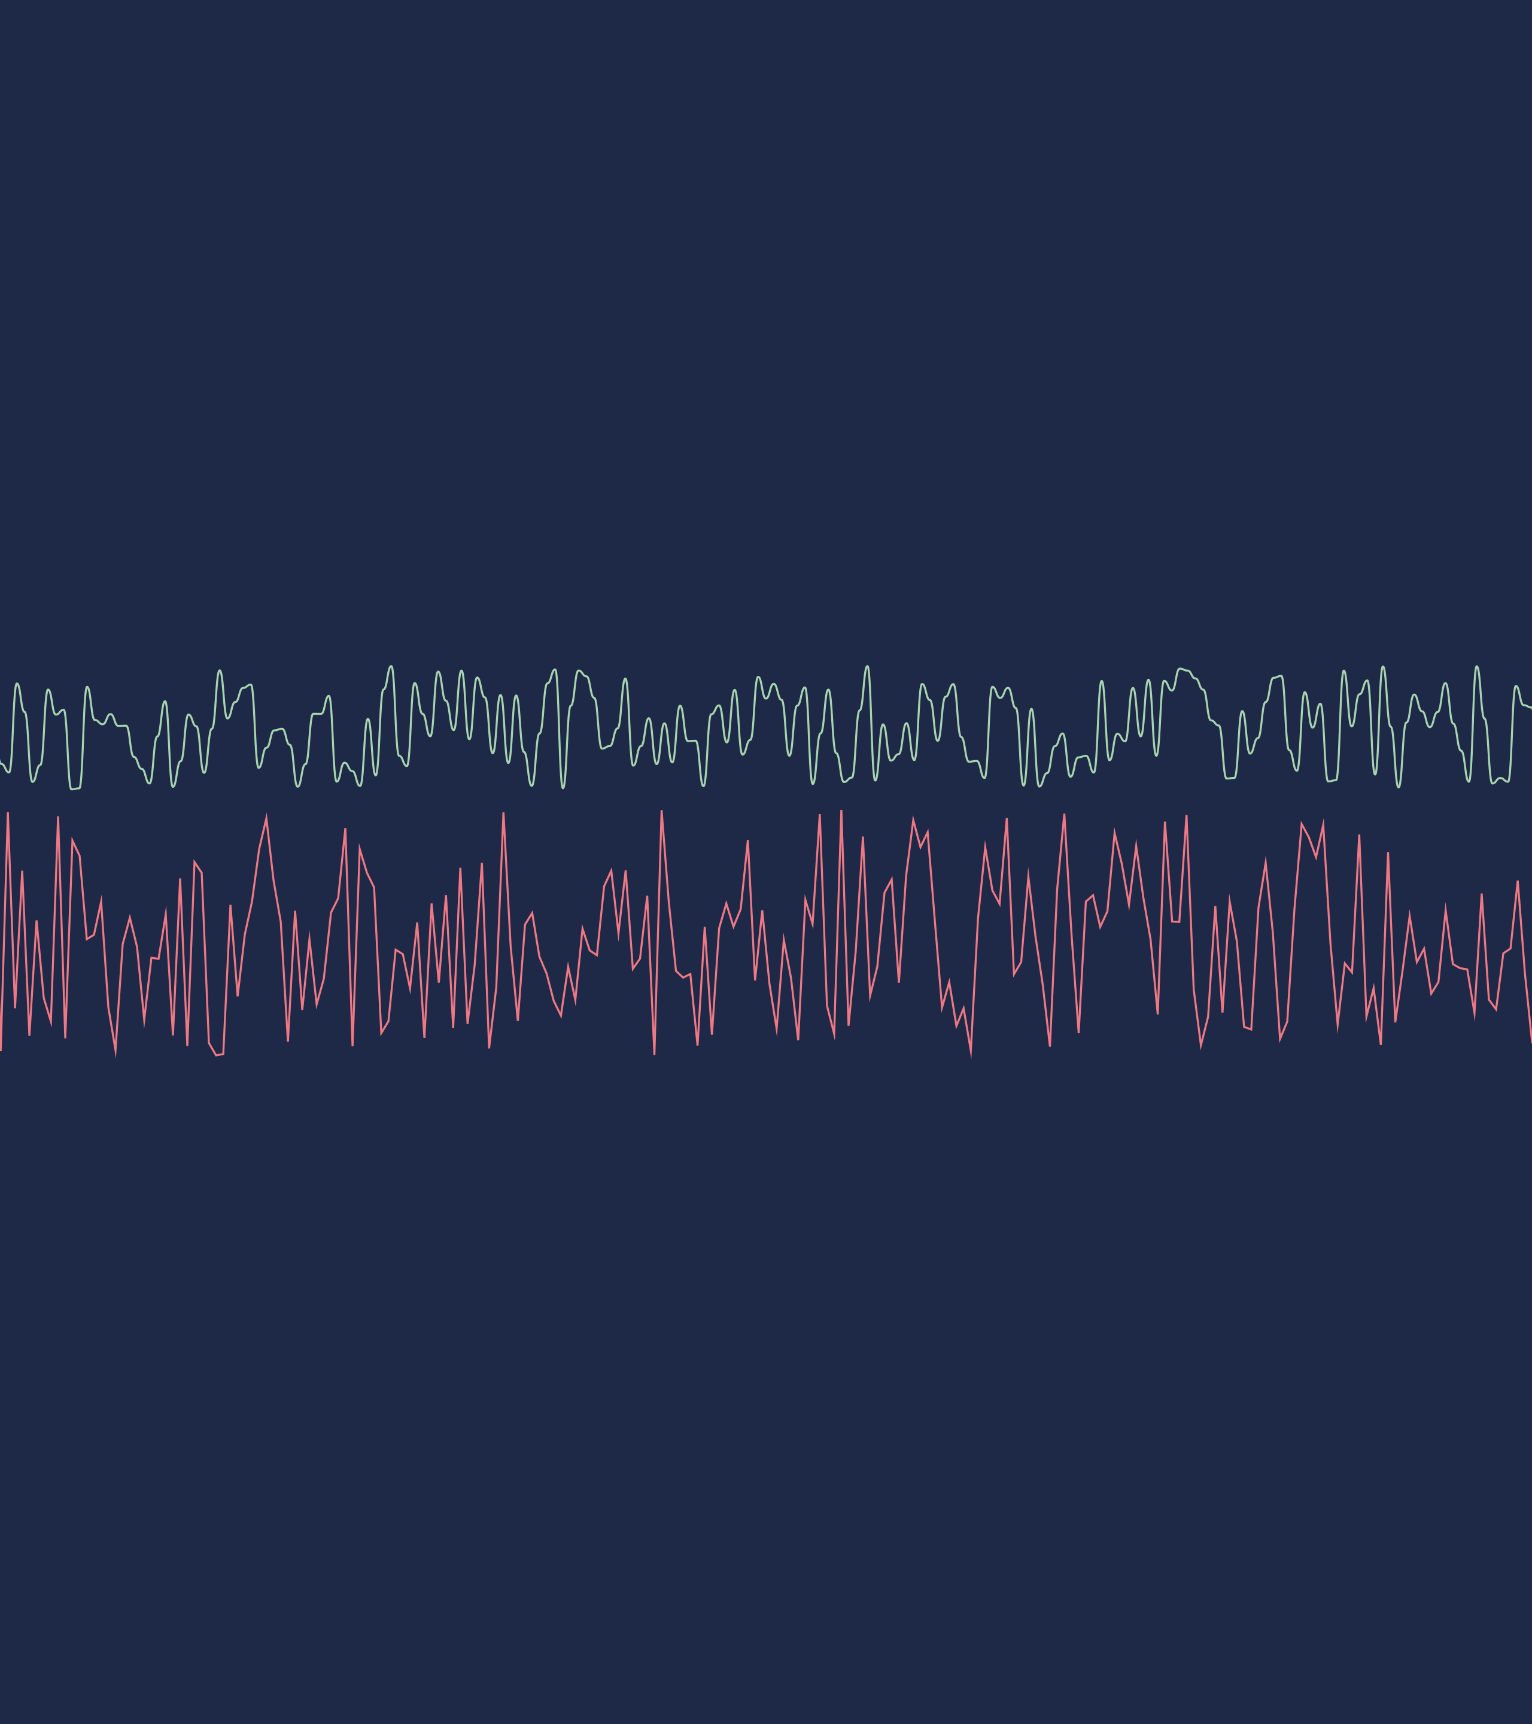
Traceability to UTC
Comparing Time with UTC Clocks
and Publishing Results

Slide 19
Monitoring System Offset to UTC
System time is based on GNSS timescales (GPS, Galileo)
UTC reference stations
  Measure performance of service against local UTC reference clocks
  Logging offsets 24/7
  Publishing logs every day for the last 24 hours
Looking for interested NMIs

Slide 20
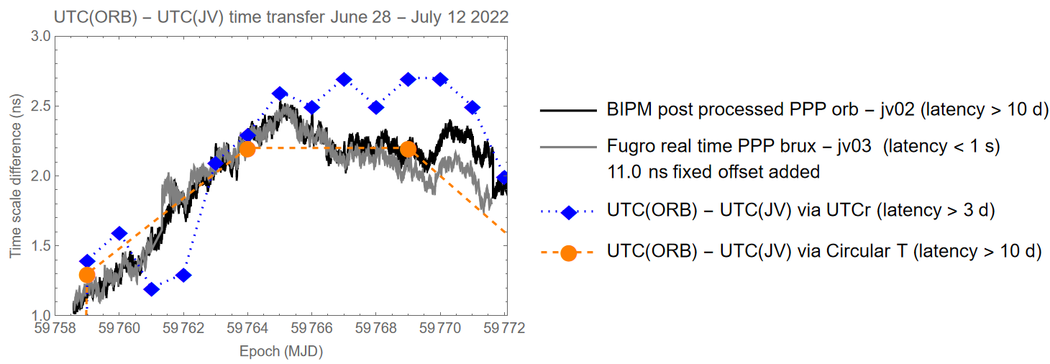
Comparison UTC(ORB) - UTC(JV) using products from BIPM and AtomiChron

Slide 21

First Commercial Implementation
Securing and Hardening GNSS for Timing

Slide 22
First Implementation in 2023
Commercial Service with SLAs and Customer Support
Multiconstellation + Multiband GNSS receiver module based on Septentrio mosaic-T GNSS module
  Already included protection against spoofing and jamming in its base version
  Special Firmware developed by Septentrio to receive and decode Inmarsat L-Band Transmissions
  Clock Module for Meinberg Timing System verifies status of NMA and takes correction data into account to improve timing

Slide 23
Thank You!

