Slide 1
Time Divergence in Multi-constellation GNSS Receivers – an investigation into risks and resilience
Akis Drosinos, Guy Buesnel, Mark Hunter
Spirent Communications

Slide 2
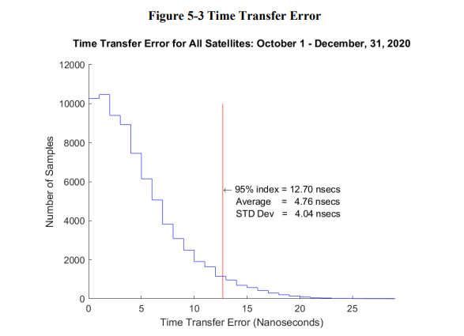
How accurate is GPS time?
UTC as maintained by the U.S. Naval Observatory (USNO) via the GPS signal in space with a time transfer accuracy relative to UTC(USNO) of
≤30 nanoseconds (billionths of a second), 95% of the time.
This performance standard assumes the use of a specialized time transfer receiver at a fixed location.
Question – is precision timing data from GPS sufficient or do we need to be able to process timing data from other constellations to complement GPS time?
Image: FAA Satellite Navigation Branch

Slide 3
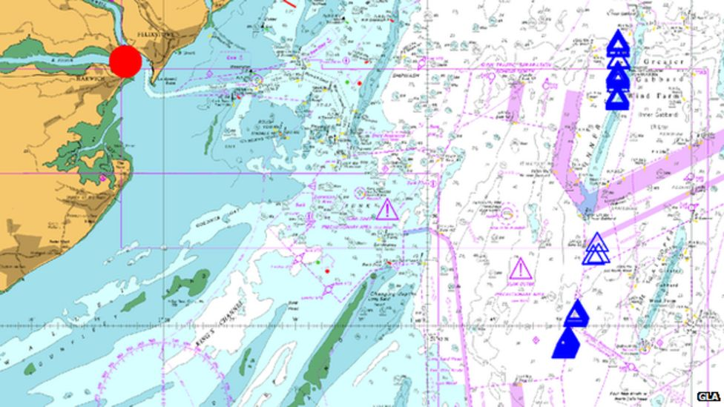
Need for timing using multi-constellation GNSS receivers (1)
April 2014: All GLONASS satellites broadcast corrupt information for 11 hours, from just past midnight until noon Russian time. The effect of this was to render the system completely unusable to all worldwide GLONASS receivers. Many reports were also received of Multi-Constellation Multi-Frequency (MCMF) receivers using GLONASS becoming unusable during this episode
A UK GLONASS receiver with true position given by red dot, reports its position as being coincident with blue triangles on map - Image taken from GLA Research and Development (GRAD)

Slide 4
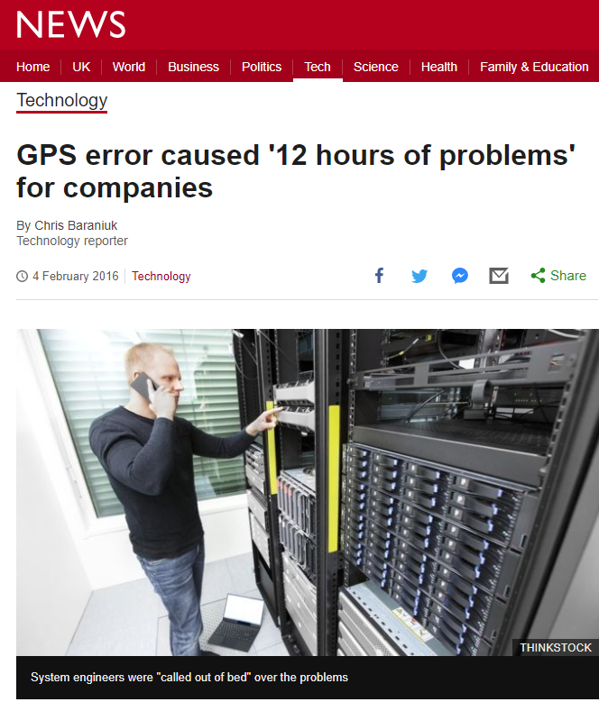
Need for timing using multi-constellation GNSS receivers (2)
January 2016 Errors in the Coordinated Universal Time (UTC) offset parameters broadcast by Global Positioning System (GPS) satellites caused many thousands of GPS clocks to be in error by approximately -13 microseconds. The incorrect UTC offset information was broadcast by 15 GPS satellites, half of the available constellation, throughout the anomaly
May 2017 Galileo hardware equipment failure in the ground segment – navigation messages not refreshed from 14 May at 15:50 to 6 May at 12:44 - Galileo Service Notice #01 covers..
Image: BBC

Slide 5
Need for timing using multi-constellation GNSS receivers (3)
Galileo, GPS and GLONASS have all experienced major constellation issues
Reliance on a single constellation as source for UTC traceable time introduces unnecessary risk
Receiver implementation is also a factor
GPS timing error – data was flagged as being out of date but many receivers processed it as current data (GPS Receiver Impact from the UTC Offset (UTCO) Anomaly of 25-26 January 2016, Karl Kovach et al is a recommended read to understand what exactly happened and why some receivers exhibited timing errors)
Leap Second implementation – Jan 2015 GPS broadcast future leap second data
Some receivers implemented this immediately
Resulted in a negative one second offset in affected receivers…

Slide 6
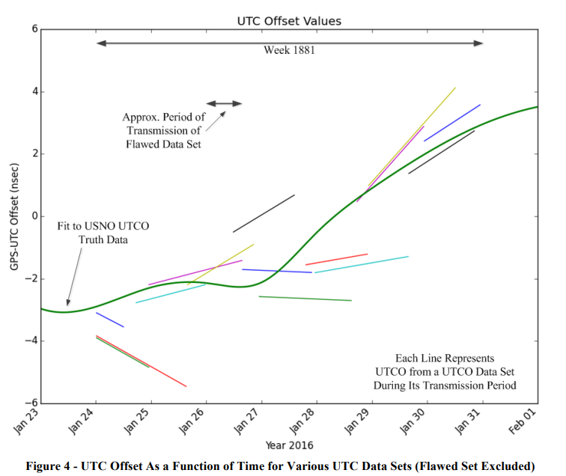
How does GNSS time trace to UTC?
“USNO estimates the timing difference between GPS Time and UTC(USNO)
This data is provided to GPS operations daily, which is used to align GPS Time (modulo whole second differences) and build the UTCO correction message.
GPS Time is specified to be kept within one microsecond of UTC(USNO) modulo whole second offset.
Over the past 20 years GPS Time has been kept within 10 nanoseconds of UTC(USNO) modulo whole second differences.”
From “GPS Receiver Impact from the UTC Offset (UTCO) Anomaly of 25-26 January 2016”, Karl Kovach, The Aerospace Corporation Philip J. Mendicki, The Aerospace Corporation Edward D. Powers, United States Naval Observatory (USNO) Brent Renfro, Applied Research Laboratories, The University of Texas at Austin

Slide 7
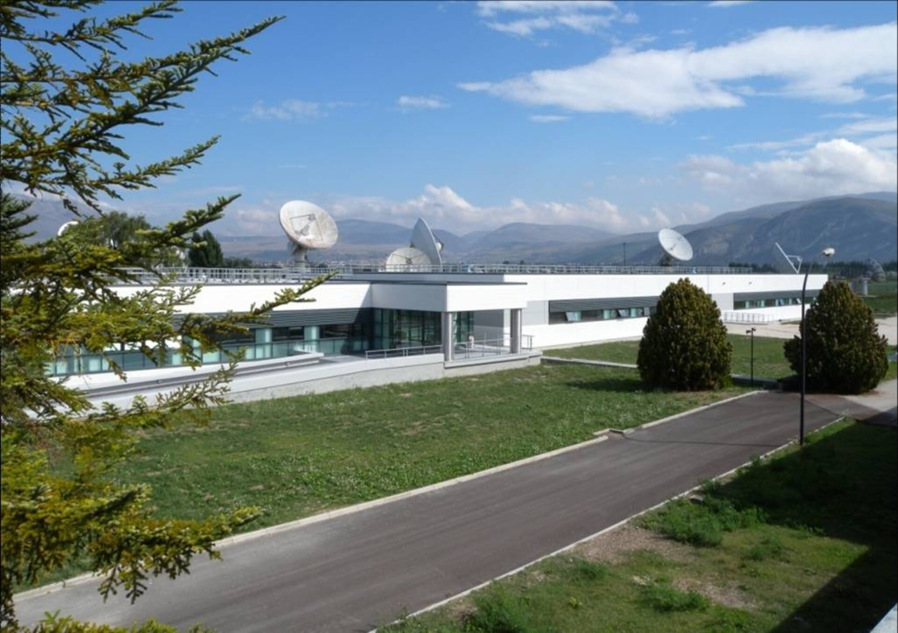
Relationship between Galileo and GPS Time
Galileo uses Galileo System Time (GST)
Generated by the Precise Timing Facility (PTF) at the Galileo Control Centre (GCC), Fucino. Based on averages of different atomic clocks.
GPS time is computed by the GPS control segment
GPS and Galileo time derived independently of one another
Both are kept close to UTC
The offset between the two is precisely calculated on a continuous basis by the PTF
Resulting GGTO distributed through Galileo Open Service Navigation Message
Image: ESA

Slide 8
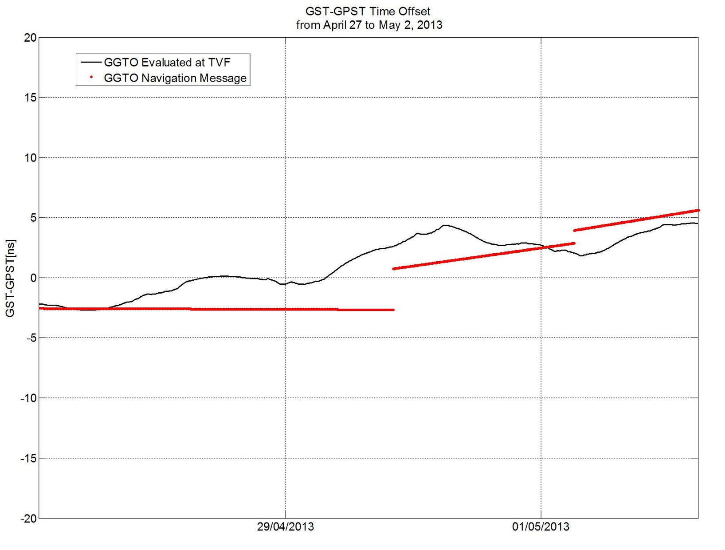
The GPS to Galileo Time Offset (GGTO)
GGTO determination methods and interface design were agreed on a preliminary basis between the Galileo Project and the US Naval Observatory back in 2003
The accuracy of the GGTO has been benchmarked by ESA at 5ns or less
What happens if there is a serious constellation error (such as the UTC Offset (UTCO) Anomaly of 25-26 January 2016?
Image: ESA

Slide 9
GPS Receiver Operation – A refresher
A GNSS Receiver has different modes (states) of operation – these modes of operation affect the vulnerability level of the receiver. The US Air Force defined these modes of operation (for military Receivers) as:
State 1: Normal Acquisition (L1 C/A code)
State 2: Direct Acquisition (applies to GPS L2 P(Y )frequency)
State 3: Code lock (Receiver maintains code lock, but cannot maintain precise carrier tracking )
State 4: Carrier lock (Receiver locks on carrier, but pseudorange and pseudorange delta values may be inaccurate)
State 5: Carrier Track/Data demodulation ( Receiver tracks carrier and demodulates signal, accurate pseudorange and pseudorange delta values)
State 6: Sequential resynchronisation (N/A for receivers with continual tracking)
State 7: Signal reacquisition ( Receiver that was tracking in State 5 but lost lock on GPS signals and is in search mode
The operation mode of the receiver is always important to consider – especially with multi-constellation, multi-frequency receivers where State 1 or State 7 might be constrained to a single constellation/frequency – e.g., GPS L1

Slide 10
MCMF Receiver considerations
Multi constellation receivers might need to acquire signals on GPS L1 C/A frequency
This means that advantages of MCMF operation when processing precise timing data do not apply if the receiver is in State 1 or State 7
Not clear how the receiver under test uses GGTO with GPS to drive the 1PPS output. Need to investigate using a selection of realistic test scenarios
How does GGTO drive solution accuracy in different environments – urban vs suburban to assess the impact of multipath? (Note this particular set of tests is limited to using the GGTO message broadcast by Galileo constellation)
Assessment of GGTO effectiveness in scenarios with differing satellite availability (large number of visible satellites vs low number of visible satellites in solution)

Slide 11
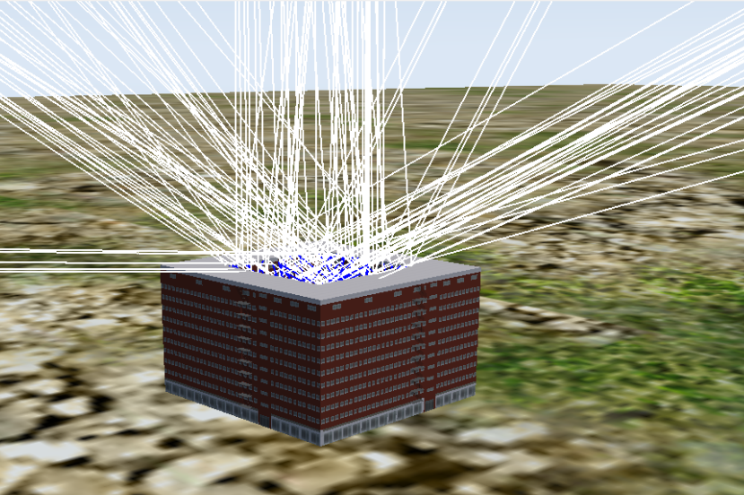

GGTO Test Set-up
30 m
30 m
Figure 1: Sim3D scene with ~60 degrees obscuration

Slide 12
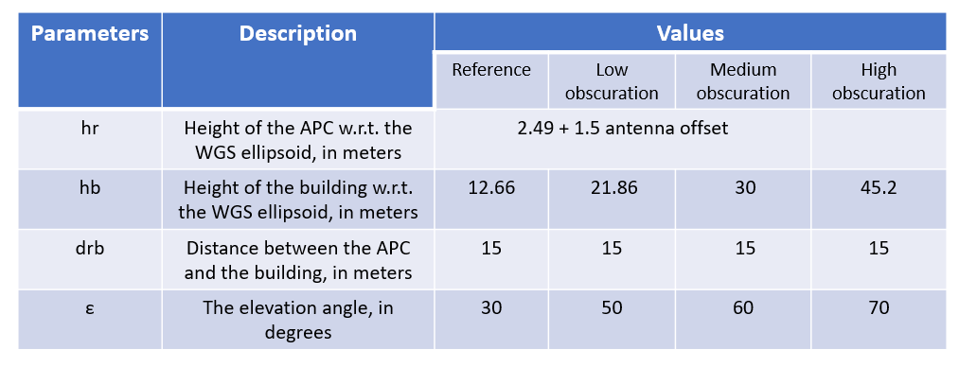
Obscuration geometry profile
Table 1: Obscuration geometry profile

Slide 13
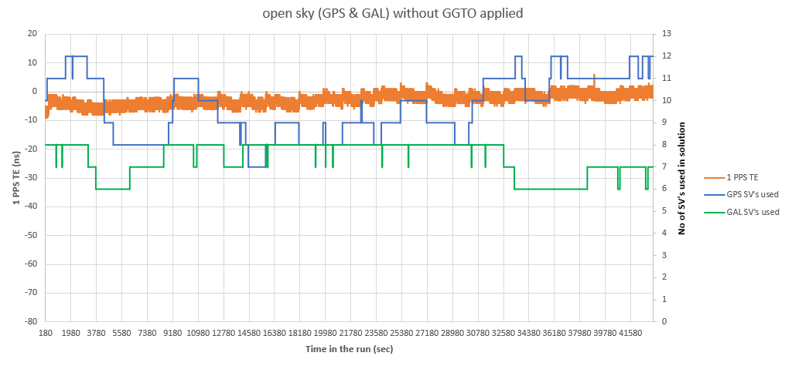
Open sky run without any GGTO applied

Slide 14
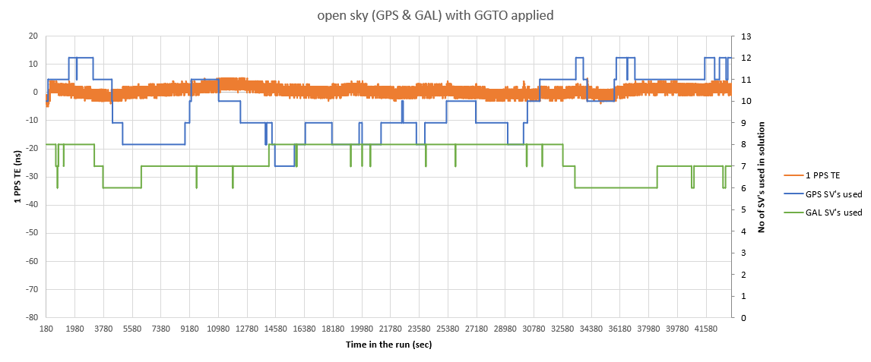
Open sky run with GGTO applied

Slide 15
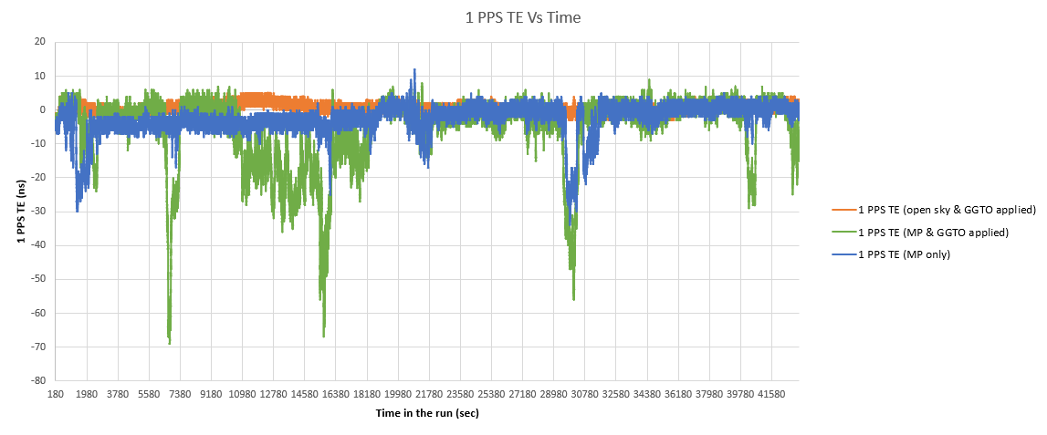
1 PPS TE Vs Time in the run

Slide 16
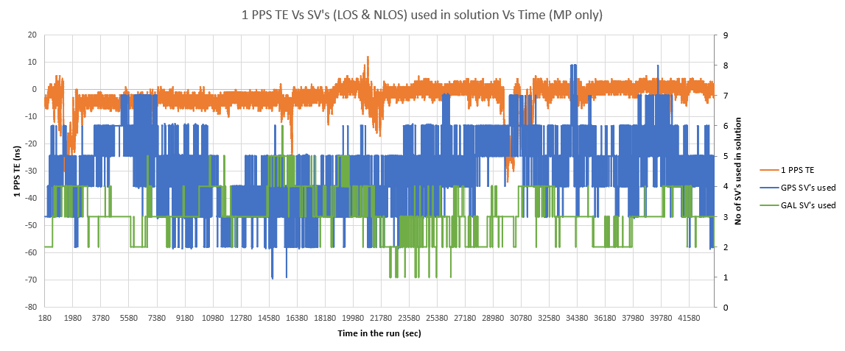
1 PPS TE under MP conditions only
-34 ns
5 GPS & 3 GAL SV’s used

Slide 17
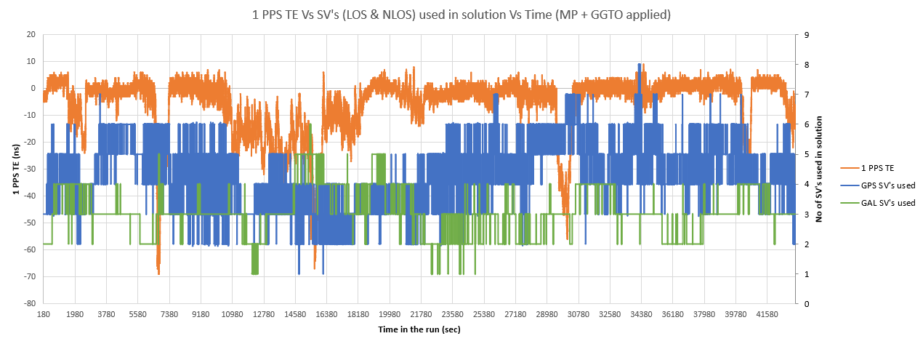
1 PPS TE under MP conditions and with GGTO applied
-69 ns
-56 ns
-67 ns
4 GPS & 3 GAL SV’s used
5 GPS & 3 GAL SV’s used
2 GPS & 5 GAL SV’s used

Slide 18

Insights/further work
GGTO divergence only becomes an issue with low numbers of satellites available (e.g. due to multipath)
This might be the case where users would place most reliance on GGTO to help with provision of precise, traceable time data
Results showed that with 8 or less satellites (LOS & NLOS) available to the receiver, GGTO divergence led to a degradation in accuracy of the Receiver PPS output
Clear need to understand how GGTO works in multi-constellation multi-frequency receivers
Users need to evaluate how their multi-constellation solutions work against relevant scenarios
Acknowledgements: Thanks to Guy Buesnel and Mark Hunter from Spirent for their valuable contributions to this study

Slide 19

Trust but Verify
Akis.Drosinos @spirent.com
www.spirent.com/products/pnt-vulnerability-test-solutions

