Slide 2
SMPTE Study Group Report on PTP Security
Leigh Whitcomb
Unaffiliated
SMPTE 32nf Technical Committee co-chair
Nov. 2022

Slide 3
PTP Security Study Report
1st Study Report
ER 1004:2021 “Report of the Study Group On Security in SMPTE ST 2059 – Threat Landscape” https://f.hubspotusercontent00.net/hubfs/5253154/6e8ed286-8887-480a-8a89-7daac0745644-hs_file_upload-er1004-2021%20(1).pdf
2nd Study Report (This presentation)
Mitigation and Detection
3rd Study Report (Maybe)
Impact of IEEE v2.1 on the Broadcast and Professional Media Industries

Slide 4
Study Group Report Details
Background
Specific Threats and their Matching Impacts and Controls
Best Current Practices
A Peek into the Future of PTP Security

Slide 5
Background
Threat Dynamics and Attacker Goals
What’s Special About Media Networks?
Up to thousands of high bandwidth (~3Gb/s) RTP streams comprised of packets that must be presented to the physical layer at precise times.
Signal processing systems that must synchronize their inputs with upstream devices
Automation systems that must accurately cue and play essence with frame-accurately by sending control commands over the network
SMPTE ST 2059-1 and -2
Notes:
- Motivation can be financial, or ideological and the attackers are increasingly highly skilled, well-funded, patient, and professional

Slide 6
What is a Broadcast and Professional Media System?
OTT Service
OTT Viewers
Firewall
Internet
Essence Blue Switch
Essence Amber Switch
Control / Management Switch
Remote Station Monitoring by Station Engineering
Firewall
Vendor Debugging
Media Node
without Separate Management
e.g. Audio Mic
Media Node
ST 2022-7
with in band Management
e.g. Camera
Media Node
ST 2022-7
with Separate Management
e.g. Multiviewer
Control Device e.g. Routing Panel
Engineering Computer
e.g. TeamViewer

Slide 7
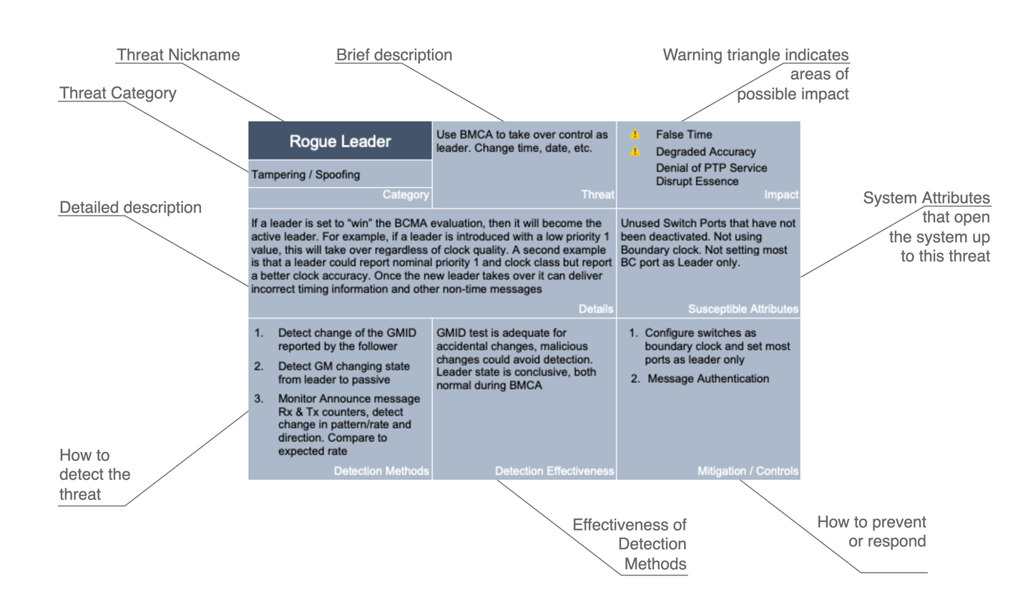
Threat Cards
Notes:
Impact
False Time - Changes to the system time
Degrade Accuracy - Disruptions or Degradations in the time distribution
Denial of PTP Service - Interruptions of the time distribution
… any of which could ultimately cause disruption of the essence.
Detection methods are based on items in YANG Model. Only takes approx. dozen items to cover all the detections. Pretty powerful.

Slide 8
Threat Card Example – Rogue Leader
Notes:
20 Threat Cards in the report

Slide 9
Threat Card Example – Bad Sync Messages

Slide 10
Best Current Practices
Strong password authentication
PTP boundary clock mode
“Leader/Master/TimeTransmitter Only”
Restrict to only the features that are required by your system
Protect GNSS
Protect external interfaces
Monitoring system
SMPTE ST 2059-15
Notes:
- If not set datasets over PTP, disable this

Slide 11
A Peek into the Future of PTP Security
Secure by Design, Secure by Default, IEEE 802.1X (RADIUS) Networking
IEEE 1588:2019 Recommendations
A. Message Authentication TLV and associated Key management system.
B. External Transport Message Security. E.g. MACsec and IPsec.
C. Network enhancements like redundant Leaders and segmented networks
D. Monitoring and Management

Slide 12
Report Status
Final review and publication phase
www.smpte.org/technology-reports-downloads

Slide 13
Summary
SMPTE has 2nd SG report on PTP security coming soon!
Focus is Specific Threats and their Matching Impacts and Controls
Best Current Practices (E.g. Use Boundary clocks)
A Peek into the Future of PTP Security
Can be applied to other industries

Slide 14
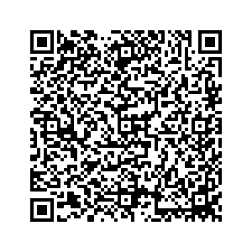
Leigh.Whitcomb.work@gmail.com
www.linkedin.com/in/leigh-whitcomb
Notes:
Leigh.Whitcomb.work@gmail.com
www.linkedin.com/in/leigh-whitcomb

