Slide 2
Impressum
Title: COMPASSO
an in-orbit verification mission testing optical key technologies for future GNSS
Date: 10.11.2022
Autor: Dr. Johann Furthner
Institute: Galileo Competence Center
Figure credits: All Figures „DLR (CC BY-NC-ND 3.0)“

Slide 3
Compasso an in-orbit verification mission testing optical key technologies for future GNSS

Slide 4
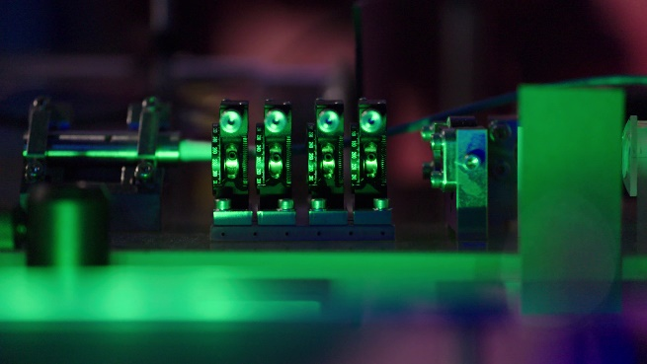
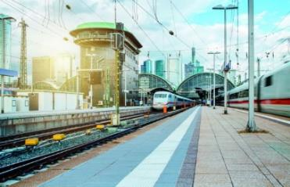


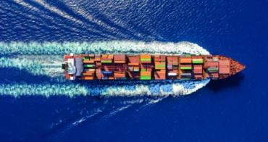
COMPASSO
What does COMPASSO stand for?
Development and validation of a new generation of high-precision optical clocks and laser terminals
What does COMPASSO make possible?
Improvement of the Galileo overall system and the services it provides

Slide 5
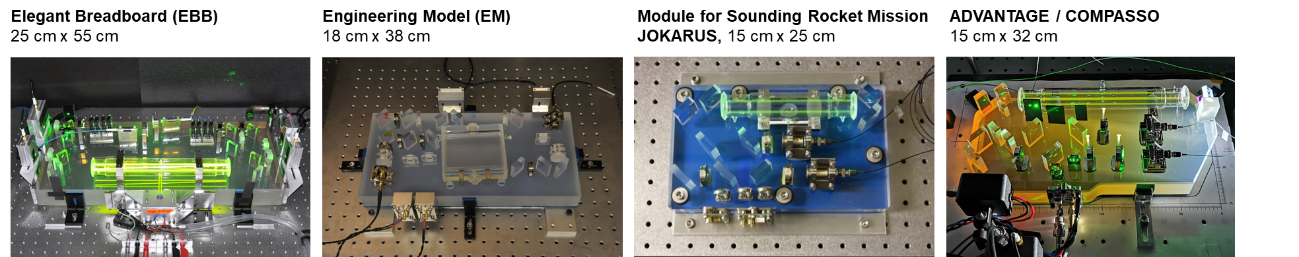
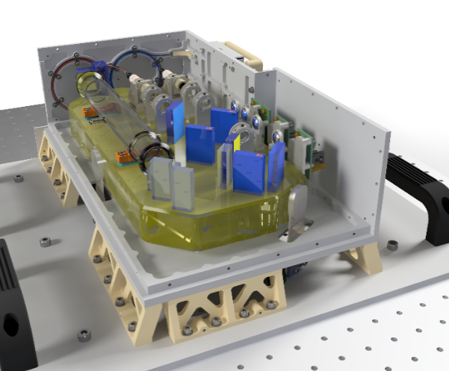
COMPASSO
Benefits of Optical Clocks for GNSS
High short time (1-10 sec) stability comparing to RF clocks (DLR Iodine Clock: Allan Deviation 10⁻¹⁴ and better)
EU sovereign technology IPR and production
Robust in Space Environment
Easy to maintain

Slide 6
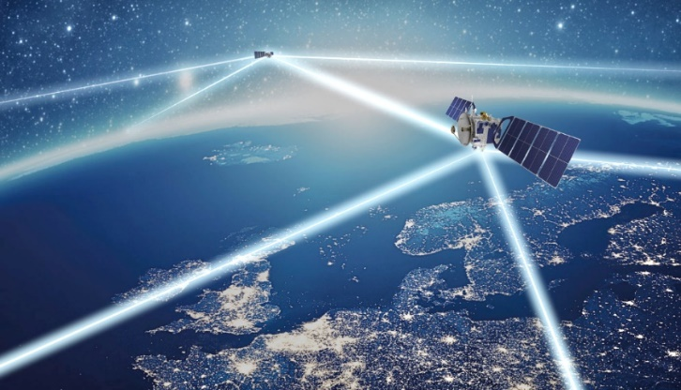
COMPASSO
Benefits of Optical Laser Terminals for GNSS
Greater signal power with lighter and smaller components
Significant higher data rate
Bidirectional communication and ranging
No ITU regulations required
No interference / no jamming
Lower bias error due to in-orbit calibration possibility
Higher chip rate for faster and more precise ranging
Robust against eavesdropping
Optical technology can enable quantum key distribution for improved security

Slide 7
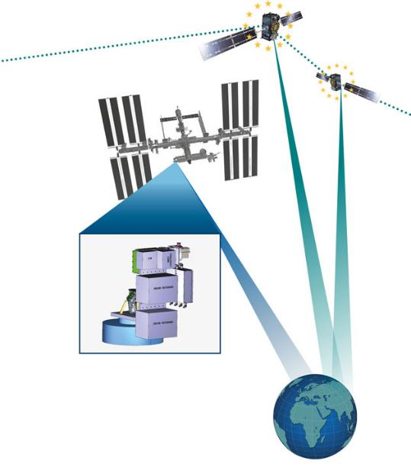

COMPASSO Experiment: Optical Payload
OBJECTIVE:
Partners
Validation of Optical Technologies
Laser terminals for communications and ranging
High-precision optical clocks (iodine clock)
Frequency comb for the optical range
Institute of Communications
and Navigation
Institute for Software Technology
Space Operations
and Astronaut Training
Institute of Quantum Technologies
Institute of Space Systems
---------------------------------------------
Airbus
Tesat
Menlo
SpaceTech Immenstaad
Deployment on the Bartolomeo platform
on the International Space Station (ISS)

Slide 8
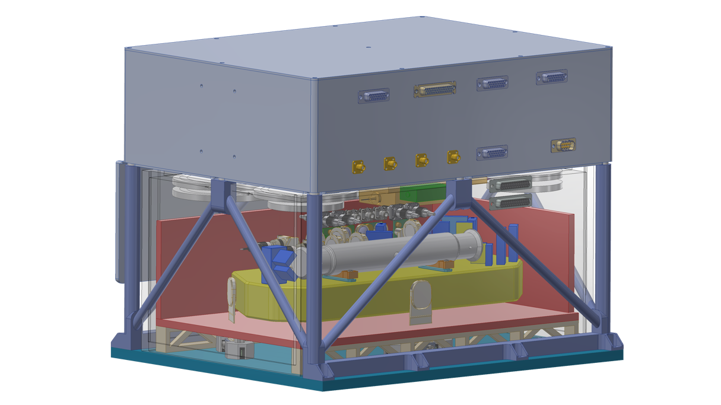
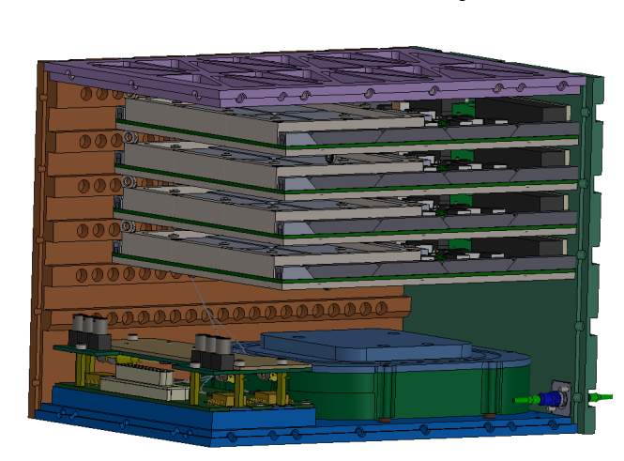
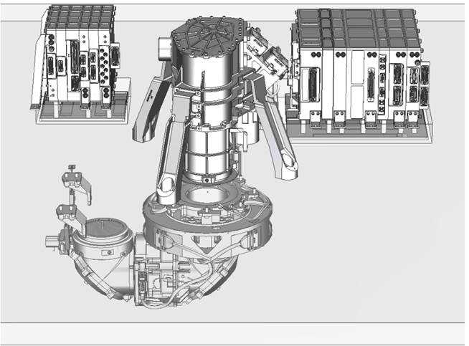
COMPASSO Core Elements
 | COMPASSO Iodine Reference (TRL 4)
mass | ~23 kg (incl. 20% margin)
power | ~57 W (incl. 20% margin)
volume | ~34 l (450 mm x 300 mm x 250 mm)
 | Frequency Comb (TRL 4)
mass | ~6.8 kg
power | ~35 W
Volume | ~7 l
 | LCRT (SmartLCT TRL 9, OSCAR TRL 4)
mass | ~ 47 kg
power | ~ 131 W
volume | ~80 l on platform, ~15 l outside

Slide 9
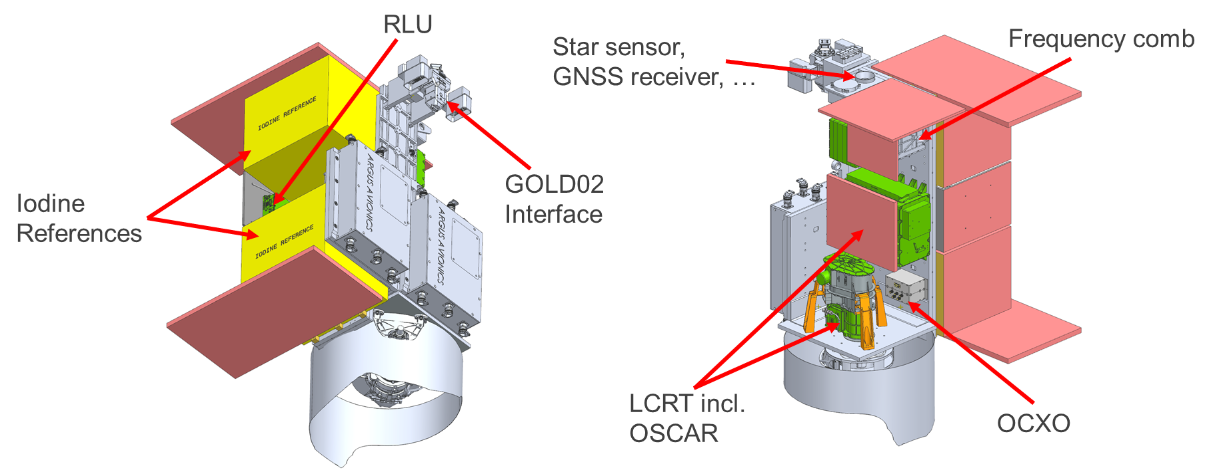
COMPASSO Accomodation

Slide 10
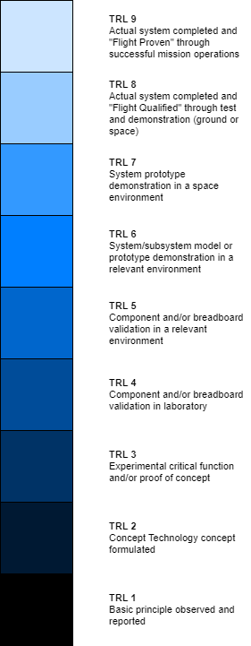
COMPASSO Input TRL
Star Sensor
PVAT
OCXO
GNSS disciplined OCXO
GNSS
Laser Communication Terminal
LCRT
Optical System for Communication and Ranging
COMPASSO
Iodine Frequency Reference
Clock
Frequency Comb

Slide 11
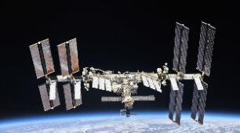
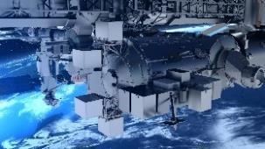



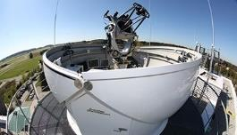
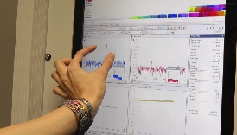



COMPASSO Mission Timeline
~ 400 km
Return of Payload (2026)
ISS
Bidirektional
Optical
Link
Launch
End.2024
Operation
Optical Ground
Station
BBM
(DLR)
DM
(DLR)
FM
(Airbus)
4 Years
1,5 Years
2 Years
Development Models
Mission 2025/26
Test & Analysis
BBM: Breadboard Model; DM: Development Model; FM: Flight Model

Slide 12
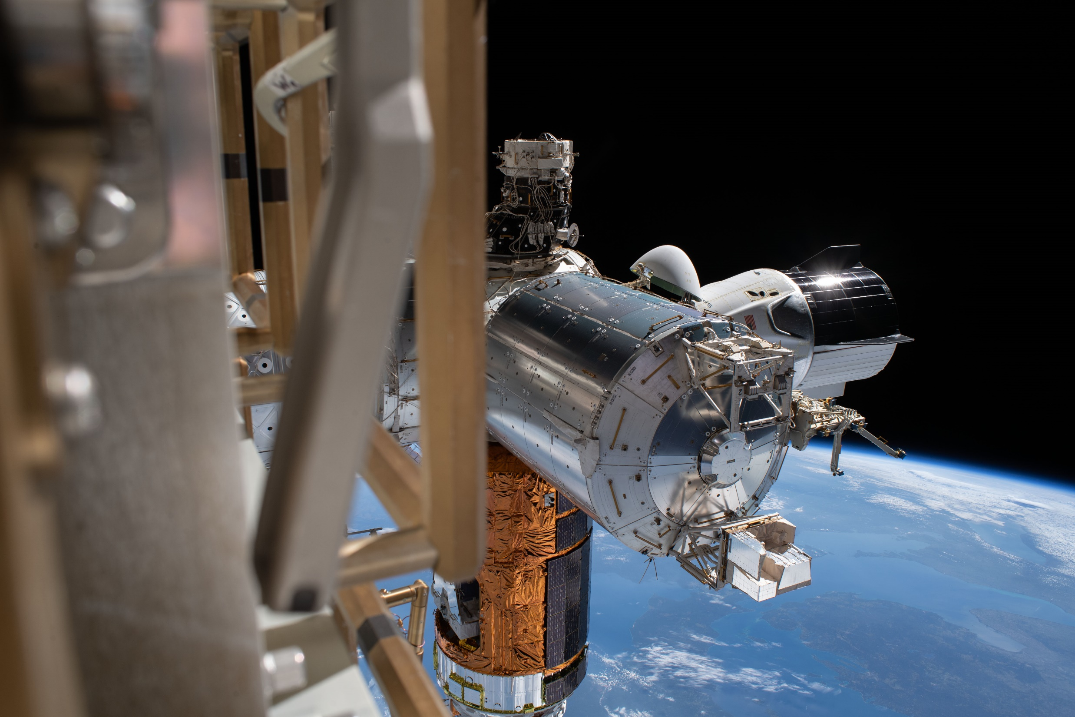
COMPASSO Impressions
Courtesy: NASA

Slide 13
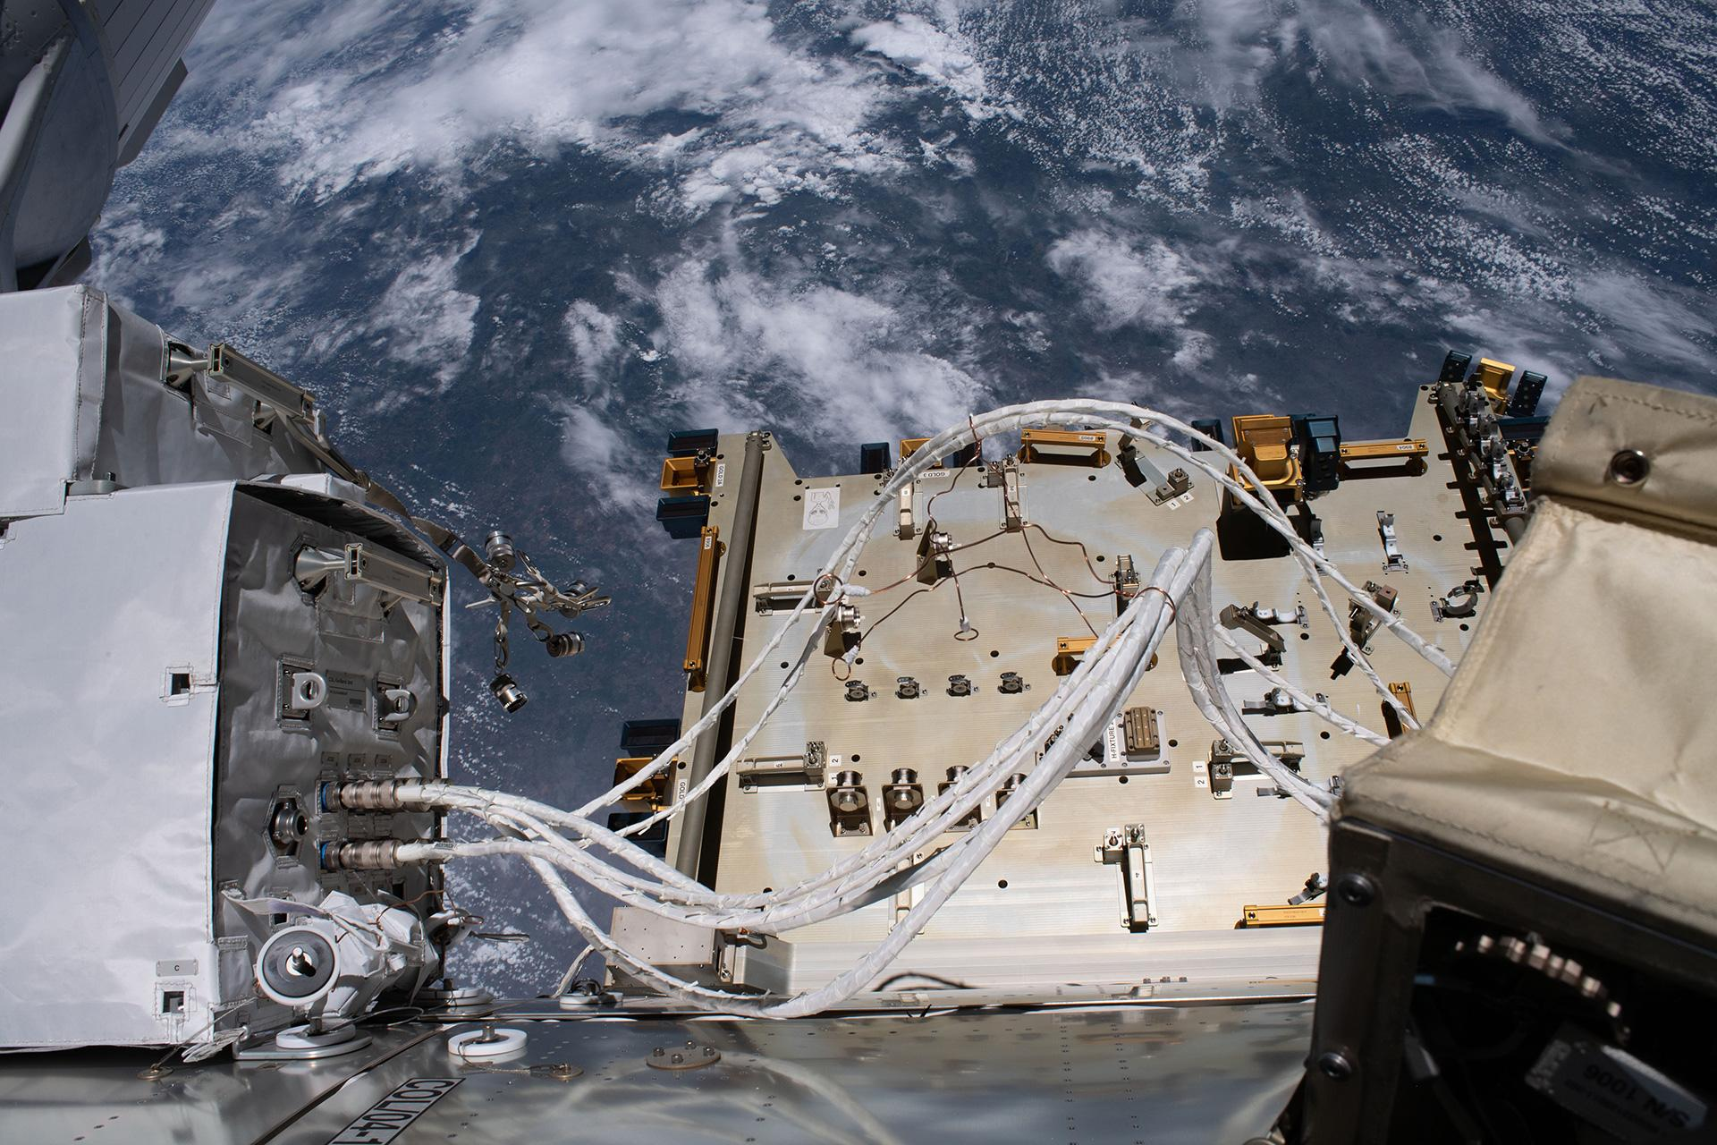
COMPASSO Impressions
Courtesy: NASA

Slide 14
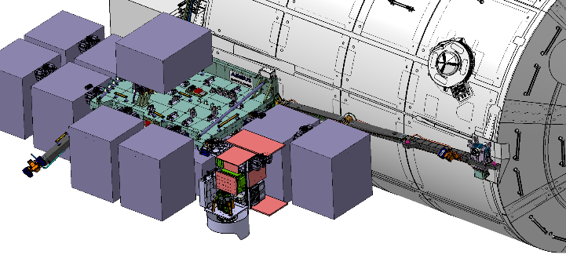
COMPASSO Impressions

Slide 15
Thank you for your attention

