Slide 1

Resilient Primary Clock concepts acc. to ITU-T with
measurement results
Helmut Imlau| ITSF 2022| 10.11.2022

Slide 2
Primary Clock concepts with measurement results Agenda
Motivation
[1] From ITU-T specification … to system under test and the choice of systems for this measurement campaign [2]
[2] Measurement setup [1]
[3] Schwabe/Hale cycle: The solar activity minimum is over [2]
[4] Measurement results *):
PRTC-A [Technology: single-band GNSS receiver] [2]
PRTC-B [Technology: multi-band GNSS receiver] [2]
ePRTC [Technology: clock combiner with multi-band GNSS receiver plus Cesium clocks] [3]
Summary
ITU-T International Tele- communication Union - Tele- communication Sector
GNSS Global Navigation Satellite System
PRTC-A/-B Primary Reference Time Clock Class A/B
ePRTC enhanced PRTC
*) NOTE: All measurement are made with commercial “out-of-the-shelf” systems, not any individual calibration was made. They are sufficiently accurate by design.
Notes:
13.08.2007
2
Autor / Thema der Präsentation

Slide 3
Primary Clock concepts with measurement results Motivation for a new measurement campaign in 2022
What’s new about primary clocks since 2020 ? *)
ITU-T has further specified primary clocks, a new resilient primary clock architecture (cnPRTC) and high-accuracy time transfer as needed for cnPRTC architecture.
Commercially available primary clocks are much more mature now.
The solar cycle minimum is over, testing of GNSS based systems is much more interesting now.
Breakthrough of multi-band GNSS based clocks (PRTC-B) for telecommunication synchronization.
Enhanced PRTC systems are commercially available now.
cnPRTC coherent network Primary Reference Time Clock
*) ITSF2020: ‘PRTC-B Using Multi-Band GNSS in ITU-T Standards with Initial Results’, Helmut Imlau, Deutsche Telekom
Notes:
13.08.2007
3
Autor / Thema der Präsentation

Slide 4
Primary Clock concepts with measurement results [1] From ITU-T specification to System Under Test (1/2)
Deutsche Telekom
view
Systems
at market
ITU-T Specifications & related technology
PRC (10⁻¹¹, G.811 1976-2016)
PRC
Systems in operation Not for new systems
Primary Reference Clocks
Frequency only
ITU-T
specified
Primary
Clocks
•
Enhanced PRC (10⁻¹², G.811.1 2017, 2023 …)
ePRC
For new systems
Typical technology: Cesium clock
PRTC-A
Systems in operation May be modernized as -B
• PRTC (G.8272 2012-2022)
• PRTC Class A (SB GNSS) (as of 2012)
PRTC-B
Preferred for GNSS usage
For
frequency
and time
Primary
Reference Time
Clocks
•
• PRTC Class B (MB GNSS) (as of 2018)
ePRTC (alone)
Currently not considered
Typical technology: GNSS
• Enhanced PRTC (ePRTC, G.8272.1 2016-2022, ….)
ePRTC
+ PRTC-B
ePRTC with PRTC-B as first step for cnPRTC architecture
Technology: Clock combiner for Cesium(s) + GNSS
ePRTC + Cs
+ PRTC-B
Separate Cs are preferred
• coherent network PRTC (cnPRTC, G.8275 as of 2018, G.8272.2 2023 ...)
New High-Accuracy Time Transfer (HA-TT) specification (5ns/1ns maxITEI over 800 km (at G.8271.1) (2022)
Under dev.
Future most resilience sync net architecture
Technology: ePRTC Clock combiner at meshed architecture e. g. at core network
HA TT
Needed & under test
Notes:
13.08.2007
4
Autor / Thema der Präsentation

Slide 5
Primary Clock concepts with measurement results From ITU-T specification to System Under Test
Systems Under Test at DT SyncLab
Systems at market
ITU-T Specification & related technology
different Cesium (ePRC) used for ePRTC clock combiner
Primary Reference Clocks
Frequency only
PRC (10⁻¹¹, G.811)
PRC
Different single-band GNSS systems
ITU-T
Speci-fied
Primary
Clocks
Enhanced PRC (10⁻¹², G.811.1)
ePRC
Typical technology: Cesium clock
Different multi-band GNSS systems
PRTC-A
ePRTC clock combiner with triple Cesium (ePRC) and external GNSS system
PRTC (G.8272)
PRTC Class A (SB GNSS)
PRTC-B
Primary
Refer-ence Time
Clocks
PRTC Class B (MB GNSS)
ePRTC (alone)
ePRTC + PRTC-B systems, combined with single external ePRC cesium
Typical technology: GNSS receiver
Enhanced PRTC (ePRTC, G.8272.1)
ePRTC
+ PRTC-B
ePRTC + PRTC-B systems combined with dual external ePRC cesium
Technology: Clock combiner for Cesium + GNSS
ePRTC + Cs
+ PRTC-B
ePRTC + PRTC-B system combined with UTC(k) frequency (instead of cesium)
coherent network PRTC (cnPRTC, G.8272.2)
Technology: Clock combiner at meshed architecture
Under dev.
For next ITSF ☺
High-Accuracy Time Transfer (G.8271.1)
HA TT
OTT-ELSTAB and WR, results: ITSF 2018
Notes:
13.08.2007
5
Autor / Thema der Präsentation

Slide 6
Primary Clock concepts with measurement results [2] Measurement setup
Deutsche Telekom Test Lab Bremen
PTB Braunschweig
NMI (National Metrology Institute) Germany
1PPS
1PPS
OTT ELSTAB Remote Module
Bi-di amplifier
OTT ELSTAB Local Module
Pico- stepper
HROG
10
UTC(PTB)
▪
▪
▪
▪
▪
▪
Deutsche Telekom UTC(DTAG) lab
Frankfurt
SUT *)
④
①
OTT ELSTAB Remote Module
Bi-di amplifier
OTT ELSTAB Local Module
③
Pico- stepper
HROG
10
UTC(DTAG)
Cascaded 1PPS Lab distribution
⑤
High-accuracy
time-transfer systems
TMM
②
Calibrated UTC Reference Point

UTC Reference supply
Evaluation is based on 1PPS measurements.
① Counter 53230 (Keysight) or GT9000 (GuideTech) ② Time Monitor Measurement / Analyzer (Microchip) ③ 1PPS Distributor (TimeTech/Spectradynamics)
④ Picostepper HROG-10 (Spectradynamics) ⑤ OTT ELSTAB (PikTime / AGH University Krakow)
*) NOTE: All SUT are commercial “out-of-the-shelf” systems, not any individual calibration was made.
Notes:
13.08.2007
6
Autor / Thema der Präsentation

Slide 7
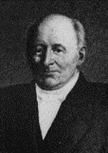
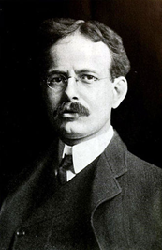
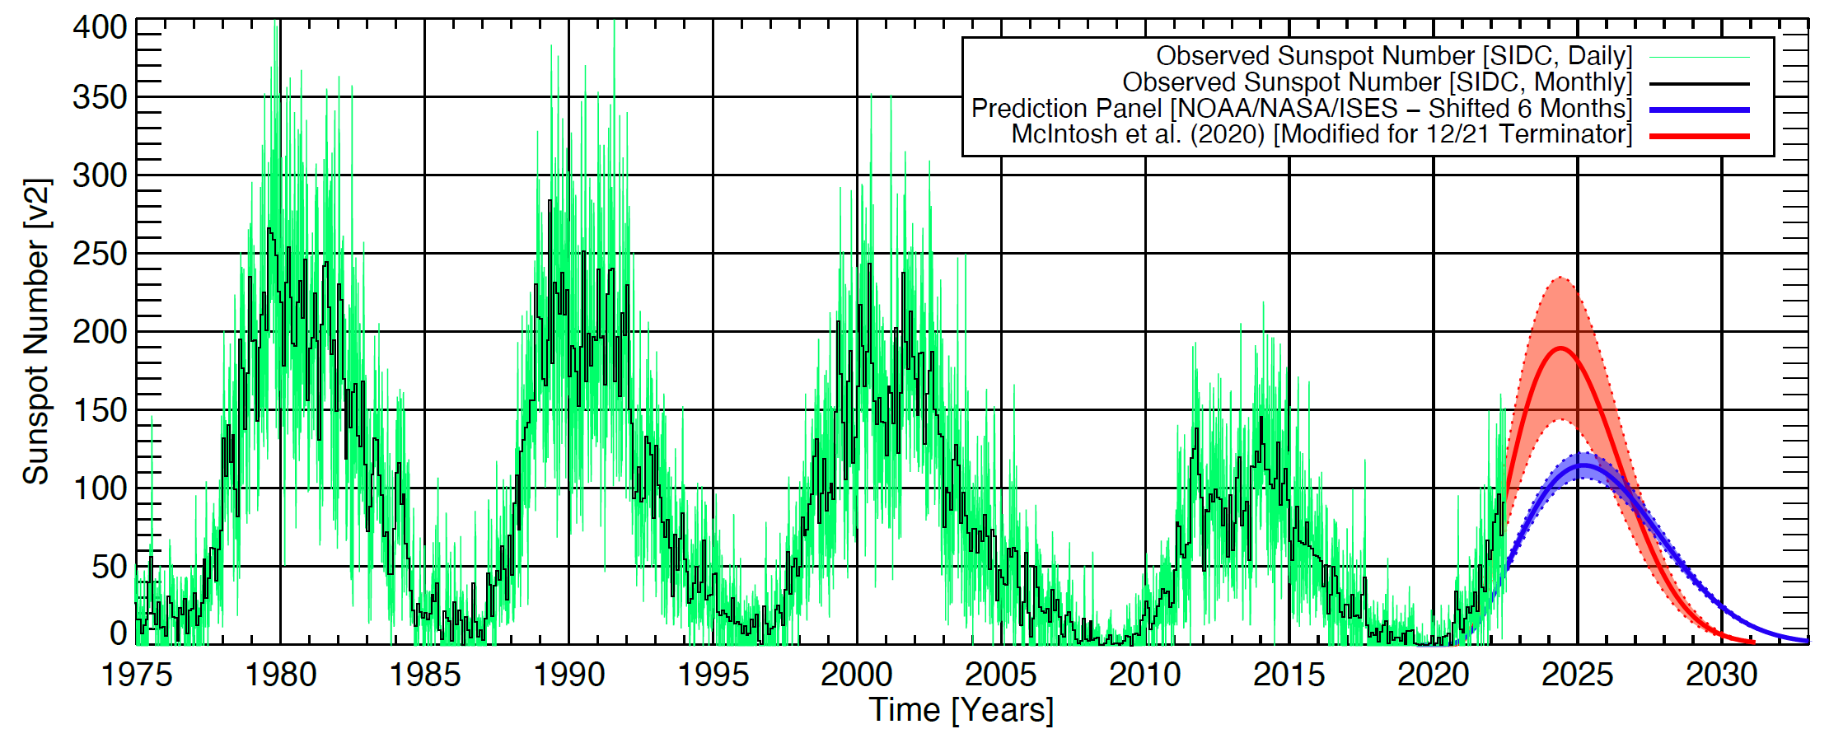
Primary Clock concepts with measurement results [3] Schwabe/Hale cycle: The solar activity minimum is over: 2020 vs. 2022
Basics:
Higher sun activity variation leads to
higher ionosphere ionization variation and
related delay variation for GNSS signals,
leads at time error for single-band GNSS systems, e. g. visible as diurnal wander
Multi-band GNSS receiver can compensate for in general.
1843: Schwabe cycles (11 years sun activity cycle) Samuel Heinrich Schwabe (*1789, †1875, Dessau, Germany) Discovery by sunspot observation (as 10 years first)
1908: Hale cycles (22 years magnetic sun cycle) George Ellery Hale (*1868, †1938, Chicago/Illinois, USA) Discovery of magnetic fields at sunspots and 22 years magnetic cycle
ITSF 2022
The solar minimum is over, compared to 2020
measurement results are looking differently now
it is not anymore so easy to reach a good performance .…
Source: NCAR S. McIntosh https://www.linkedin.com/posts/scott-mcintosh-14724561_
terminator-sunspotcycle25-sun-activity-6955036559523930112- a2fl?utm_source=linkedin_share&utm_medium= member_desktop_web
ITSF 2020 talk “PRTC-B Using Multi-Band GNSS in ITU-T Standards with Initial Results”
Notes:
13.08.2007
7
Autor / Thema der Präsentation

Slide 8
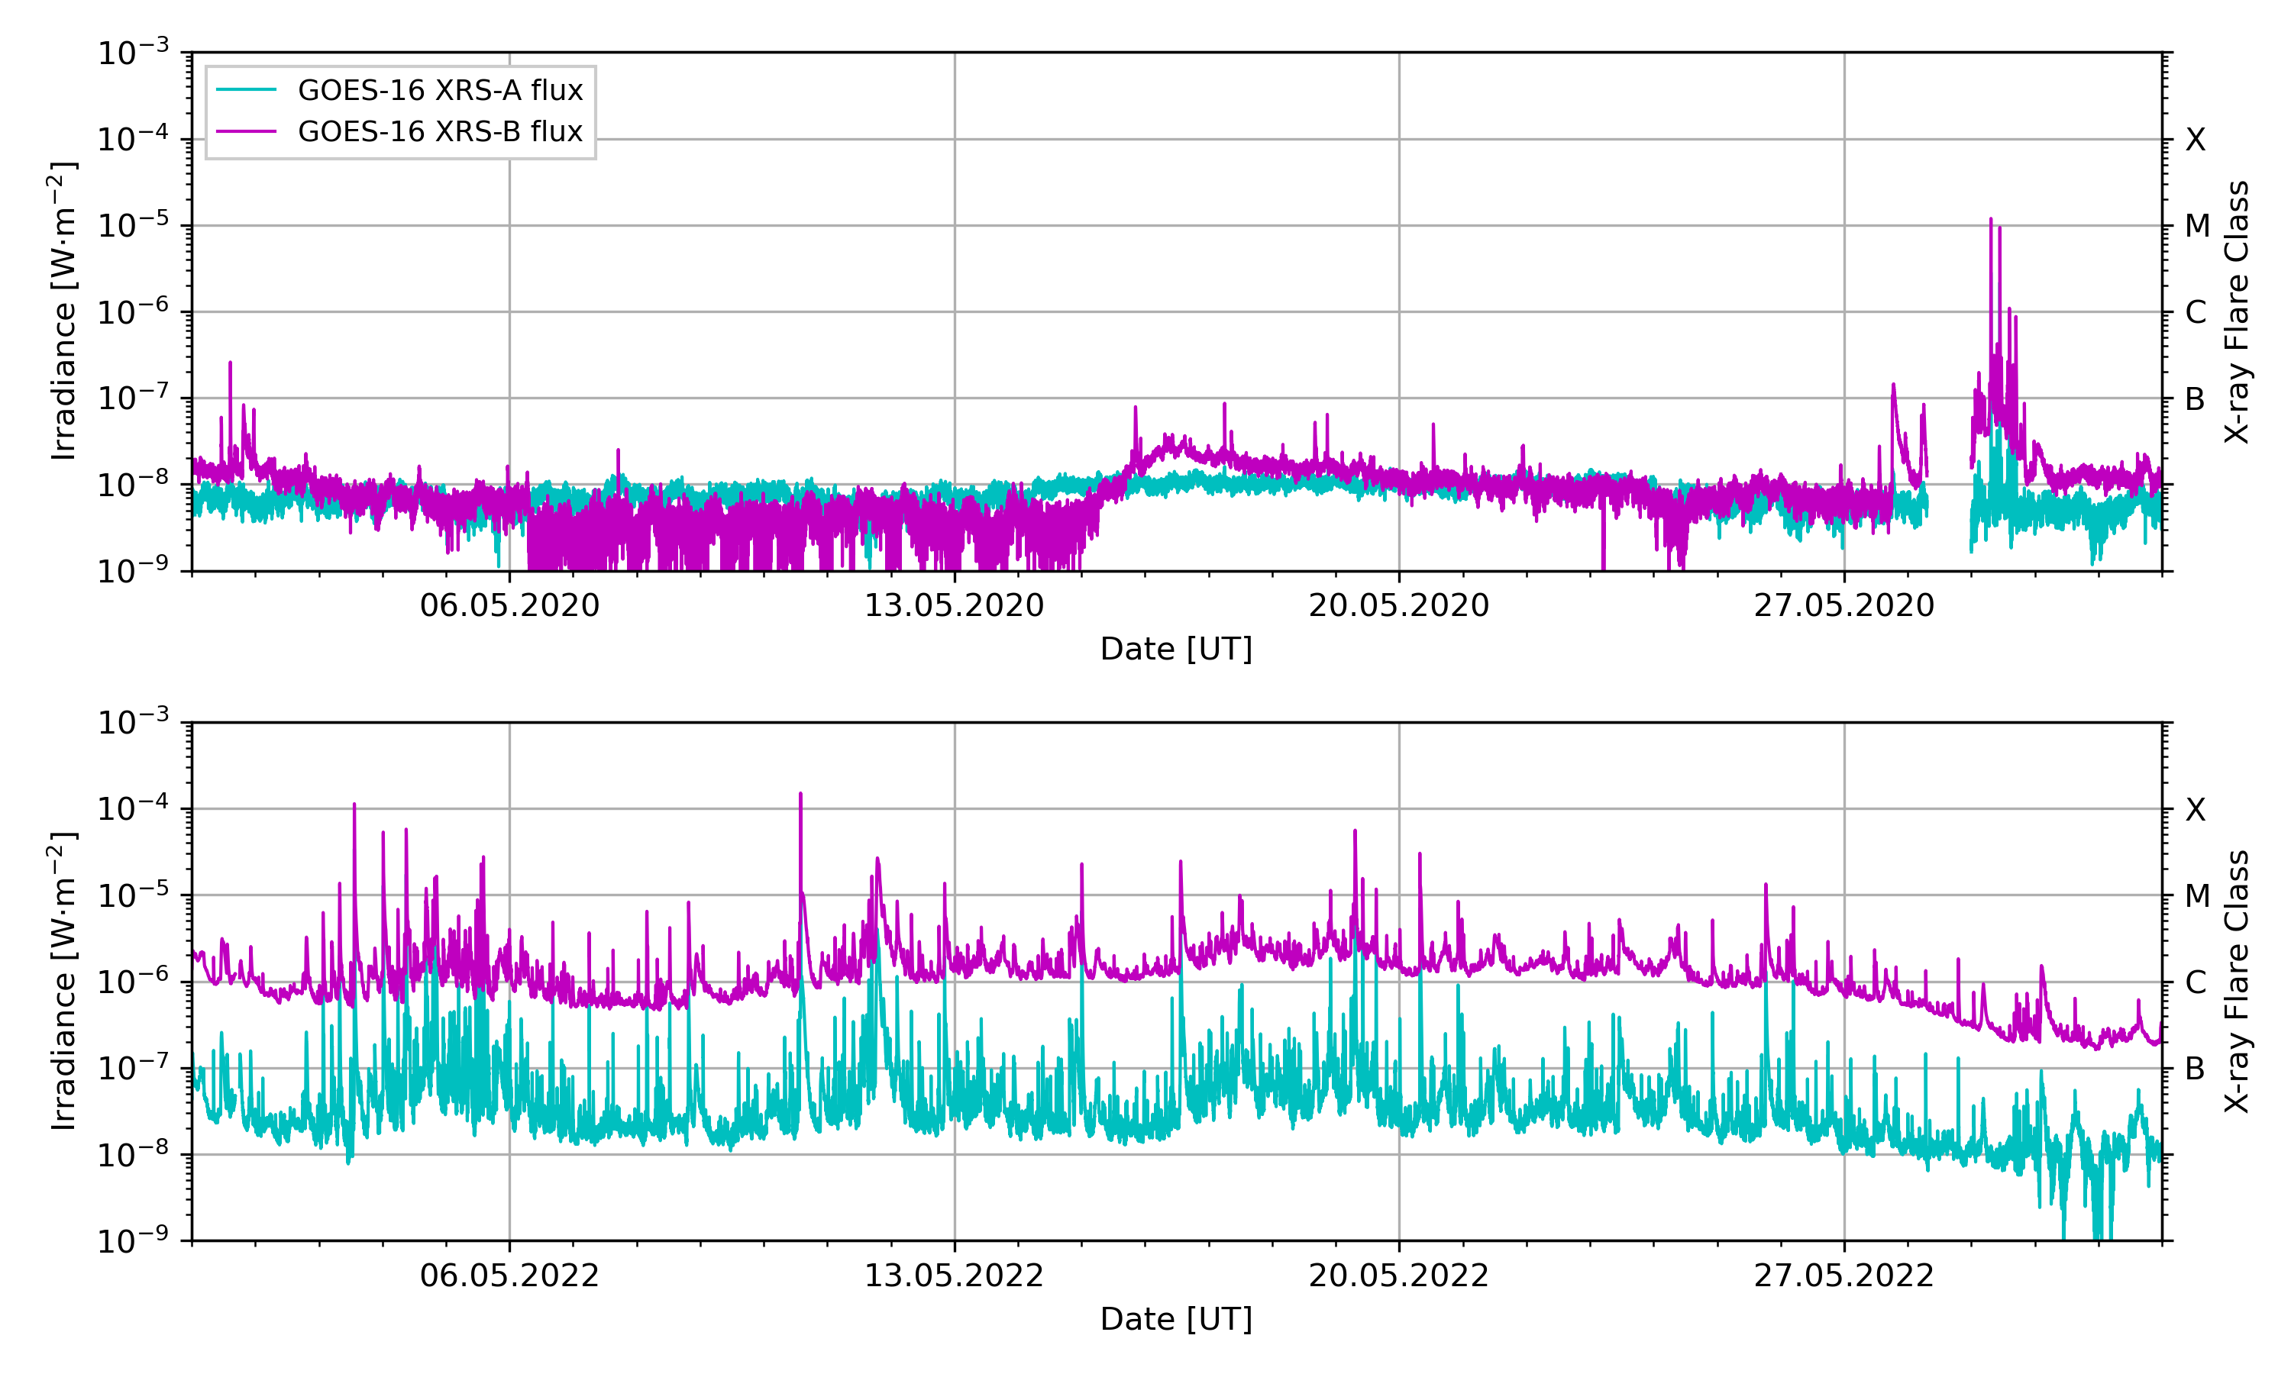
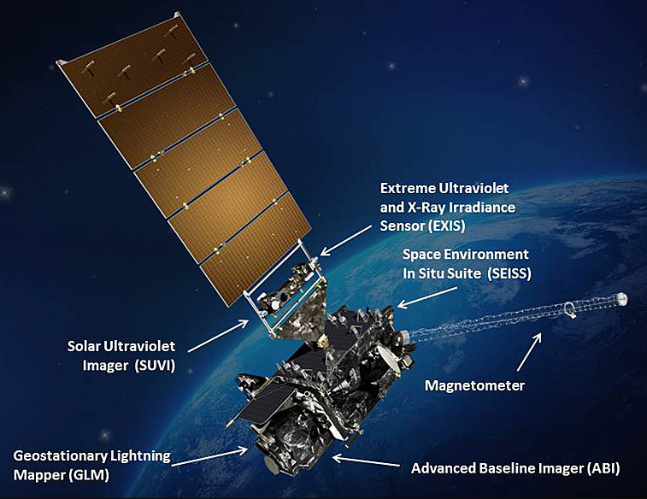
Primary Clock concepts with measurement results [3] The solar activity minimum is over: 2020 vs. 2022
Another parameter for sun acticity: Evaluation based on X-ray radiation, detected by satellite
Measured X-Ray irradiance: May 2020
GOES-R Space Weather observation satellites
Measured X-Ray irradiance: May 2022
GEOSTATIONARY OPERATIONAL ENVIRONMENTAL SATELLITES—R SERIES
A collaborative NOAA & NASA program
https://www.ngdc.noaa.gov/stp/satellite/goes-r.html
Figure based on GOES-16 satellite data, courtesy of Dr. Erik Schmölter, DLR Institute for Solar-Terrestrial Physics Neustrelitz, Germany
Notes:
13.08.2007
8
Autor / Thema der Präsentation

Slide 9
Resilient Primary Clock concepts acc. to ITU-T with measurement results
PRTC-A
[Technology: single-band GNSS based systems] ➔ the ionosphere delay variation is fully visible, no compensation

Slide 10
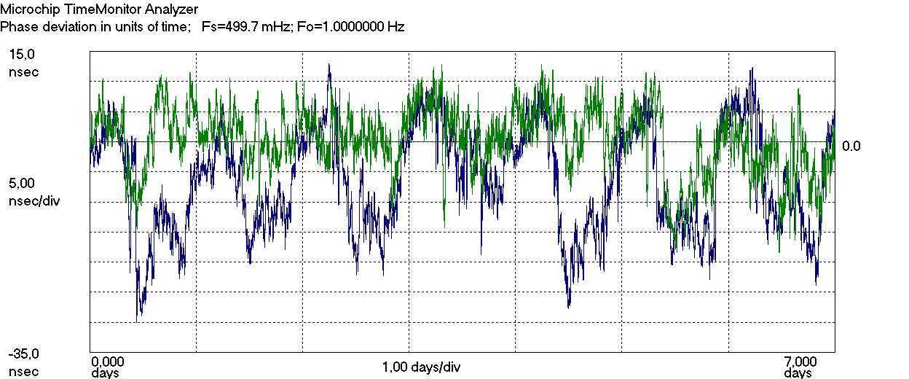
Primary Clock concepts with measurement results [4] The solar activity minimum is over: PRTC-A results 2020 vs. 2022
Dynamic Time Error 2020 vs. 2022, same system type from same vendor – one week
Blue – start: 2022.04.05 00:00:00 Green – start: 2020.04.30 00:00:00
PRTC-A is related to single-band GNSS technology
Notes:
13.08.2007
10
Autor / Thema der Präsentation

Slide 11
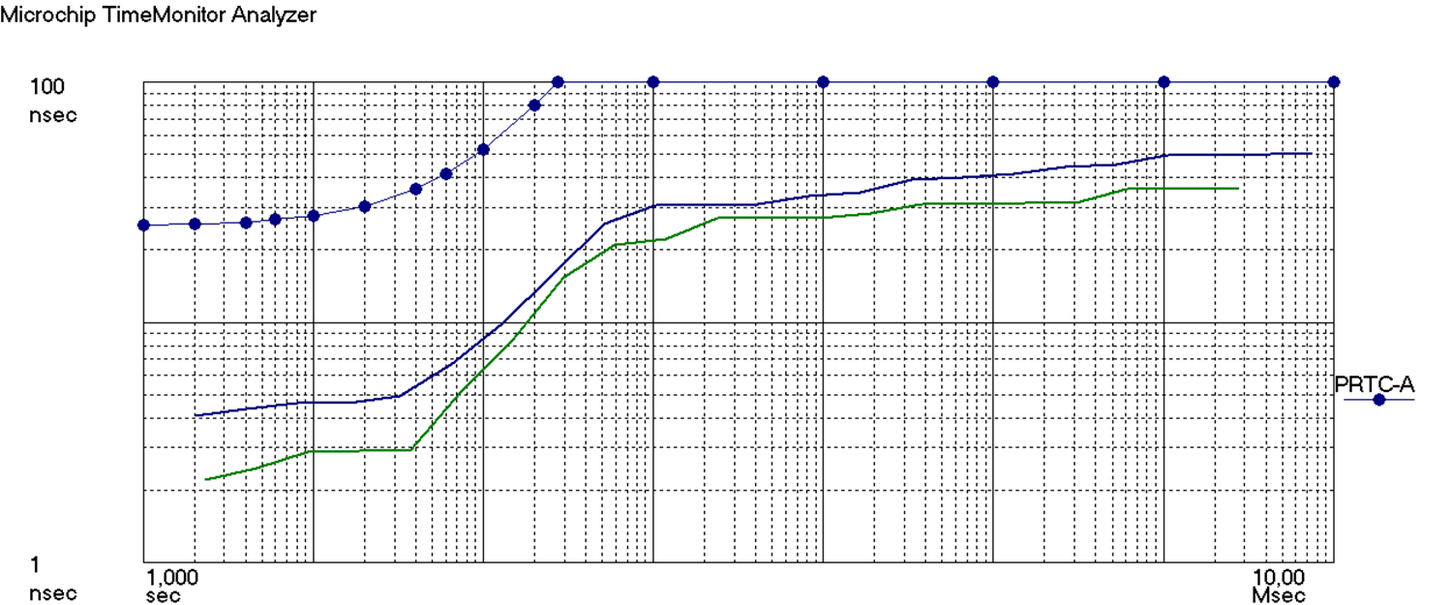

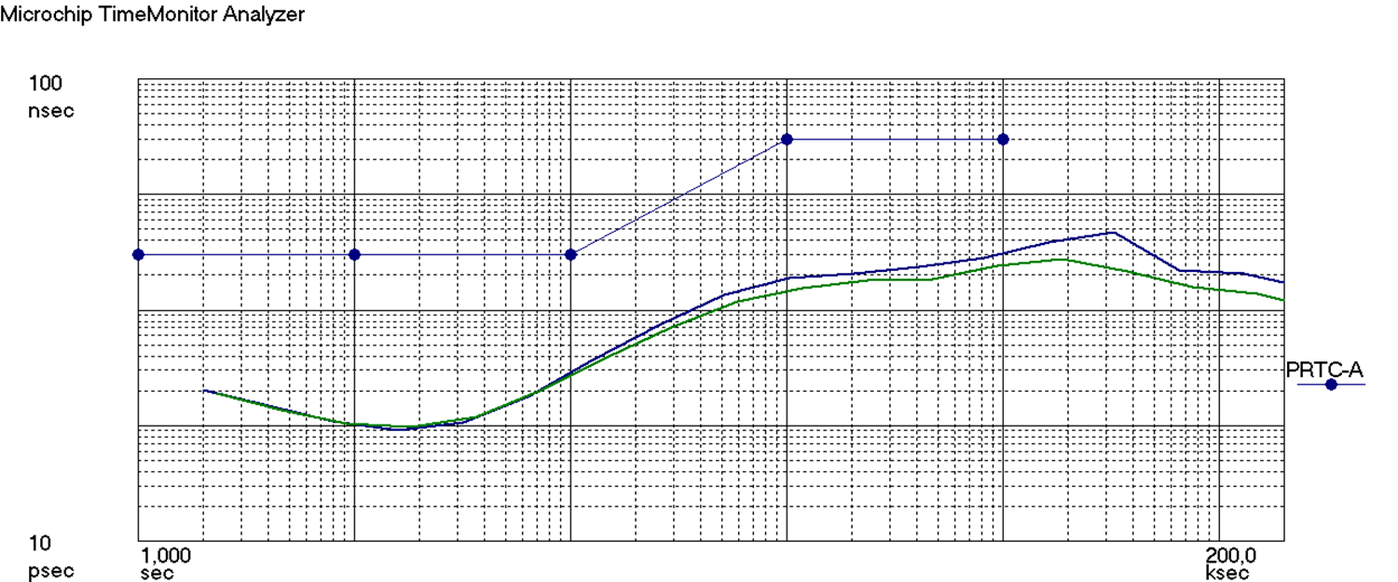
Primary Clock concepts with measurement results [4] The solar activity minimum is over: PRTC-A results 2020 vs. 2022
blue: 2022
Green: 2020
MTIE: Maximum Time Interval Error
TDEV: Time Deviation
acc. to ITU-T G.810 PRTC-A masks for MTIE and TDEV acc. to ITU-T G.8272
G.8272 PRTC-A MTIE mask is fulfilled
blue: 2022
Green: 2020
G.8272 PRTC-A TDEV mask is fulfilled
Notes:
13.08.2007
11
Autor / Thema der Präsentation

Slide 12
Resilient Primary Clock concepts acc. to ITU-T with measurement results
PRTC-B
[Technology: multi-band GNSS based systems] ➔ can compensate *) for the ionosphere delay variation
*) not by 100%

Slide 13
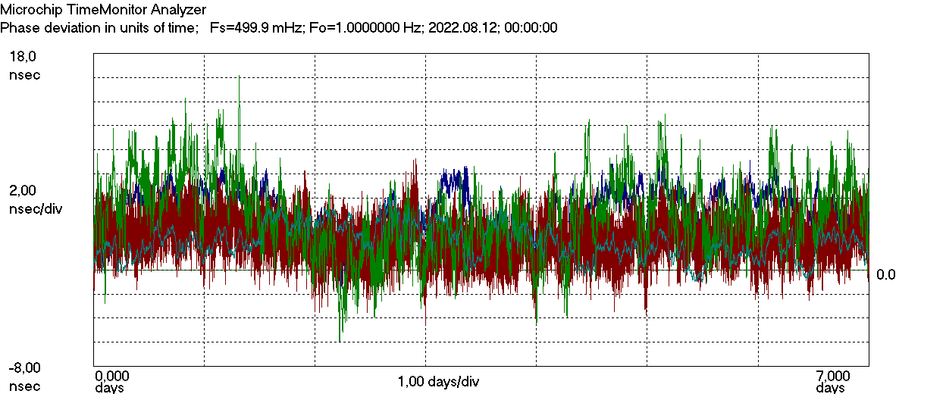
Primary Clock concepts with measurement results [4] The solar activity minimum is over: PRTC-B results
4 GNSS Multi-band Systems: Dynamic Time Error
PRTC-B is related to multi-band GNSS technology
Notes:
13.08.2007
13
Autor / Thema der Präsentation

Slide 14
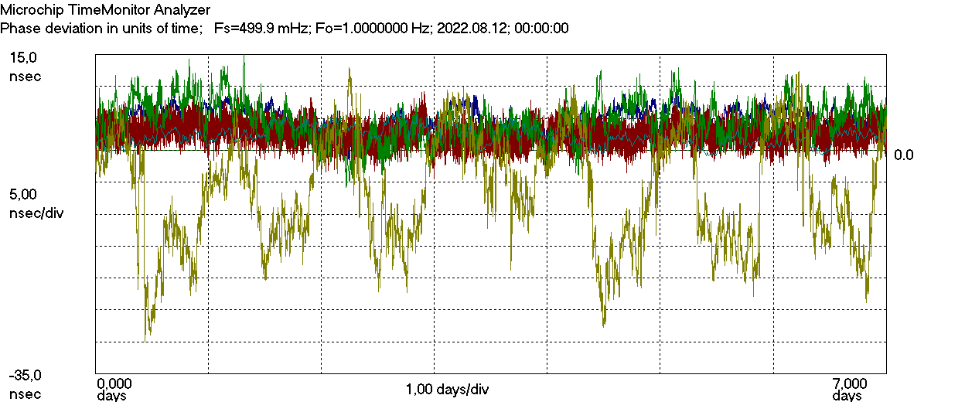
Primary Clock concepts with measurement results [4] The solar activity minimum is over: PRTC-B results
4 GNSS Multi-band Systems + (1 Single-band): Dynamic Time Error
Single-band for comparison only
PRTC-B is related to multi-band GNSS technology
Notes:
13.08.2007
14
Autor / Thema der Präsentation

Slide 15
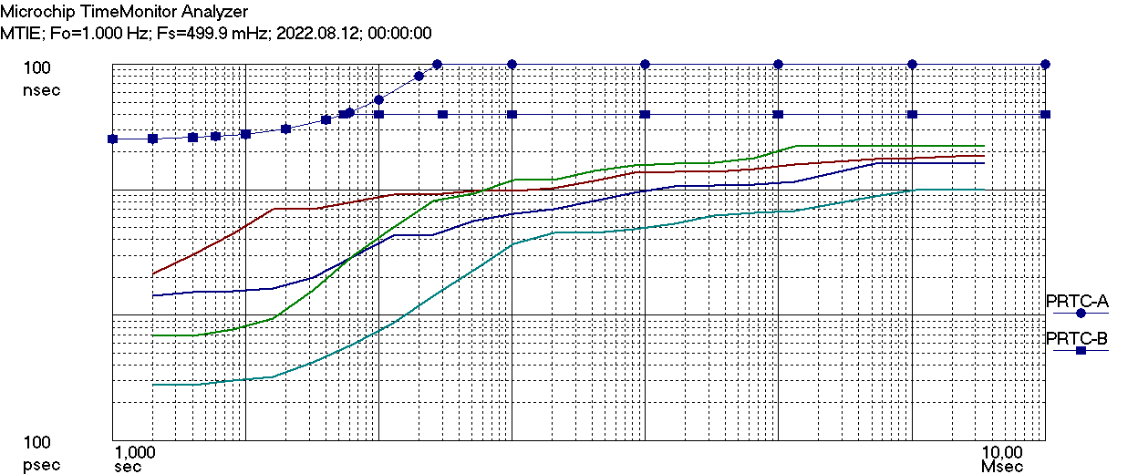
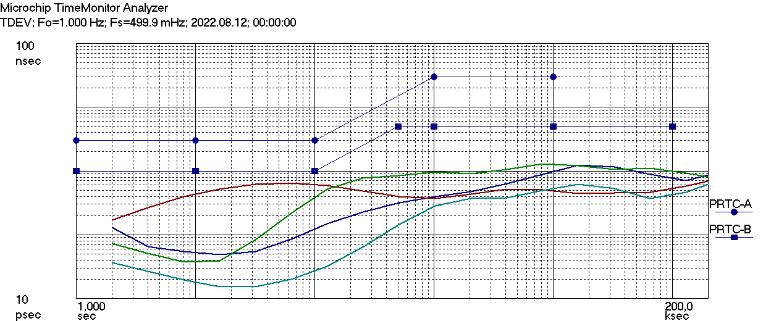
Primary Clock concepts with measurement results [4] The solar activity minimum is over: PRTC-B results
MTIE: Maximum Time Interval Error
TDEV: Time Deviation
acc. to ITU-TG.810 PRTC-B masks for MTIE and TDEV acc. to ITU-T G.8272
G.8272 PRTC-B MTIE mask is fulfilled
G.8272 PRTC-B TDEV mask is fulfilled
Notes:
13.08.2007
15
Autor / Thema der Präsentation

Slide 16
Resilient Primary Clock concepts acc. to ITU-T with measurement results
ePRTC [Technology: clock combiner multi-band GNSS receiver together with Cesium clocks or UTC(k)]
Evaluation as maxITEI evaluation (includes cTE)

Slide 17
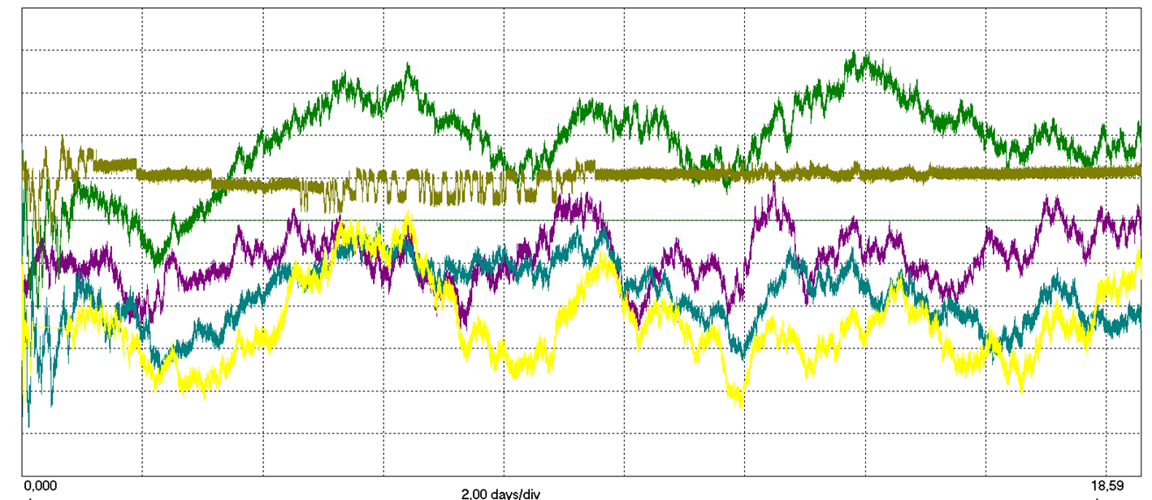
Primary Clock concepts with measurement results [4] ePRTC results: Time Error during startup phase and locked mode
20 ns
2 Cs system 1
UTC system
4 ns/div
1 Cs system 1
1 Cs system 2
2 Cs system 2
-24 ns
0 days 2 days/div 18 days
G.8272.1 ePRTC: maxITEI<30ns is fulfilled [w/o individual calibration]
Notes:
13.08.2007
17
Autor / Thema der Präsentation

Slide 18
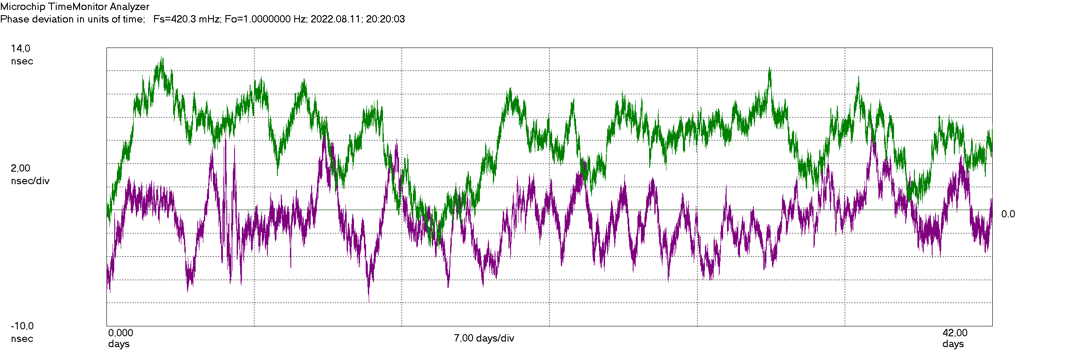
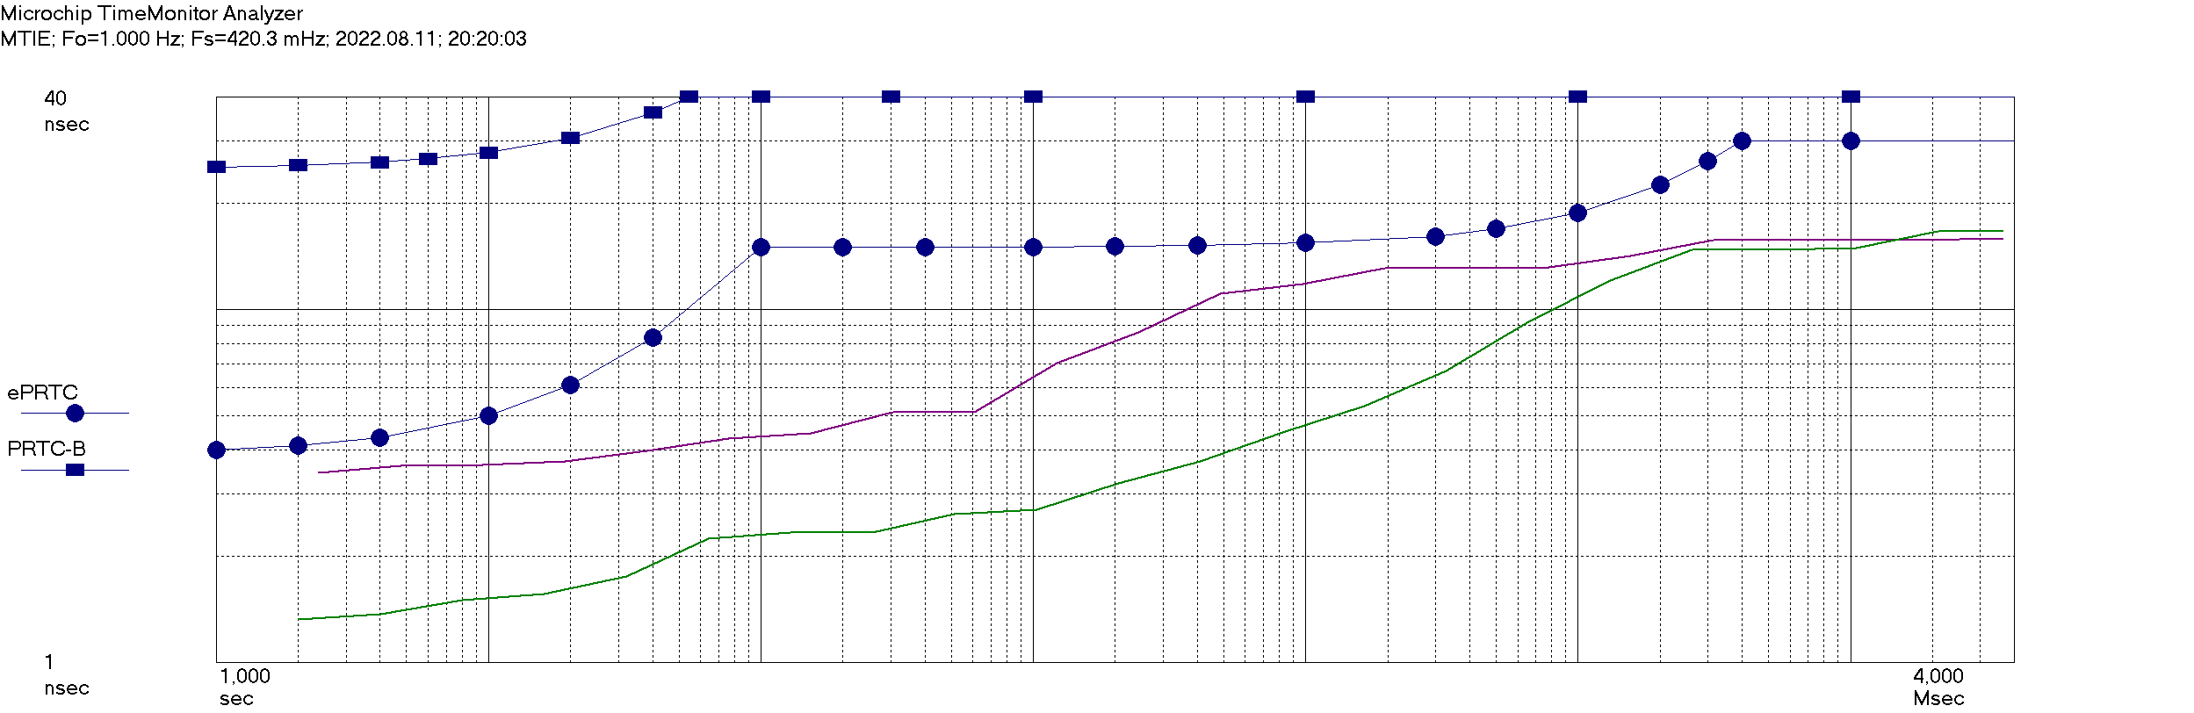
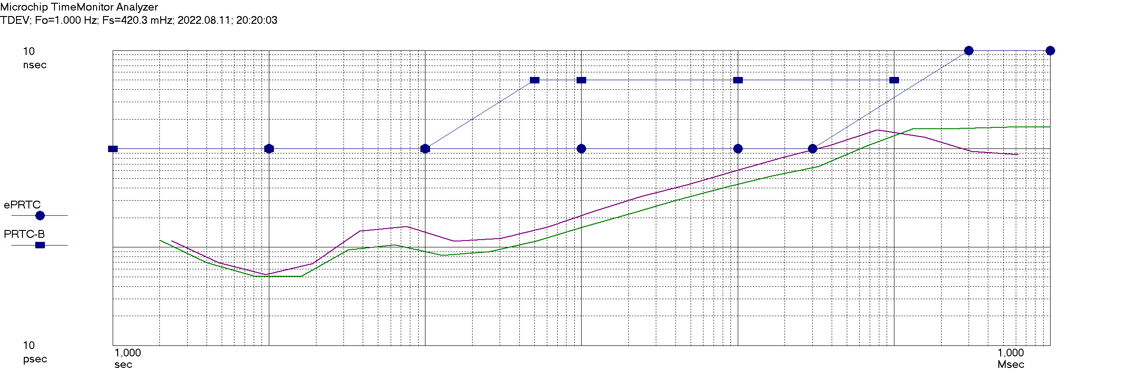
Primary Clock concepts with measurement results [4] ePRTC results in locked mode phase with MTIE and TDEV masks
2 Cs system
1 Cs system
TDEV
MTIE
G.8272.1 ePRTC MTIE mask is fulfilled
G.8272.1 ePRTC TDEV mask is fulfilled
30ksec
Notes:
13.08.2007
18
Autor / Thema der Präsentation

Slide 19
Primary Clock concepts with measurement results [4] ePRTC results in locked mode phase with MTIE and TDEV masks
2 Cs system
1 Cs system
TDEV
MTIE
G.8272.1 ePRTC MTIE mask is fulfilled
G.8272.1 ePRTC TDEV mask is fulfilled
30ksec
Notes:
13.08.2007
19
Autor / Thema der Präsentation

Slide 20
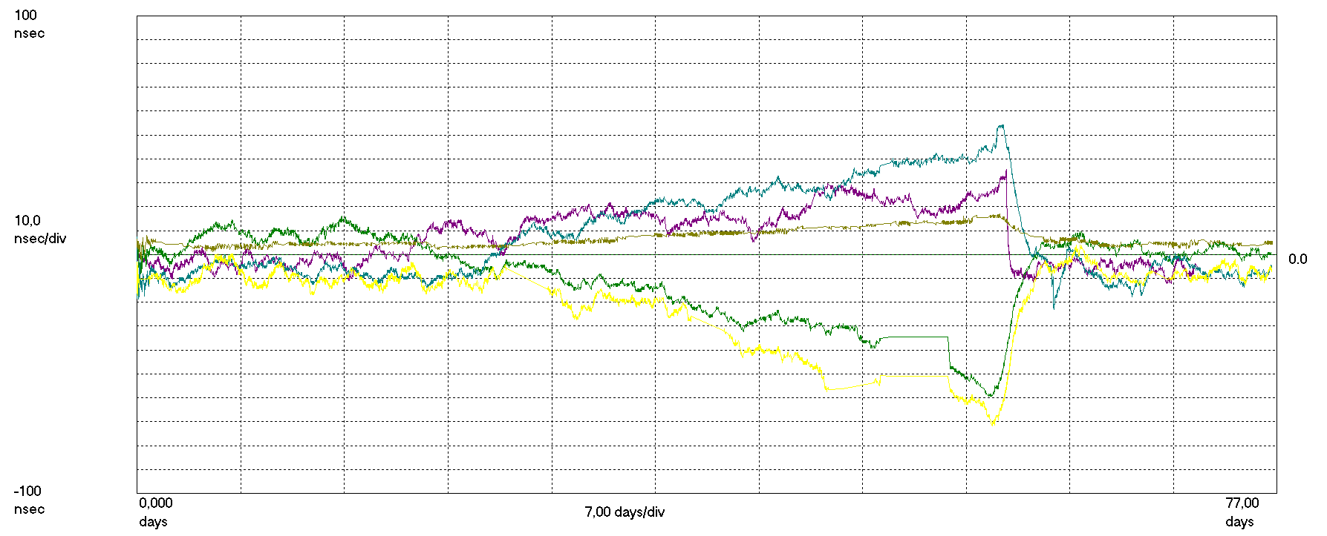
Primary Clock concepts with measurement results [4] ePRTC results: locked - holdover – locked mode
2 Cs system 1
UTC system
1 Cs system 1
1 Cs system 2
2 Cs system 2
Initial sync
GNSS loss
Re-sync
ePRTC in locked mode
5,5 holdover weeks
ePRTC in locked mode
Notes:
13.08.2007
20
Autor / Thema der Präsentation

Slide 21
Primary Clock concepts with measurement results [4] ePRTC results: locked - holdover – locked mode
2 Cs system 1
UTC system
1 Cs system 1
1 Cs system 2
2 Cs system 2
GNSS loss
Re-sync
Startup with
ITU-T PRTC-B limit
ITU-T limit for ePRTC
in locked mode
ITU-T limit 14 days
of holdover
+40 ns
+30 ns
-30 ns
-40 ns
ePRTC in locked mode
G.8272.1 ePRTC Holdover mode fulfilled
G.8272.1 ePRTC Locked mode maxITEI fulfilled
G.8272.1 ePRTC Locked mode maxITEI fulfilled
First 2 holdover weeks
3,5 additional holdover weeks
ePRTC in locked mode
Performance back to locked mode specification is open
Holdover > 14 days specification is open
Notes:
13.08.2007
21
Autor / Thema der Präsentation

Slide 22
Primary Clock concepts with measurement results Outcome / summary
ITU-T: Latest clock and clock architectural specifications are aiming at high resilience and high performance.
Commercial systems acc. to ITU-T specification: Specified performance can be reached w/o any system individual calibration. Predefined planning units with specific antenna cable length (all components from same system vendor) are the key.
PRTC-A: For simple single-band GNSS based systems, growing dynamic time error due to Schwabe/Hale cycle is visible.
PRTC-B: Multi-band systems are commercially available now, based on new GNSS chipsets. They work well. Multi-band may replace single-band for telecommunication synchronization in future.
ePRTC: Commercial ePRTC systems can limit the dynamic time error enormously, provide a very long holdover and do fulfill latest ITU-T specifications with margin.
cnPRTC: Future cnPRTC architecture is foreseen overcome any GNSS related risk. Need high-accuracy time transfer systems are available. CnPRTC measurement results as of ITSF next year?
Notes:
13.08.2007
22
Autor / Thema der Präsentation

Slide 23
Primary Clock concepts with measurement results
Thank you very much. Questions?
References:
ITSF 2018: High Accurate Time Dissemination in Telecommunication Networks, Helmut Imlau, Deutsche Telekom
ITSF 2020: PRTC-B Using Multi-Band GNSS in ITU-T Standards with Initial Results, Helmut Imlau, Deutsche Telekom
ITU-T G.811.1: Timing characteristics of enhanced primary reference clocks https://www.itu.int/rec/T-REC-G.811.1-201708-I
ITU-T G.8271.1/Y.1366.1: Network limits for time synchronization in packet networks with full timing support from the network https://www.itu.int/itu-t/recommendations/rec.aspx?rec=14210
ITU-T G.8272/Y.1367: Timing characteristics of primary reference time clocks https://www.itu.int/itu-t/recommendations/rec.aspx?rec=13769
ITU-T G.8272.1: Timing characteristics of enhanced primary reference time clocks https://www.itu.int/itu-t/recommendations/rec.aspx?rec=13162
ITU-T G.8272.2: Timing characteristics of a coherent network Primary Reference Time Clock (Under study, latest draft for ITU-T members only (via TIES account))
ITU-T G.8275/Y.1369: Architecture and requirements for packet-based time and phase distribution (Includes cnPRTC) https://www.itu.int/itu-t/recommendations/rec.aspx?rec=14509
Notes:
13.08.2007
23
Autor / Thema der Präsentation

Slide 24
Resilient Primary Clock concepts acc. to ITU-T with measurement results
Backup

Slide 25
Primary Clock concepts with measurement results Backup: Systems are accurate by design
System performance specification by ITU-T:
is for the entire system at output interface, e. g. including antenna delay and antenna cable length compensation error, and including time error of GNSS system under normal operation conditions
Typical systems for network operators:
PRTC-B or ePRTC systems with in-build GNSS receiver including antenna and antenna cable from system vendor
Vendor has overall performance responsibility e. g. to reach ±40ns for PRTC-B and ±30ns for ePRTC
Antenna cable with known length: To simplify operation: A few planning units only, with specific cable length and specific known cable delay compensation values, not shortened.
Supplier can reproduce performance from (a few) calibrated system at all serial produced systems ➔ No need for individually performed calibration of deployed system at telecommunication office ➔ Based on: Using pre-defined planning units with 5-6 antenna cable length ➔ Cesium atomic clocks: no need to be steered individually
Notes:
13.08.2007
25
Autor / Thema der Präsentation

Slide 26
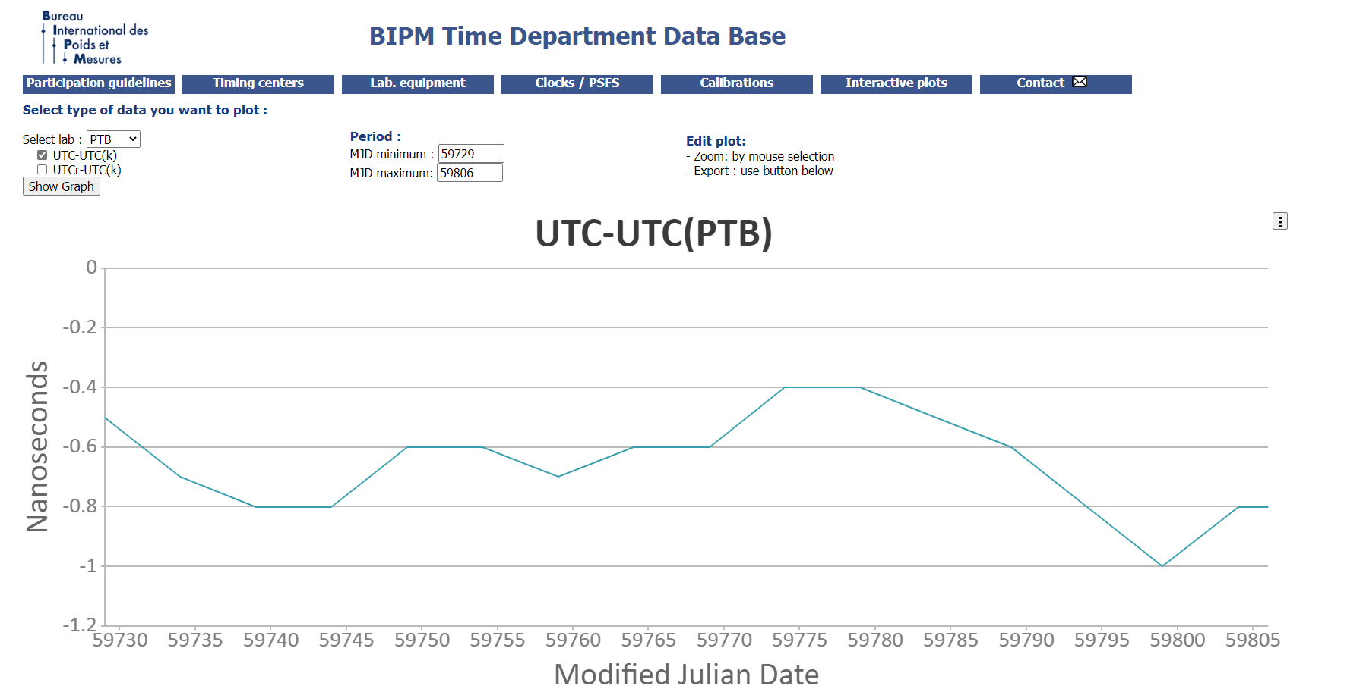
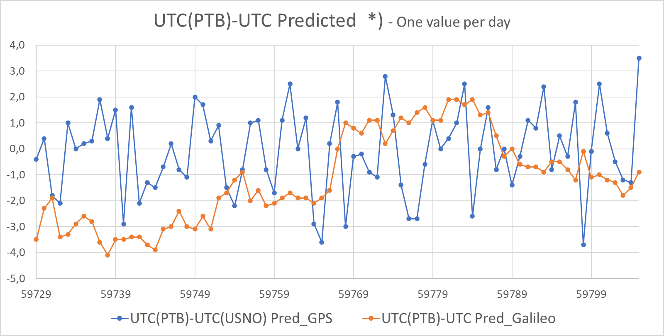
Primary Clock concepts with measurement results Backup: contributions to uncertainty of measurement results
Fig. 1 UTC(PTB) is measurement reference and has its own deviation: see official PTB contribution for BIPM at Circular-T (±1,5ns)
Fig. 2 GNSS systems have their own deviation: Measured by PTB at Braunschweig (includes time error from fig. 1)
*) Measured with BIPM registered and calibrated GNSS receiver, evaluation based on RINEX data
Data from PTB “Time Service Bulletin”
https://www.ptb.de/cms/fileadmin/internet/fachabteilungen/abteilung_4/4.4_zeit_und_frequenz/4.42/time_bulletins/tsb.html
Contributions to measurement uncertainty
±1ns for UTC-UTC(PTB) during measurement campaign
±40 ps for UTC(PTB) over OTT-ELSTAB
±1ns for DT lab in-house 1PPS reference distribution
±20 ps Counter accuracy
Contributions to SUT time error budget
±5ns for UTC(PTB)-UTC Predicted (GNSS) (from figure 2, includes UTC-UTC(PTB) from fig. 1)
Notes:
13.08.2007
26
Autor / Thema der Präsentation

