Slide 1
Galileo as a Time Source - a Look at First Generation and Beyond
David Ibáñez – Head Galileo G1 System Engineering Unit
ITSF 2022

Slide 2
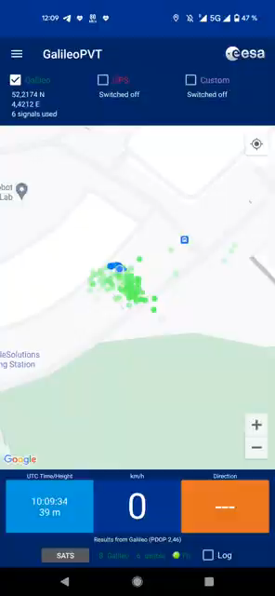
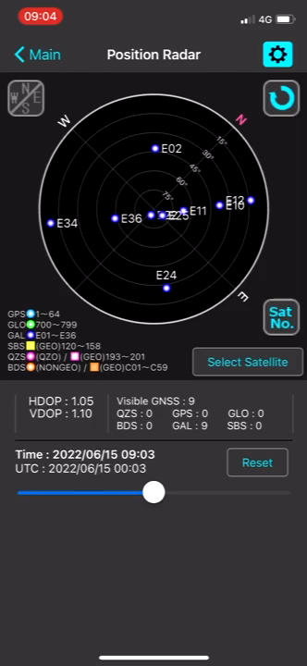
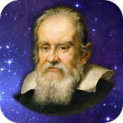


But… does Galileo work?
GalileoPVT
GNSS View

Slide 3

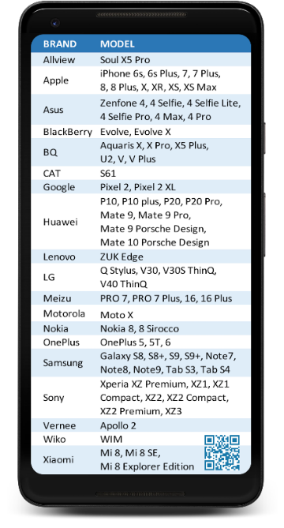




Satellite Navigation “made in Europe”
~ 3.5 Billion
Estimated number of Galileo enabled smartphones sold until today
Putting Europe at the forefront of this strategically and economically important sector
Galileo provides a highly accurate, guaranteed global positioning service under civilian control
Sep 2022
www.usegalileo.eu

Slide 4
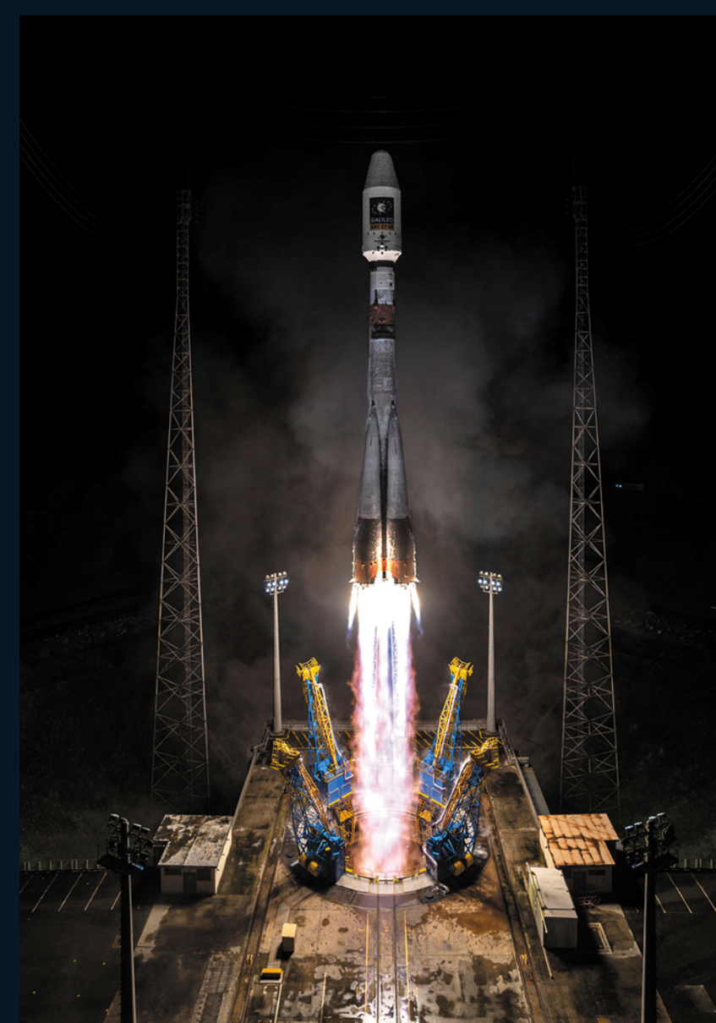
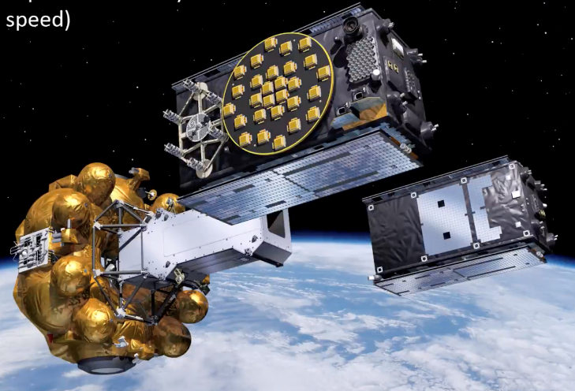
Launch#11 SAT27 & SAT 28 In Service
L11 launched on 5 December 2021
Commissioning and In Orbit testing successfully completed
In-Orbit Test Review completed:
  Both satellites fully healthy
  Excellent Clock and Payload performance
Updated NSGU I/NAV software uploaded and successfully tested over summer.
Both L11 Satellites have been included in the operational Galileo constellation providing service to the users
L11 Launch on 5 December 2021

Slide 5
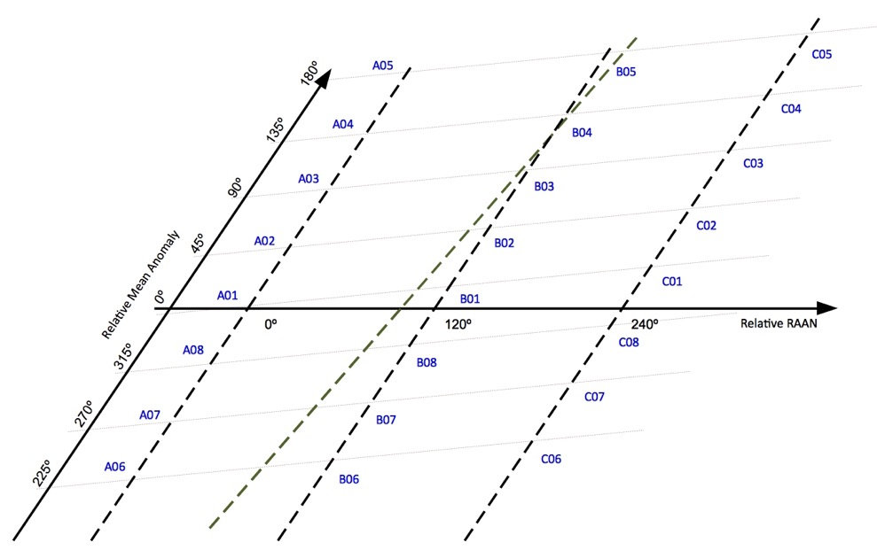
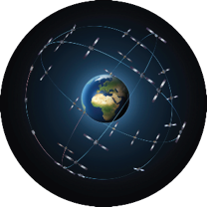


Galileo Constellation Status:
Navigation (23 in service)
Search and Rescue (25 in service)
C05
C14
B14
28 satellites in orbit
3 not usable
C12
1 spare
1 unavailable
2 no SAR (by design)
GSAT 104 (Spare, NAVANT failure), relocation from C05 to C14 completed on 12/05/2021
GSAT 204 (Spare, SAR off), relocation from B03 to B14 completed on 06/05/2021
GSAT 201/202 (set to unhealthy)
GSAT 210 currently Not Usable, NAGU2022035
L11 slots on Plane B: B03, B15
B15
Plane A Plane B Plane C
GSAT223/224 entered into Service on 29 August

Slide 6
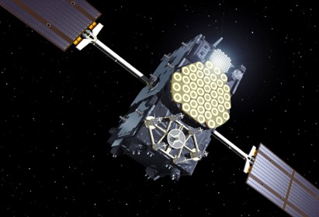
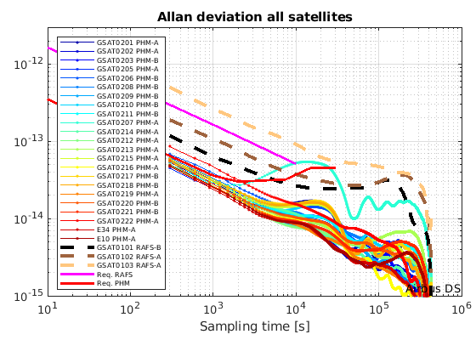
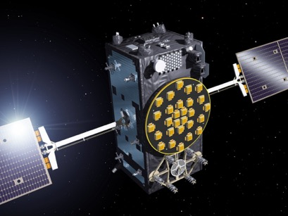
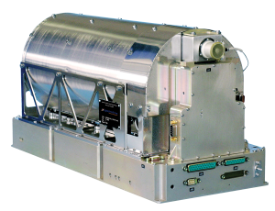
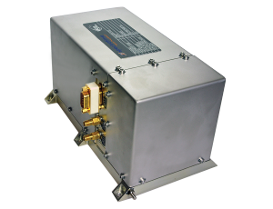
Galileo Satellites In Orbit
S/C Prime Contractor Astrium GmbH
(now Airbus Defence & Space)
24 SIS
All 4 satellites in-orbit
IOV Satellites
FOC Satellites
S/C Prime Contractor OHB Systems GmbH
P/L Prime Contractor SSTL Ltd
24 satellites in-orbit
Embarked Clocks:
Rubidium Atomic Frequency Standard
Passive Hydrogen Maser

Slide 7

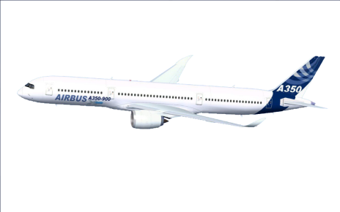
Galileo Services
PRS
OS
CS
EGNOS
SAR

Slide 8
Stable As-observed Ranging Performance STABLE (1/2)
y-axis linear scale
y-axis log scale
Very stable Signal In Space Ranging Error (SISE) trend → 0.22m (95%) all satellites, in July (FNAV)

Slide 9
Stable As-observed Ranging Performance STABLE (2/2)
Satellites SISE RMS daily statistics
BEST SAT
WORST SAT
GSAT0214 0.017m
29th June 2022
GSAT0210 5.2m
29th April 2022
Constellation SISE RMS daily statistics
BEST DAY
WORST DAY
0.076m
19th February 2022
0.23m
4th March 2022
Monthly SISE 95% statistics
Satellites with
RAFS
BEST SAT
WORST SAT
GSAT0215 0.18m
April 2022
GSAT0101 0.36m
April 2022
SISE FNAV DF 95th monthly ranges
SISE FNAV DF values computed at average user location (SISE Global Average)

Slide 10


Galileo as Time Source
Galileo broadcasts the offset between Galileo System Time (GST) and UTC and the GPS to Galileo Time Offset (GGTO)
Galileo access to UTC is provided via the leading European metrological institutes (INRIM (IT), OP (FR), PTD (DE), ROA (ES), SP (S))
The International Bureau of the Weights and Measures (BIPM) updated the standard for the GNSS time transfer to include also Galileo: version 2E of the CGGTTS standard was published in 2015, professional Galileo timing receivers are available on the market

Slide 11
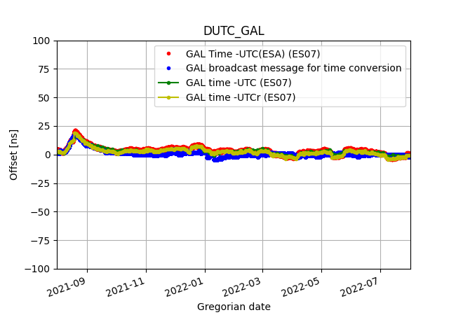
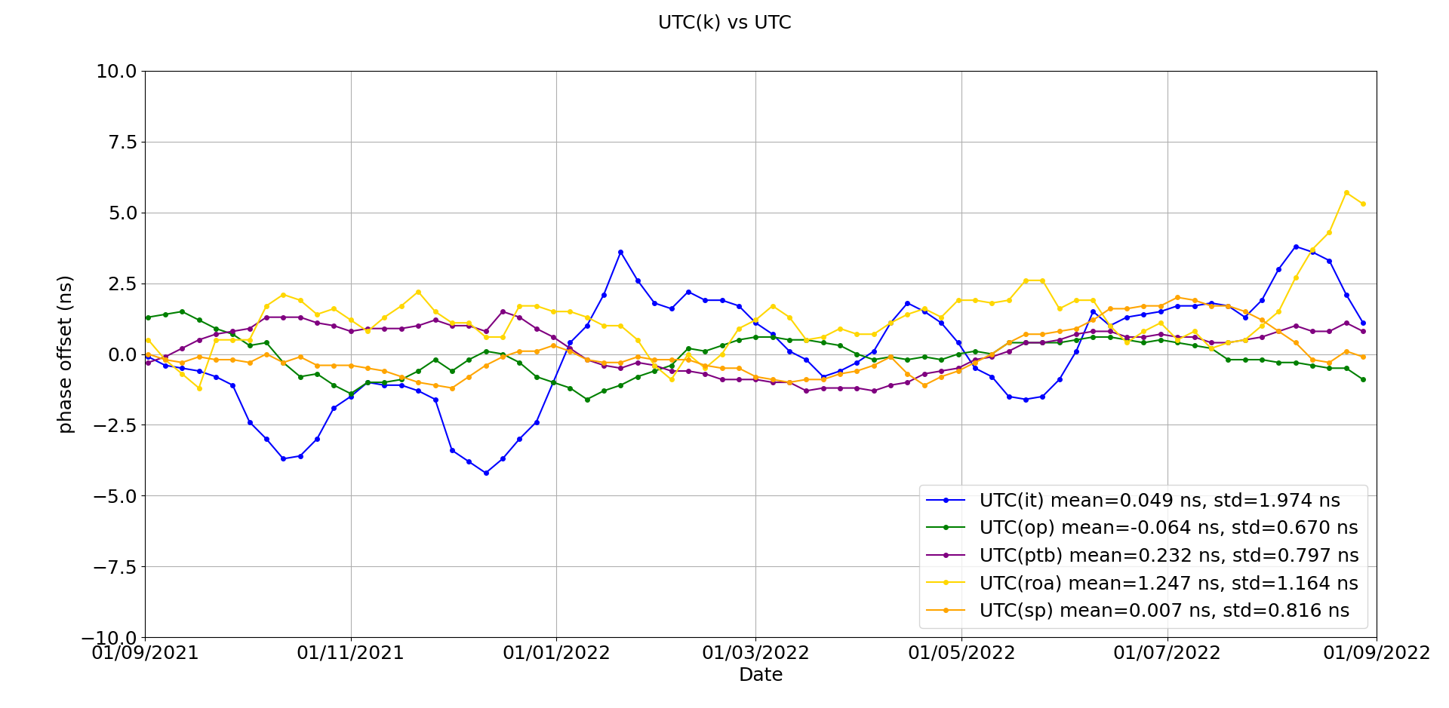
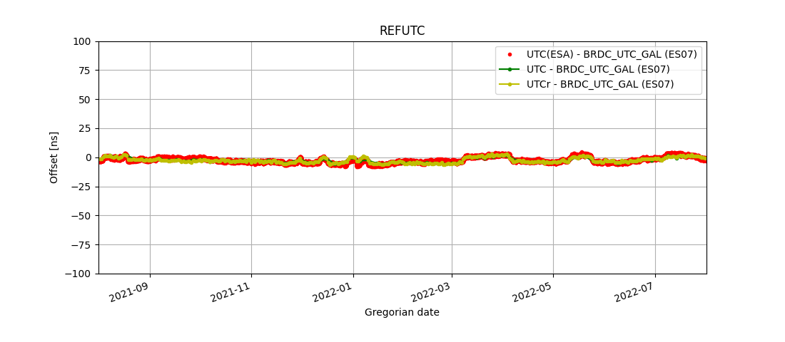
Galileo UTC labs – UTC offset
Notes:
33

Slide 12
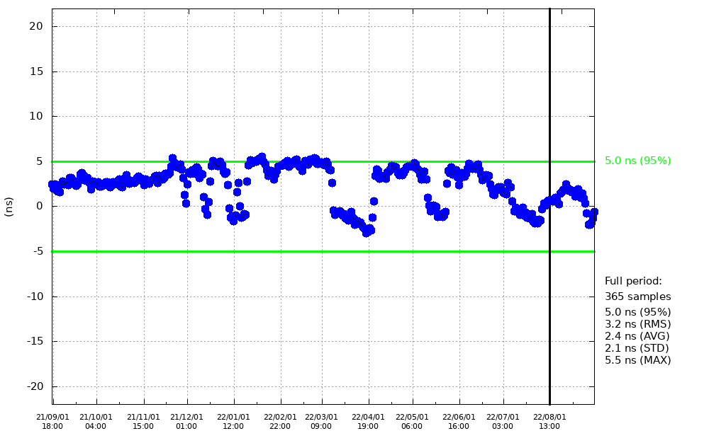
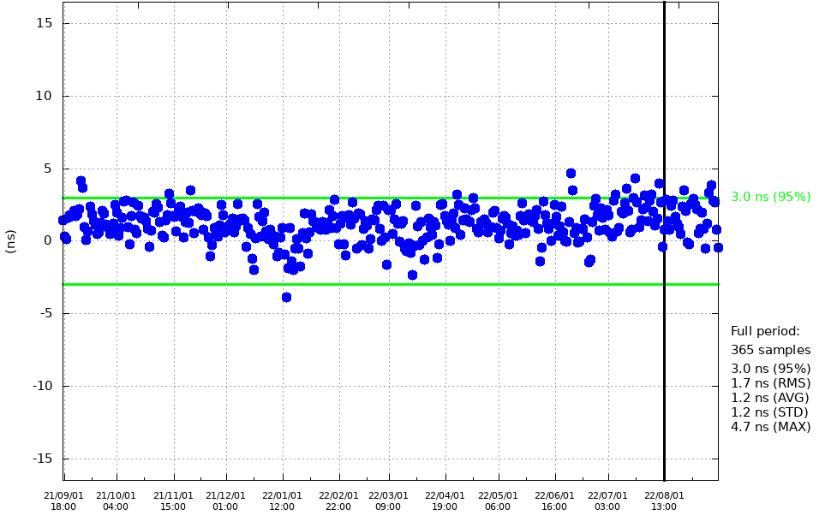
Galileo Timing Accuracy → STABLE
Broadcast UTC offset
GGTO accuracy
5.0ns (95%) < 30ns IS target
3.0ns (95%) < 20ns IS target
Evaluated with calibrated timing GPS/Galileo receiver operated in UTC(k) laboratory (PTB, INRIM)

Slide 13
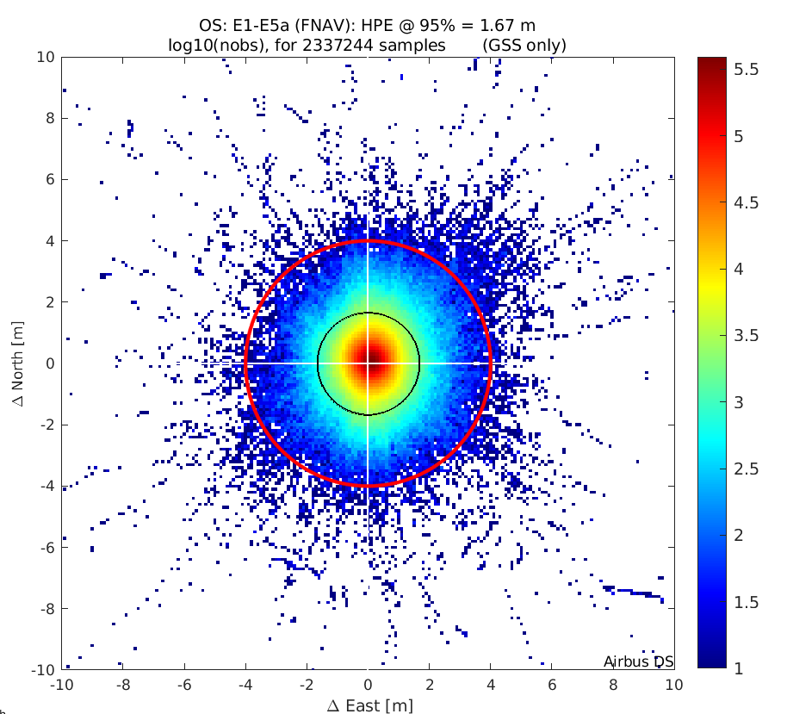
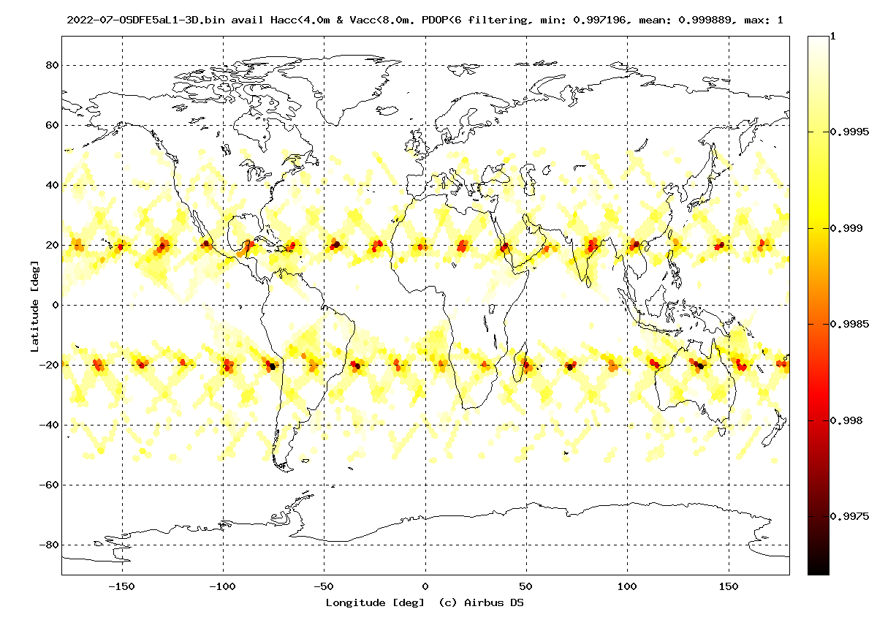
System Availability
Operational Satellites: 23
Availability of H. Accuracy <4 m 99.99% (Average User Location)
Global PDOP <=6 availability 99.99% (Average User Location)
Availability for Timing Service 100%
IOV
IOV
FOC
FOC
1.67m
(95%)
Availability of Horizontal Position Accuracy < 10 m for 22 satellites

Slide 14





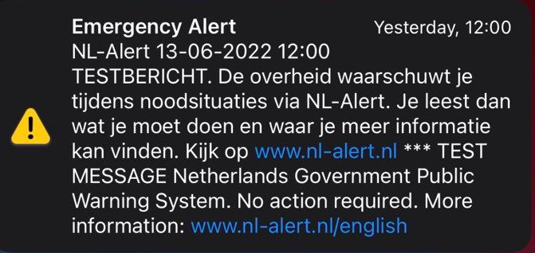
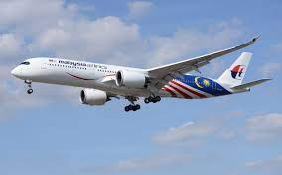
Galileo is evolving!
I/NAV Improvement
Allows faster Time to First Fix
High Accuracy Service (HAS)
Allows sub-decimetre level positioning accuracy
OS Authentication (OSNMA)
Data authentication function to ensure trusted source
IOV
Commercial Service Authentication (CAS)
Provides controlled access and authentication function to users
FOC
FOC
Safety of Life (SoL) – H-ARAIM
Integrity
Emergency Warning Service (EWS)
Alerting population in case of an emergency
Beacon Command Service (BCS)
Remote control of SAR beacons

Slide 15

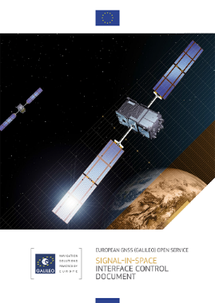
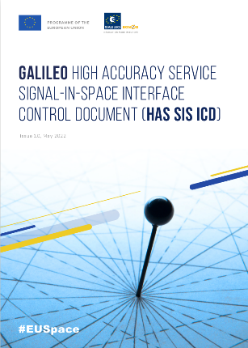
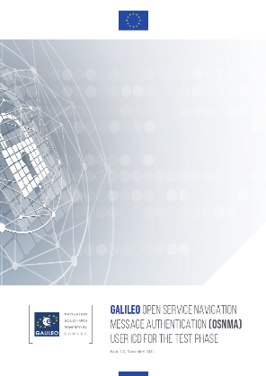
Galileo Reference documentation
https://www.gsc-europa.eu/electronic-library/programme-reference-documents
Galileo High Accuracy Service Signal In Space Interface Control Document
Galileo OS Service Definition Document
Version 1.2, November 2021
Galileo Open Service Signal In Space Interface Control Document (OS SIS ICD)
Issue 2.0, January 2021
Minimum Performance Levels (MPLs)
SIS UTC Dissemination Accuracy < 30ns (95%)
SIS UTC Frequency Dissemination Accuracy <3E-13 (95%)
Availability of OS UTC Time Dissemination Service ≥ 87%
Availability of OS UTC Time Determination Service ≥ 87% with
UTC Time Determination accuracy better than 31ns (95%)
GST-UTC Conversion Algorithm and Parameters
GPS to Galileo System Time Conversion and Parameters
Galileo Open Service Navigation Message Authentication User Interface Control Document

Slide 16
Takeaways
Galileo is a reliable time source
  Recognised by the International Bureau of the Weights and Measures (BIPM)
  Excellent and stable Galileo System performance and availability
  Outstanding timing performance for GNSS & clock stability demonstrated with UTC (SIS) better than 5 ns
  Galileo is a reality in mass-market devices
Galileo is in constant evolution to provide new capabilities
  Open Service enhancements (I/NAV, HAS)
  Data Authentication (OS-NMA, CAS)
  Safety (EWS, RBA/BCS)

Slide 17
Do you want to know more ?
https://www.esa.int/Applications/Navigation
David.Ibanez@esa.int

Slide 18
Backup Slides

Slide 19


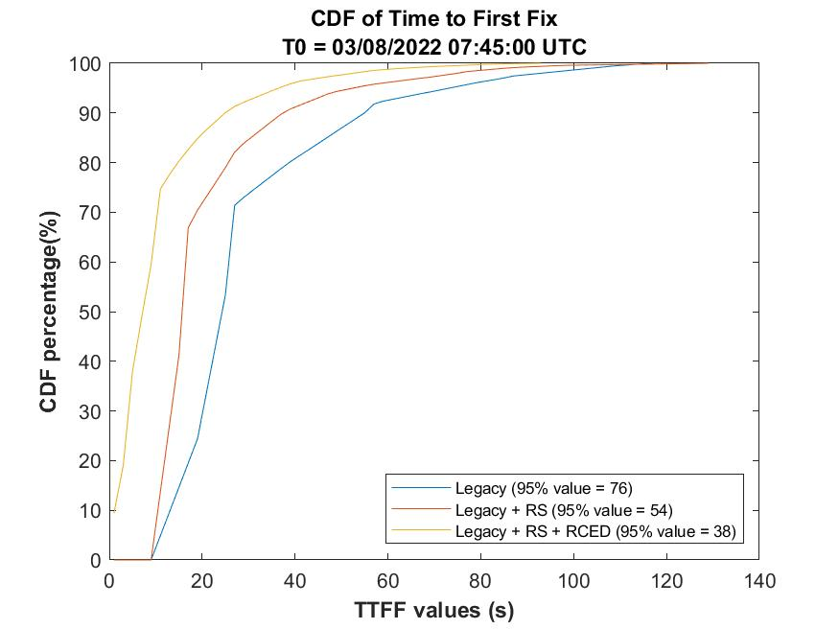
Galileo Evolutions (I/NAV Improvement) (1/2)
Faster Time to First Fix (TTFF)
Better Data Demodulation Robustness
Reduced Clock and Ephemeris (redCED)
Reed Solomon Clock and Eph. Data (RS-CED)
Key performance parameter from user perspective is TTFF (also as consequence of better data demodulation robustness)
User performance improvement validated during I/NAV IOV in Urban Environment
I/NAV Improvement
Legacy I/NAV
No Fix
Faster TTFF
Hor. Acc.
No Fix
redCED acc
Hor. Acc.
5 m
Galileo typical acc
Better Data Demodulation
2 m
2 m
Galileo typical acc
No fix in Legacy (for comparison)
TTFF Impr.
Time
TTFF legacy
Time
I/NAV Improvement provides 2-times faster First Fix with Galileo!

Slide 20
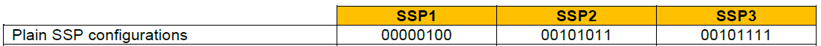
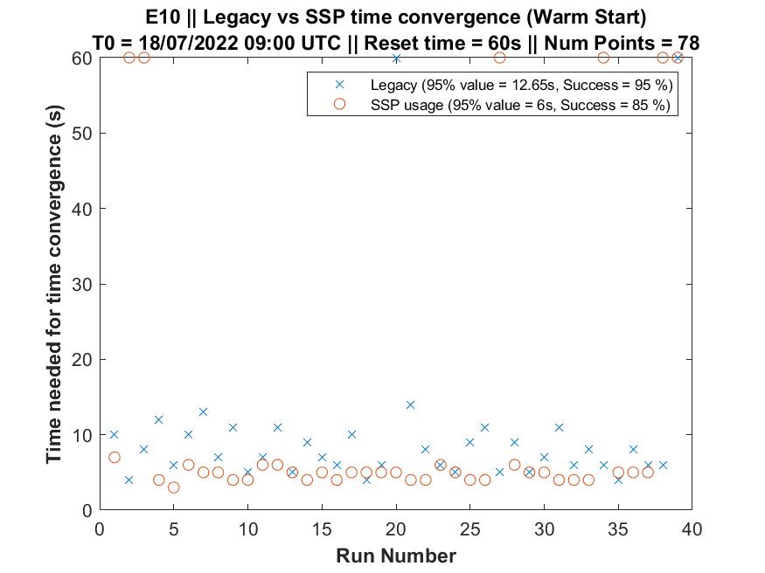
Galileo Evolutions (I/NAV Improvement) (2/2)
Time Ambiguity Resolution
Secondary Synchronization Pattern (SSP)
SSP provide to users that already have coarse time information (+/- 1.5 sec) the means to resolve remaining time ambiguity and give access to the Galileo System Time. No need to demodulate time information from the navigation message.
User performance improvement validated during I/NAV IOV in Urban Environment
Access to Galileo System Time is key for connected mass market users!
I/NAV Improvement provides 2-times faster access to Galileo system time for users that have coarse time information in Urban Environment!
Note: non-successful cases are related to loss of satellite line of sight in Urban

Slide 21
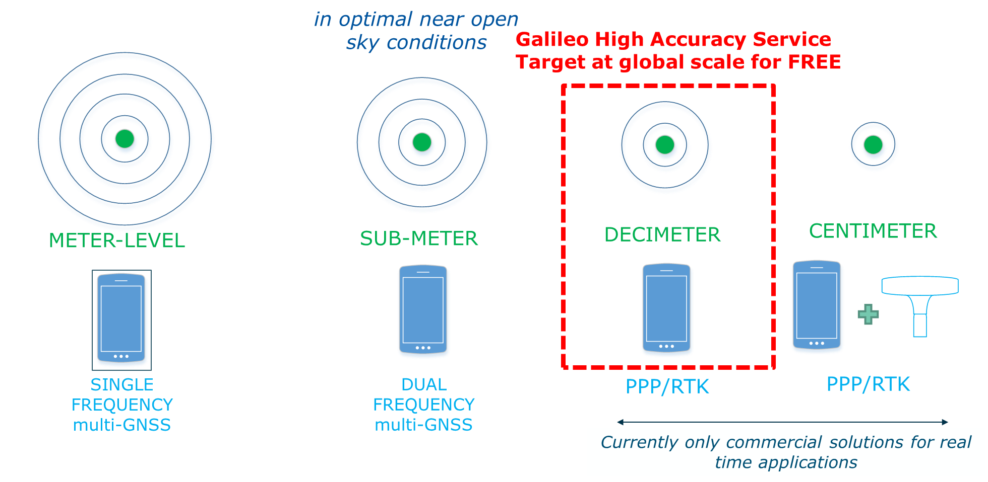

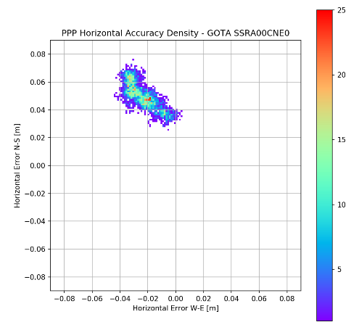
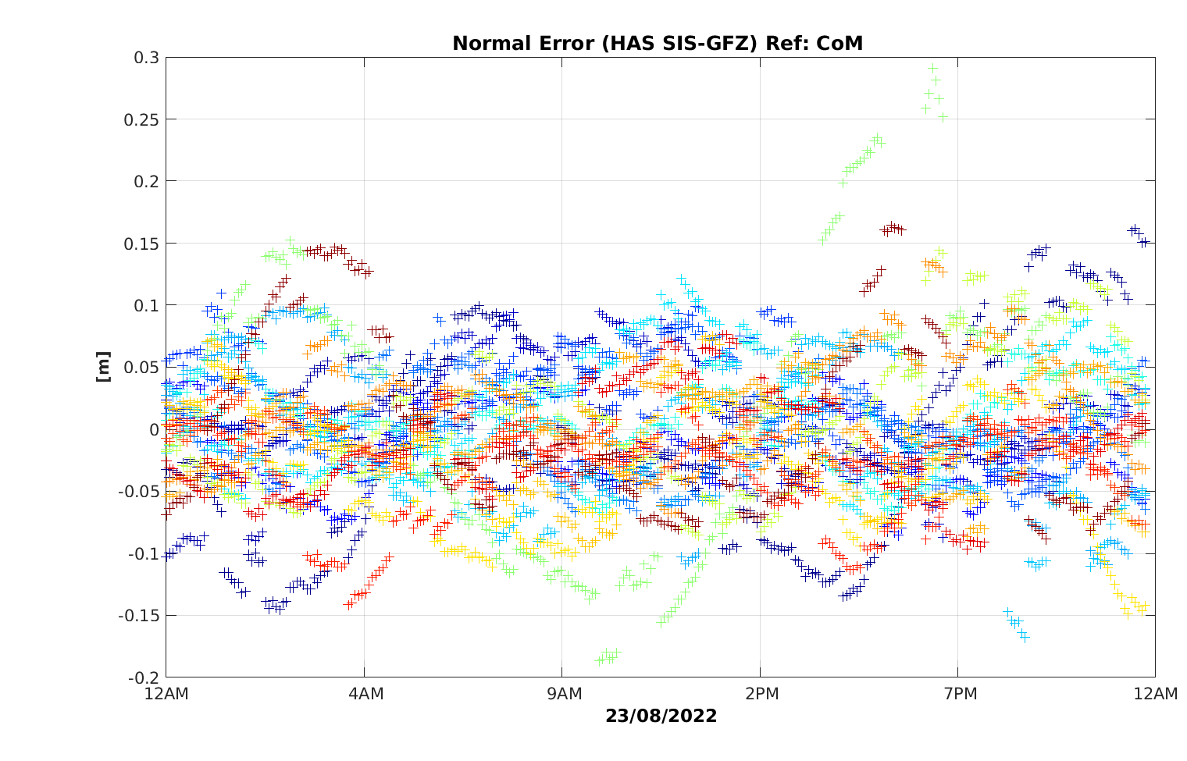
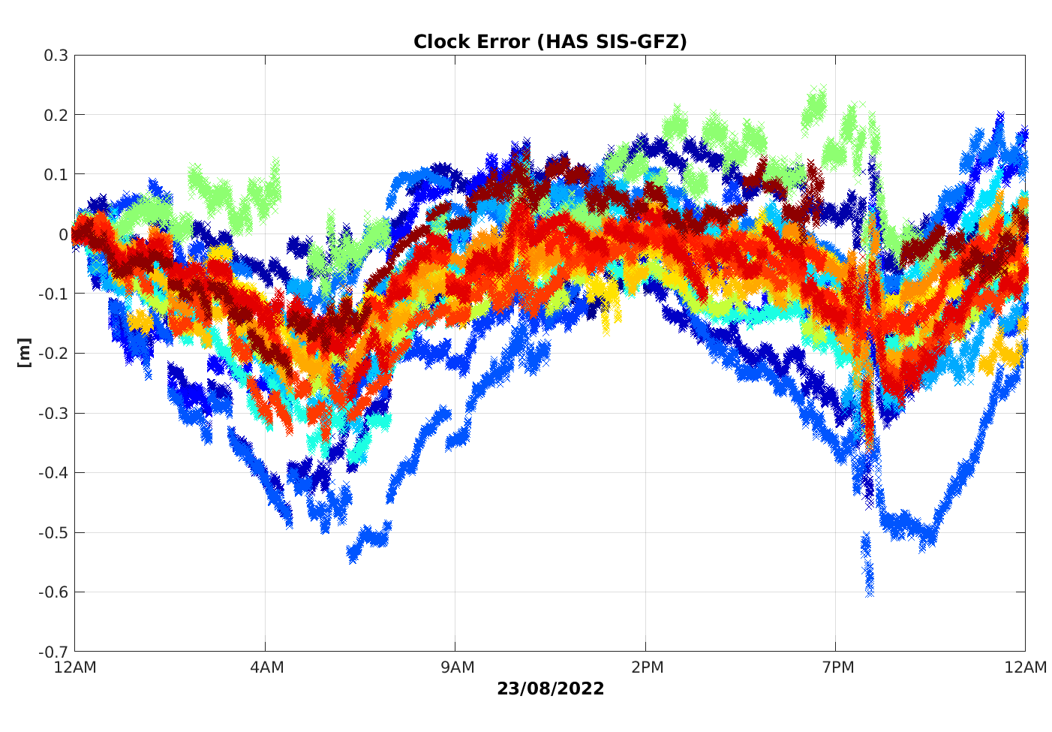
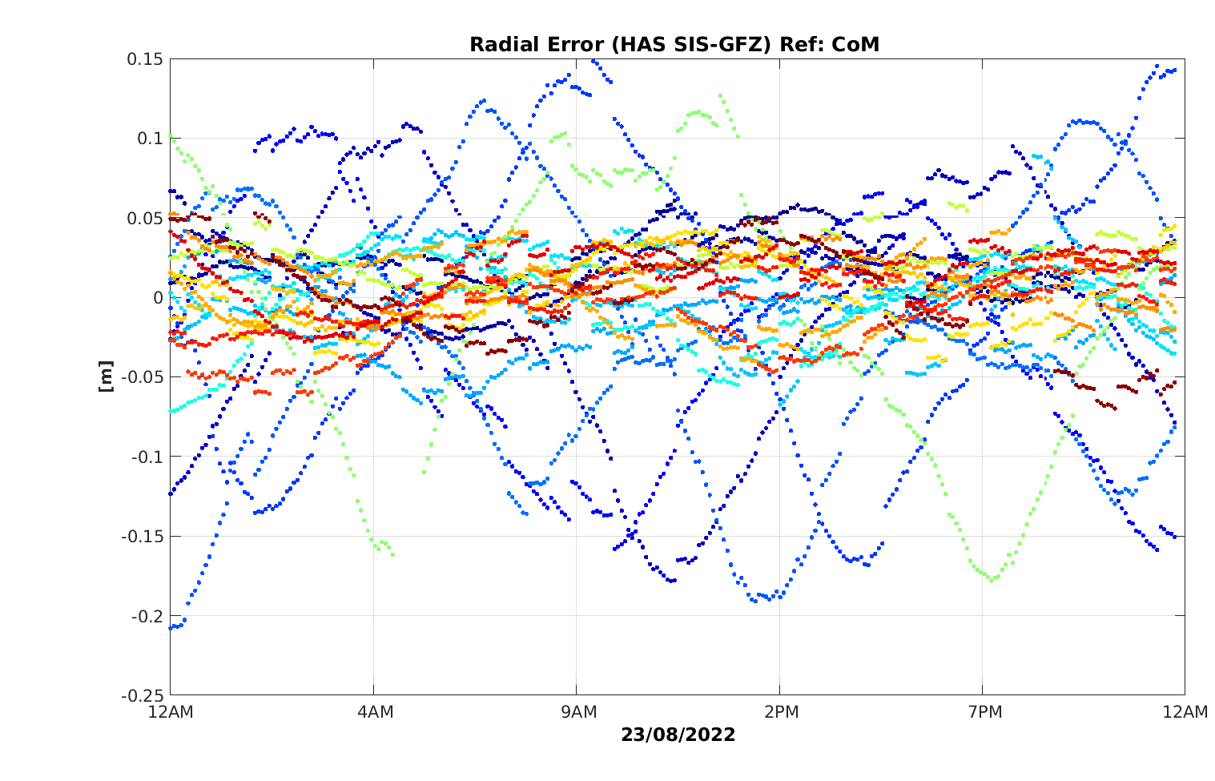
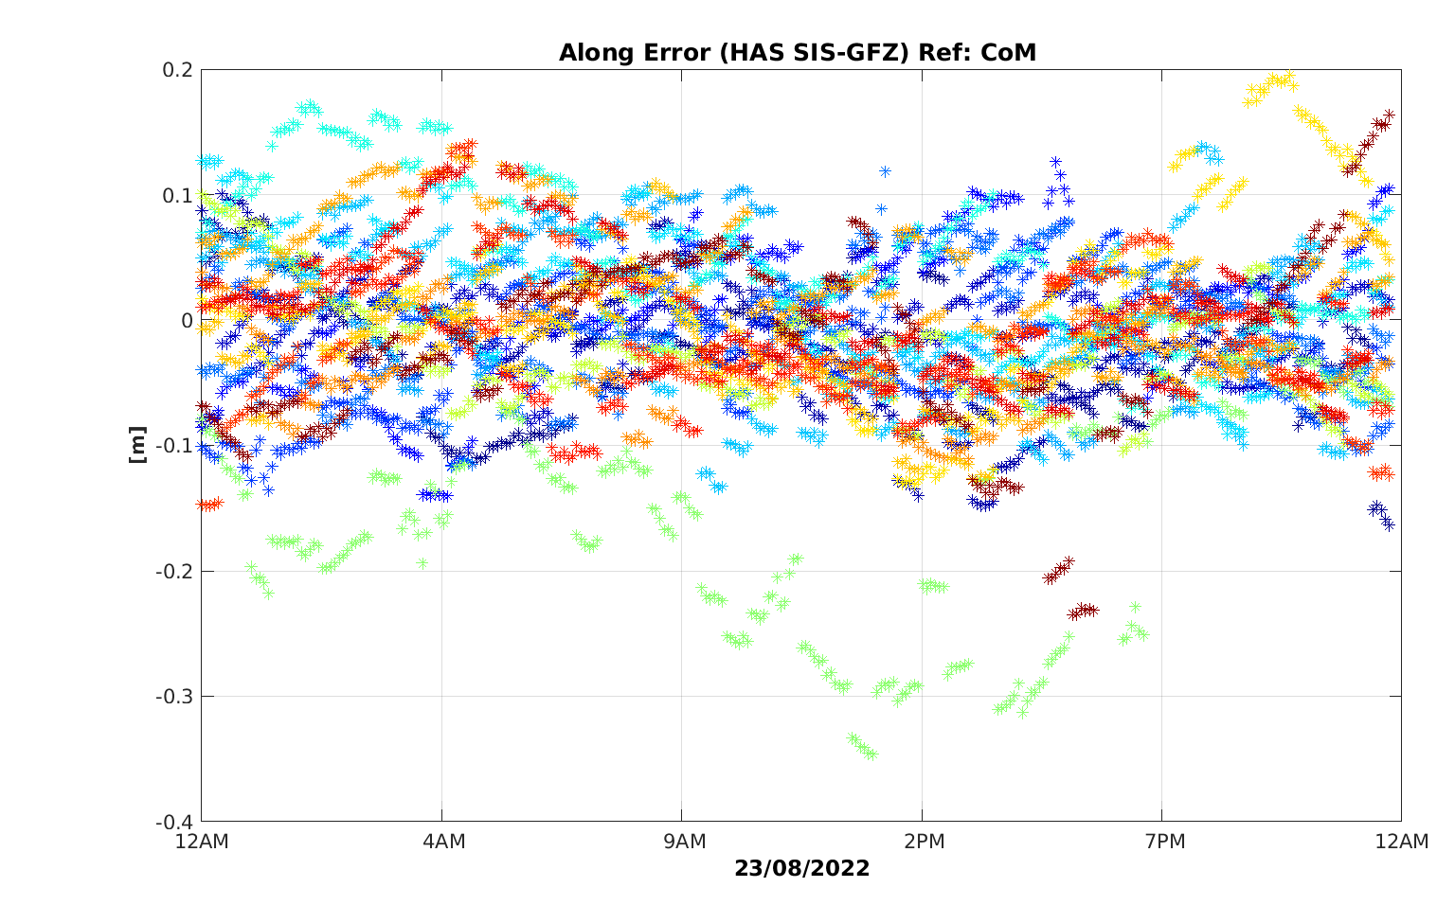
Galileo Evolutions (HAS)
HAS
HAS corrections: orbits, clocks, code and phase biases; atmospheric corrections (full service).
Accessible: E6-B Signal in Space (SiS), terrestrial link,
Multi-constellation and multi-frequency: Galileo E1/E5a/E5b/E6; E5 AltBOC and GPS L1/L5; L2C.
Open format: corrections follow a similar format to Compact-State Space Representation (CSSR).
(Initial HAS SIS ICD under preparation)
HAS SIS test campaigns ongoing with E6B Signal transmission
Horizontal Accuracy: <20 cm
Vertical Accuracy: <40 cm
Convergence Time: < 300 s (SL1)
< 100 s (SL2)
Availability: 99%
Service Targets:

Slide 22
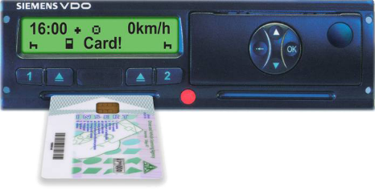



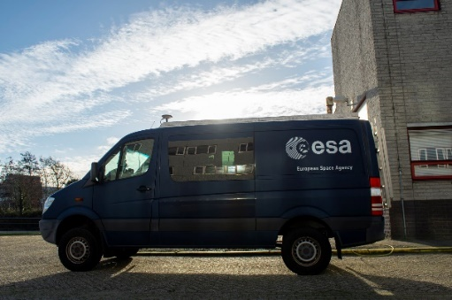
Galileo Evolutions (OS-NMA)
GNSS Open Service (OS) signals are of low power and the signal definition is publicly available
With emerging technology and sophisticated tools available for low price, spoofing is a threat
Key applications identified
“Live” test campaign completed; Public Observation Phase ongoing
OS-NMA
GNSS receiver minimal capabilities: single frequency E1
Object of authentication: Navigation data (E1B I/Nav and E5b I/Nav) – includes GST to UTC conversion parameters
No need to store raw GNSS signal at Receiver; the Receiver only stores a public key
No need of a network connection
Time to First Authentication: one to few minutes
Authentication availability: expected above 95%
Need of Time synchronisation
EU Regulation in Place for use of OS-NMA
Digital Tachograph
Fishery
Transport Dangerous/
Valuable Goods
Fleet Management

